Slide 1
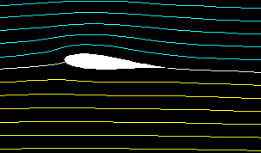
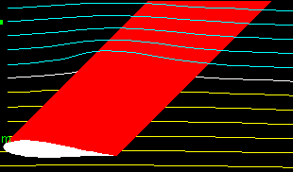
INCOMPRESSIBLE FLOW OVER FINITE WINGS
Incompressible Flow over Finite Wings

Slide 2
AIRFOILS AND WINGS
The properties of airfoils are the same as the properties of a wing of infinite span.
All real airplanes have wings of finite span, and our purpose is to apply our knowledge of airfoil properties to the analysis of finite wings.
Incompressible Flow over Finite Wings

Slide 3
AIRFOILS AND WINGS
Question: Why are the aerodynamic characteristics of a finite wing any different from the properties of its airfoil sections?
The flow over an airfoil is two-dimensional.
A finite wing is a three-dimensional body, and consequently the flow over the finite wing is three-dimensional; that is, there is a component of flow in the spanwise direction.
Incompressible Flow over Finite Wings

Slide 4
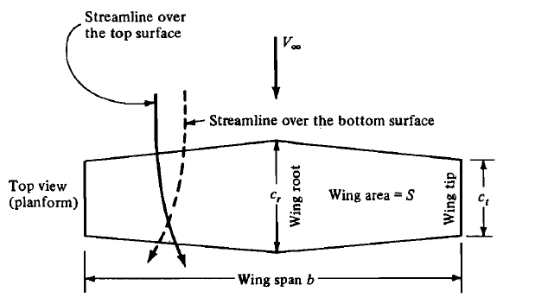
THREE-DIMENSIONAL FLOW OVER A FINITE WING
Incompressible Flow over Finite Wings

Slide 5

LIFT GENERATION BY WINGS
The physical mechanism for generating lift on the wing is the existence of a high pressure on the bottom surface and a low pressure on the top surface.
The net imbalance of the pressure distribution creates the lift.
Low Pressure
Low Pressure
High Pressure
High Pressure
Incompressible Flow over Finite Wings

Slide 6
WING-TIP VORTEX
As a by-product of this pressure imbalance, the flow near the wing tips tends to curl around the tips, being forced from the high-pressure region just underneath the tips to the low-pressure region on top.
Low Pressure
Low Pressure
High Pressure
High Pressure
Incompressible Flow over Finite Wings

Slide 7
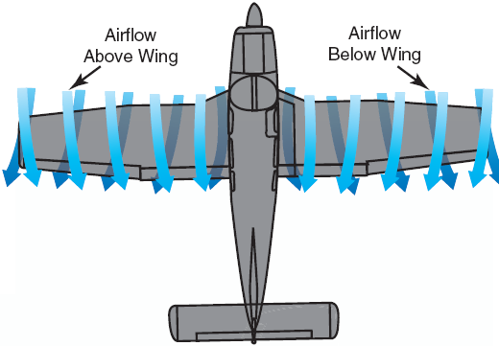
WING-TIP VORTEX
As a result, on the top surface of the wing, there is generally a spanwise component of flow from the tip toward the wing root, causing the streamlines over the top surface to bend toward the root.
On the bottom surface of
the wing, there is generally
a spanwise component of
flow from the root toward
the tip, causing the
streamlines over the bottom
surface to bend toward the
tip.
Incompressible Flow over Finite Wings

Slide 8
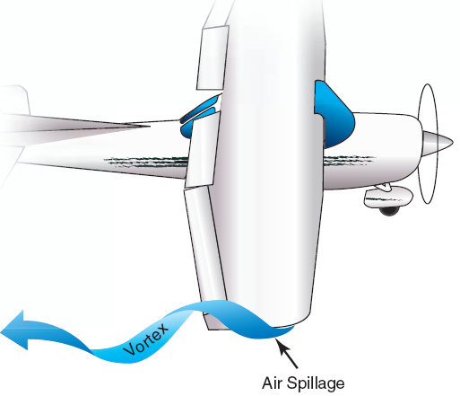
WING-TIP VORTEX
The tendency for the flow to "leak" around the wing tips establishes a circulatory motion that trails downstream of the wing; that is, a trailing vortex is created at each wing tip.
Incompressible Flow over Finite Wings

Slide 9
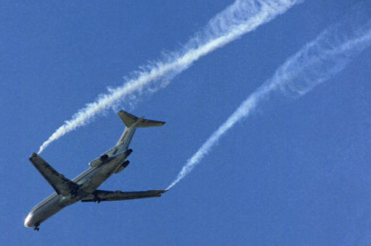
WING-TIP VORTEX
The tip vortices are essentially weak "tornadoes“ that trail downstream of the finite wing.
For large airplanes such as
a Boeing 747, these tip vortices
can be powerful enough to
cause light airplanes
following too closely to go
out of control.
This is one reason for large spacings between aircraft landing or taking off consecutively at airports.
Incompressible Flow over Finite Wings

Slide 10
DOWNWASH
The two vortices tend to drag the surrounding air around with them, and this secondary movement induces a small velocity component in the downward direction at the wing.
This downward component is called downwash, denoted by the symbol w.
Incompressible Flow over Finite Wings

Slide 11
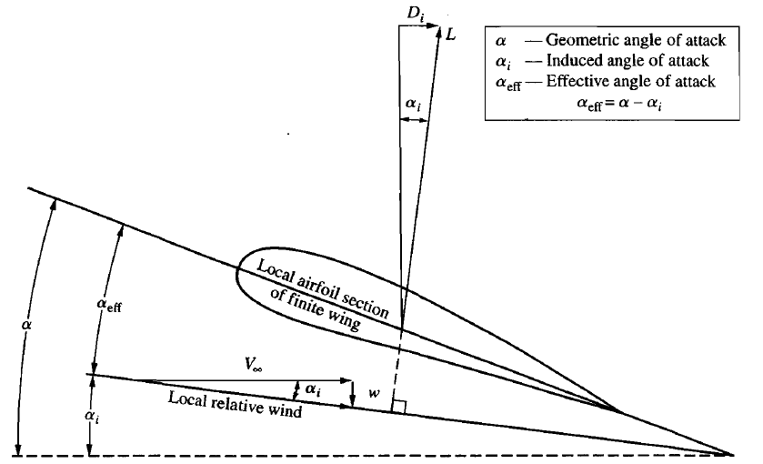
DOWNWASH
The downwash combines with the freestream velocity V∞ to produce a local relative wind which is canted downward in the vicinity of each airfoil section of the wing.
Incompressible Flow over Finite Wings

Slide 12
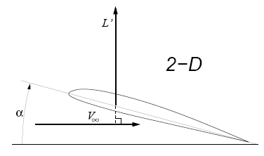
INDUCED DRAG
Incompressible Flow over Finite Wings

Slide 13



INDUCED DRAG
Defining the profile drag coefficient as
and the induced drag coefficient as
the total drag coefficient for the finite wing C_{D} is given by
Incompressible Flow over Finite Wings

Slide 14
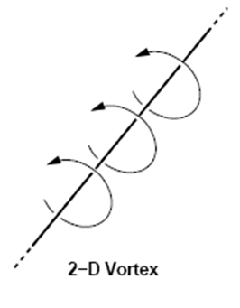


THE VORTEX FILAMENT
Г
Incompressible Flow over Finite Wings

Slide 15
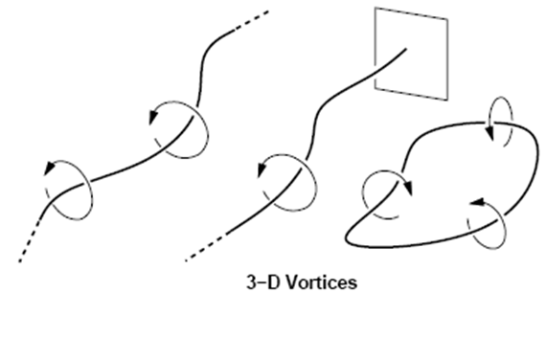
HELMHOLTZ’S THEOREMS
A general 3-D vortex can take any arbitrary shape. It is subject to the Helmholtz’s Vortex Theorems:
1) The strength Г of a vortex filament is constant all along its length.
2) The vortex filament cannot end inside the fluid. It must either
  a) extend to ±∞, or
  b) end at a solid boundary, or
  c) form a closed loop.
Incompressible Flow over Finite Wings
15

Slide 16

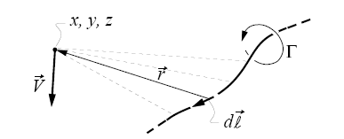

THE BIOT-SAVART LAW
The velocity field of a vortex of general shape is given by the Biot-Savart Law.
The magnetic field strength dB induced at point P by a segment of the wire dl with the current moving in the direction of dl is
where μ is the permeability
Incompressible Flow over Finite Wings
16

Slide 17

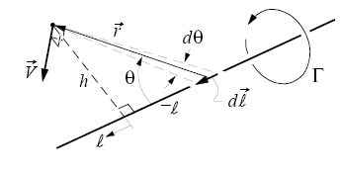



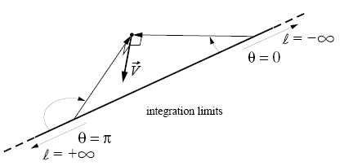


STRAIGHT-VORTEX FILAMENT
Incompressible Flow over Finite Wings
17

Slide 18
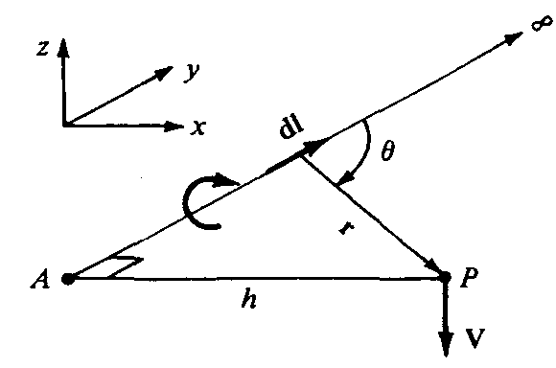
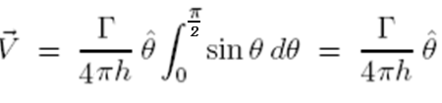
STRAIGHT-VORTEX FILAMENT
Consider the semi-infinite vortex filament shown in Figure. The filament extends from point A to ∞.
Incompressible Flow over Finite Wings
18

Slide 19
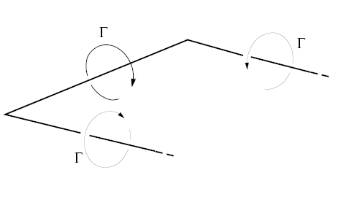
LIFTING-LINE THEORY
Wing vortex model
Horseshoe vortex
Incompressible Flow over Finite Wings

Slide 20
LIFTING-LINE THEORY
A vortex filament of strength Γ that is somehow bound to a fixed location in a flow (bound vortex) will experience a force L’=ρ∞V∞Γ from the Kutta-Joukowski theorem.
The bound vortex is in contrast to a free vortex, which moves with the same fluid elements throughout a flow.
Incompressible Flow over Finite Wings
20

Slide 21
LIFTING-LINE THEORY
Let us replace a finite wing of span b with a bound vortex, extending from y = -b/2 to y = b/2. Assume the vortex filament continues as two free vortices trailing downstream from the wing tips to infinity.
Incompressible Flow over Finite Wings
21

Slide 22
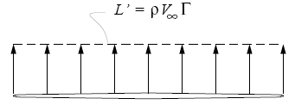
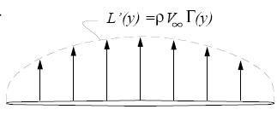
LIFTING-LINE THEORY
Incompressible Flow over Finite Wings
22

Slide 23
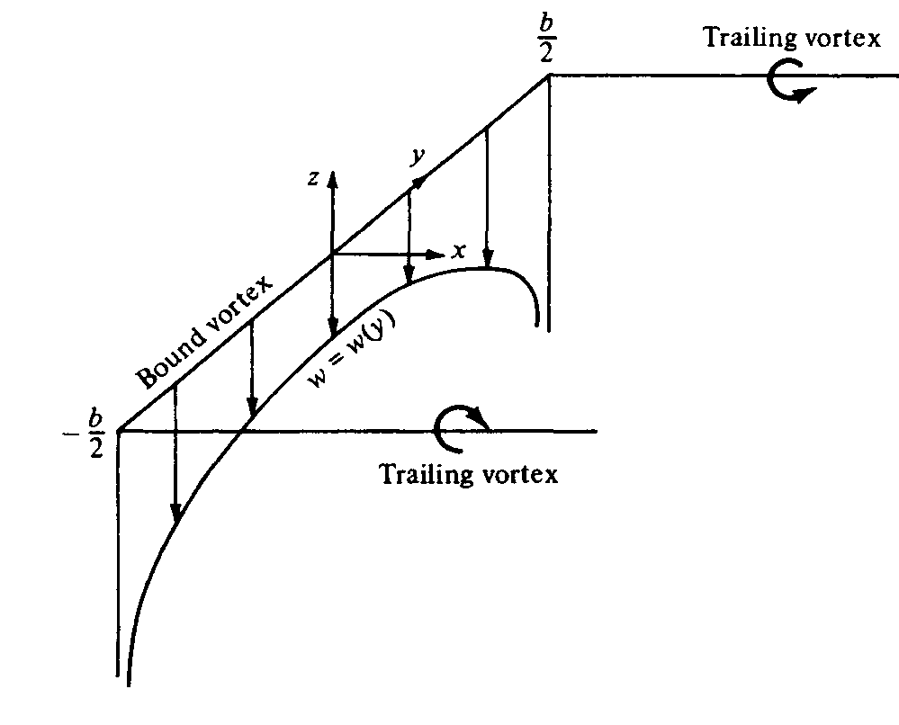


LIFTING-LINE THEORY
Consider the downwash w induced along the bound vortex from -b/2 to b/2 by the horseshoe vortex.
  The bound vortex induces no velocity along itself
  The two trailing vortices both contribute to the induced velocity.
Incompressible Flow over Finite Wings
23

Slide 24
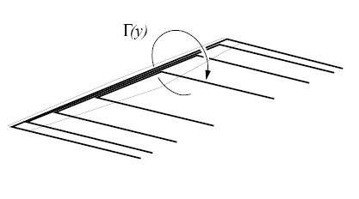
LIFTING-LINE THEORY
The downwash distribution due to the single horseshoe vortex does not realistically simulate that of a finite wing. A better flow field model employs multiple distributed horseshoe vortices.
Incompressible Flow over Finite Wings

Slide 25
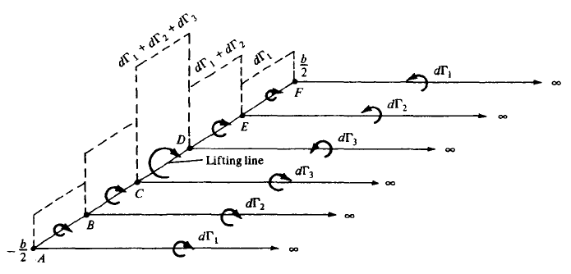
LIFTING-LINE THEORY
The figure shows 3 horseshoe vortices on the wing, each with different length of bound vortex, but with all bound vortices coincident along a single line. This line is called the Lifting Line.
Incompressible Flow over Finite Wings
25

Slide 26
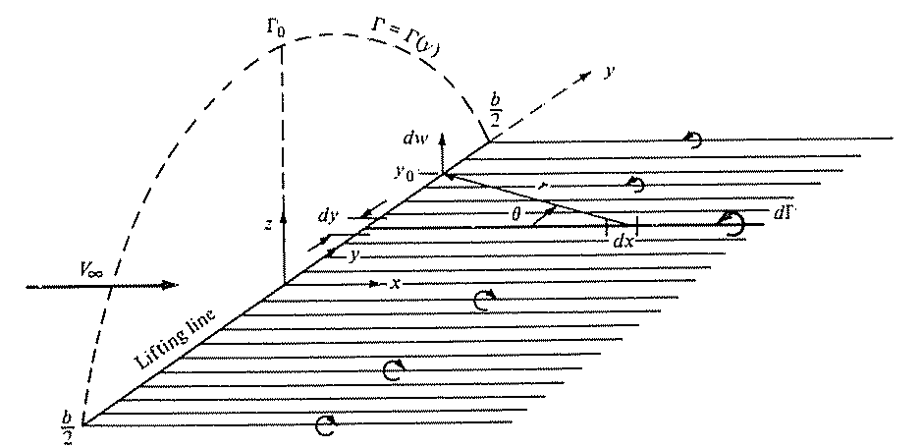
LIFTING-LINE THEORY
The figure shows infinite number of horseshoe vortices superimposed along lifting line, each with a vanishingly small strength dΓ.
It has a continuous distribution of Γ = Γ(y) along the lifting line.
Incompressible Flow over Finite Wings
26

Slide 27
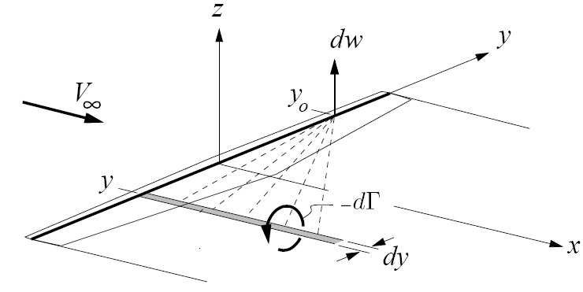

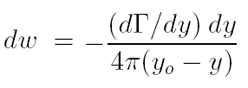
LIFTING-LINE THEORY
Incompressible Flow over Finite Wings

Slide 28
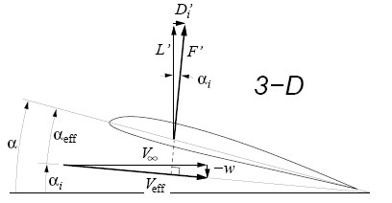



LIFTING-LINE THEORY
Incompressible Flow over Finite Wings
28

Slide 29




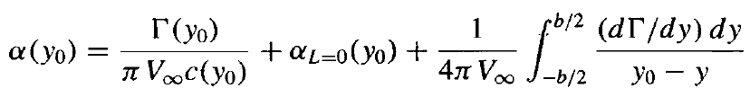
LIFTING-LINE THEORY
fundamental equation of Prandtl's lifting-line theory
Incompressible Flow over Finite Wings

Slide 30




LIFTING-LINE THEORY
The solution Γ = Γ(y₀), gives us the three main aerodynamic characteristics of a finite wing, as follows:
1. The lift distribution is obtained from the Kutta-Joukowski theorem:
2. The total lift is obtained by integrating L’(y₀) over the span
Incompressible Flow over Finite Wings

Slide 31





LIFTING-LINE THEORY
The solution Γ = Γ(y₀), gives us the three main aerodynamic characteristics of a finite wing, as follows:
3. The induced drag per unit span is
Since α_{i} is small, this relation becomes
The total induced drag is obtained by integrating D’_{i} over the span:
Incompressible Flow over Finite Wings

Slide 32
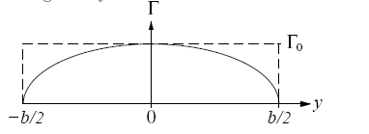


ELLIPTICAL LIFT DISTRIBUTION
Consider an elliptical spanwise circulation distribution given by:
Incompressible Flow over Finite Wings

Slide 33


ELLIPTICAL LIFT DISTRIBUTION
DOWNWASH CALCULATION
Incompressible Flow over Finite Wings
33

Slide 34
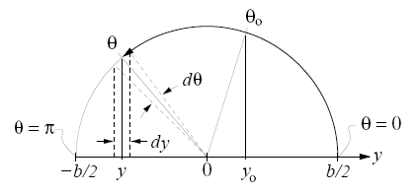
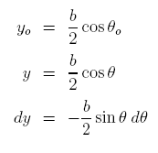
ELLIPTICAL LIFT DISTRIBUTION
As in thin airfoil theory, the mathematical problem is considerably simplified by making the trigonometric substitution
Incompressible Flow over Finite Wings
34

Slide 35



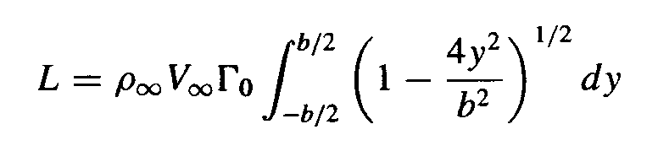

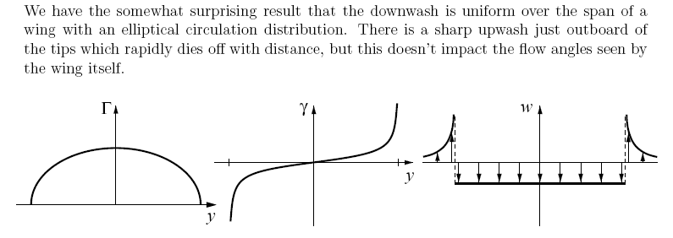
ELLIPTICAL LIFT DISTRIBUTION
Incompressible Flow over Finite Wings

Slide 36


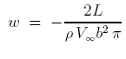

ELLIPTICAL LIFT DISTRIBUTION
INDUCED DRAG
Solving above Equation for Γ₀, we have
Which allows eliminating Γ₀ from the w result to give a somewhat more convenient expression
Induced angle of attack
Incompressible Flow over Finite Wings

Slide 37






ELLIPTICAL LIFT DISTRIBUTION
INDUCED DRAG
Induced drag
Incompressible Flow over Finite Wings

Slide 38


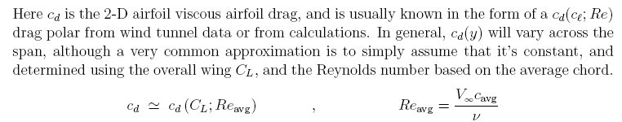
TOTAL WING DRAG
Incompressible Flow over Finite Wings

Slide 39
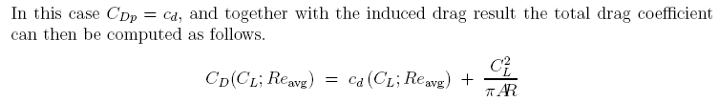
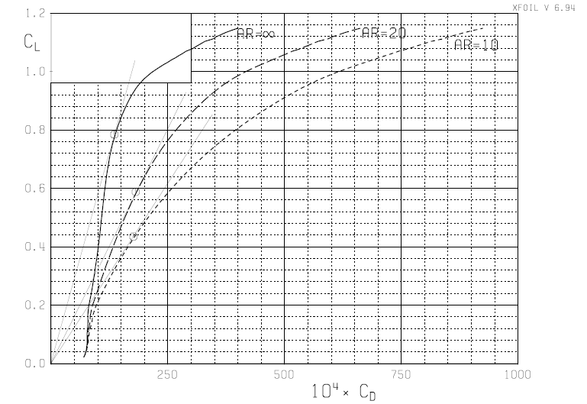
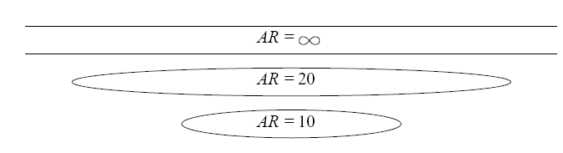
TOTAL WING DRAG
Atypical CD(CL) polar plot for one Reynolds number
Incompressible Flow over Finite Wings

Slide 40
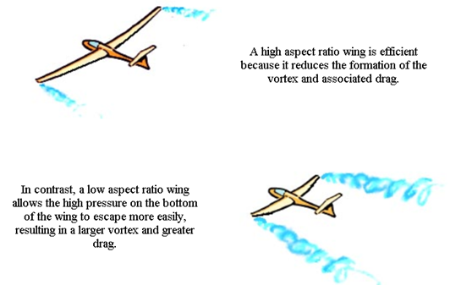
EFFECT OF ASPECT RATIO
The aspect ratio of the 1903 Wright Flyer was 6 and that today the aspect ratios of conventional subsonic aircraft range typically from 6 to 8. (Exceptions are the Lockheed U-2 high-altitude reconnaissance aircraft with AR = 14.3 and sailplanes with aspect ratios as high as 51.
Incompressible Flow over Finite Wings

Slide 41
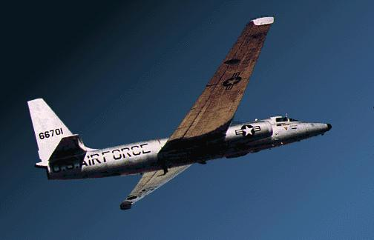
EFFECT OF ASPECT RATIO
LOCKHEED U-2
Incompressible Flow over Finite Wings

Slide 42

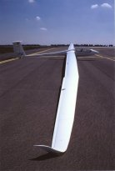
EFFECT OF ASPECT RATIO
Incompressible Flow over Finite Wings

Slide 43


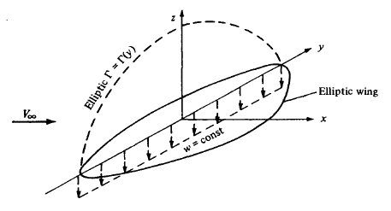
ELLIPTICAL LIFT DISTRIBUTION
We have seen that α_{i}, is constant along the span. Hence, α_{eff} = α - α_{i} is also constant along the span.
c_{l} must be constant along the span.
The chord must vary elliptically along the span
Incompressible Flow over Finite Wings

Slide 44



GENERAL WINGS
General circulation distribution and downwash
This hints that a Fourier sine series would be an appropriate expression for the general circulation distribution along an arbitrary finite wing.
Incompressible Flow over Finite Wings

Slide 45
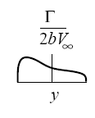
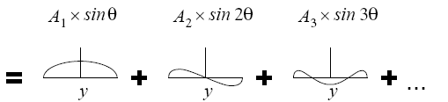
GENERAL WINGS
Incompressible Flow over Finite Wings

Slide 46



GENERAL WINGS
Let us choose N different spanwise stations, and let us evaluate Equation at each of these N stations. We then obtain a system of N independent algebraic equations with N unknowns, namely, A1, A2,… , A_{N}.
Incompressible Flow over Finite Wings

Slide 47

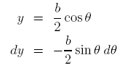




GENERAL WINGS
The orthogonality property
of the sine functions:
Incompressible Flow over Finite Wings

Slide 48


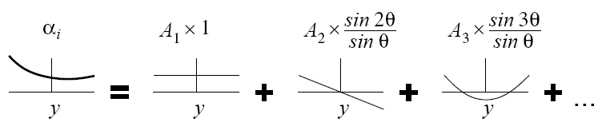
GENERAL WINGS
The leading n = 1 term is the same as the elliptic loading case, with the expected uniform induced angle.
Incompressible Flow over Finite Wings

Slide 49





GENERAL WINGS
INDUCED DRAG
Incompressible Flow over Finite Wings

Slide 50
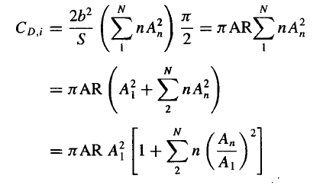



GENERAL WINGS
INDUCED DRAG
span efficiency
The minimum drag corresponding to elliptic loading, for which e = 1.
Incompressible Flow over Finite Wings

Slide 51
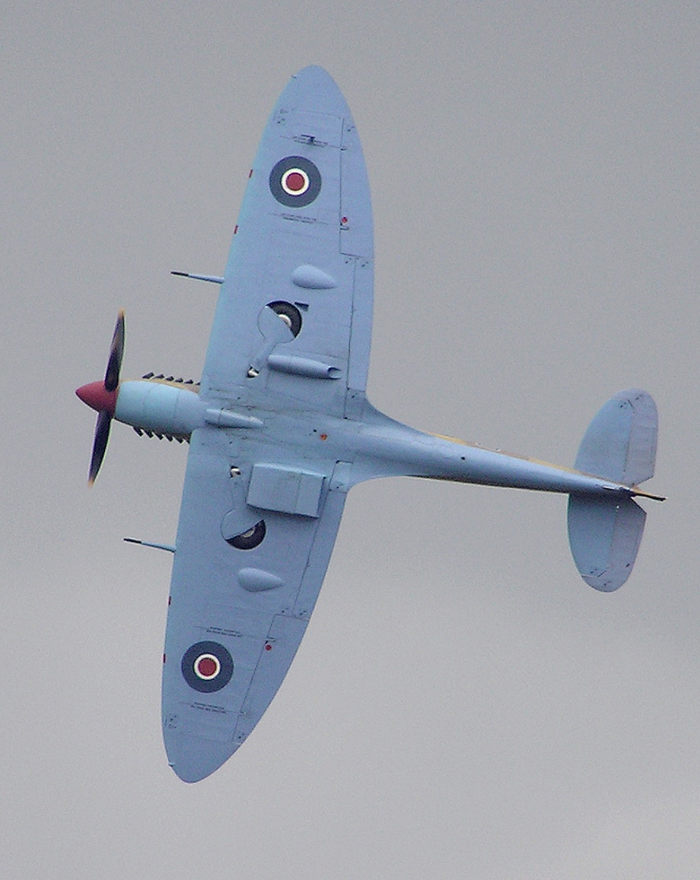
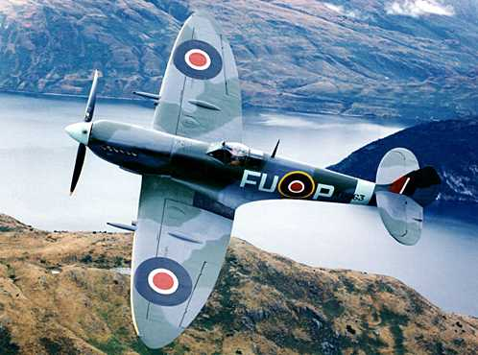
THE SUPERMARINE SPITFIRE
Incompressible Flow over Finite Wings
51

Slide 52
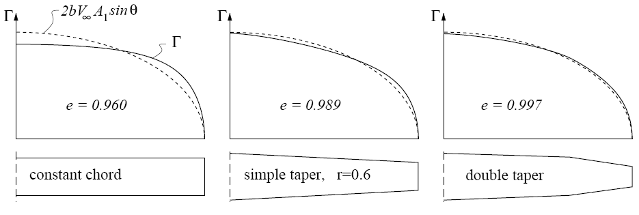
LOAD DISTRIBUTIONS ON TYPICAL PLANFORMS
Incompressible Flow over Finite Wings

Slide 53
WING COMPONENTS
Incompressible Flow over Finite Wings

Slide 54
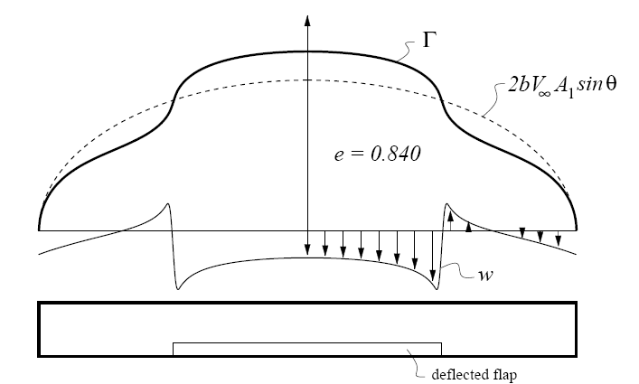
EFFECTS OF TRAILING EDGE FLAPS
Note also the strongly non-uniform downwash distribution resulting from this distorted loading.
Incompressible Flow over Finite Wings

Slide 55
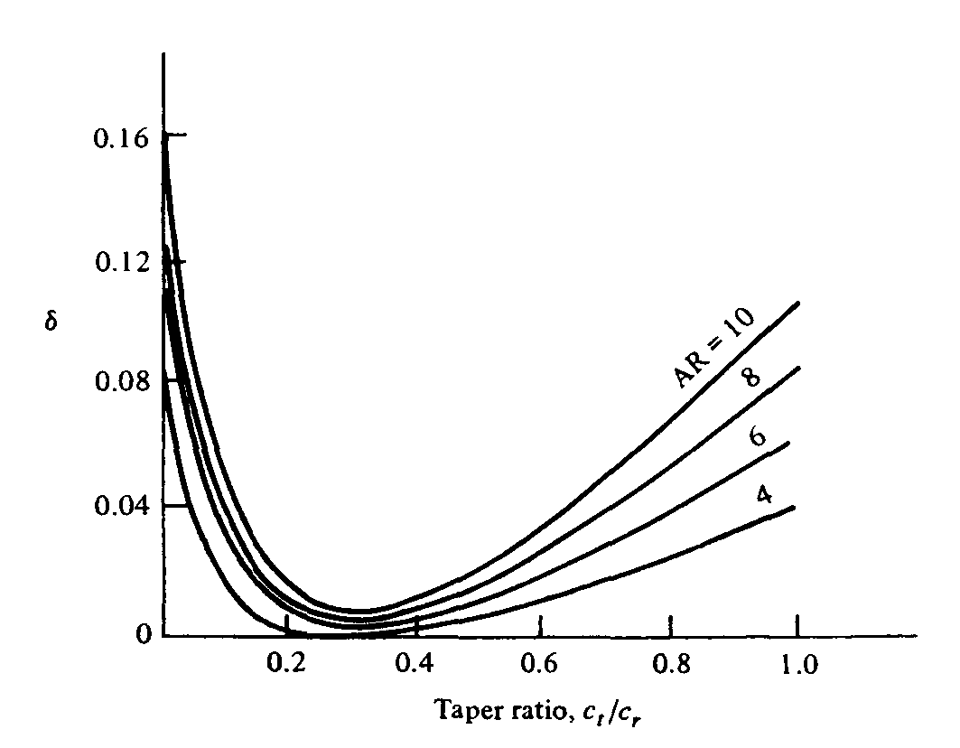
EFFECT OF ASPECT RATIO
Induced drag factor δ as a function of taper ratio.
Incompressible Flow over Finite Wings

Slide 56



EFFECT OF ASPECT RATIO
If we consider two wings with different aspect ratios AR₁ and AR₂
Assume that the wings are at the same C_{L}
Incompressible Flow over Finite Wings

Slide 57

EFFECT OF ASPECT RATIO
For historical interest, we reproduce
here Prandtl‘s actual graphs.
Note that, in his nomenclature,
C_{a} = lift coefficient and
C_{w} =drag coefficient
Incompressible Flow over Finite Wings

Slide 58


EFFECT OF ASPECT RATIO
Incompressible Flow over Finite Wings

Slide 59





LIFT SLOPE REDUCTION
The downwash behind any finite wing modifies the wing’s lift slope
Consider the c_{ℓ}-angle relation at a typical spanwise location
For a finite wing of general planform, the equation is slightly modified, as given below:
τ is a function of the Fourier coefficients A_{n}. Values of τ typically range between 0.05 and 0.25.
Incompressible Flow over Finite Wings

Slide 60

LIFT SLOPE REDUCTION
Incompressible Flow over Finite Wings

Slide 61

EFFECT OF ASPECT RATIO ON LIFT SLOPE
Incompressible Flow over Finite Wings

Slide 62





EXAMPLE 1
Incompressible Flow over Finite Wings

Slide 63



EXAMPLE 2
First, let us calculate C_{L} for the wing with aspect ratio 6
The lift slope of this wing is therefore
1
2
Incompressible Flow over Finite Wings

Slide 64



EXAMPLE 2 (CONT.)
The lift slope for the airfoil (the infinite wing) can be obtained
Since the second wing (with AR = 10) has the same airfoil section, then:
Incompressible Flow over Finite Wings

Slide 65


EXAMPLE 2 (CONT.)
The lift coefficient for the second wing is therefore
The induced drag coefficient is
Incompressible Flow over Finite Wings

Slide 66




EXAMPLE 3
Consider an airplane that with α_{L=0}=-2°, the lift slope of the airfoil section is 0.1 per degree, the lift efficiency factor τ = 0.04, and the wing aspect ratio is 7.96. At the cruising condition, the lift coefficient equal to 0.21.
Calculate the angle of attack of the airplane.
The lift slope of the airfoil section in radians is:
Incompressible Flow over Finite Wings

Slide 67

EXAMPLE 4
We considered the Beechcraft Baron 58 flying such that the wing is at a 4-degree angle of attack. The wing of this airplane has an NACA 23015 airfoil at the root, tapering to a 23010 airfoil at the tip. The data for the NACA 23015 airfoil is available. The airfoil lift and drag coefficients at α = 4°, namely, c_{l} = 0.54 and c_{d} = 0.0068, Consider the wing of the airplane at a 4-degree angle of attack. The wing has an aspect ratio of 7.61 and a taper ratio of 0.45. Calculate C_{L} and C_{D} for the wing.
Incompressible Flow over Finite Wings

Slide 68





EXAMPLE 4 (CONT.)
Incompressible Flow over Finite Wings

Slide 69







EXAMPLE 4 (CONT.)
Incompressible Flow over Finite Wings

Slide 70




EXAMPLE 4 (CONT.)
Here, c_{d} is the section drag coefficient given in data. Note that in data, c_{d} is plotted versus the section lift coefficient c_{l}. To accurately read c_{d} from data, we need to know the value of c_{l} actually sensed by the airfoil section on the finite wing, that is, the value of the airfoil c_{l} for the airfoil at its effective angle of attack, α_{eff}. To estimate α_{eff} we will assume an elliptical lift distribution over the wing. We know this is not quite correct, but with a value of δ = 0.01, it is not very far off. for an elliptical lift distribution, the induced angle of attack is:
Incompressible Flow over Finite Wings
70

Slide 71



EXAMPLE 4 (CONT.)
taking the data at the highest Reynolds number shown:
Incompressible Flow over Finite Wings

Slide 72

A NUMERICAL NONLINEAR
LIFTING-LINE METHOD
Consider the most general case of a finite wing of given planform and geometric twist, with different airfoil sections at different spanwise stations. Assume that we have experimental data for the lift curves of the airfoil sections, including the nonlinear regime (i.e., assume we have the conditions of the following Figure for all the given airfoil sections). A numerical iterative solution for the finite-wing properties can be obtained as follows:
Incompressible Flow over Finite Wings

Slide 73

A NUMERICAL NONLINEAR
LIFTING-LINE METHOD
1. Divide the wing into a number of spanwise stations, as shown in The following Figure. Here k + 1 stations are shown, with n designating any specific station.
2. For the given wing at a given a, assume the lift distribution along the span; that is, assume values for Γ at all the stations Γ₁, Γ₂,…, Γ_{n} ,… , Γ_{k+1}. An elliptical lift distribution is satisfactory for such an assumed distribution.
Incompressible Flow over Finite Wings

Slide 74


A NUMERICAL NONLINEAR
LIFTING-LINE METHOD
3. With this assumed variation of Γ, calculate the induced angle of attack α_{i} at each of the stations:
The integral is evaluated numerically. If Simpson's rule is used
where Δy is the distance between stations.
when y_{n} = y_{j-1}, y_{j}, or y_{j+1}, a singularity occurs (a denominator goes to zero).
When this singularity occurs, it can be avoided by replacing the given term by
its average value based on the two adjacent sections.
Incompressible Flow over Finite Wings

Slide 75



A NUMERICAL NONLINEAR
LIFTING-LINE METHOD
Incompressible Flow over Finite Wings

Slide 76



A NUMERICAL NONLINEAR
LIFTING-LINE METHOD
Incompressible Flow over Finite Wings

Slide 77


A NUMERICAL NONLINEAR
LIFTING-LINE METHOD
Incompressible Flow over Finite Wings

Slide 78

A NUMERICAL NONLINEAR
LIFTING-LINE METHOD
Typical results
Incompressible Flow over Finite Wings

Slide 79

A NUMERICAL NONLINEAR
LIFTING-LINE METHOD
An example of the use of the numerical method for the nonlinear regime is shown in this figure:
The numerical lifting-line solution at high angle of attack agrees with the experiment to within 20 percent, and much closer for many cases.
Incompressible Flow over Finite Wings

