Slide 1
Introduction to Three-Dimensional Incompressible Flows
To this point in our aerodynamic discussions, we have been working mainly in a two-dimensional world;
Fortunately, the two-dimensional analyses go a long way toward understanding many practical flows, but they also have distinct limitations.
The real world of aerodynamic applications is three- dimensional. However, because of the addition of one more independent variable, the analyses generally
become more complex.

Slide 2


The real world of aerodynamic applications is three-dimensional. However, because of the addition of one more independent variable, the analyses generally become more complex.
Governing Equation
For flow over a body must satisfy the flow-tangency boundary condition on the body, that is:
φ is, in general, a function of three-dimensional space

Slide 3
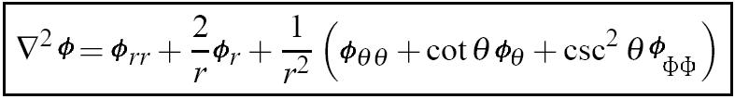
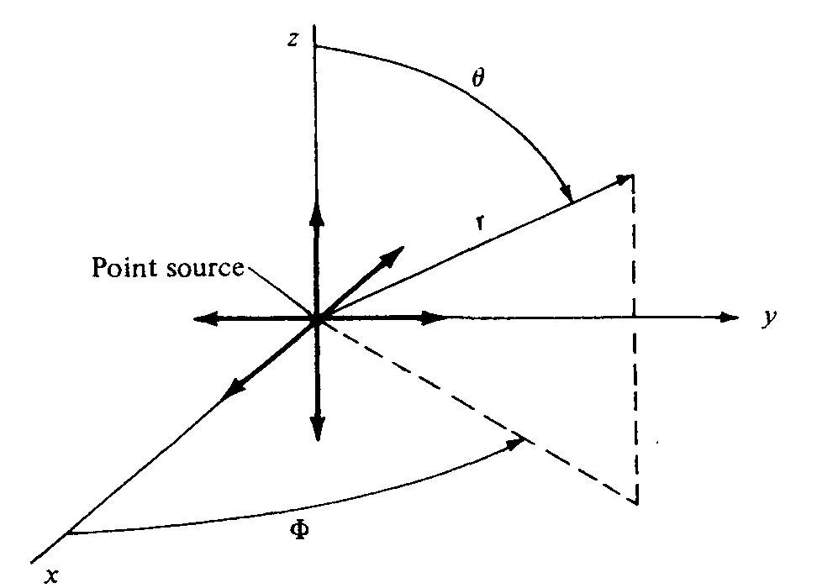
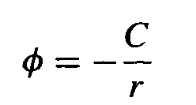
Some elementary three-dimensional incompressible flows
THREE-DIMENSIONAL SOURCE
Return to Laplace's equation written in spherical coordinates,
Consider the velocity potential given by
where C is a constant and r is the radial coordinate from the origin.

Slide 4
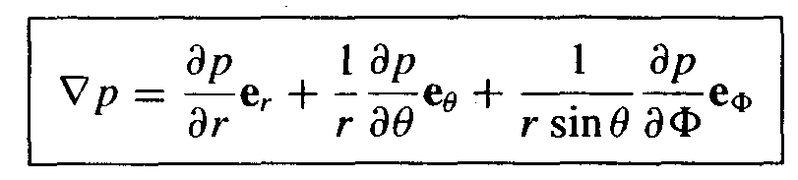
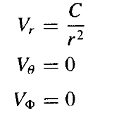


Slide 5





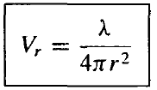
To evaluate the constant C
r
The volume flow:
λ is defined as the strength of the source.

Slide 6
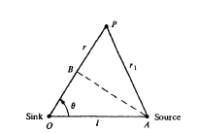



THREE-DIMENSIONAL DOUBLET
Consider a sink and source of equal but opposite strength located at points O and A
The velocity potential at P is:

Slide 7


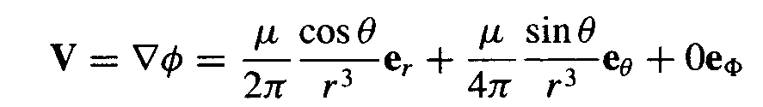
p
r
r1
B
o
A
l

Slide 8
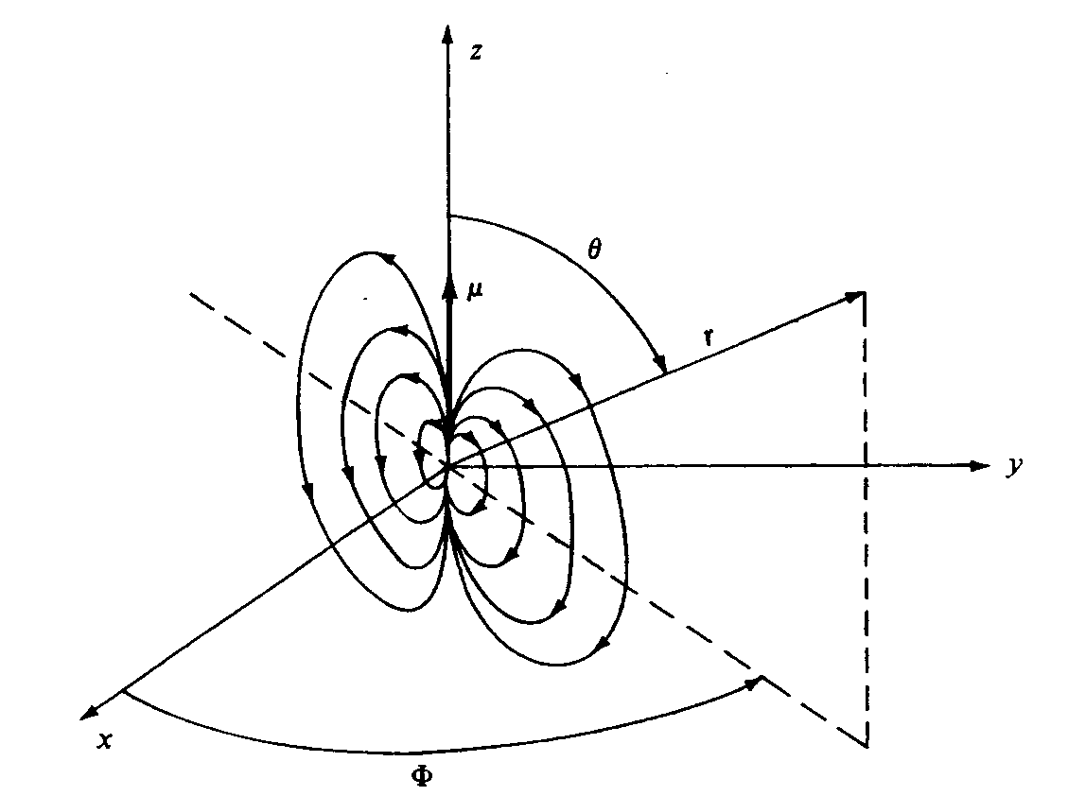
The velocity field depends only on r and θ. Such a flow is defined as axisymmetric flow.

Slide 9
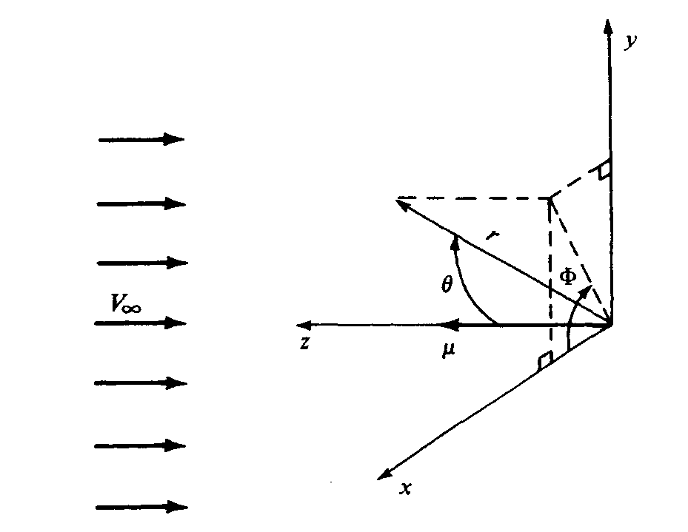
FLOW OVER A SPHERE
The superposition of a uniform flow and a three-dimensional doublet.

Slide 10
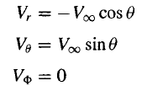
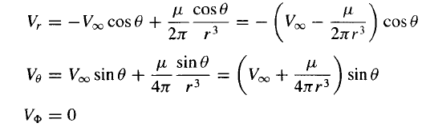
The spherical coordinates of the freestream are:
combined flow:

Slide 11



To find the stagnation points in the flow
Hence, there are two stagnation points, both on the z axis,

Slide 12


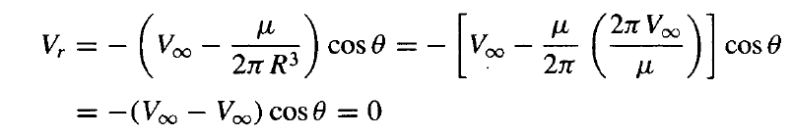
This is precisely the flow-tangency condition for flow over a sphere of radius R.

Slide 13
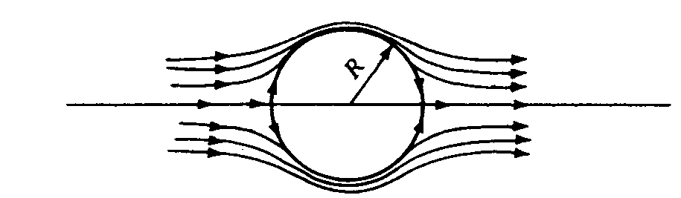

Slide 14
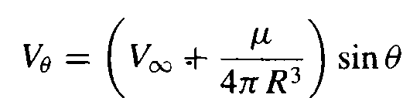




r= R

Slide 15
The maximum velocity occurs at the top and bottom points of the sphere, and its magnitude is( 3/2)V∞.
For the two-dimensional flow, the maximum
velocity is 2V∞.
Three-dimensional relieving effect

Slide 16


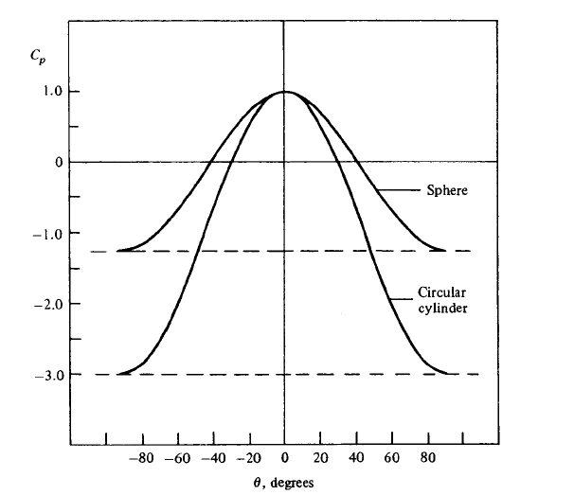
The pressure distribution on the surface of the sphere:

Slide 17
GENERAL THREE-DIMENSIONAL FLOWS:
PANEL TECHNIQUES
Three-dimensional, inviscid, incompressible flows are almost always calculated by means of numerical panel techniques.
The general idea behind all 3 D panel methods is to cover the three-dimensional body with panels over which there is an unknown distribution of singularities (such as point sources, doublets, or vortices).
For a nonlifting body such as illustrated in the following figure, a distribution of source panels is sufficient. However, for a lifting body, both source and vortex panels (or their equivalent) are necessary.

Slide 18
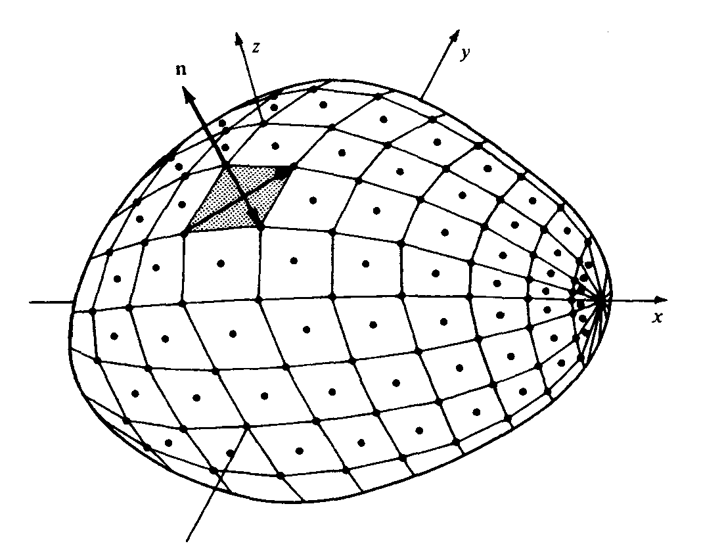

Slide 19
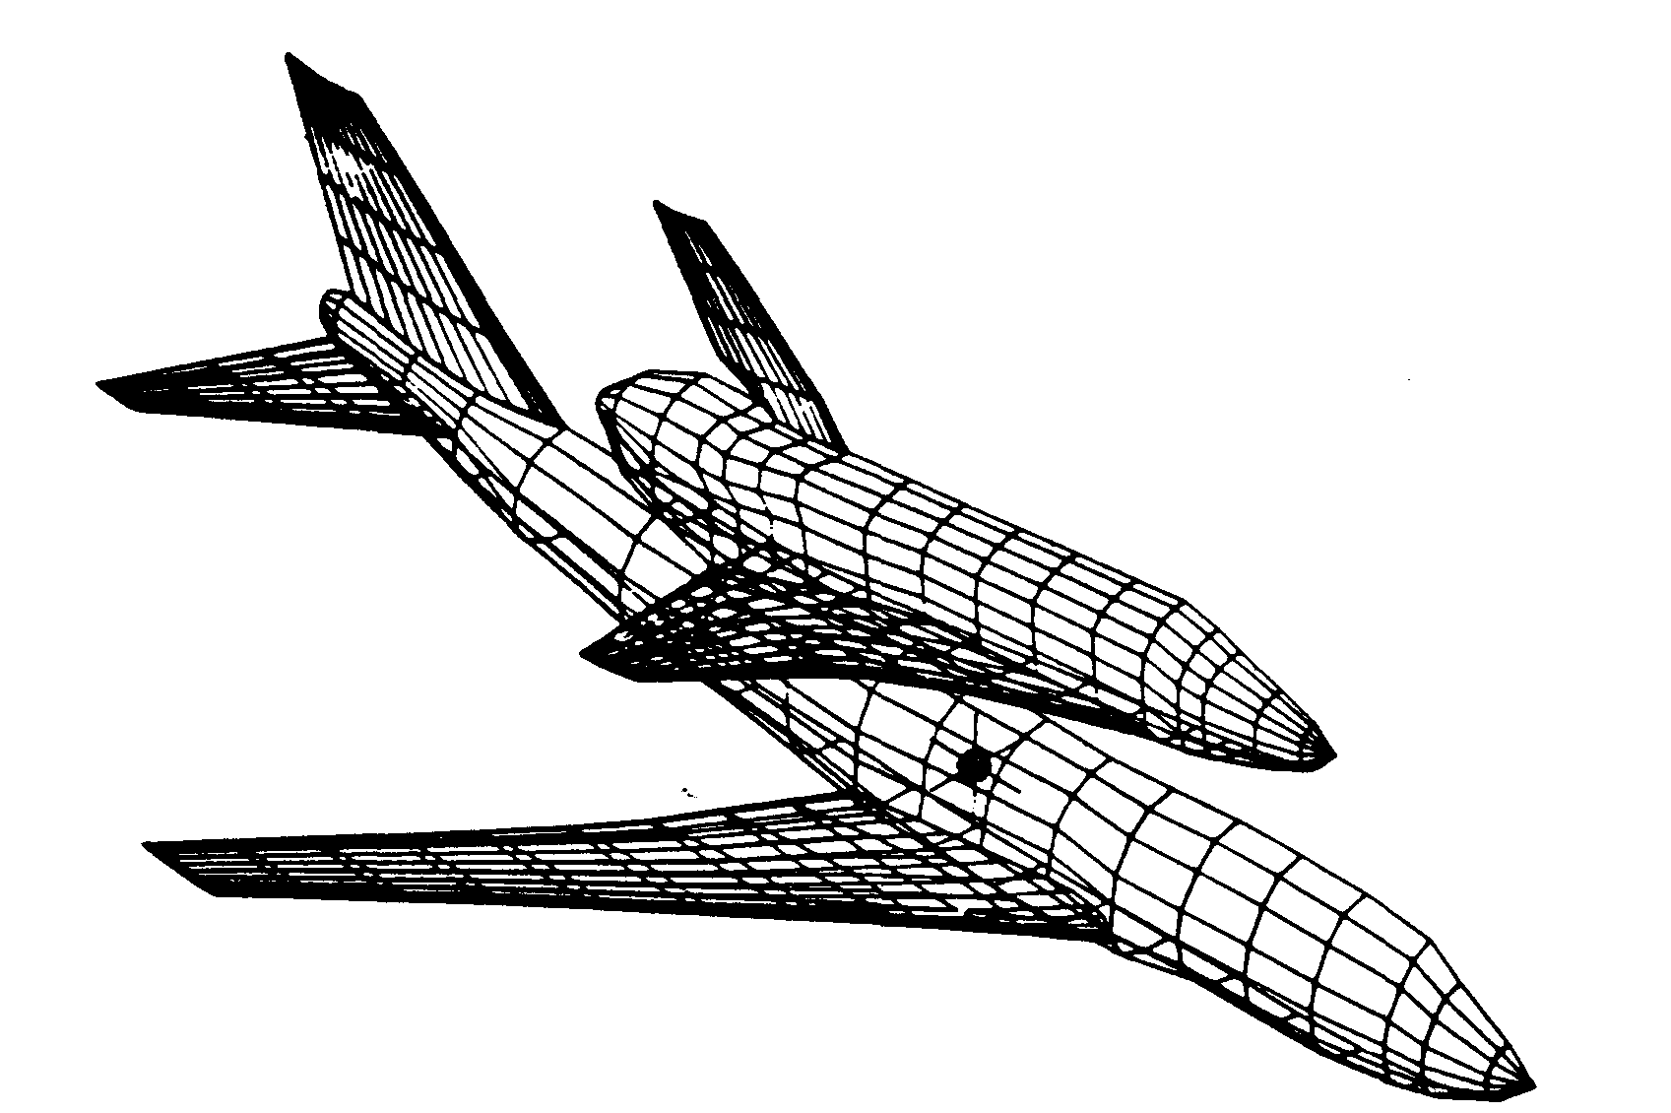
Panel distribution for the analysis of the Boeing 747 carrying the space shuttle orbiter.

Slide 20
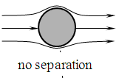
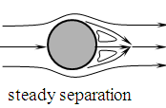
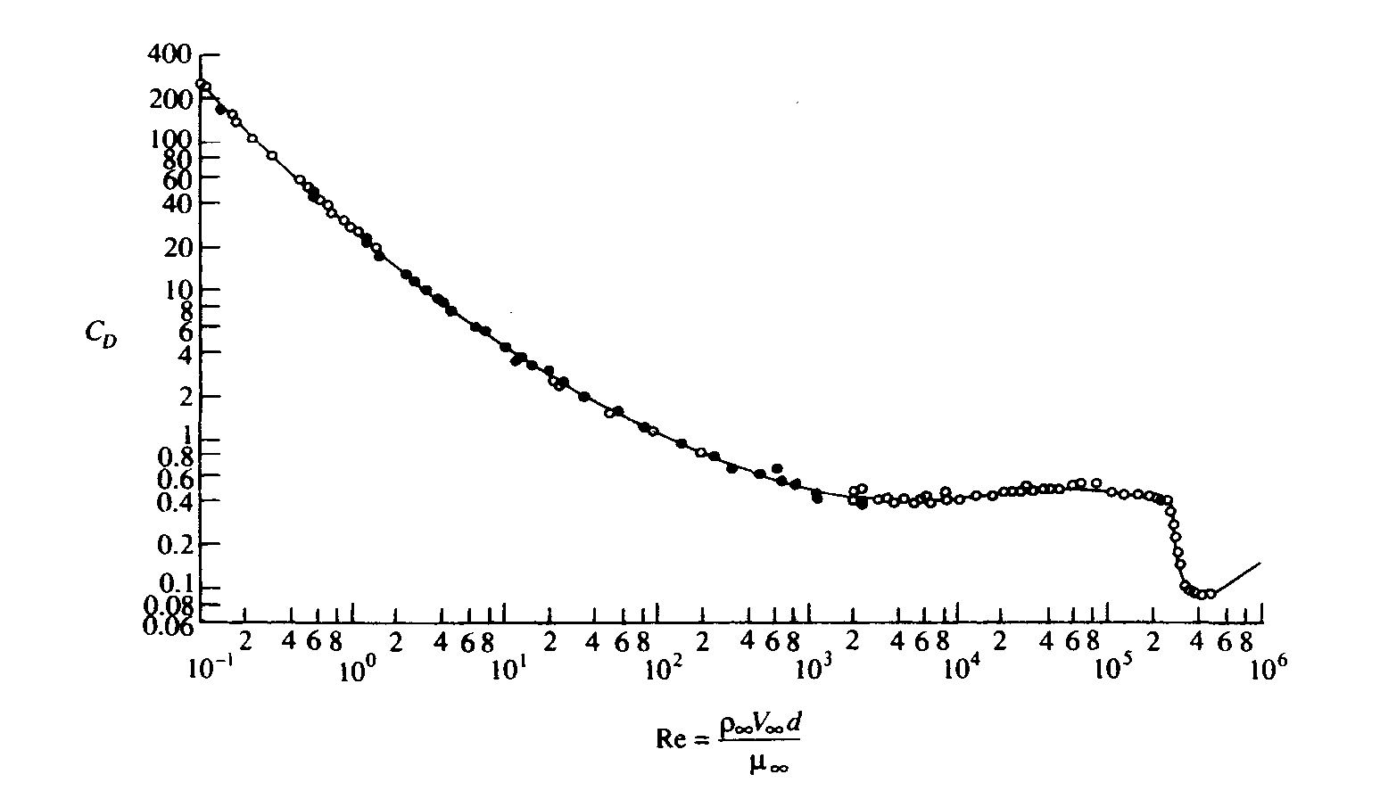
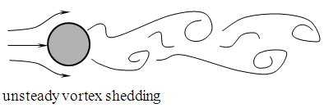


APPLIED AERODYNAMICS: THE FLOW OVER
A SPHERE—THE REAL CASE
turbulent BL
narrow turbulent wake

Slide 21
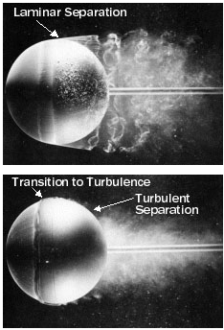
Tripping the boundary layer
Here we see how the addition of a trip wire to induce transition to turbulence changes the separation line further to the rear of the sphere, reducing the size of the wake and thus drastically diminishing overall drag.
This well-known fact can be taken advantage of in a number of applications, such as dimples in golf balls and turbulence generation devices on airfoils.

Slide 22
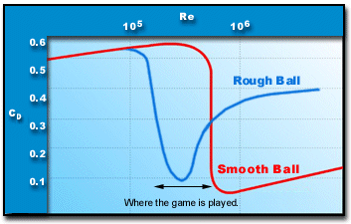
Sports balls
Many games involve balls designed to use drag reduction brought about by surface roughness.
Many sports balls have some type of surface roughness, such as the seams on baseballs or cricket balls and the fuzz on tennis balls.
It is the Reynolds number (not the speed, per se) that determines whether the boundary layer is laminar or turbulent. Thus, the larger the ball, the lower the speed at which a rough surface can be of help in reducing the drag.
Typically sports ball games that use surface roughness to promote an early transition of the boundary layer from a laminar to a turbulent flow are played over a Reynolds number range that is near the “trough” of the Cd versus Re curve, where drag is lowest.

