Slide 1
WHAT IS AERODYNAMICS?
“A branch of dynamics that deals with the motion of air and other gaseous fluids, and with the forces acting on bodies in motion relative to such fluids.”
… Webster’s Dictionary
WHAT IS AERODYNAMICS?

Slide 2
LET’S DISCUSS…
What does “Aerodynamics” mean to you?
In what other areas or products besides airplanes does aerodynamics matter?
WHAT IS AERODYNAMICS?

Slide 3
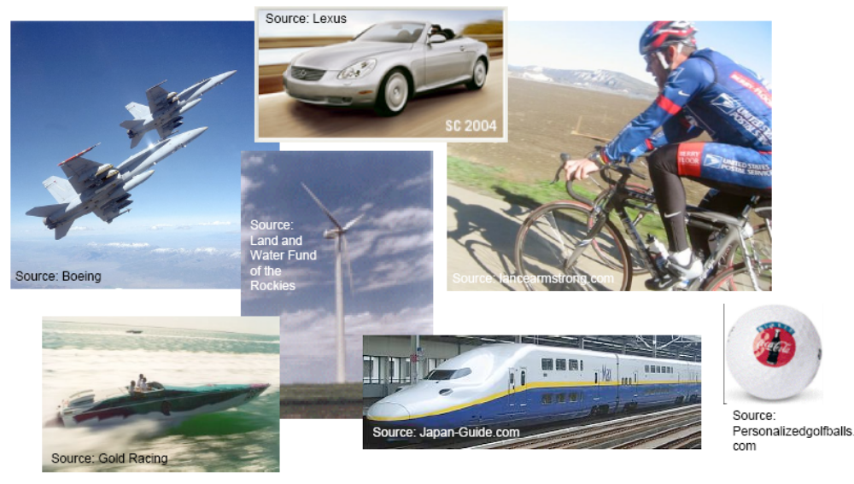
AERODYNAMICS MATTERS…
WHAT IS AERODYNAMICS?

Slide 4
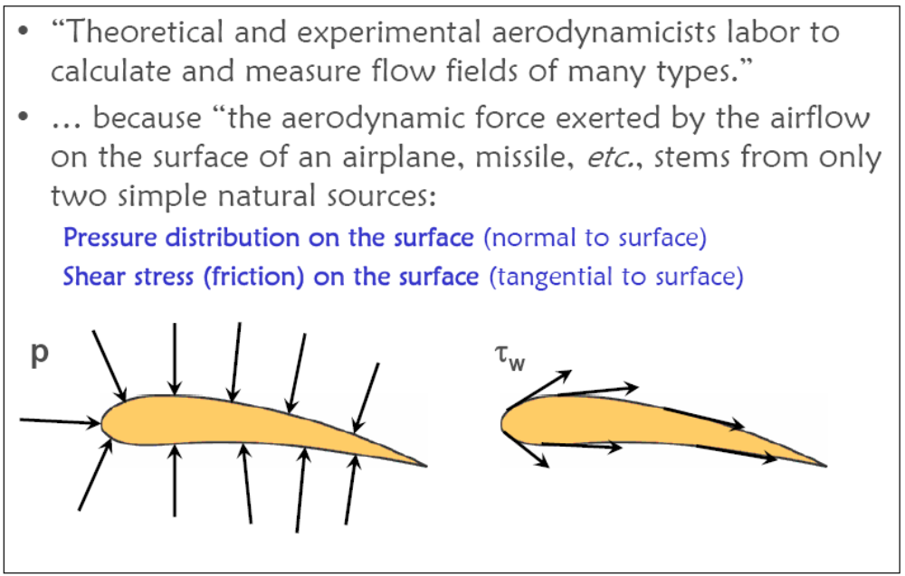
SOURCE OF AERODYNAMIC FORCES…
“Theoretical and experimental aerodynamicists labor to calculate and measure flow fields of many types”
… Because “ the aerodynamic forces exerted by the airflow on the surface of an airplane, missile, etc., stems from only two simple natural sources:
  Pressure distribution over the surface (normal to surface)
  Shear stress (friction) over the surface (tangential to surface)
WHAT IS AERODYNAMICS?

Slide 5
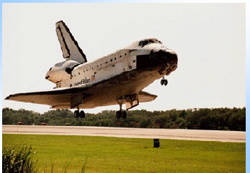
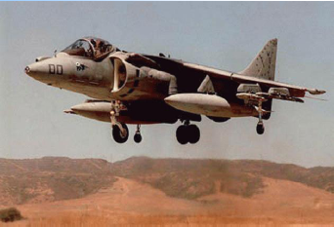
SOURCE OF AERODYNAMIC FORCES…
WHAT IS AERODYNAMICS?

Slide 6
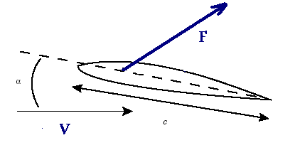
“LIFT” AND “DRAG” COMPONENTS OF AERODYNAMIC FORCE
Normal
Lift
M
Drag
Axial
WHAT IS AERODYNAMICS?

Slide 7
AERODYNAMICS…
Deals with calculations of Forces and Moments due to body-air relative movement for all range of speeds. From very low speed to several times more than speed of sound
WHAT IS AERODYNAMICS?

Slide 8
AERODYNAMICS CLASSIFICATION-1…
Low speed (Incompressible)
Subsonic
Transonic
Supersonic
Hypersonic
Classification is based on:
Flow Compressibility
WHAT IS AERODYNAMICS?

Slide 9
DEFINITION OF COMPRESSIBLE FLOW…
Compressible flow is routinely defined as variable density flow.
v-dv
v
dp
WHAT IS AERODYNAMICS?

Slide 10
DEFINITION OF COMPRESSIBLE FLOW…
For the flow of gases with their attendant large values of Compressibility, moderate to strong pressure gradients lead to substantial changes in the density.
At the same time, such pressure gradients create large velocity changes in the gas.
Such flows are defined as compressible flows, where density is a variable.
WHAT IS AERODYNAMICS?

Slide 11
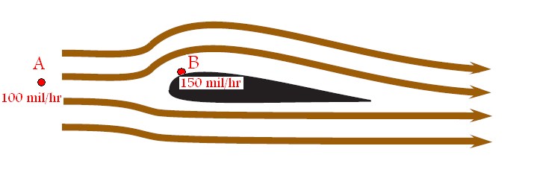
EXAMPLE
Consider the low-speed flow of air over an airplane wing at standard conditions:
the percentage change in pressure is 1.5%
WHAT IS AERODYNAMICS?

Slide 12
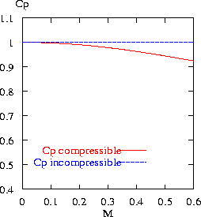
EXTENDED CONSTANT-DENSITY FLOWS
Mach number is defined as the ratio of the local flow velocity to the speed of sound:
WHAT IS AERODYNAMICS?

Slide 13
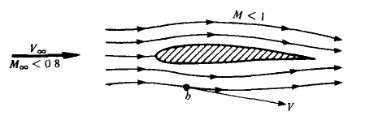
INCOMPRESSIBLE - SUBSONIC FLOWS
WHAT IS AERODYNAMICS?

Slide 14
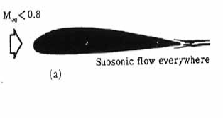
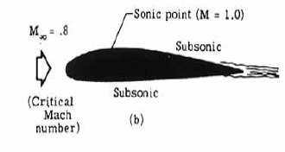
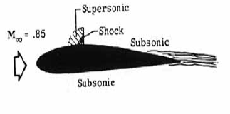
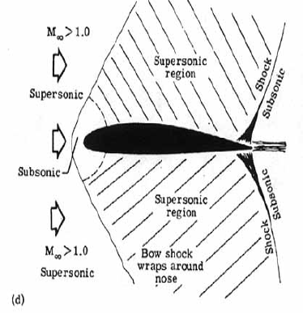
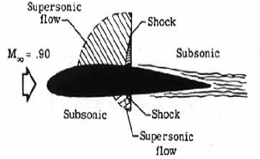
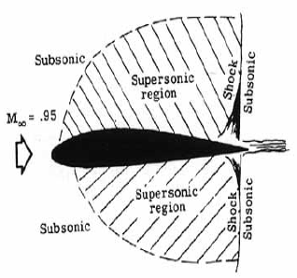
TRANSONIC FLOW
WHAT IS AERODYNAMICS?

Slide 15
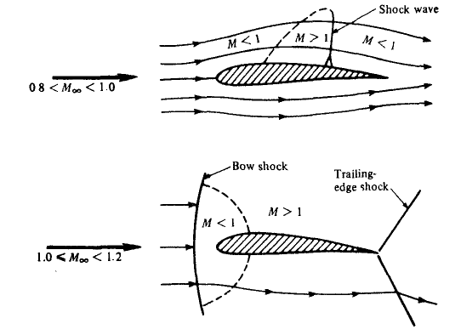
TRANSONIC FLOW
WHAT IS AERODYNAMICS?

Slide 16
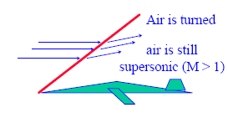
SUPERSONIC FLOW
WHAT IS AERODYNAMICS?

Slide 17
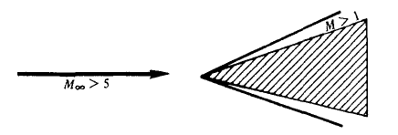
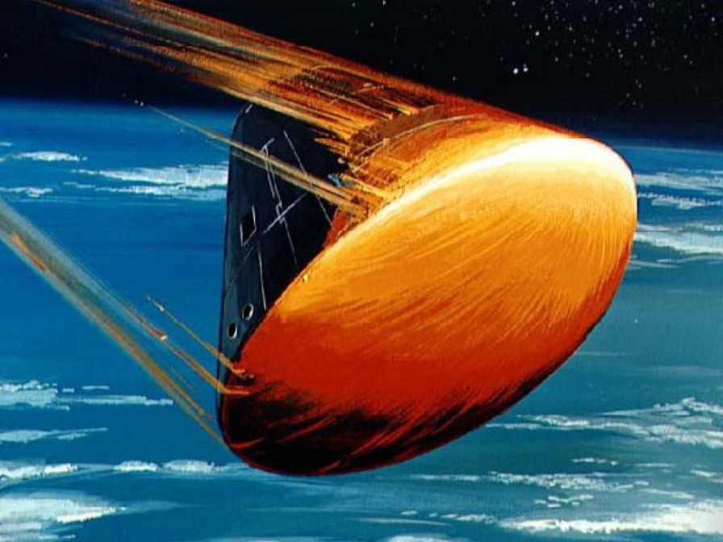

HYPERSONIC FLOW
WHAT IS AERODYNAMICS?

Slide 18


SUPERCAVITATION
WHAT IS AERODYNAMICS?

Slide 19
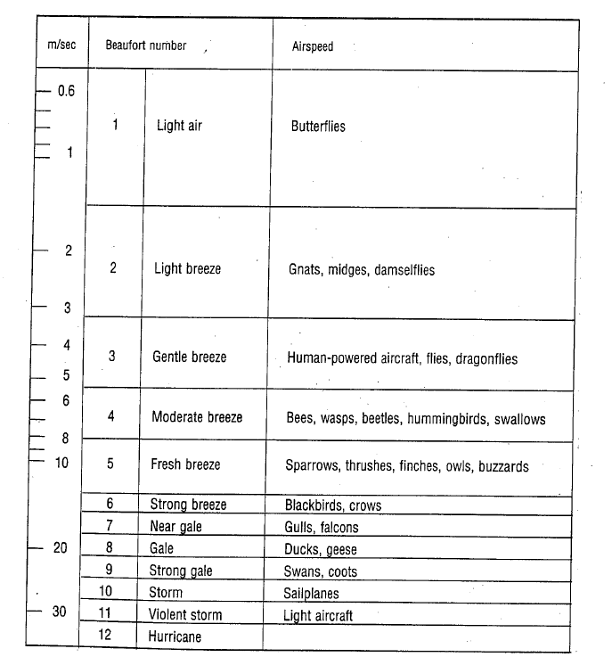
WHAT IS AERODYNAMICS?

Slide 20
FLOW CLASSIFICATION - 2
Inviscid flow:
  Rotational
  Irrotational
Viscous flow:
  Laminar
  Turbulent
WHAT IS AERODYNAMICS?

