Slide 1
LIFTING FLOWS OVER ARBITRARY BODIES:
THE VORTEX PANEL NUMERICAL METHOD
The thin airfoil theory applies only to thin airfoils at small angles of attack.
The advantage of thin airfoil theory is that closed-form expressions are obtained for the aerodynamic coefficients. Moreover, the results compare favorably with experimental data for airfoils of about 12 percent thickness or less.
We need a method that allows us to calculate the aerodynamic characteristics of bodies of arbitrary shape, thickness, and orientation.
The Numerical Vortex Panel Method
1

Slide 2
REVIEW OF PANEL METHOD BASIC IDEAS
Approximate the surface of a given body by a series of panels.
Place distributions of singularities (such as sources, vortices or doublets) on each panel.
The problem is to find the values of the unknown strengths of the singularities for the given geometry. Find the unknown strengths by solving a linear set of algebraic equations.
With the aid of panel methods, the requirement to find the solution over the entire flowfield (a 3D problem) is replaced with the problem of finding the solution for the singularity distribution over a surface (a 2D problem).
The Numerical Vortex Panel Method
2

Slide 3
REVIEW OF PANEL METHOD BASIC IDEAS
Possible differences in panel methods are in:
Using various types of singularities (sources, doublets and vortices or any combination of them)
Using various distributions of singularity strength over each panel (zero-, first-, second-order, etc.).
Using various panel geometries.
The Numerical Vortex Panel Method
3

Slide 4

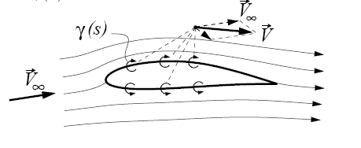
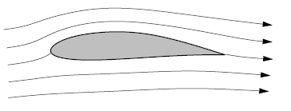
VORTEX PANEL METHOD
We treat the vortex panel method, which is a numerical technique that has come into widespread use since the early 1970s.
The vortex panel method is directly analogous to the source panel method. However, because a source has zero circulation, source panels are useful only for nonlifting cases. In contrast, vortices have circulation, and hence vortex panels can be used for lifting cases.
The philosophy of covering a body surface with a vortex sheet of such a
strength to make the surface a streamline of the flow was discussed
Conformal Mapping in Aerodynamics
4

Slide 5
VORTEX PANEL METHOD
P
r
θ
S
j
2
1
α
i
n
V∞
Control Points
Boundary points
5
5
The Numerical Vortex Panel Method

Slide 6




VORTEX PANEL METHOD
(x,y)
P
r_{pj}
θ_{pj}
ds_{j}
j
i
6
6
The Numerical Vortex Panel Method

Slide 7
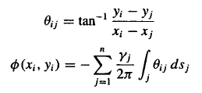
VORTEX PANEL METHOD
ds_{j}
j
r_{ij}
i
7
7
The Numerical Vortex Panel Method

Slide 8





VORTEX PANEL METHOD
n_{i}
V∞
S
j
β_{i}
α
i
α
V∞
8
8
The Numerical Vortex Panel Method

Slide 9
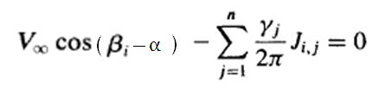
VORTEX PANEL METHOD
The above equation is a linear algebraic equation with n unknowns, γ₁ , γ₂ , …, γ_{n} It represents the flow boundary condition evaluated at the control point of the ith panel.
If the equation is applied to the control points of all the panels, we obtain
a system of n linear equations with n unknowns.
To this point, we have been deliberately paralleling the discussion of the
source panel method; however, the similarity stops here.
9
9
The Numerical Vortex Panel Method

Slide 10
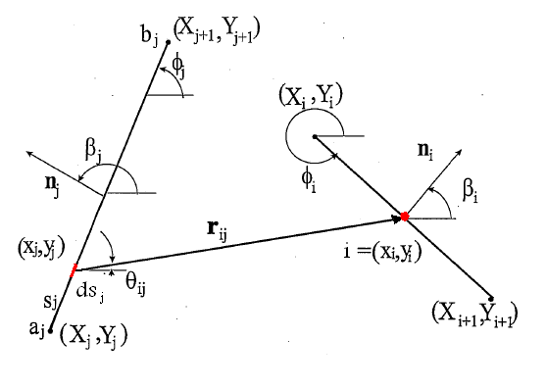


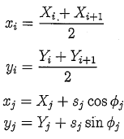
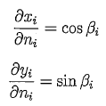
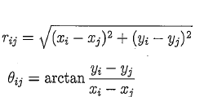


VORTEX PANEL METHOD
10
10
The Numerical Vortex Panel Method

Slide 11
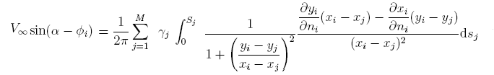


VORTEX PANEL METHOD
Replace the derivatives with their values:
11
11
The Numerical Vortex Panel Method

Slide 12
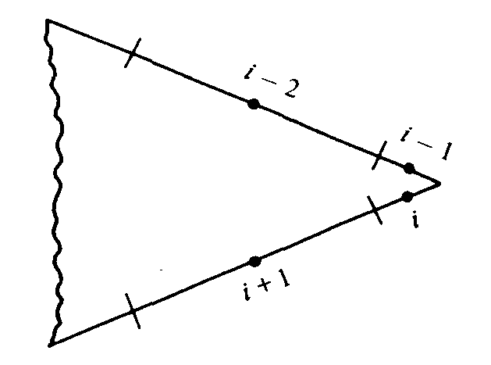
KUTTA CONDITION
For the source panel method, the n equations for the n unknown source strengths are routinely solved, giving the flow over a nonlifting body. In contrast, for the lifting case with vortex panels, in addition to the n equations applied at all the panels, we must also satisfy the Kutta condition.
To approximate this numerically, if points i and i - 1 are
close enough to the trailing edge, we can write:
Such that the strengths of the two vortex panels i and i - 1 exactly cancel at the point where they touch at the trailing edge. Thus, in order to impose the Kutta condition on the solution of the flow
12
12
The Numerical Vortex Panel Method

Slide 13


VORTEX PANEL METHOD
An overdetermined system of n unknowns with n + 1 equations.
We choose to ignore one of the control points, and we have n-1 equation the other n - 1 control points. This, in combination with Kutta condition, now gives a system of n linear algebraic equations with n unknowns, which can be solved by standard techniques.
The total circulation and the resulting lift are obtained as follows:
Let s_{j} be the length of the jth panel. Then the circulation due to the jth panel is . In turn, the total circulation due to all the panels is
13
13
The Numerical Vortex Panel Method

Slide 14
VORTEX PANEL METHOD
Although the method may appear to be straightforward, its numerical implementation can sometimes be frustrating.
For example,
1- The results for a given body are sensitive to the number of panels used,
their various sizes, and the way they are distributed over the body surface (i.e., it is usually advantageous to place a large number of small panels near the leading and trailing edges of an airfoil and a smaller number of larger panels in the middle).
2-The need to ignore one of the control points in order to have a determined system in n equations for n unknowns also introduces some arbitrariness in the numerical solution. Which control point do you ignore? Different choices sometimes yield different numerical answers for the distribution of y over the surface.
3- Moreover, the resulting numerical distributions for γ are not always smooth, but rather, they have oscillations from one panel to the next as a result of numerical inaccuracies.
14
14
The Numerical Vortex Panel Method

Slide 15
VORTEX PANEL METHOD
To overcome the problems:
The mentioned problems are usually overcome in different ways.
For example,
1- What is more common today is to use a combination of both source and vortex panels (source panels to basically simulate the airfoil thickness and vortex panels to introduce circulation) in a panel solution.
2-Higher–order panel method, we have used first order panel method in which the distribution of γ is constant along each panel. Other distributions for γ may be used. For example linear distribution of γ
15
15
The Numerical Vortex Panel Method

Slide 16
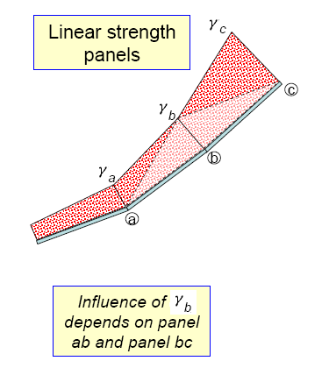
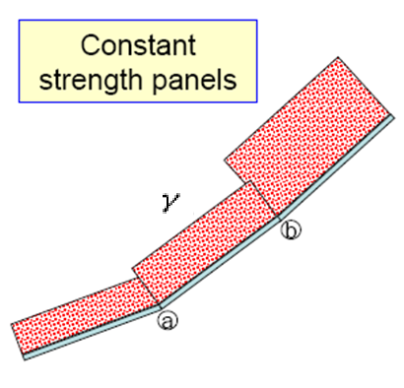
HIGHER ORDER PANEL METHOD
16
16
The Numerical Vortex Panel Method

Slide 17



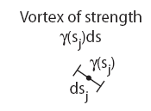
LINEAR STRENGTH PANELS
_{Sj}
s_{j}
j
ds_{j}
j
j+1
17
17
The Numerical Vortex Panel Method

Slide 18


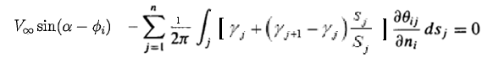
LINEAR STRENGTH PANELS
18
18
The Numerical Vortex Panel Method

Slide 19
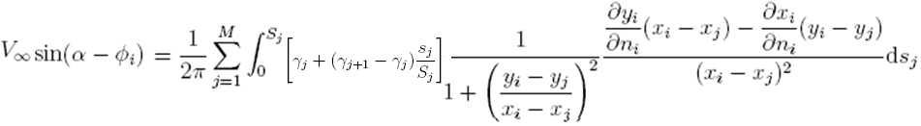


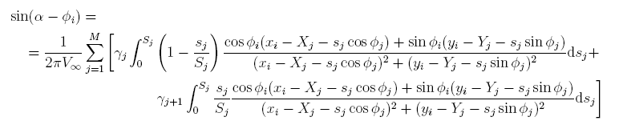
LINEAR STRENGTH PANELS
Replace the derivatives with their values:
19
19
The Numerical Vortex Panel Method

Slide 20
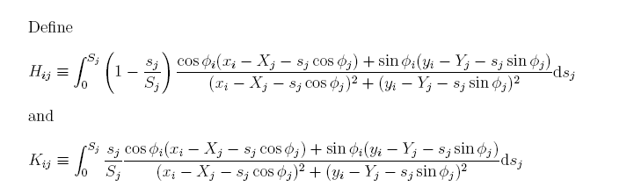

LINEAR STRENGTH PANELS
20
20
The Numerical Vortex Panel Method

Slide 21
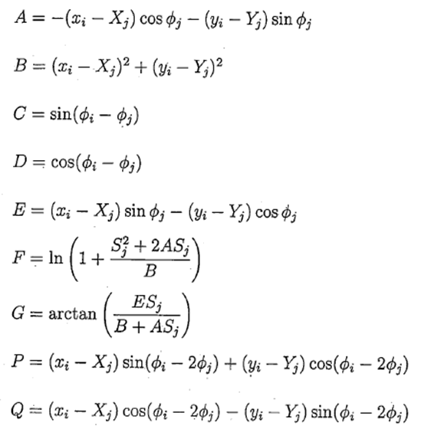
LINEAR STRENGTH PANELS
21
21
The Numerical Vortex Panel Method

Slide 22
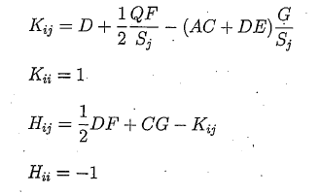



LINEAR STRENGTH PANELS
22
22
The Numerical Vortex Panel Method

Slide 23
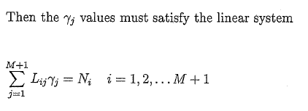
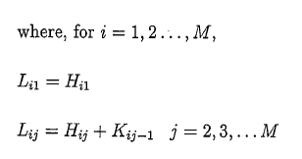
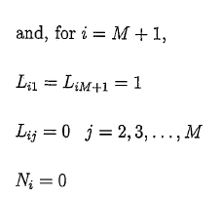

LINEAR STRENGTH PANELS
23
23
The Numerical Vortex Panel Method

Slide 24
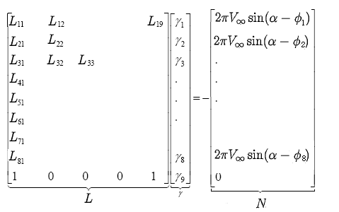
LINEAR STRENGTH PANELS
24
24
The Numerical Vortex Panel Method

Slide 25
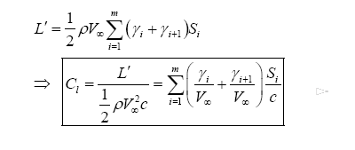


LINEAR STRENGTH PANELS
n_{i}
j
V∞
β_{i}
α
i
25
25
The Numerical Vortex Panel Method

Slide 26
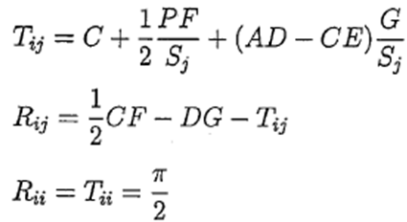

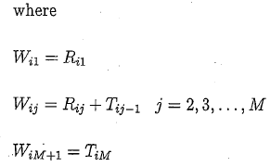

LINEAR STRENGTH PANELS
26
26
The Numerical Vortex Panel Method

Slide 27
VORTEX PANEL METHOD - SUMMARY
Write down the velocities in terms of contributions from all the singularities.
Find the algebraic equations defining the influence coefficients.
Write down flow tangency conditions in terms of the velocities (N equations, N+1 unknowns)
Write down the Kutta condition equation to get the N+1 equation.
Solve the resulting linear algebraic system of equations
Write down the equations for tangential velocity at each control point.
Determine the pressure distribution from Bernoulli’s equation using the tangential velocity on each panel.
The Numerical Vortex Panel Method
27

Slide 28
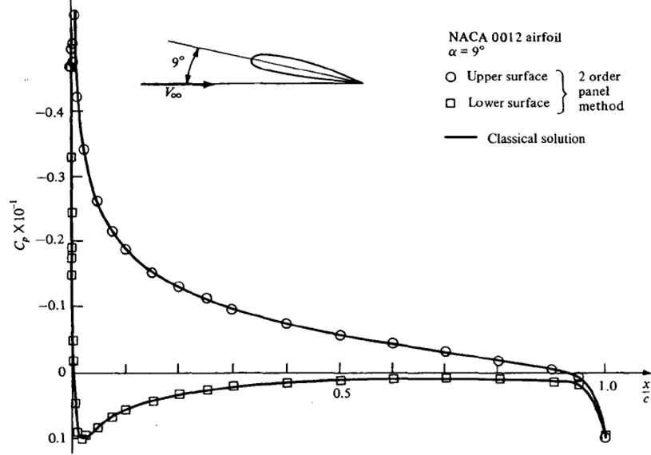
VORTEX PANEL METHOD
28
28
The Numerical Vortex Panel Method

