Slide 1
INVISCID – VISCOUS FLUID FLOW
Most of our previous discussions have dealt with inviscid flows. A large number of practical aerodynamic applications are appropriately treated by assuming inviscid flow, as we have already seen.
Inviscid flows do not truly exist in nature; however, there are many practical aerodynamic flows (more than you would think) where the influence of transport phenomena is small, and we can model the flow as being inviscid.
Theoretically, inviscid flow is approached in the limit as the Reynolds number goes to infinity.
Introduction to Boundary Layers

Slide 2
INVISCID – VISCOUS FLUID FLOW
Some aspects of aerodynamics are inherently viscous in nature, such as skin-friction drag, aerodynamic heating and flow separation.
To deal with these important aspects, we have to undertake the study of Viscous Flow.
Introduction to Boundary Layers

Slide 3
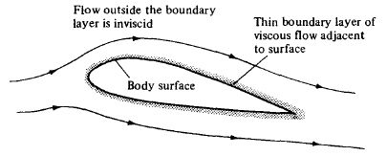
WHTAT IS A BOUNDARY LAYER?
For practical problems, many flows with high but finite Re can be assumed to be inviscid. For such flows, the influence of friction, is limited to a very thin region adjacent to the body surface called the boundary layer.
The boundary layer is the thin region
of flow adjacent to a surface, where
the flow is retarded by the influence of friction between a solid surface and the fluid.
Although the influence of friction is present every point throughout flow, it is usually of no consequence except in a thin region adjacent to the surface of a body immersed in the flow.
Introduction to Boundary Layers

Slide 4
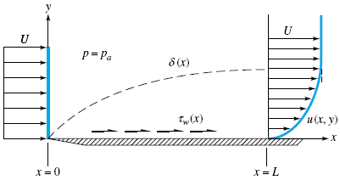
WHTAT IS A BOUNDARY LAYER?
Consider the viscous flow over a flat plate. The viscous effects are contained within a thin layer adjacent to the surface.
The influence of friction is to
create V=0 right at the plate
surface. This is called the no-slip
condition which dominates
viscous flow.
Above the surface, the flow velocity increases in y direction until, for all practical purposes, it equals the freestream velocity.
Introduction to Boundary Layers

Slide 5
WHTAT IS A BOUNDARY LAYER?
Consider the viscous flow over a flat plate. The viscous effects are contained within a thin layer adjacent to the surface.
δ (boundary layer thickness)
is defined as that distance above
the wall where u=0.99U; Here,
U is the velocity at the outer edge
of the boundary layer.
At any x station, the variation of u between y=0 and y= δ, that is, u=u(y) is defined as the velocity profile.
Introduction to Boundary Layers

Slide 6

WHTAT IS A BOUNDARY LAYER?
Consider the viscous flow over a flat plate. The viscous effects are contained within a thin layer adjacent to the surface.
The consequence of the
velocity gradient at the wall is
the generation of shear stress
at the wall:
Introduction to Boundary Layers

Slide 7
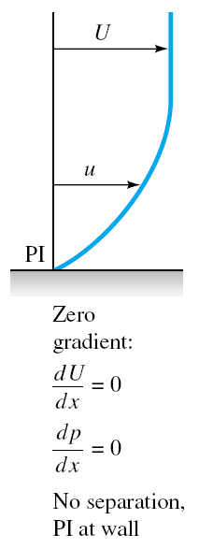
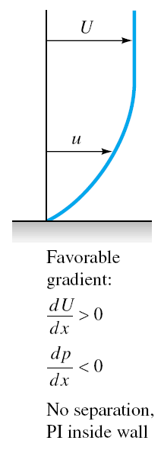
EFFECT OF PRESSURE GRADIENT ON VELOCITY PROFILE
Introduction to Boundary Layers

Slide 8
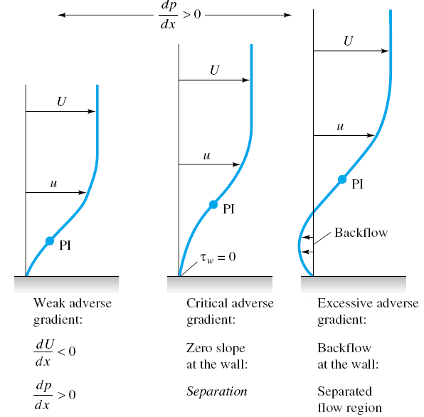
EFFECT OF PRESSURE GRADIENT ON VELOCITY PROFILE (SEPARATION)
Introduction to Boundary Layers

Slide 9
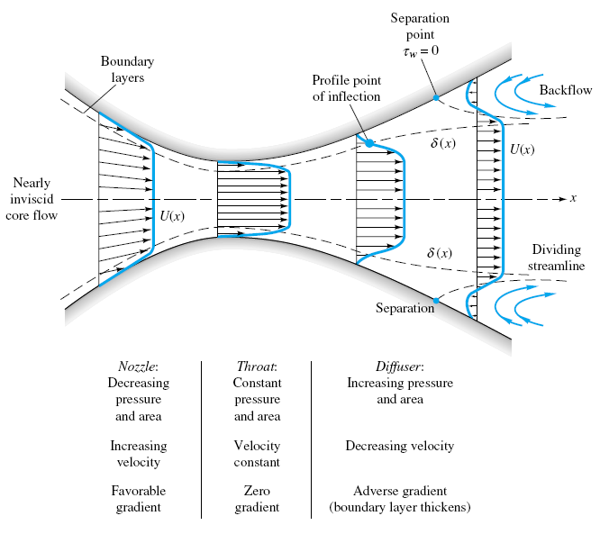
EFFECT OF PRESSURE GRADIENT ON VELOCITY PROFILE (SEPARATION)
Introduction to Boundary Layers

Slide 10
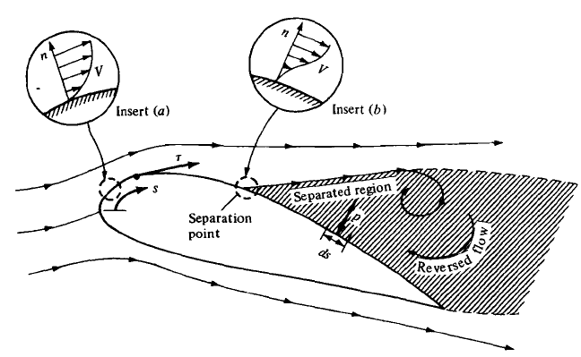
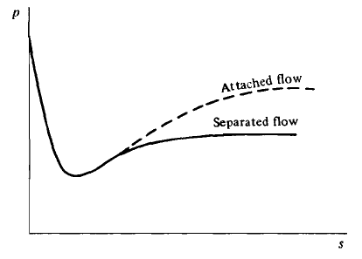
EFFECT OF PRESSURE GRADIENT ON VELOCITY PROFILE (SEPARATION)
Introduction to Boundary Layers

Slide 11
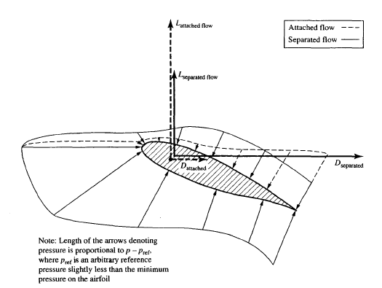
EFFECT OF PRESSURE GRADIENT ON VELOCITY PROFILE (SEPARATION)
Introduction to Boundary Layers

Slide 12
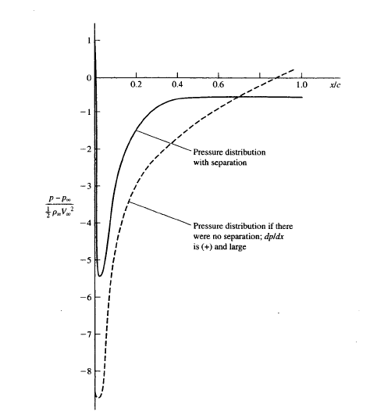
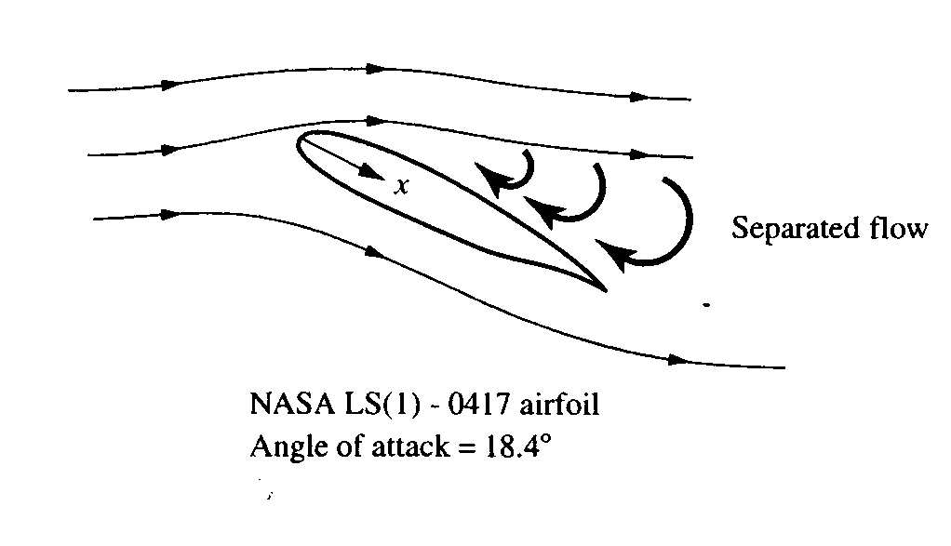
EFFECT OF PRESSURE GRADIENT ON VELOCITY PROFILE (SEPARATION)
Introduction to Boundary Layers

Slide 13
EFFECTS OF VISCOUSITY ON DRAG
With the assumption of an inviscid flow, the integrated pressure distribution over body would give zero drag!
(d’ Alembert’s paradox)
The effects of viscosity are to produce two types of drag:
  Skin-friction drag (D_{f}): The component in the drag direction of the integral of the shear stress over body.
  Pressure drag (D_{p}) due to separation, that is, the component in the drag direction of the integral of the pressure distribution over body. Pressure drag is sometimes called form drag.
  The sum D_{f} + D_{p} is called the profile drag of a two-dimensional body. This is frequently called parasite drag.
Introduction to Boundary Layers

Slide 14
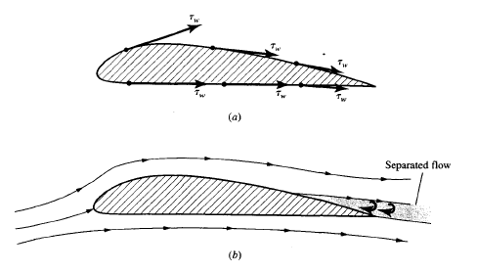
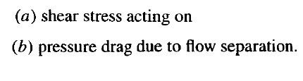
EFFECTS OF VISCOUSITY ON DRAG
p < 0
τ_{w}
U
U
p > 0
Introduction to Boundary Layers

Slide 15
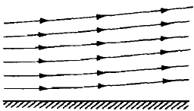
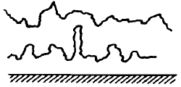
LAMINAR AND TURBULENT FLOWS
Consider the viscous flow over a surface.
  Laminar flow: The path lines of various fluid elements are smooth and regular.
  Turbulent flow: The motion of a fluid element is very irregular and tortuous.
Introduction to Boundary Layers

Slide 16
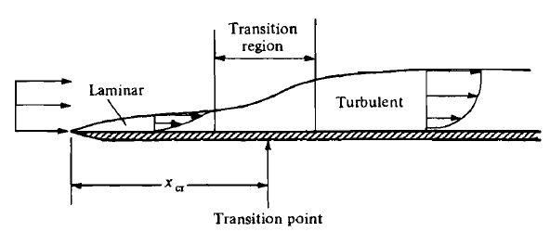

TRANSITION FROM LAMINAR TO TURBULENT BOUNDARY LAYERS
For the laminar boundary layer over a flat plate, after a certain distance from the leading edge, instabilities will appear in the laminar flow.
The instabilities rapidly grow, causing transition to turbulent flow.
For purposes of
analysis, we
frequently model the
Transition region as a
single point, called the
transition point.
Introduction to Boundary Layers

Slide 17
TRANSITION FROM LAMINAR TO TURBULENT BOUNDARY LAYERS
Some characteristics which encourage transition from laminar to turbulent flow, are:
Increased surface roughness
Increased turbulence in the freestream
Adverse pressure gradient
Heating of the fluid by the surface
Introduction to Boundary Layers

Slide 18
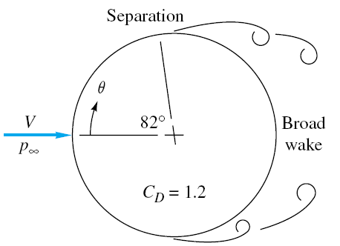
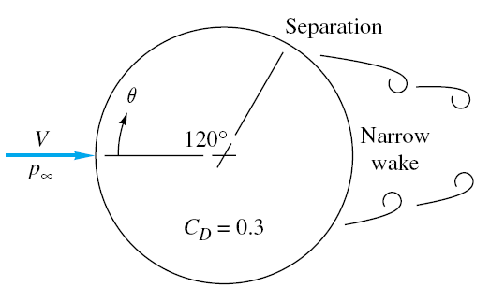
FLOW PAST A CIRCULAR CYLINDER
Laminar Separation
Turbulent Separation
Introduction to Boundary Layers

Slide 19
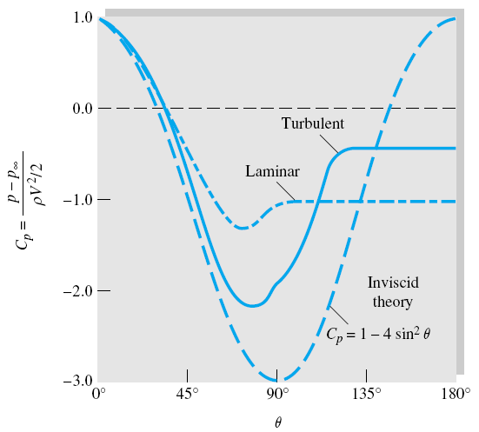
FLOW PAST A CIRCULAR CYLINDER
Introduction to Boundary Layers

Slide 20
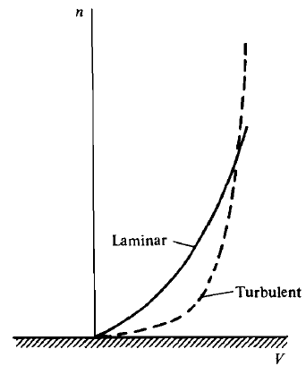

VELOCITY PROFILES FOR LAMINAR AND TURBULENT FLOWS
Introduction to Boundary Layers

Slide 21
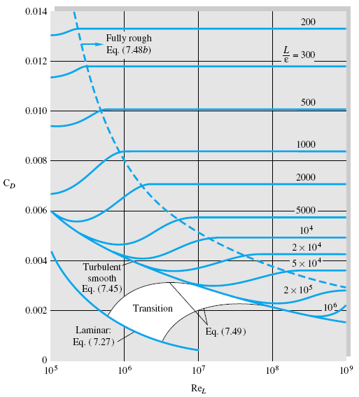
DRAG COEFFICIENT OF LAMINAR AND TURBULENT BOUNDARY LAYERS
Drag coefficient of
laminar and turbulent
boundary layers on
smooth and rough
flat plates:
Introduction to Boundary Layers

Slide 22
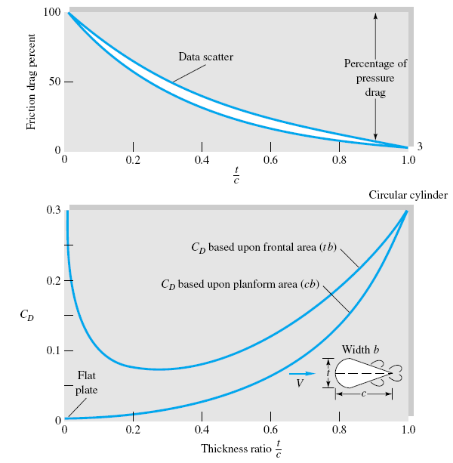
EXPERIMENTAL EXTERNAL FLOWS
Drag of a streamlined
two-dimensional
cylinder at Re_{c} = 10⁶
Introduction to Boundary Layers

Slide 23
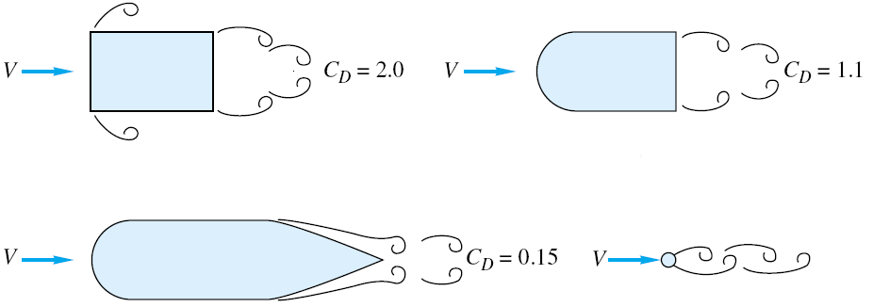
EXPERIMENTAL EXTERNAL FLOWS
The importance of streamlining in reducing drag of a body (C_{D} based on frontal area)
Introduction to Boundary Layers

Slide 24
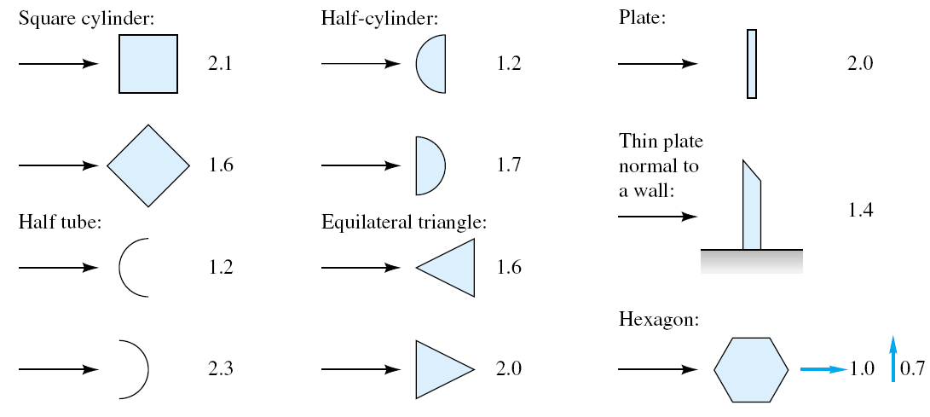
EXPERIMENTAL EXTERNAL FLOWS
Drag of two-dimensional bodies Re>10⁴
Introduction to Boundary Layers

Slide 25
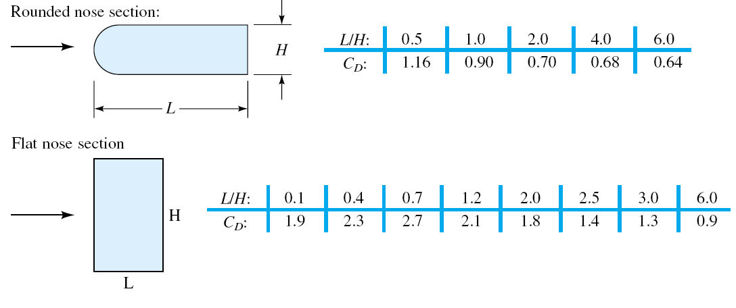
EXPERIMENTAL EXTERNAL FLOWS
Drag of two-dimensional bodies Re>10⁴
Introduction to Boundary Layers

Slide 26
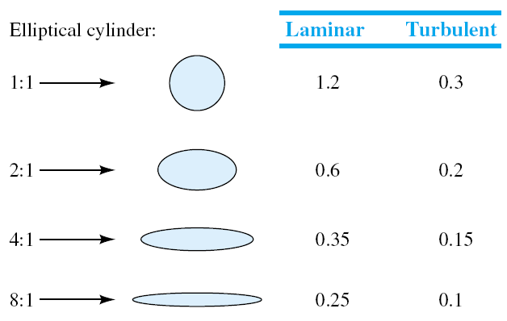
EXPERIMENTAL EXTERNAL FLOWS
Drag of two-dimensional bodies Re>10⁴
Introduction to Boundary Layers

Slide 27
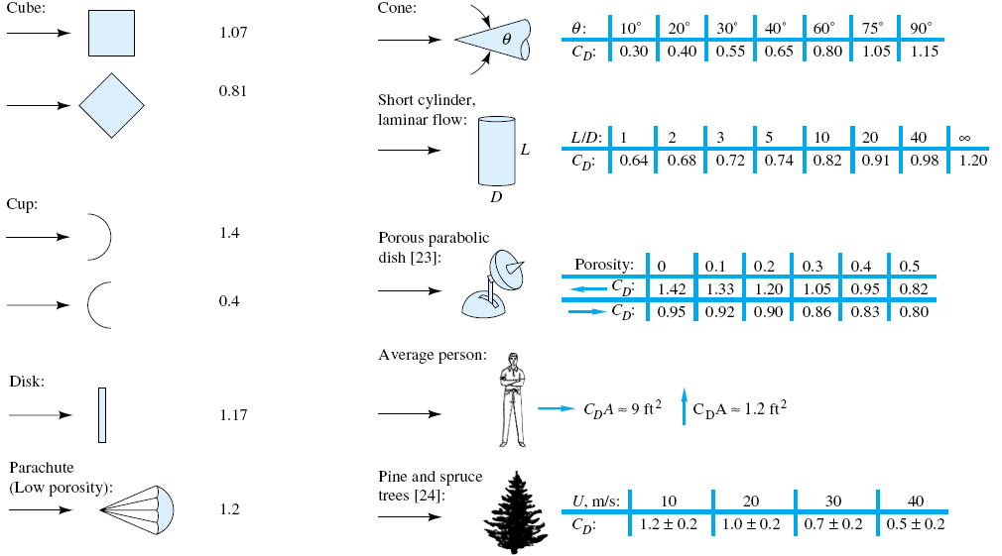
EXPERIMENTAL EXTERNAL FLOWS
Drag of three-dimensional bodies Re>10⁴
Introduction to Boundary Layers

Slide 28
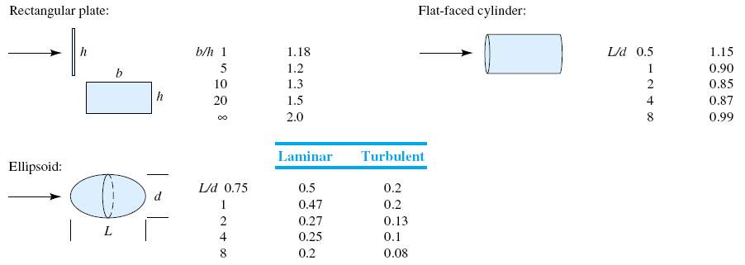
EXPERIMENTAL EXTERNAL FLOWS
Drag of three-dimensional bodies Re>10⁴
Introduction to Boundary Layers

Slide 29
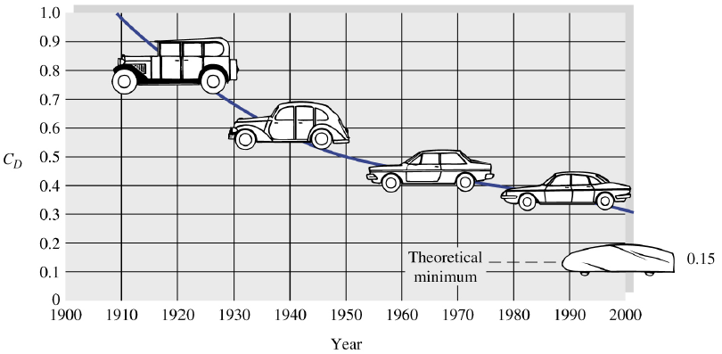
EXPERIMENTAL EXTERNAL FLOWS
Aerodynamic force on road vehicles
Introduction to Boundary Layers

Slide 30
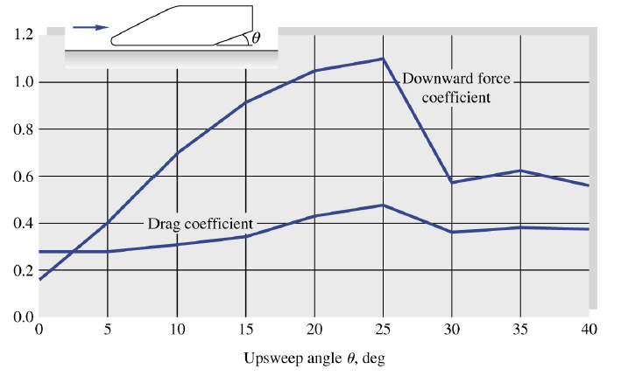
EXPERIMENTAL EXTERNAL FLOWS
Aerodynamics of automobiles
Introduction to Boundary Layers

Slide 31
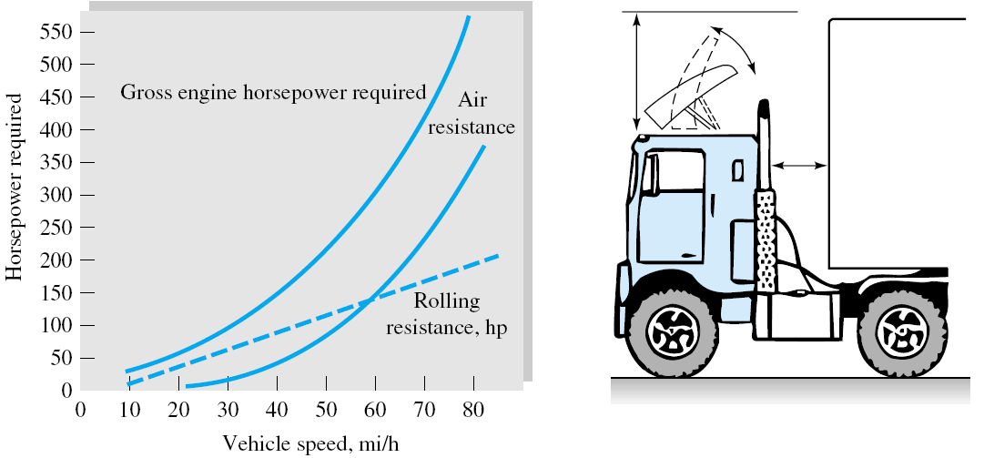
EXPERIMENTAL EXTERNAL FLOWS
Drag reduction of a tractor-trailer truck
Introduction to Boundary Layers

Slide 32
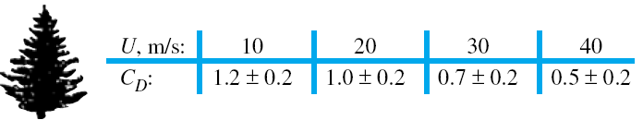
BIOLOGICAL DRAG REDUCTION
A great deal of engineering effort goes into designing immersed bodies to reduce their drag. Most such effort concentrates on rigid-body shapes.
A different process occurs in nature, as organisms adapt to survive high winds or currents. Flexible structure of a tree allows it to reconfigure in high winds and thus reduce drag and damage.
as wind velocity increases, the shape of the tree changes to offer less
Resistance.
Introduction to Boundary Layers

Slide 33
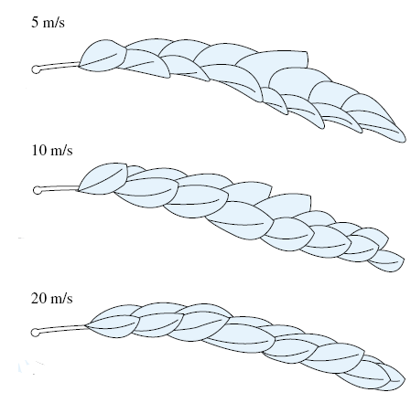
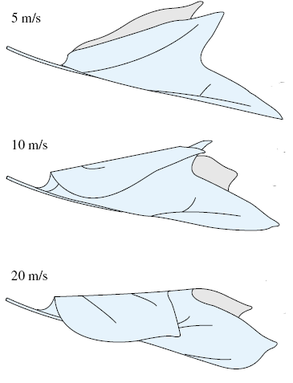
BIOLOGICAL DRAG REDUCTION
The individual branches and leaves of a tree also curl and cluster to reduce drag.
Introduction to Boundary Layers

Slide 34
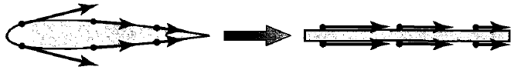
ESTIMATING SKIN-FRICTION DRAG OF A AIRFOIL
We assume that skin-friction drag on an airfoil is essentially
the same as the skin-friction drag on a flat plate at zero angle of attack.
This approximation becomes more accurate the thinner the airfoil and the smaller the angle of attack.
Viscous Flow – Airfoil Drag

Slide 35
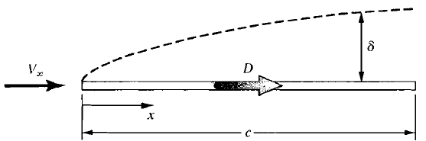
ESTIMATING SKIN-FRICTION DRAG OF A AIRFOIL
LAMINAR FLOW
We first deal with the case of completely laminar flow over the airfoil (and hence the flat plate)
There is an exact analytical solution for the laminar boundary-layer flow over a flat plate.
Viscous Flow – Airfoil Drag

Slide 36




ESTIMATING SKIN-FRICTION DRAG OF A AIRFOIL
LAMINAR FLOW
The boundary-layer thickness for incompressible laminar flow over a flat plate at zero angle of attack is given by
Where
The local shear stress, integrated over both the top and bottom surfaces of the flat plate, yields the net friction drag, D_{f}, on the plate
Viscous Flow – Airfoil Drag

Slide 37



ESTIMATING SKIN-FRICTION DRAG OF A AIRFOIL
LAMINAR FLOW
Define the skin-friction drag coefficient for the flow over one surface as
The laminar skin-friction drag coefficient is a function of the Reynolds number
Where Re_{c} is the Reynolds number based on the chord length c.
Viscous Flow – Airfoil Drag

Slide 38
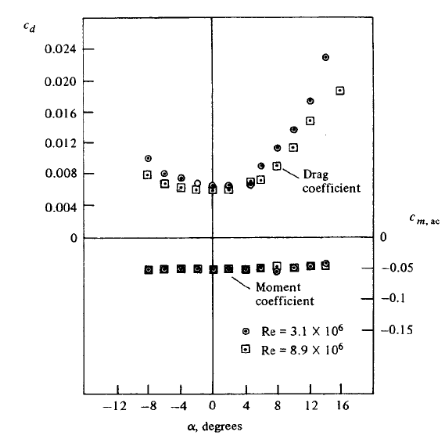



ESTIMATING SKIN-FRICTION DRAG OF A AIRFOIL
LAMINAR FLOW (EXAMPLE)
Consider the NACA 2412 airfoil, data for which is given in Figure. The data are given for two values of the Reynolds number based on chord length. For the case where Re_{c} = 3.1 x 10⁶ , estimate:
the laminar boundary layer thickness
at the trailing edge for a chord
length of 1.5 m
(b) the net laminar skin-friction drag
coefficient for the airfoil.
This measured value is about 4.5 times higher
than the value of 0.0015
0.0068
Viscous Flow – Airfoil Drag

Slide 39
ESTIMATING SKIN-FRICTION DRAG OF A AIRFOIL
TURBULENT FLOW
There are no exact analytical solutions for turbulent flow.
The analysis of any turbulent flow requires some amount of empirical data.
All analyses of turbulent flow are approximate
Viscous Flow – Airfoil Drag

Slide 40


ESTIMATING SKIN-FRICTION DRAG OF A AIRFOIL
TURBULENT FLOW
For incompressible flow over a flat plate, the boundary-layer thickness is given approximately by
With regard to skin friction drag, for incompressible turbulent flow over a flat plate, we have
Note that, in contrast to the inverse square root variation with Reynolds number for laminar flow, the turbulent flow results show an inverse fifth root variation with Reynolds number
Viscous Flow – Airfoil Drag

Slide 41



ESTIMATING SKIN-FRICTION DRAG OF A AIRFOIL
TURBULENT FLOW (EXAMPLE)
Consider the NACA 2412 airfoil, data for which is given in Figure. The data are given for two values of the Reynolds number based on chord length. For the case where Re_{c} = 3.1 x 10⁶ , estimate:
the Turbulent boundary layer thickness
at the trailing edge for a chord
length of 1.5 m
(b) the net Turbulent skin-friction drag
coefficient for the airfoil.
0.0068
This result is a factor of five larger than for the laminar
boundary layer
Viscous Flow – Airfoil Drag

Slide 42
ESTIMATING SKIN-FRICTION DRAG OF A AIRFOIL
TURBULENT FLOW
The result for the skin friction drag coefficient in the previous example is larger than the measured drag coefficient of the airfoil of 0.0068, which is the sum of both skin friction drag and pressure drag due to flow separation. So our result in this example clearly overestimates the skin friction drag coefficient for the airfoil.
Viscous Flow – Airfoil Drag

Slide 43
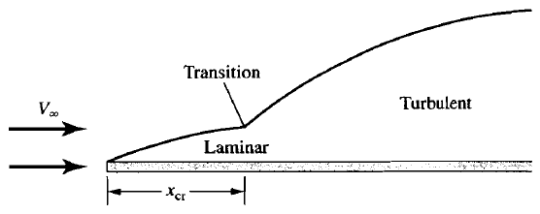
ESTIMATING SKIN-FRICTION DRAG OF A AIRFOIL
LAMINAR/TURBULENT FLOW
In actuality, the boundary layer over a body always starts out as a laminar boundary for some distance from the leading edge, and then transits to a turbulent boundary layer at some point downstream of the leading edge.
The skin-friction drag is a combination of laminar skin friction over the forward part of the airfoil, and turbulent skin friction over the remaining part.
Viscous Flow – Airfoil Drag

Slide 44

ESTIMATING SKIN-FRICTION DRAG OF A AIRFOIL
LAMINAR/TURBULENT FLOW
The value of x where transition is said to take place is the critical value x_{cr} . In turn, x_{cr} allows the definition of a critical Reynolds number for transition as
Viscous Flow – Airfoil Drag

Slide 45
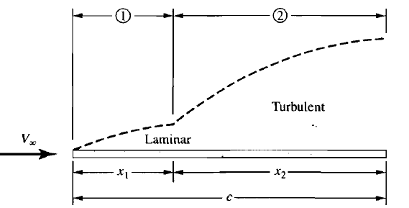




ESTIMATING SKIN-FRICTION DRAG OF A AIRFOIL
LAMINAR/TURBULENT FLOW (EXAMPLE)
For the NACA 2412 airfoil and the conditions in previous example, calculate the net skin friction drag coefficient assuming that the critical Reynolds number is 500,000.
Viscous Flow – Airfoil Drag

Slide 46




ESTIMATING SKIN-FRICTION DRAG OF A AIRFOIL
LAMINAR/TURBULENT FLOW (EXAMPLE)
Assuming all turbulent flow over the entire length of the plate, the drag (on one side of the plate) is (D_{f,c})_{turbulent} where
The turbulent drag on just region 1 is
And the turbulent drag just on region 2 is:
Viscous Flow – Airfoil Drag

Slide 47



ESTIMATING SKIN-FRICTION DRAG OF A AIRFOIL
LAMINAR/TURBULENT FLOW (EXAMPLE)
The laminar drag on region 1 is:
The total skin-friction drag on the plate, D_{f}, is then
The total skin-friction drag coefficient is
Viscous Flow – Airfoil Drag

Slide 48




ESTIMATING SKIN-FRICTION DRAG OF A AIRFOIL
LAMINAR/TURBULENT FLOW (EXAMPLE)
Viscous Flow – Airfoil Drag

Slide 49
ESTIMATING SKIN-FRICTION DRAG OF A AIRFOIL
LAMINAR/TURBULENT FLOW
the measured airfoil drag coefficient is 0.0068, which includes both skin friction drag and pressure drag due to flow separation. The result from Example, therefore, is qualitatively reasonable,. giving a skin friction drag coefficient slightly less than the measure total drag coefficient.
We do not know what the critical Reynolds number is for the experiments.
Viscous Flow – Airfoil Drag

Slide 50





ESTIMATING SKIN-FRICTION DRAG OF A AIRFOIL
LAMINAR/TURBULENT FLOW (EXAMPLE)
Repeat the example but assuming the critical Reynolds number is 1 x 10⁶.
Viscous Flow – Airfoil Drag

Slide 51
ESTIMATING SKIN-FRICTION DRAG OF A AIRFOIL
LAMINAR/TURBULENT FLOW (EXAMPLE)
Comparing the results from the recent two Examples, we see that an increase in Re_{cr} from 500,000 to 1,000,000 resulted in a skin friction drag coefficient that is eight percent smaller. This difference underscores the importance of knowing where transition takes place on a surface for the calculation of skin friction drag.
The result from the last example CF = 0.00582 would imply that the pressure drag due to flow separation is about 15 percent of the total drag.
The drag on a streamlined two-dimensional shape is mostly skin friction drag, and by comparison the pressure drag is small.
Viscous Flow – Airfoil Drag

