Slide 1
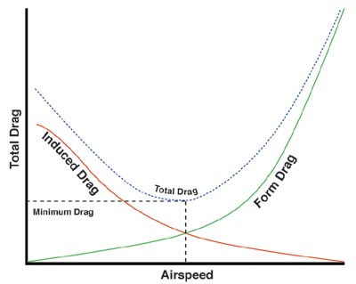
Reduction of Induced Drag
The Vortex Lattice Numerical Method

Slide 2
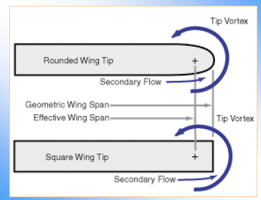
Reduction of Induced Drag
The Vortex Lattice Numerical Method

Slide 3
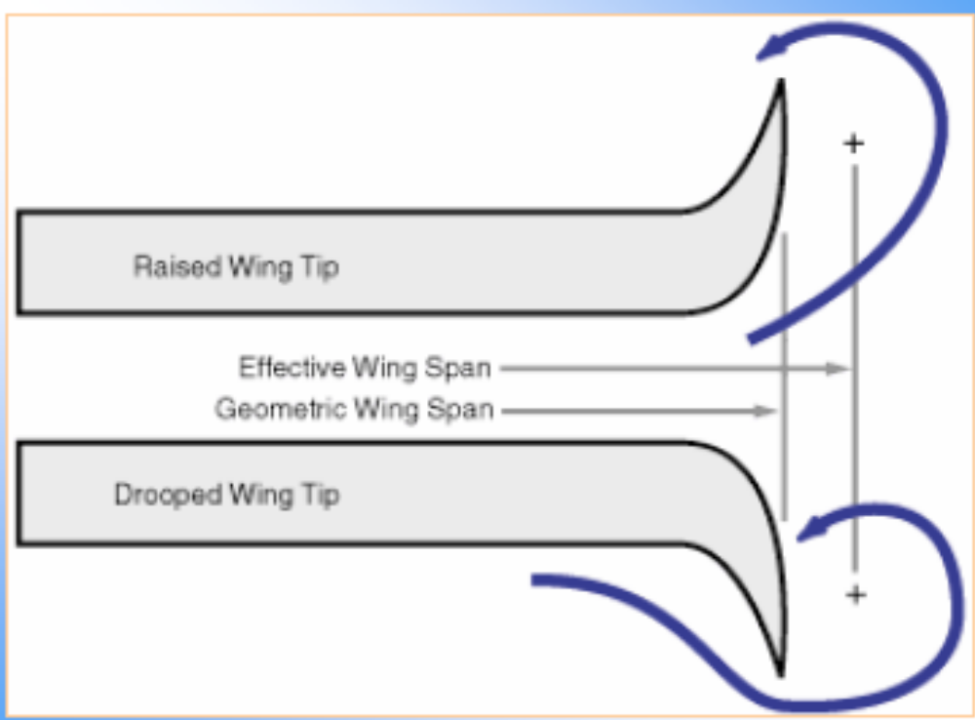
Reduction of Induced Drag
The Vortex Lattice Numerical Method

Slide 4
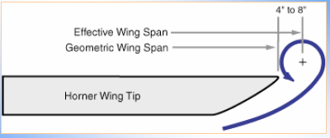
Reduction of Induced Drag
The Vortex Lattice Numerical Method

Slide 5
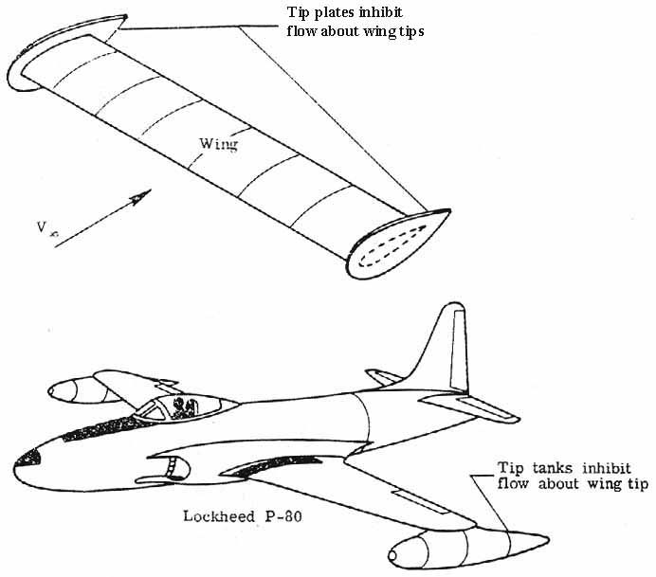
Reduction of Induced Drag
The Vortex Lattice Numerical Method

Slide 6
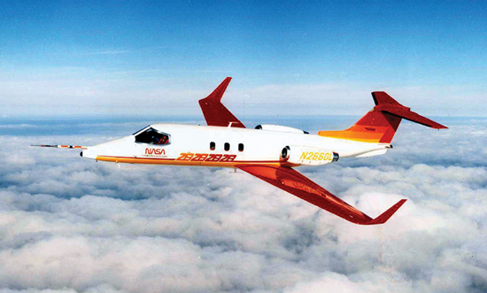
Reduction of Induced Drag
The Vortex Lattice Numerical Method

Slide 7
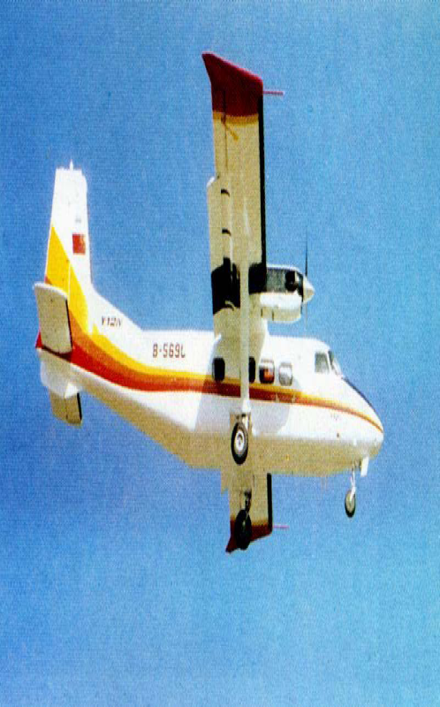
Reduction of Induced Drag
The Vortex Lattice Numerical Method

Slide 8
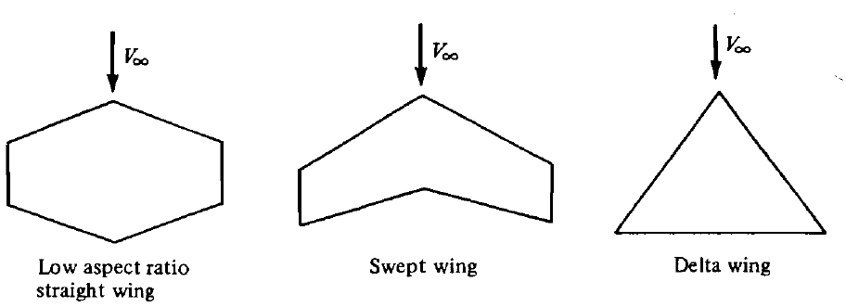
THE LIFTING-SURFACE THEORY AND THE
VORTEX LATTICE NUMERICAL METHOD
Prandtl's classical lifting-line theory gives reasonable results for straight wings at moderate to high aspect ratio.
For low-aspect-ratio straight wings, swept wings, and delta wings, classical lifting-line theory is inappropriate.
For such planforms, a more sophisticated model must be used.
The Vortex Lattice Numerical Method

Slide 9
VORTEX LATTICE METHOD (VLM)
The VLM represents the wing as a planar surface on which a grid of horseshoe vortices is superimposed.
The velocities induced by each horseshoe vortex at a specified control point are calculated using the law of Biot-Savart.
A summation is performed for all control points on the wing to produce a set of linear algebraic equations for the horseshoe vortex strengths that satisfy the boundary condition of no flow through the wing.
The vortex strengths are related to the wing circulation and the pressure differential between the upper and lower wing surfaces.
The Vortex Lattice Numerical Method

Slide 10
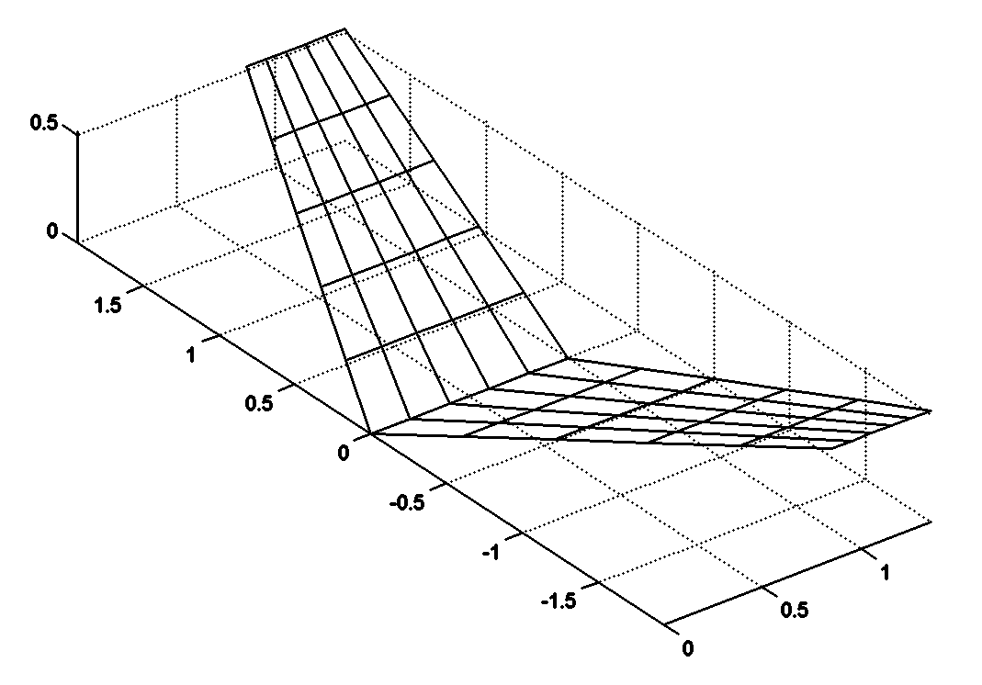
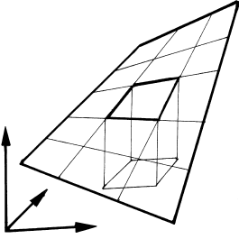
VORTEX LATTICE METHOD (VLM)
1. The wing surface is divided into several trapezoidal sub regions (finite elements or lattices)
The Vortex Lattice Numerical Method

Slide 11
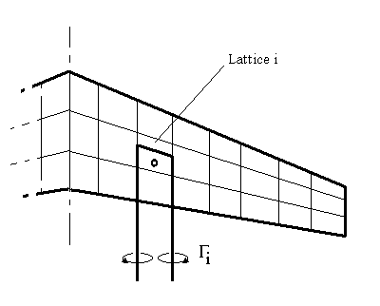
VORTEX LATTICE METHOD (VLM)
2. A horseshoe vortex is placed on each lattice.
Place the bound vortex of the horseshoe vortex on the 1/4 chord element line of each panel.
Place the control point on the 3/4 chord point of each panel at the midpoint in the spanwise direction.
The Vortex Lattice Numerical Method

Slide 12
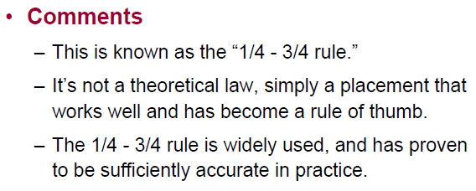
VORTEX LATTICE METHOD (VLM)

Slide 13
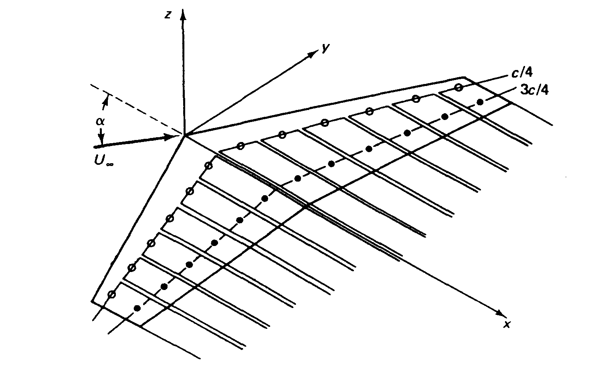
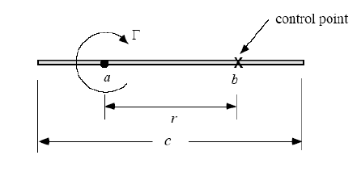
VORTEX LATTICE METHOD (VLM)
The Vortex Lattice Numerical Method

Slide 14
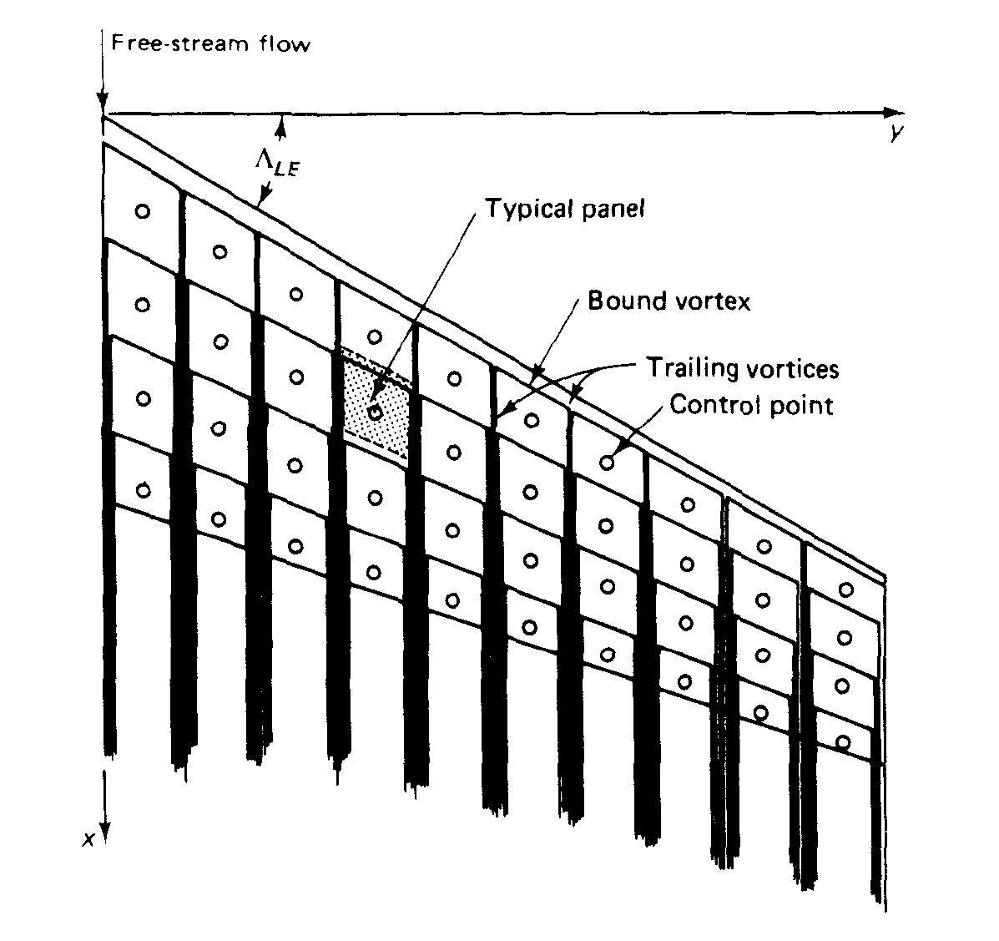
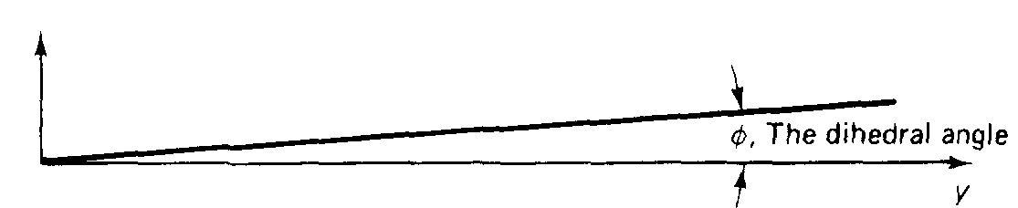
VORTEX LATTICE METHOD (VLM)
z
x
x
The Vortex Lattice Numerical Method

Slide 15
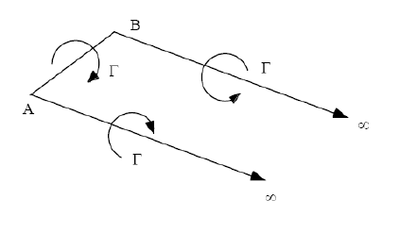

THE HORSESHOE VORTEX INDUCED VELOCITY
The Vortex Lattice Numerical Method

Slide 16
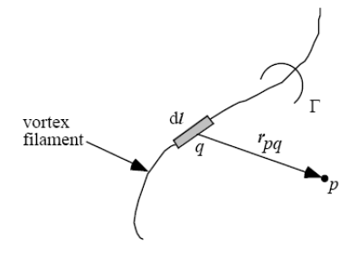
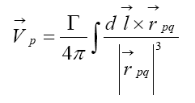
THE HORSESHOE VORTEX INDUCED VELOCITY
The velocity induced by a vortex filament of strength Γ and a length of dl is given by the law of Biot and Savart.
Since we are interested in the flow field induced by a horseshoe vortex which consists of three straight segments, let us use this equation to calculate the effect of each segment separately.
The Vortex Lattice Numerical Method

Slide 17
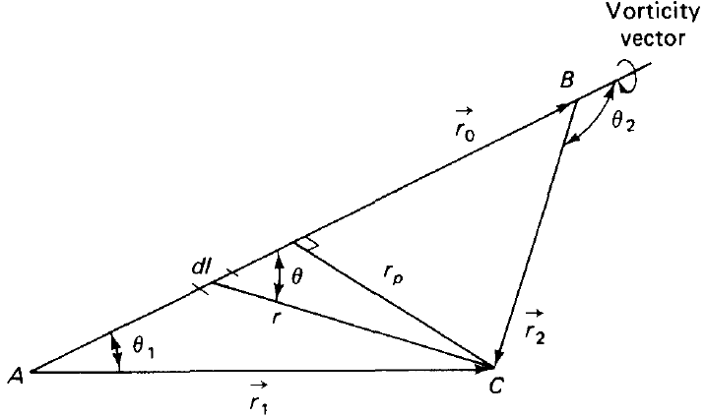



THE HORSESHOE VORTEX INDUCED VELOCITY
Let AB be such a segment, with the vorticity vector directed from A to B. Let C be a point in space whose normal distance from the line AB is r_{p}.
We can integrate between A and B to
find the magnitude of the
induced velocity:
The Vortex Lattice Numerical Method

Slide 18
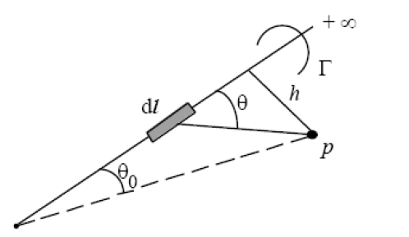

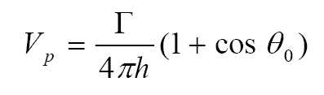
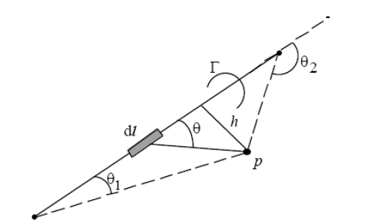


THE HORSESHOE VORTEX INDUCED VELOCITY
The Vortex Lattice Numerical Method

Slide 19

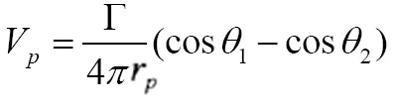



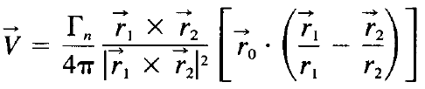
THE HORSESHOE VORTEX INDUCED VELOCITY
The direction of the induced velocity is given by the unit vector:
The Vortex Lattice Numerical Method

Slide 20
THE HORSESHOE VORTEX INDUCED VELOCITY
This is the basic expression for the calculation of the induced velocity by the horseshoe vortices in the VLM. It can be used regardless of the assumed orientation of the vortices.
We shall now use this equation to calculate the velocity that is induced at a general point in space (x, y, z) by the horseshoe vortex. This horseshoe vortex may be assumed to represent that for a typical wing panel.
The Vortex Lattice Numerical Method

Slide 21
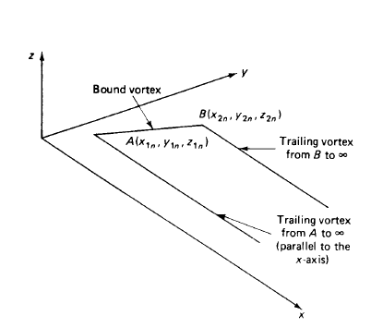
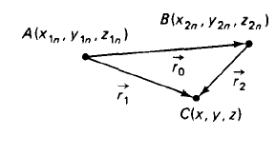
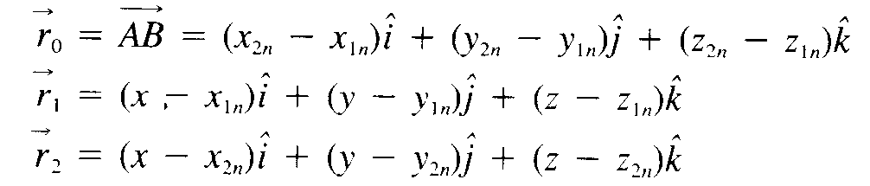
THE HORSESHOE VORTEX INDUCED VELOCITY
For the bound vortex, segment AB:
The Vortex Lattice Numerical Method

Slide 22

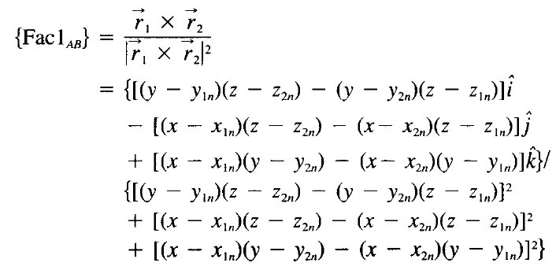
THE HORSESHOE VORTEX INDUCED VELOCITY
The Vortex Lattice Numerical Method

Slide 23
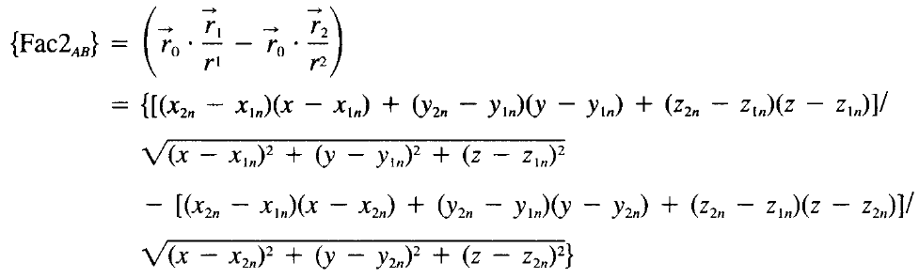
THE HORSESHOE VORTEX INDUCED VELOCITY
The Vortex Lattice Numerical Method

Slide 24
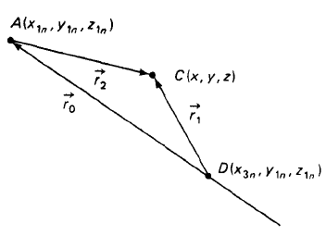
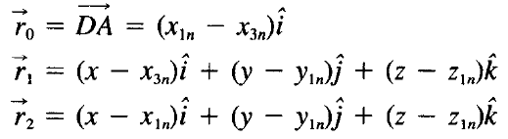


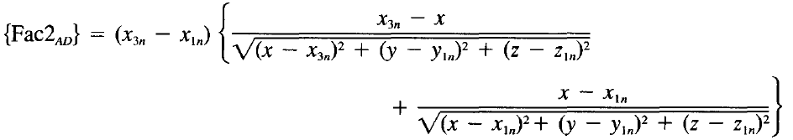
THE HORSESHOE VORTEX INDUCED VELOCITY
To calculate the velocity induced by the filament that extends from A to ∞:
The Vortex Lattice Numerical Method

Slide 25
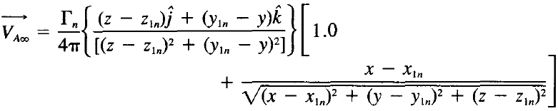
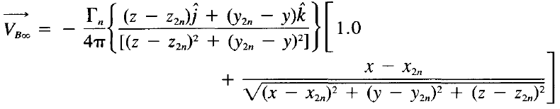
THE HORSESHOE VORTEX INDUCED VELOCITY
Similarly, the velocity induced by the vortex filament that extends from B to ∞
The Vortex Lattice Numerical Method

Slide 26


THE HORSESHOE VORTEX INDUCED VELOCITY
The velocity induced at the mth control point by the vortex representing the nth panel will be designated as
We have 2N of these equations, one for each of the control points
The strengths of the horseshoe vortices are not known
The Vortex Lattice Numerical Method

Slide 27
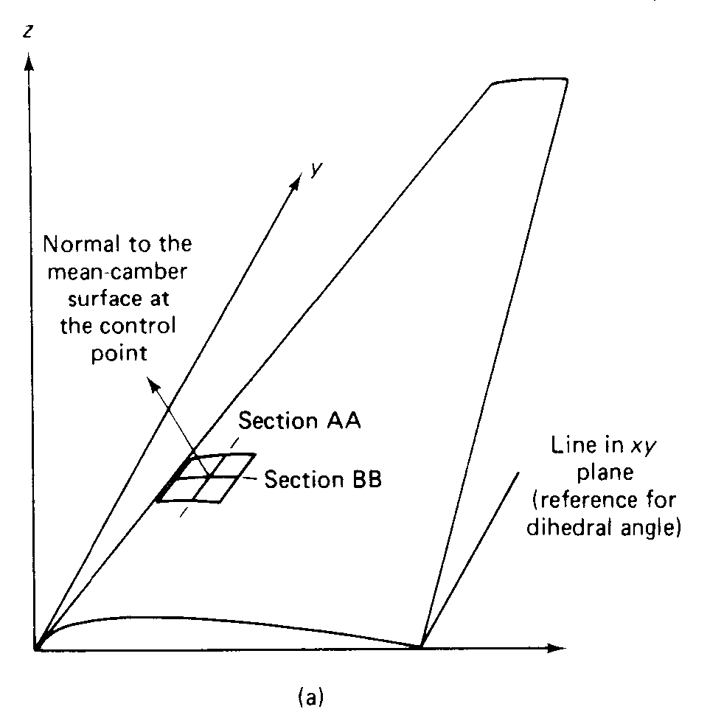
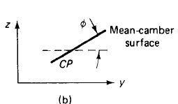
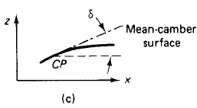

APPLICATION OF THE BOUNDARY CONDITIONS
The resultant flow is tangent to the wing at each and every control point (which is located at the midspan of the three-quarter-chord line of each elemental panel). If the flow is tangent to the wing, the component of the induced velocity normal to the wing at the control point balances the normal component of the free-stream velocity.
φ is the dihedral angle
δ is the slope of the mean
camber line
The Vortex Lattice Numerical Method

Slide 28
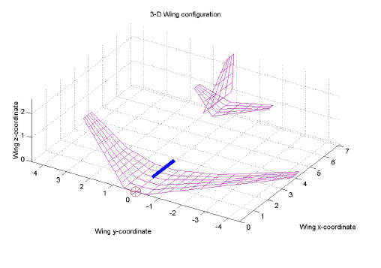
APPLICATION OF THE BOUNDARY CONDITIONS

Slide 29


APPLICATION OF THE BOUNDARY CONDITIONS
The tangency requirement yields the relation
For wings where the slope of the mean camber line is small and are at small angles of attack, this equation can be replaced by the approximation:
The Vortex Lattice Numerical Method

Slide 30
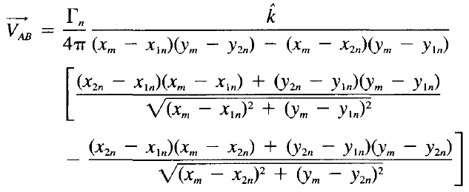
RELATIONS FOR A PLANAR WING
Let us apply these equations to a relatively simple geometry. A planar wing (i.e., one that lies in the xy plane),
For a planar wing, z_{1n} = z_{2n} = 0 for all the bound vortices. Furthermore, z_{m} = 0 for all the control points
The Vortex Lattice Numerical Method

Slide 31


RELATIONS FOR A PLANAR WING
Let us apply these equations to a relatively simple geometry. A planar wing (i.e., one that lies in the xy plane),
For a planar wing, z_{1n} = z_{2n} = 0 for all the bound vortices. Furthermore, z_{m} = 0 for all the control points
The Vortex Lattice Numerical Method

Slide 32
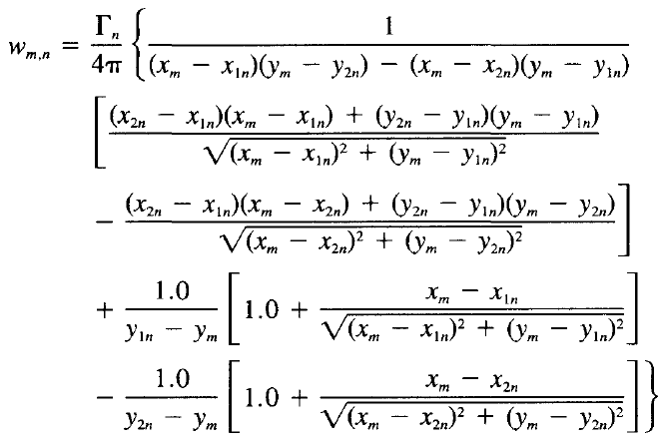

RELATIONS FOR A PLANAR WING
Note that, for the planar wing, all three components of the vortex representing the nth panel induce a velocity at the control point of the mth panel which is in
the z direction
(i.e., a downwash).
Therefore, we can
simplify equations by
combining the components
into one expression:
Summing the contributions
of all the vortices to the
downwash at the control
point of the mth panel:
The Vortex Lattice Numerical Method

Slide 33


RELATIONS FOR A PLANAR WING
Since we are considering a planar wing:
The component of the free-stream velocity perpendicular to the wing is at any point on the wing. The resultant flow will be tangent to the wing if the total vortex-induced downwash at the control point of the mth panel, balances the normal component of the free-stream velocity:
For small angles of attack,
The Vortex Lattice Numerical Method

Slide 34
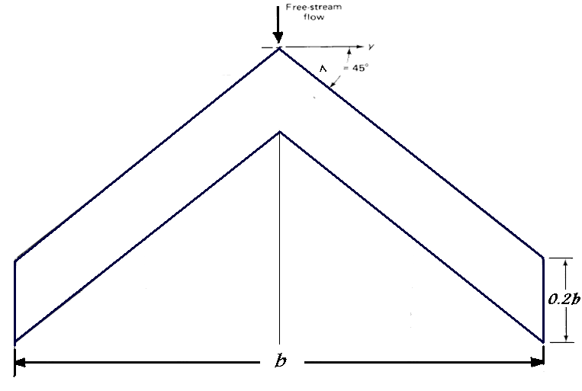
EXAMPLE
Let us use the relations developed in this section to calculate the lift coefficient for a swept wing. So that the calculation procedures can be easily followed, let us consider a wing with a relatively simple geometry. Plot C_{L}-α of the wing.
The Vortex Lattice Numerical Method

Slide 35

EXAMPLE (CONT.)
The wing has an aspect ratio of 5, a taper ratio of unity (i.e., c_{t} = c_{r}). and an uncambered section (i.e., it is a flat plate). Since the taper ratio is unity, the leading edge, the quarter-chord line, the three-quarter-chord line, and the trailing edge all have the same sweep, 45 deg.
For a swept, untapered wing
It is clear that b = 5c. Using this relation, it is possible to calculate all of the necessary coordinates in terms of the parameter b. Therefore, the solution does not require that we know the physical dimensions of the configuration.
The Vortex Lattice Numerical Method

Slide 36
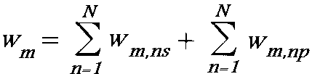
EXAMPLE (CONT.)
The flow field under consideration is symmetric with respect to the y=0 plane (xz plane); that is, there is no yaw. Thus, the lift force acting at a point on the starboard wing (+y) is equal to that at the corresponding point on the port wing (-y).
Because of symmetry, we need only to solve for the strengths of the vortices of the starboard wing.
We must remember to include the contributions of the horseshoe vortices of the port wing to the velocities induced at these control points (of the starboard wing).
Tangency condition:
the symbols s and p represent the starboard and port wings, respectively
The Vortex Lattice Numerical Method

Slide 37
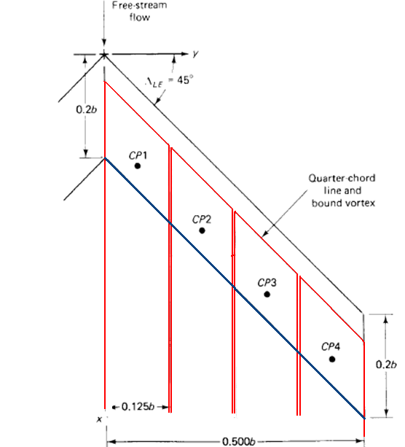
EXAMPLE (CONT.)
The planform of the starboard wing is divided into four panels, each panel extending from the leading edge to the trailing edge. By limiting ourselves to only four spanwise panels.
The Vortex Lattice Numerical Method

Slide 38
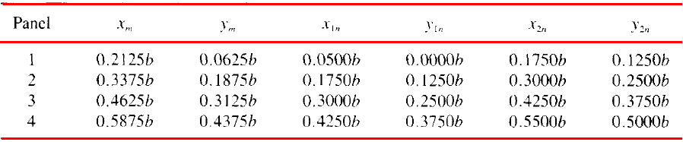
EXAMPLE (CONT.)
The planform of the starboard wing is divided into four panels, each panel extending from the leading edge to the trailing edge. By limiting ourselves to only four spanwise panels.
coordinates of the bound vortices and of the control points of the starboard wing
The Vortex Lattice Numerical Method

Slide 39
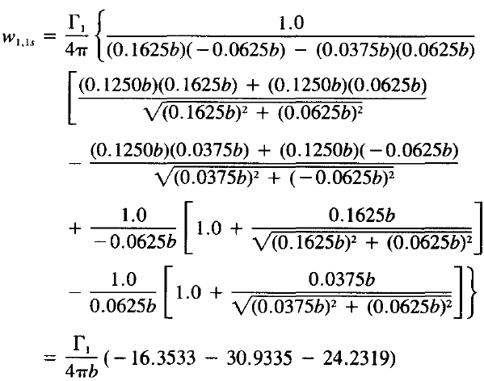

EXAMPLE (CONT.)
The downwash
velocity at the CP of
panel 1 induced by the
horseshoe vortex of
panel 1 of the starboard wing:
The Vortex Lattice Numerical Method

Slide 40
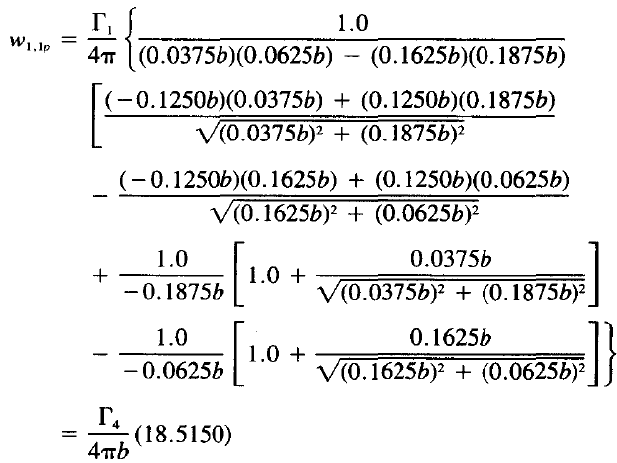
EXAMPLE (CONT.)
The downwash velocity at the CP of panel 1 (of the starboard wing) induced by I the horseshoe vortex of panel 1 of the port wing:
The Vortex Lattice Numerical Method

Slide 41
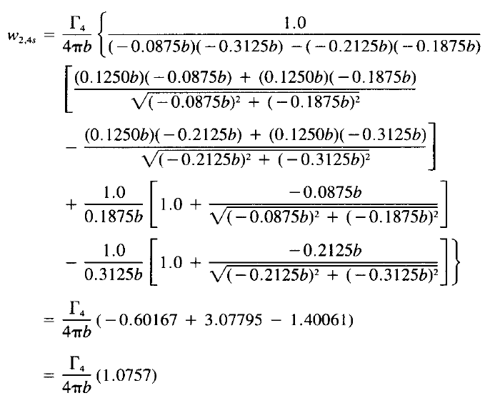
EXAMPLE (CONT.)
Similarly, the downwash velocity at the CP of panel 2 induced by the horseshoe vortex of panel 4 of the starboard wing:
The Vortex Lattice Numerical Method

Slide 42
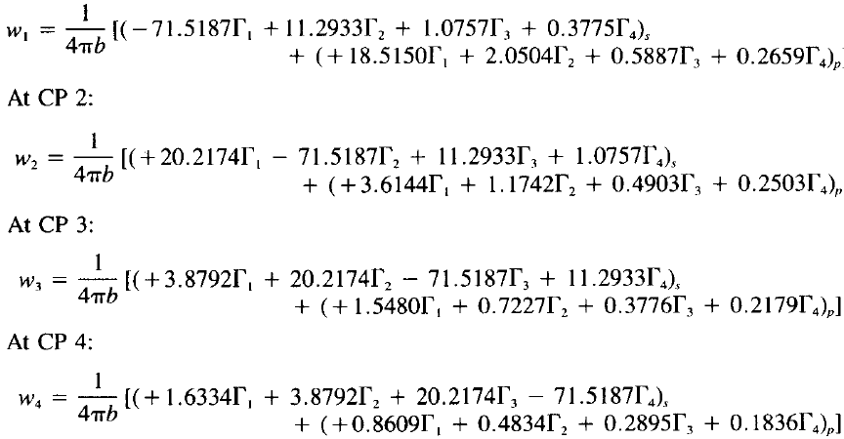
EXAMPLE (CONT.)
Evaluating all of the various components (or influence coefficients), we find that
at control point 1:
The Vortex Lattice Numerical Method

Slide 43

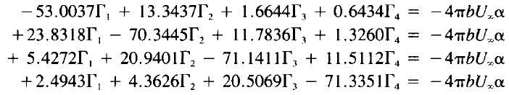
EXAMPLE (CONT.)
Since it is a planar wing with no dihedral, the no-flow condition of equation requires that
The Vortex Lattice Numerical Method

Slide 44



EXAMPLE (CONT.)
Solving for Γ₁, Γ₂, Γ₃ and Γ₄, we find that
the lift acting on the nth panel is
Since the flow is symmetric, the total lift for the wing is
The Vortex Lattice Numerical Method

Slide 45



EXAMPLE (CONT.)
To calculate the lift coefficient, recall that S = bc and b = 5c for this wing. Therefore,
The Vortex Lattice Numerical Method

Slide 46

EXAMPLE (CONT.)
The Vortex Lattice Numerical Method

Slide 47




EXAMPLE (CONT.)
where c_{av} is the average chord (and is equal to S/b), c is the local chord, and j is the index for an elemental panel in the chordwise row.
The Vortex Lattice Numerical Method

Slide 48

EXAMPLE (CONT.)
The theoretical distribution is compared with the experimentally determined spanwise load distribution for an angle of attack of 4.2 deg. The increased loading of the outer wing sections promotes premature boundary-layer separation there. This unfavorable behavior is amplified by the fact that the spanwise velocity component causes the already decelerated fluid particles in the boundary layer to move toward the wing tips. This transverse flow results in a large increase in the boundary-layer thickness near the wing tips. Thus, at large angles of attack, premature separation may occur on the suction side of the wing near the tip. If significant tip stall occurs on the swept wing, there is a loss of the effectiveness of the control surfaces and a forward shift in the wing center of pressure that creates an unstable, nose-up increase in the pitching moment.
The Vortex Lattice Numerical Method

Slide 49

BOUNDARY-LAYER FENCE
Boundary-layer fences are often used to break up the spanwise flow on swept wings.
The essential effect of the boundary-Iayer fence does not so much consist in the prevention of the transverse flow but, much more important, in that the fence divides each wing into an inner and an outer portion.
Both transverse flow and boundary-layer separation may be present, but to a reduced extent.
The Vortex Lattice Numerical Method

Slide 50

BOUNDARY-LAYER FENCE
The Vortex Lattice Numerical Method

Slide 51



EXAMPLE (CONT.)
The induced drag coefficient may be calculated using the relation given
where α_{i} which is the induced incidence, given by
For a symmetrical loading
The Vortex Lattice Numerical Method
51

Slide 52
Winglet Modeling
Tornado© VLM code for MATLAB
Winglet Geometry
Λ = 57 deg
b/20, b/10
Taper => λ = 0.3

Slide 53

Winglet Modeling
Aircraft Configuration
dihedral = 4.6º
Λ_{1/4} = 20º
λ = 0.6
The Vortex Lattice Numerical Method
53

Slide 54

Winglet Modeling (Cont.)
Original Configuration
α = 8º
L/D = 51

Slide 55


Winglet Modeling (Cont.)
Small Version
11% drag reduction
(7% when compared to an extended wing)
8% drag reduction
(4% when compared to an extended wing)

Slide 56


Winglet Modeling (Cont.)
Large Version
22% drag reduction
(14% when compared to an extended wing)
12% drag reduction
(4% when compared to an extended wing)

Slide 57

Winglet Modeling (Cont.)
Side View

