Slide 1
INTRODUCTION TO THREE-DIMENSIONAL INCOMPRESSIBLE FLOWS
To this point in our aerodynamic discussions, we have been working mainly in a two-dimensional world; the flows over the bodies treated so far, involved only two dimensions in a single plane (planar flows).
The relative simplicity of dealing with two dimensions is self-evident and is the reason why a large bulk of aerodynamic theory deals with two-dimensional flows.
The two-dimensional analyses go a long way toward understanding many practical flows, but they also have distinct limitations.
Three-Dimensional Incompressible Flow

Slide 2
INTRODUCTION TO THREE-DIMENSIONAL INCOMPRESSIBLE FLOWS
The real world of aerodynamic applications is three-dimensional. However, because of the addition of one more independent variable, the analyses generally become more complex.
Our purpose is to introduce some very basic considerations of three-dimensional incompressible flow.
Three-Dimensional Incompressible Flow

Slide 3



INTRODUCTION TO THREE-DIMENSIONAL INCOMPRESSIBLE FLOWS
For an irrotational flow, there exists a scalar function ϕ such that
If the flow is also incompressible, the velocity potential is given by Laplace's equation
Solutions of this equation for flow over a body must satisfy the flow-tangency boundary condition on the body
where n is a unit vector normal to the body surface.
Three-Dimensional Incompressible Flow

Slide 4





INTRODUCTION TO THREE-DIMENSIONAL INCOMPRESSIBLE FLOWS
ϕ is, in general, a function of three-dimensional space.
Cartesian coordinates
Cylindrical coordinates
Spherical coordinates
Three-Dimensional Incompressible Flow

Slide 5
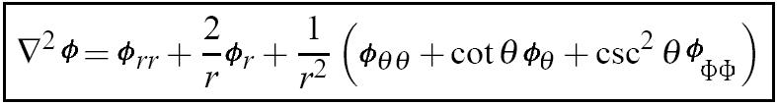
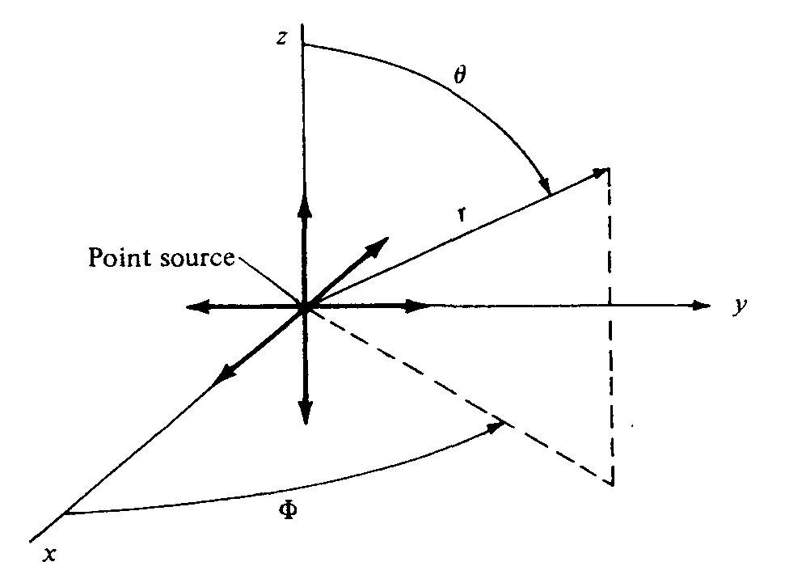
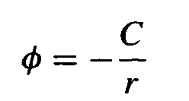
THREE-DIMENSIONAL SOURCE
Return to Laplace's equation written in spherical coordinates,
Consider the velocity potential given by
where C is a constant and r is the radial coordinate from the origin.
Three-Dimensional Incompressible Flow

Slide 6
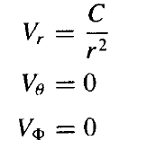

THREE-DIMENSIONAL SOURCE
VELOCITY COMPONENTS
Three-Dimensional Incompressible Flow

Slide 7





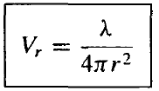
THREE-DIMENSIONAL SOURCE
To evaluate the constant C, consider a sphere of radius r and surface S centered at the origin
r
The volume flow:
λ is defined as the strength of the source.
Three-Dimensional Incompressible Flow

Slide 8
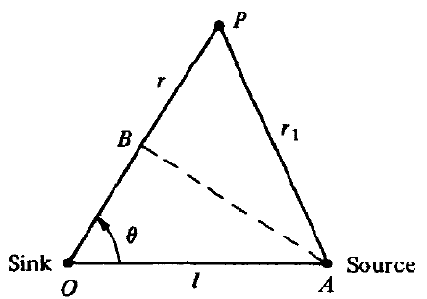


THREE-DIMENSIONAL DOUBLET
Consider a sink and source of equal but opposite strength located at points O and A
The velocity potential at P is:
Three-Dimensional Incompressible Flow

Slide 9



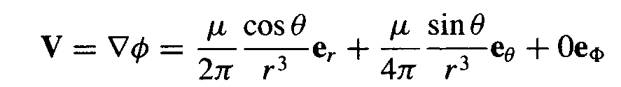
THREE-DIMENSIONAL DOUBLET
Let the source approach the sink as their strengths become infinite; that is, let
Three-Dimensional Incompressible Flow

Slide 10
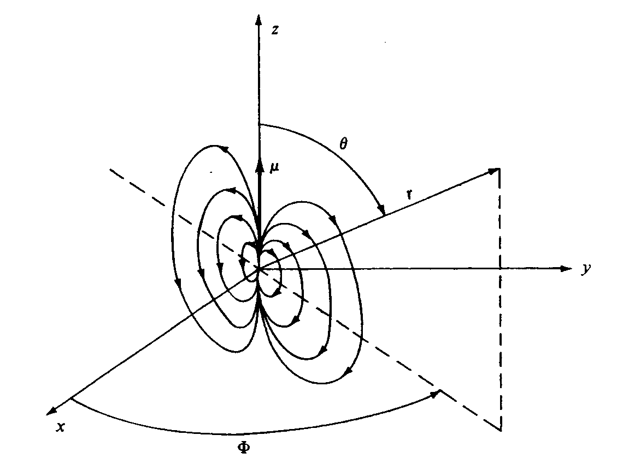
THREE-DIMENSIONAL DOUBLET
The velocity field depends only on r and θ. Such a flow is defined as axisymmetric flow.
Three-Dimensional Incompressible Flow

Slide 11
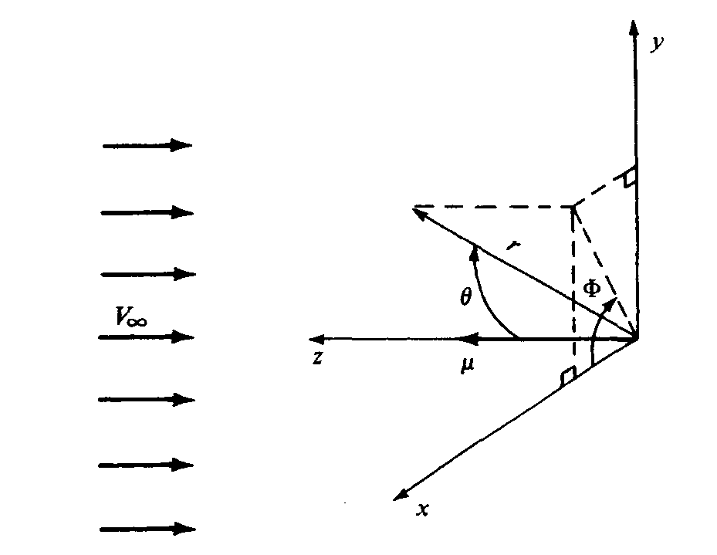
FLOW OVER A SPHERE
Consider the flow induced by the three-dimensional doublet.
Superimpose on this flow a uniform velocity field of magnitude V∞ in the negative z direction
Three-Dimensional Incompressible Flow

Slide 12
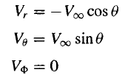
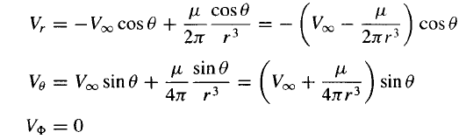
FLOW OVER A SPHERE
The spherical coordinates of the freestream are:
Combined flow:
Three-Dimensional Incompressible Flow

Slide 13



FLOW OVER A SPHERE (STAGNATION POINTS)
To find the stagnation points in the flow
Hence, there are two stagnation points, both on the z axis,
Three-Dimensional Incompressible Flow

Slide 14
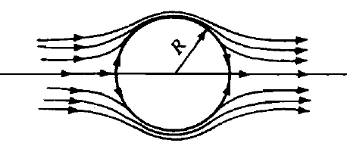


FLOW OVER A SPHERE (TANGENTIAL VELOCITY)
The incompressible flow over a sphere of radius R is qualitatively similar to the flow over the cylinder, but quantitatively different.
On the surface of the sphere, where r = R, the tangential velocity is
The pressure distribution on the surface of the sphere is
Three-Dimensional Incompressible Flow

Slide 15
THREE-DIMENSIONAL RELIEVING EFFECT
 | Cylinder | Sphere
Location of maximum velocity
Maximum velocity | 2V∞ | 1.5V∞
Maximum pressure coefficient | ₁ | ₁
Minimum pressure coefficient | ₋₃ | _{-5/4}
The flow over a sphere is somewhat relieved in comparison with the flow over a cylinder. The flow over a sphere has an extra dimension in which to move out of the way of the solid body; the flow can move sideways as well as up and down. In contrast, the flow over a cylinder is more constrained; it can only move up and down.
Three-Dimensional Incompressible Flow

Slide 16
THE FLOW OVER A SPHERE
THE REAL CASE
The qualitative features of the real flow over a sphere are similar to those discussed for a cylinder (the phenomenon of flow separation, the variation of drag coefficient with a Reynolds number, the precipitous drop in drag coefficient when the flow transits from laminar to turbulent ahead of the separation point at the critical Reynolds number, and the general structure of the wake).
These items are similar for both cases. However, because of the three-dimensional relieving effect, the flow over a sphere is quantitatively different from that for a cylinder.
Three-Dimensional Incompressible Flow

Slide 17
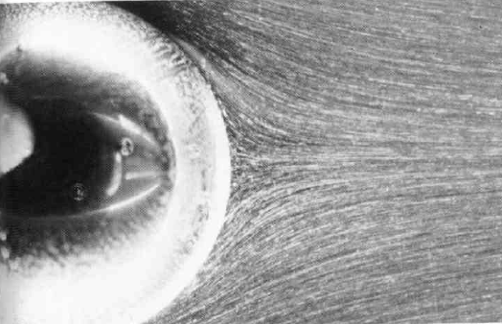
THE FLOW OVER A SPHERE
THE REAL CASE
The flow over sphere – Re=17.9
Three-Dimensional Incompressible Flow

Slide 18
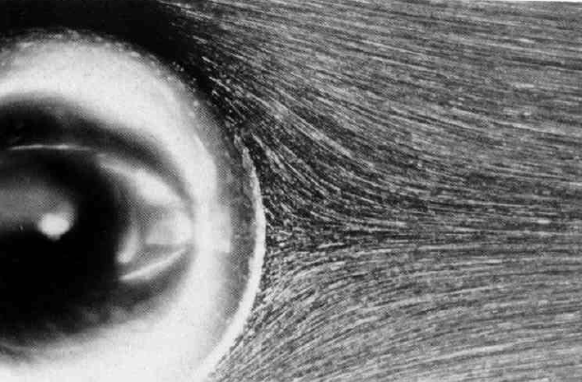
THE FLOW OVER A SPHERE
THE REAL CASE
The flow over sphere – Re=25.5
Although it is not obvious, the flow is just to have separated at the rear at this Reynolds number.
Three-Dimensional Incompressible Flow

Slide 19
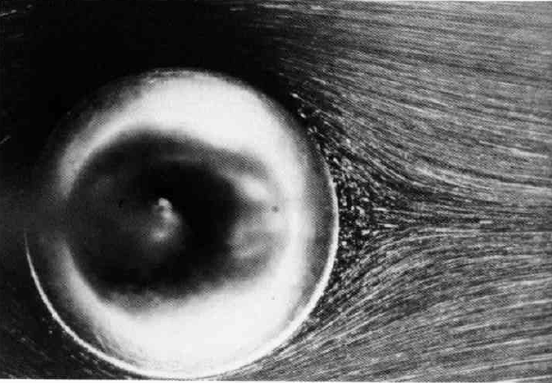
THE FLOW OVER A SPHERE
THE REAL CASE
The flow over sphere – Re=26.8
The flow is clearly separated over the rear of the sphere..
Three-Dimensional Incompressible Flow

Slide 20
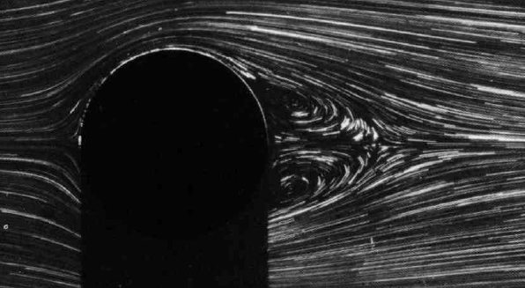
THE FLOW OVER A SPHERE
THE REAL CASE
The flow over sphere – Re=56.5
Three-Dimensional Incompressible Flow

Slide 21
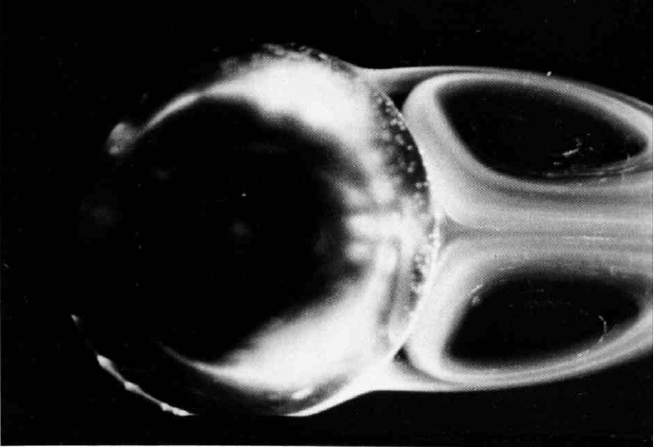
THE FLOW OVER A SPHERE
THE REAL CASE
The flow over sphere – Re=104
Three-Dimensional Incompressible Flow

Slide 22
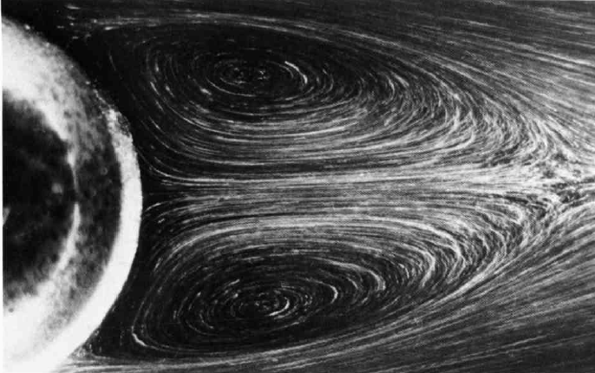
THE FLOW OVER A SPHERE
THE REAL CASE
The flow over sphere – Re=118
The flow is clearly separated over the rear of the sphere.
Three-Dimensional Incompressible Flow

Slide 23
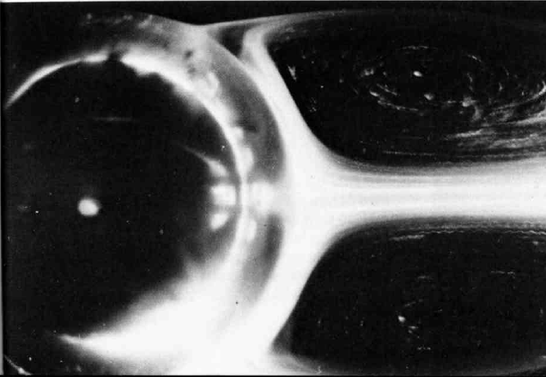
THE FLOW OVER A SPHERE
THE REAL CASE
The flow over sphere – Re=202
Three-Dimensional Incompressible Flow

Slide 24
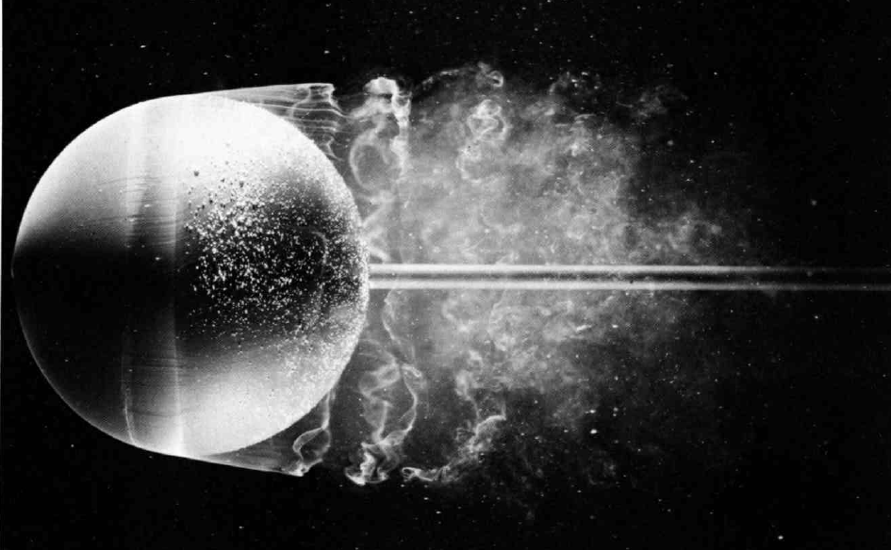
THE FLOW OVER A SPHERE
THE REAL CASE
The flow over sphere – Re=15000
Three-Dimensional Incompressible Flow

Slide 25
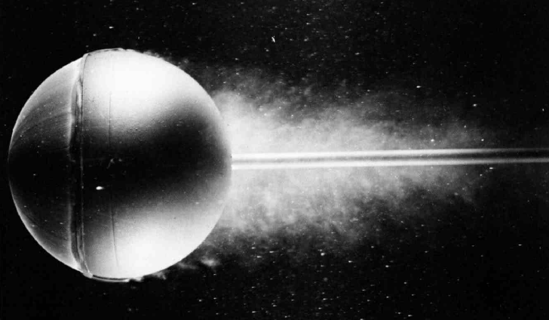
THE FLOW OVER A SPHERE
THE REAL CASE
The flow over sphere – Re=30000 (Turbulent flow. Forced by a trip wire hoop ahead of the equator, causing the laminar flow to become turbulent suddenly)
Because the flow is turbulent, separation takes place much farther over the back surface of sphere.
Three-Dimensional Incompressible Flow

Slide 26
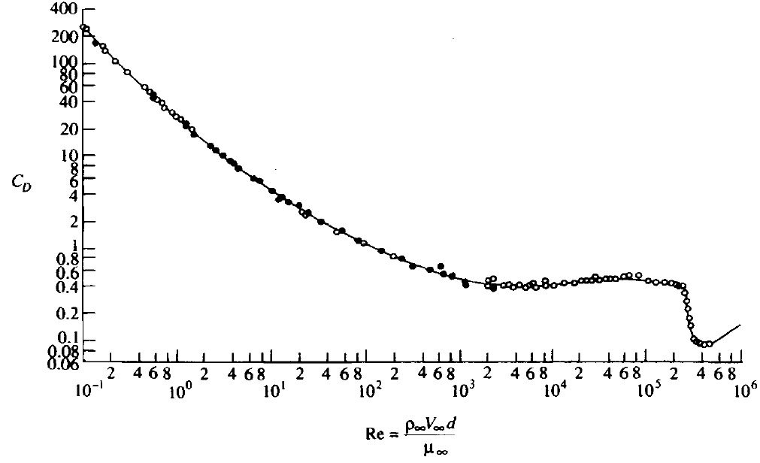
THE FLOW OVER A SPHERE
THE REAL CASE
Variation of drag coefficient C_{D} with the Reynolds number
Three-Dimensional Incompressible Flow

Slide 27
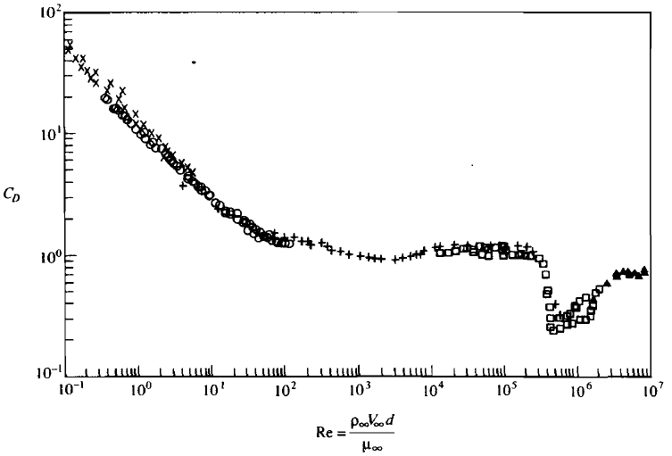
THE FLOW OVER A SPHERE AND
CIRCULAR CYLINDER
the C_{D} variations are qualitatively similar, both with a precipitous decrease in C_{D} near a critical Reynolds number of 300,000, coinciding with natural transition from laminar to turbulent flow.
However, quantitatively the two curves are quite different. In the Reynolds number range most appropriate to practical problems, that is, for Re>1000, the values of C_{D} for the sphere are considerably smaller than those for a cylinder-a classic example of the three-dimensional relieving effect.
Sphere
Circular cylinder
Three-Dimensional Incompressible Flow

Slide 28
THE FLOW OVER A SPHERE AND
CIRCULAR CYLINDER
The value of C_{D} for Re slightly less than the critical value is about 1 and drops to 0.3 for Re slightly above the critical value. In contrast, for the sphere, C_{D} is about 0.4 in the Reynolds number range below the critical value and drops to about 0.1 for Reynolds numbers above the critical value.
Sphere
Circular cylinder
Three-Dimensional Incompressible Flow

