Slide 1
FLUID MOTION
The motion of the fluid is controlled by:
  Governing Equations
  Boundary Conditions
FLUID MECHANICS REVIEW

Slide 2
GOVERNING EQUATIONS - CONSERVATION LAWS
The governing equations are given by conservation laws:
  Conservation of mass Continuity
  Conservation of momentum Newton’s 2nd Law, F=ma
  Conservation of Energy 1st law of thermodynamics
FLUID MECHANICS REVIEW

Slide 3
FORMS OF GOVERNING EQUATIONS
Equations
Differential
(Point by point detail)
Integral
(Overall Features)
FLUID MECHANICS REVIEW

Slide 4
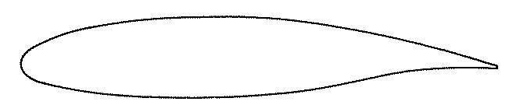
COORDINATE SYSTEMS
Cartesian coordinates: Are normally used to describe vehicle geometry.
Cylindrical coordinates
Spherical coordinates
General non-orthogonal curvilinear coordinates
FLUID MECHANICS REVIEW

Slide 5
VARIABLES AND UNKNOWN QUANTITIES
In general Cartesian coordinates, the independent variables are: x, y, z and t.
We want to know the velocity components (u, v, w) and the fluid properties (p, ρ, T).
These six unknowns require six equations:
  Continuity Equation: 1 Equation
  Momentum Equations: 3 Equations
  Energy Equation: 1 Equation
  Equation of State: 1 Equation
FLUID MECHANICS REVIEW

Slide 6
MOTIVATIONS
We want to find the flow field velocity (u, v, w), pressure (p) and temperature (T) distribution.
We need to develop a mathematical model of the fluid motion suitable for use in numerical calculations.
The mathematical model is based on the conservations laws and the fluid properties.
FLUID MECHANICS REVIEW

Slide 7
DESCRIPTION OF FLUID MOTION
Lagrangian:
  Each fluid particle is traced as it moves around the body.
  This method corresponds to the conventional concept of Newton’s 2nd law
Eulerian:
  We look at the entire space around the body as a field, and determine flow properties at various points in the field while the fluid stream past.
  We consider the distribution of velocity and pressure throughout the field, and ignore the motion of individual fluid particles.
FLUID MECHANICS REVIEW

Slide 8
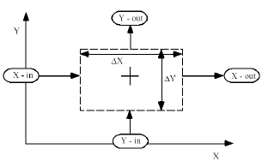
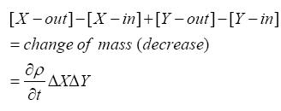
THE CONTINUITY EQUATION
The statement of Conservation of Mass is in the words simply:
Net outflow of mass through the surface surrounding the volume
Time rate of decrease of mass within the volume
=
[Mass can be neither created or destroyed ]
FLUID MECHANICS REVIEW

Slide 9
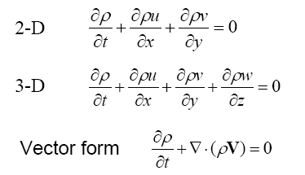
THE CONTINUITY EQUATION
The differential form:
The integral form:
FLUID MECHANICS REVIEW

Slide 10
CONSERATION OF MOMENTUM
Newton’s 2nd law: The time rate of change of momentum of a body, equals the net force exerted on it.
For a fixed mass, this is the famous equation:
[Force = Time rate of change of momentum]
FLUID MECHANICS REVIEW

Slide 11
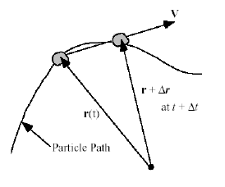
CONSERATION OF MOMENTUM
Substantial Derivative:
  We need to apply Newton’s law to a moving fluid element from our fixed coordinate system.
  Consider any fluid property,
The change in position of the particle between at t, and
at is:
The rate of change of Q is:
FLUID MECHANICS REVIEW

Slide 12



CONSERATION OF MOMENTUM
The second term has the unknown velocity V multiplying a term containing the unknown Q. This is important!
The convective derivative introduces a fundamental nonlinearity into the system.
FLUID MECHANICS REVIEW

Slide 13
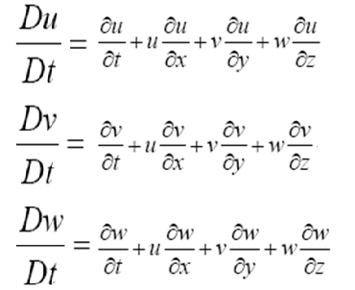
CONSERATION OF MOMENTUM
In coordinates, , and the substantial derivative becomes:
FLUID MECHANICS REVIEW

Slide 14
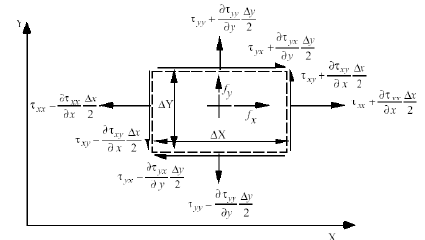
CONSERATION OF MOMENTUM
Sources of the force exerted on the fluid element:
  Body forces
    Gravitational forces
    Electromagnetic force
    …
  Surface forces
    Pressure
    Shear stress
FLUID MECHANICS REVIEW

Slide 15
CONSERATION OF MOMENTUM
The net force in the x-direction is found to be:
Using the Substantial Derivative and the definition of the mass, , and considering the x component,
in three dimensional case, we have:
FLUID MECHANICS REVIEW

Slide 16
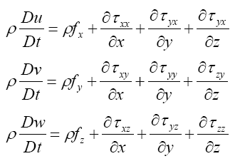
CONSERATION OF MOMENTUM
General conservation of momentum relations:
  Differential form:
  Integral Form:
FLUID MECHANICS REVIEW

Slide 17
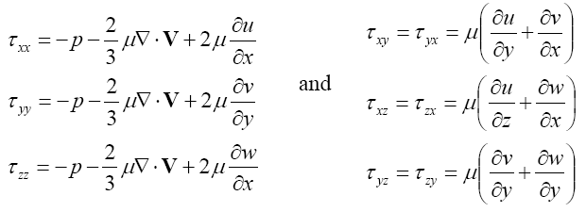
CONSERATION OF MOMENTUM
Relations between stress and μ based on the assumptions
FLUID MECHANICS REVIEW

Slide 18
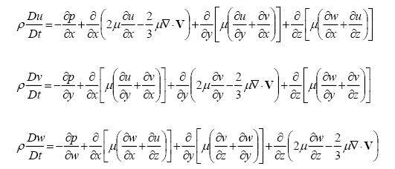
THE CLASSIC NAVIER-STOKES EQUATIONS
Written in the standard aerodynamics form neglecting the body force.
These equations are:
  Non-linear (recall that superposition of solutions is not allowed).
  Highly coupled.
  Long!
FLUID MECHANICS REVIEW

Slide 19
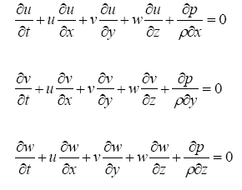
EULER EQUATIONS
When the viscous terms are small and thus ignored, the flow is termed inviscid.
The resulting equations are known as the Euler Equations.
FLUID MECHANICS REVIEW

Slide 20
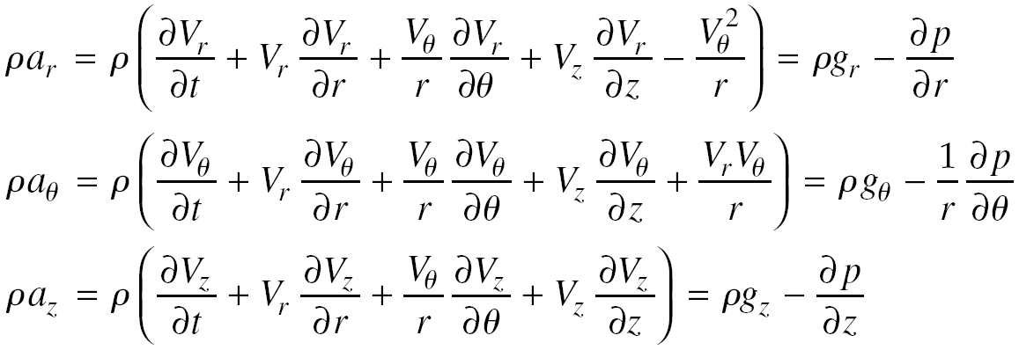
EULER EQUATIONS
Euler Equations in cylindrical coordinate system:
FLUID MECHANICS REVIEW

Slide 21
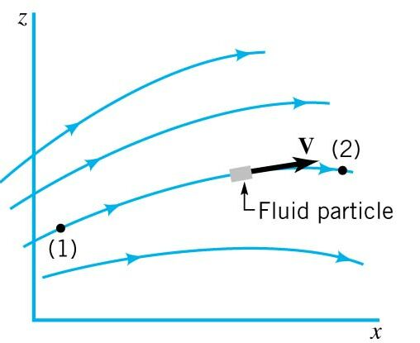
NEWTON’S SECOND LAW: FLUID DYNAMICS
We describe the motion of each particle with a velocity vector: V
Particles follow specific paths base on the velocity of the particle.
Location of particle is based on its initial position at an initial time, and its velocity along the path.
If the flow is a steady flow, each successive particle will follow the same path.
FLUID MECHANICS REVIEW

Slide 22
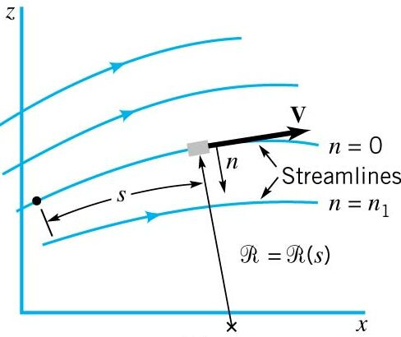
NEWTON’S SECOND LAW: STEADY FLOW
For Steady Flow, each particle slides along its path, and the velocity vector is every tangent to the path.
The lines that the velocity vectors are tangent to are called streamlines.
We can introduce streamline coordinate, s(t) along the streamline and n, normal to the streamline.
Then ℜ(s) is the radius of curvature of the streamline.
FLUID MECHANICS REVIEW

Slide 23






NEWTON’S SECOND LAW: STEADY FLOW
For 2-D Flows, there are two acceleration components:
  s-direction by chain rule:
  Normal direction (n) is the centrifugal acceleration:
In general there is acceleration along the streamline:
There is also acceleration normal to the streamline:
However, to produce an acceleration there must be a force!
FLUID MECHANICS REVIEW

Slide 24
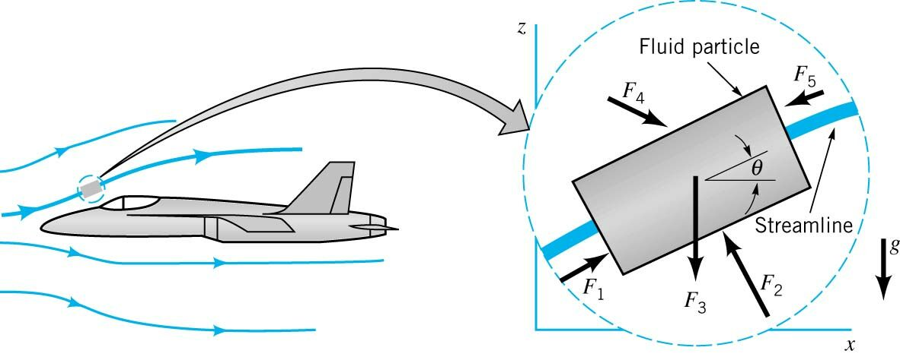
NEWTON’S SECOND LAW: STEADY FLOW F.B.D.
Remove, the fluid particle from its surroundings.
Draw the F.B.D. of the flow.
Assume pressure forces and gravity forces are important.
Neglect surface tension and viscous forces.
FLUID MECHANICS REVIEW

Slide 25

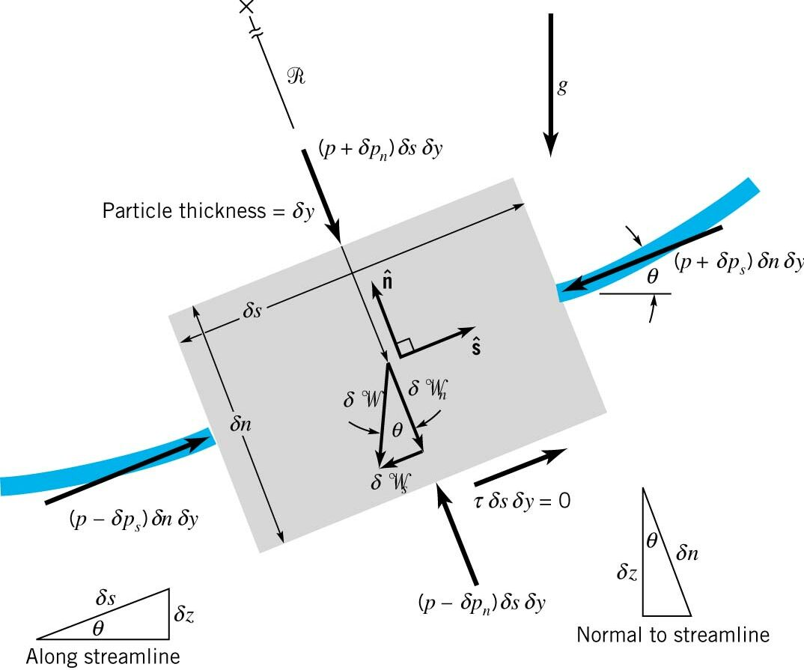


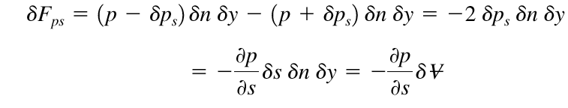

NEWTON’S SECOND LAW: ALONG A STREAMLINE
Use Streamline coordinates, our element is ds x dn x dy, and the unit vectors are n and s, and apply Newton’s Second Law in the Streamline Direction.
Streamline, F = ma:
                Gravity Forces:
                Pressure Forces (Taylor Series):
                arises since pressures vary in a fluid. P is the pressure at the center of the element.
                Shear Forces: Neglected, Inviscid!
FLUID MECHANICS REVIEW

Slide 26

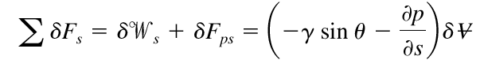


NEWTON’S SECOND LAW: ALONG A STREAMLINE
Then
Divide out volume, recall
- The change of fluid particle speed is accomplished by the appropriate combination of pressure gradient and particle weight along the streamline.
- In a static fluid the R.H.S is zero, and pressure and gravity balance.
In a dynamic fluid, the pressure and gravity are unbalanced causing fluid flow.
- In a dynamic fluid, the pressure and gravity are unbalanced causing fluid flow.
=
FLUID MECHANICS REVIEW

Slide 27






NEWTON’S SECOND LAW: ALONG A STREAMLINE
Note, we can rewrite terms in the above equation:
Then
Simplifying,
0 = constant along a streamline
FLUID MECHANICS REVIEW

Slide 28

NEWTON’S SECOND LAW: ALONG A STREAMLINE
Integrate,
In general, we can not integrate the pressure term because density can vary with temperature and pressure; however, for now we assume constant density.
Assumptions:
  Viscous effects are assumed negligible (inviscid).
  The flow is assumed steady.
  The flow is assume incompressible.
  The equation is applicable along a streamline
Celebrated Bernoulli’s Equation
* We can apply along a streamline in planar and non-planar flows!
FLUID MECHANICS REVIEW

Slide 29
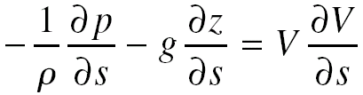
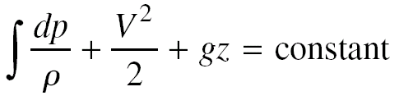
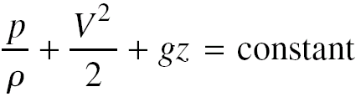
NEWTON’S SECOND LAW: ALONG A STREAMLINE
Integrating along S
Incompressible flow
FLUID MECHANICS REVIEW

Slide 30
BERNOULLI’S EQUATION
Steady Flow
No Friction
Flow Along a Streamline
Incompressible Flow
FLUID MECHANICS REVIEW

Slide 31
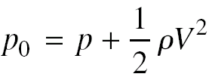
STATIC, STAGNATION AND DYNAMIC PRESSURES
  Stagnation Pressure
  Dynamic Pressure
  Static Pressure
FLUID MECHANICS REVIEW

Slide 32
FLUID KINEMATICS
Motion of a rigid body:
  Translation: all points in the body, move in parallel straight lines.
  Rotation: all points in the body move in circular paths about the axis of rotation.
  General motion
FLUID MECHANICS REVIEW

Slide 33
FLUID KINEMATICS
We can decompose the motion of an infinitesimal fluid particle, into four components:
  Translation
  Rotation
  Linear deformation (Linear strain)
  Angular deformation (Shear strain)
FLUID MECHANICS REVIEW

Slide 34
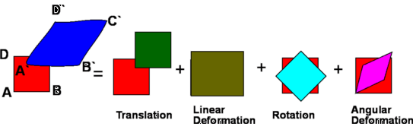
FLUID KINEMATICS
FLUID MECHANICS REVIEW

Slide 35
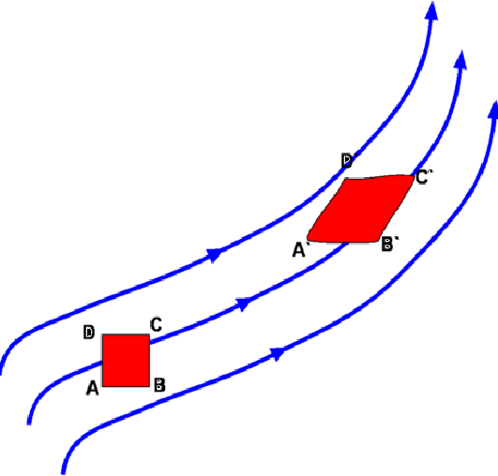
FLUID KINEMATICS
FLUID MECHANICS REVIEW

Slide 36
TRANSLATION
U Δ t
V Δ t
No Shear Stress
FLUID MECHANICS REVIEW

Slide 37
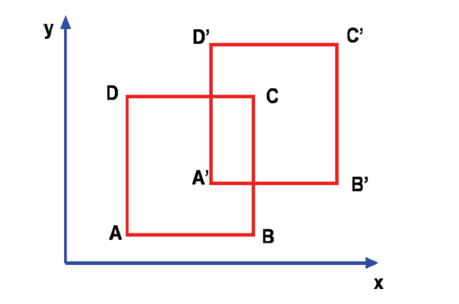


TRANSLATION
FLUID MECHANICS REVIEW

Slide 38
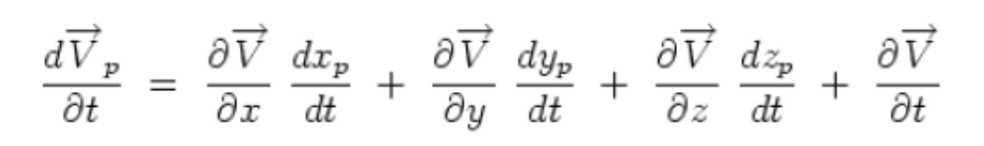
TRANSLATION
Acceleration of fluid element
FLUID MECHANICS REVIEW

Slide 39
LINEAR DEFORMATION
Incompressible flow
v
u
FLUID MECHANICS REVIEW

Slide 40
LINEAR DEFORMATION
FLUID MECHANICS REVIEW

Slide 41
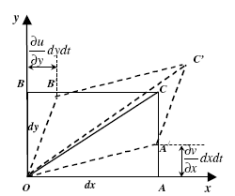



ANGULAR DEFORMATION
Similarly
FLUID MECHANICS REVIEW

Slide 42
FLUID MECHANICS REVIEW

Slide 43
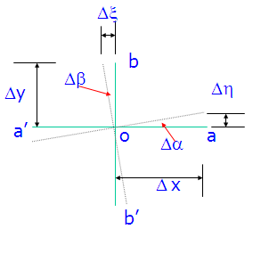
ROTATION
FLUID MECHANICS REVIEW

Slide 44
ROTATION
FLUID MECHANICS REVIEW

Slide 45
ROTATION
In three-dimensional space:
[ Vorticity = Curl of velocity ]
FLUID MECHANICS REVIEW

Slide 46
ROTATIONAL AND IRROTATIONAL FLOWS
Rotational flow:
at every point. The fluid elements have a finite angular velocity.
Irrotational flow:
at every point. The fluid elements have no angular velocity (pure translation).
FLUID MECHANICS REVIEW

Slide 47
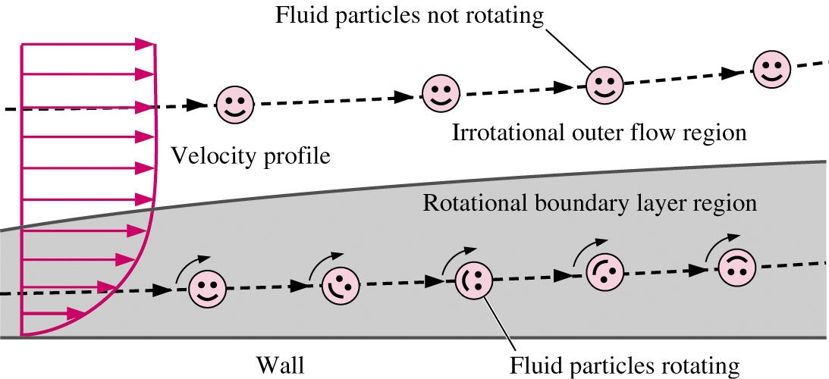
ROTATIONAL AND IRROTATIONAL FLOWS
FLUID MECHANICS REVIEW

Slide 48
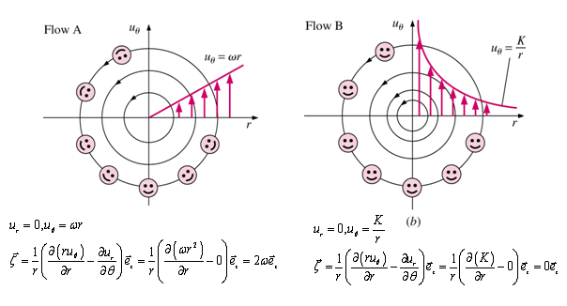
ROTATIONAL AND IRROTATIONAL FLOWS
Flow A is rotational
Flow B is irrotational
FLUID MECHANICS REVIEW

Slide 49
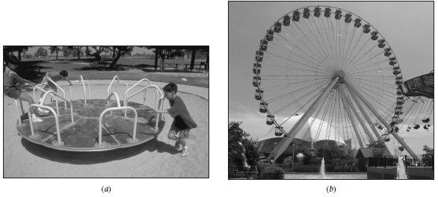
ROTATIONAL AND IRROTATIONAL FLOWS
FLUID MECHANICS REVIEW

Slide 50
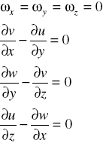
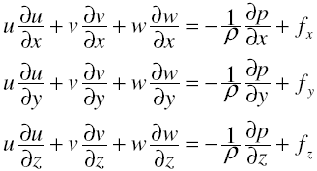
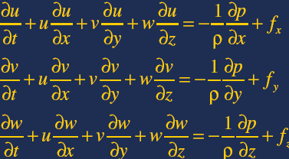
BERNOULLI’S EQUATION FOR IRROTATIONAL FLOWS
Euler Equations:
FLUID MECHANICS REVIEW

Slide 51
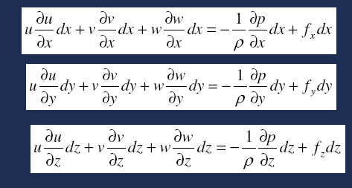



BERNOULLI’S EQUATION FOR IRROTATIONAL FLOWS
Adding above equations:
FLUID MECHANICS REVIEW

Slide 52



BERNOULLI’S EQUATION FOR IRROTATIONAL FLOWS
Integrating
For (Incompressible flow):
FLUID MECHANICS REVIEW

