Slide 1
AERODYNAMIC VARIABLES
The most frequent used terms in aerodynamics are:
  Pressure
  Density
  Temperature
  Velocity
  Viscosity
FUNDAMENTAL PRINCIPLES

Slide 2
AERODYNAMIC VARIABLES
Pressure:
  Pressure can be defined at any point in a fluid, whether liquid or gas.
  Pressure is the normal force per unit area exerted on a surface due to the time rate of change of momentum of the gas molecules impacting on that surface.
  Pressure is defined at a point in the fluid (or solid). Pressure is a point property.
  Dimension: [M/T²L], [FL/T] (T: Time)
FUNDAMENTAL PRINCIPLES

Slide 3
AERODYNAMIC VARIABLES
Density:
  Density is defined as the “mass per unit volume”. It’s the mass of the fluid contained in an incremental volume surrounding the point.
  In a fluid, density may vary from point to point. Density is a point property.
  Dimension: [M/L³], [FT²/L⁴] (T: Time)
FUNDAMENTAL PRINCIPLES

Slide 4
AERODYNAMIC VARIABLES
Temperature:
  Temperature is directly proportional to the average kinetic energy of the molecules of the fluid.
  - KE: mean molecular kinetic energy
  - k: Boltzmann constant
FUNDAMENTAL PRINCIPLES

Slide 5
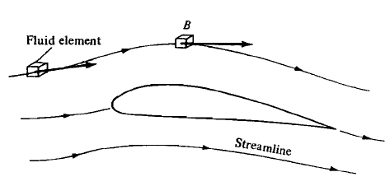
AERODYNAMIC VARIABLES
Velocity:
  Flow velocity is a vector quantity; it has both magnitude and direction.
  The velocity of a flowing fluid at any fixed point B, is the velocity of an infinitesimally small fluid element as it sweeps through B.
FUNDAMENTAL PRINCIPLES

Slide 6
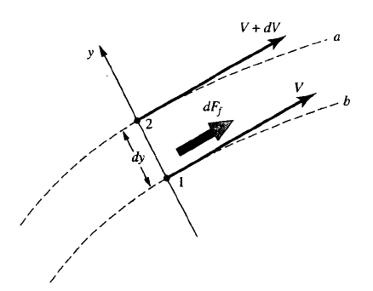
AERODYNAMIC VARIABLES
Viscosity:
  Viscosity of a fluid is regarded as its tendency to resist sliding between layers.
  In a Newtonian fluid, the shearing stress is proportional to the rate of shearing deformation. The constant of proportionality is called the coefficient of viscosity μ.
  Viscosity of a fluid relates to the transport of momentum in the direction of the velocity gradient (but opposite in sense. Viscosity is a transport property.
FUNDAMENTAL PRINCIPLES

Slide 7

AERODYNAMIC VARIABLES
Viscosity:
  The coefficient of viscosity depends on the composition of the fluid, its temperature and its pressure.
  Sutherland's formula can be used to derive the dynamic viscosity of an ideal gas as a function of the temperature:
where:
μ = dynamic viscosity in (Pa·s) at input temperature T
μ₀ = reference viscosity in (Pa·s) at reference temperature T₀
T = input temperature in kelvin
T₀ = reference temperature in kelvin
C = Sutherland's constant for the gaseous material in question
Valid for temperatures between 0 < T < 555 K with an error due to pressure less than 10% below 3.45 MPa
FUNDAMENTAL PRINCIPLES
FUNDAMENTAL PRINCIPLES
7

Slide 8
AERODYNAMIC VARIABLES
Viscosity:
  The coefficient of viscosity depends on the composition of the fluid, its temperature and its pressure.
  Sutherland's formula can be used to derive the dynamic viscosity of an ideal gas as a function of the temperature:
Gas | C [K] | T₀ [K] | μ₀ [10⁻⁶ Pa s]
air | 120 | 291.15 | 18.27
nitrogen | 111 | 300.55 | 17.81
oxygen | 127 | 292.25 | 20.18
carbon dioxide | 240 | 293.15 | 14.8
carbon monoxide | 118 | 288.15 | 17.2
hydrogen | 72 | 293.85 | 8.76
ammonia | 370 | 293.15 | 9.82
sulfur dioxide | 416 | 293.65 | 12.54
helium | 79.4 | 273 | 19
FUNDAMENTAL PRINCIPLES
FUNDAMENTAL PRINCIPLES
8

Slide 9
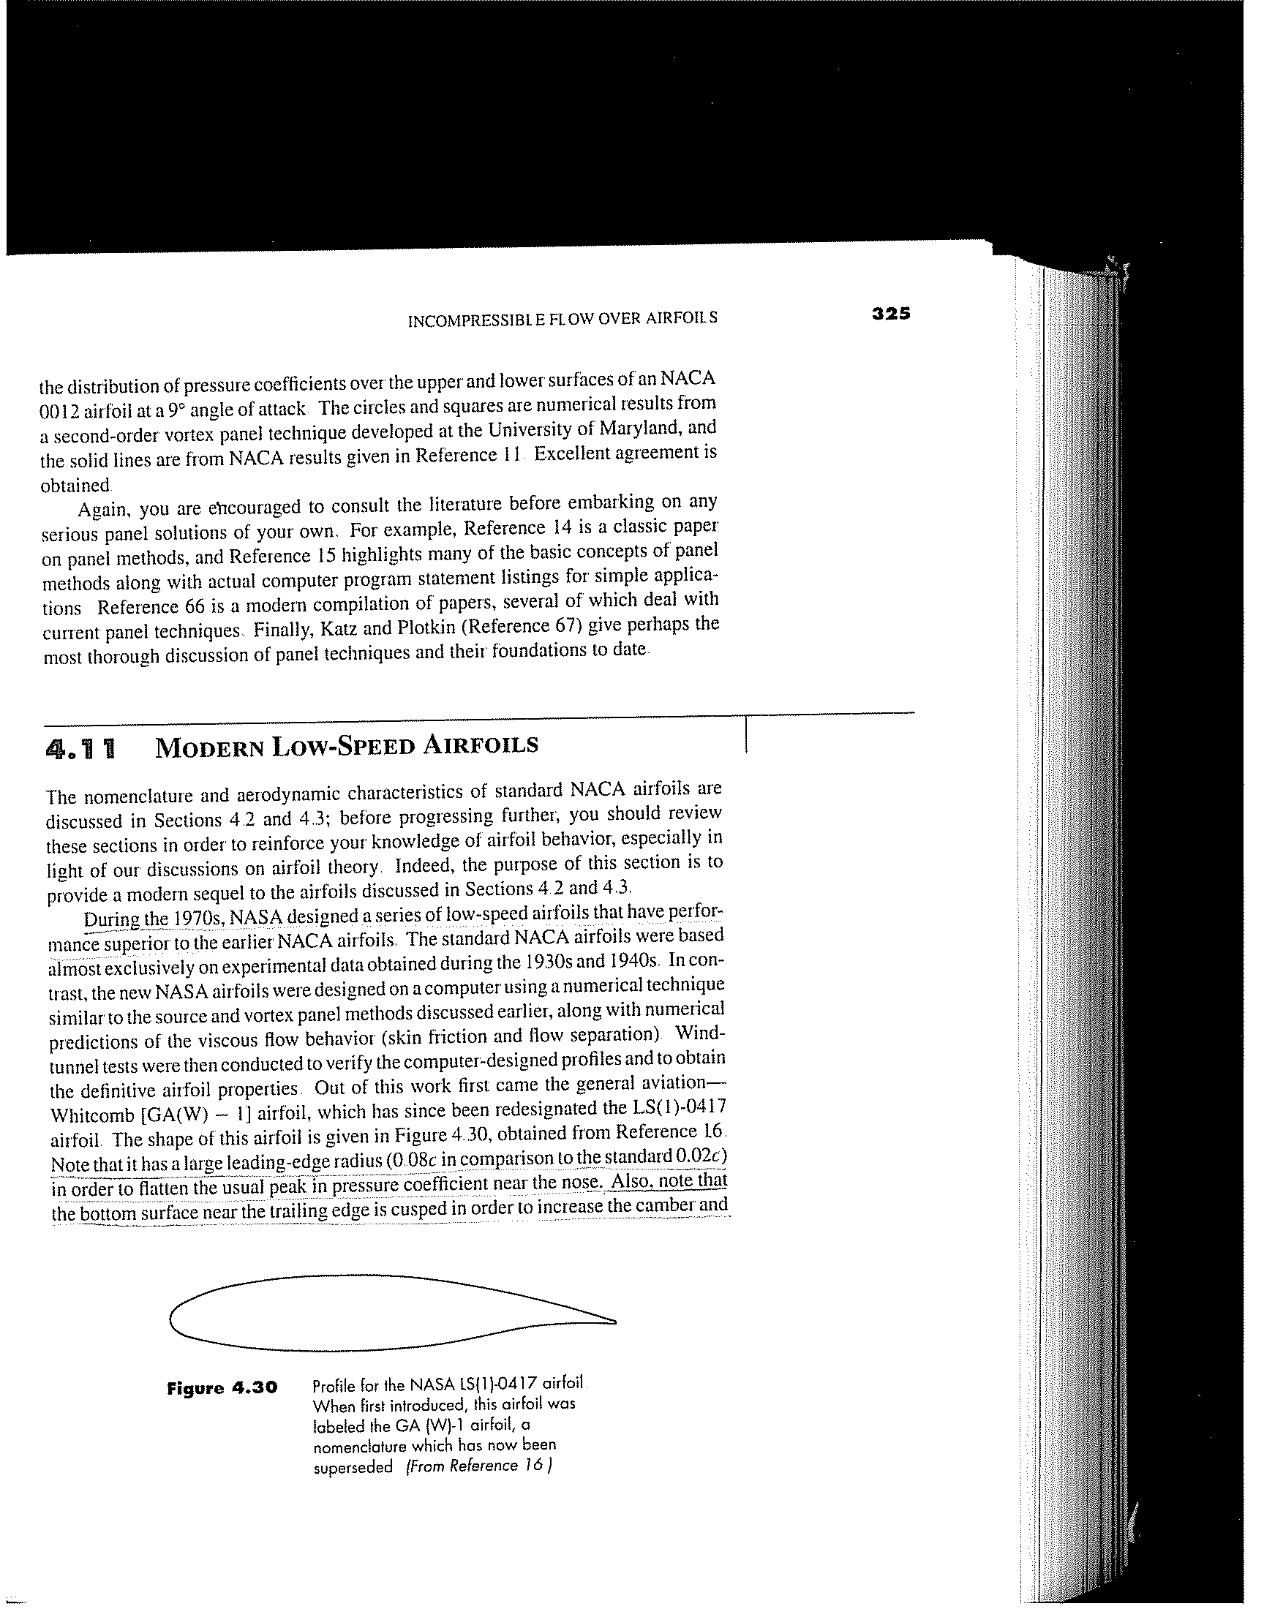
AERODYNAMIC FORCES AND MOMENTS
Sources of aerodynamic forces and moments:
  Pressure distribution (Normal to the surface)
  Shear stress distribution (Tangential to the surface)
FUNDAMENTAL PRINCIPLES

Slide 10
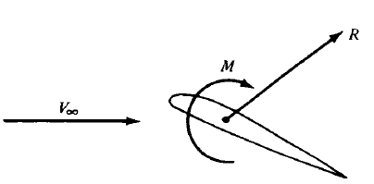
AERODYNAMIC FORCES AND MOMENTS
The net effect of pressure and shear stress distribution, integrated over the body surface is:
    Aerodynamic force: R
    Aerodynamic moment: M
FUNDAMENTAL PRINCIPLES

Slide 11
AERODYNAMIC FORCES AND MOMENTS
Components of aerodynamic force (R):
  L: Lift (perpendicular to freestream velocity)
  D: Drag (parallel to freestram velocity)
  N: Normal force (perpendicular to chord)
  A: Axial force (parallel to chord)
FUNDAMENTAL PRINCIPLES

Slide 12
SIGN CONVENTIOM FOR AERODYNAMIC MOMENT
By convention:
  Positive moments tend to increase the angle of attack:
  Negative moments tend to decrease the angle of attack:
FUNDAMENTAL PRINCIPLES

Slide 13
AERODYNAMIC COEFFICIENTS
The dimensionless force and moment coefficients:
  Lift coefficient
  Drag coefficient
  Normal force coefficient
  Axial force coefficient
  Moment coefficient
  Where:
  q is called the freestream dynamic pressure:
  l: reference length
  S: reference area
FUNDAMENTAL PRINCIPLES

Slide 14
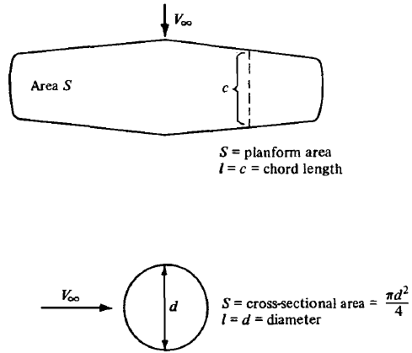
AERODYNAMIC COEFFICIENTS
FUNDAMENTAL PRINCIPLES

Slide 15
AERODYNAMIC COEFFICIENTS
Two additional dimensionless quantities:
  Pressure coefficient
  Skin friction coefficient
FUNDAMENTAL PRINCIPLES

Slide 16
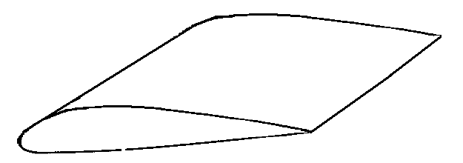
WING PARAMETERS
Trailing Edge (T.E.)
Leading Edge (L.E.)
Span
Chord
α
FUNDAMENTAL PRINCIPLES

Slide 17
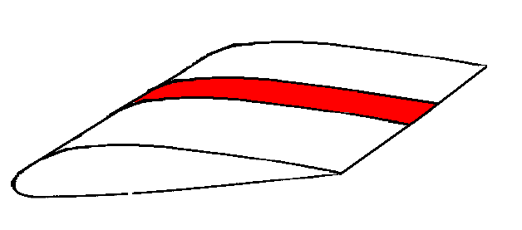
TWO-DIMENSIONAL BODIES
A
Unit span
FUNDAMENTAL PRINCIPLES

Slide 18
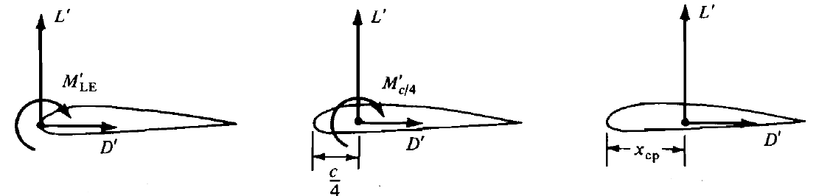
CENTER OF PRESSURE
Center of pressure is a point about which the aerodynamic moment is zero.
For small angles of attack:
Center of Pressure
FUNDAMENTAL PRINCIPLES

Slide 19
CENTER OF PRESSURE
Center of pressure is a point about which the aerodynamic moment is zero.
Center of Pressure
FUNDAMENTAL PRINCIPLES

Slide 20
CENTER OF PRESSURE - EXAMPLE
In low-speed, incompressible flow, the following experimental data are obtained for an airfoil section at an angle of attack of 4 ̊:
c_{l =}0.85 and c_{m, c/4} = -0.09.
Calculate the location of the center of pressure.
FUNDAMENTAL PRINCIPLES

Slide 21
DIMENSIONAL ANALYSIS:
THE BUCKINGHAM PI THEOREM
Question:
What physical quantities determine the variation of Aerodynamic forces and moments?
The answer can be found from the powerful method of
dimensional analysis
FUNDAMENTAL PRINCIPLES

Slide 22
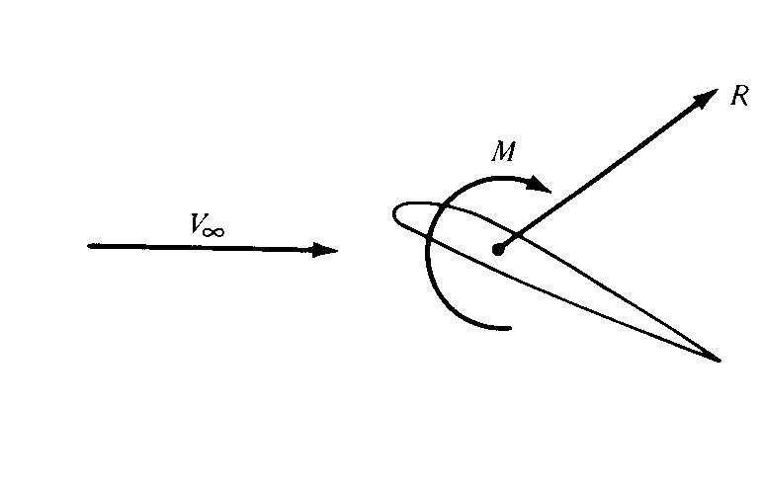
DIMENSIONAL ANALYSIS:
THE BUCKINGHAM PI THEOREM
On a physical, intuitive basis, we expect the aerodynamic force to depend on:
Freestream velocity, V∞
Freestream density, ρ∞ .
Viscosity of the fluid, μ∞ .
The size of the body, represented by some chosen reference length. Reference length is the chord length c.
The compressibility of the fluid. Compressibility is related to the speed of sound, a. Therefore, let us represent the influence of compressibility on aerodynamic forces and moments by the free stream speed of sound, a∞.
α
FUNDAMENTAL PRINCIPLES

Slide 23
DIMENSIONAL ANALYSIS:
THE BUCKINGHAM PI THEOREM
α
FUNDAMENTAL PRINCIPLES

Slide 24

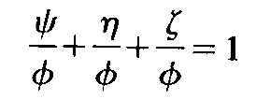
DIMENSIONAL ANALYSIS:
THE BUCKINGHAM PI THEOREM
The object of dimensional analysis is to group several variables together to form a new variable that is nondimensional.
Dimensional analysis is based on the obvious fact that an equation dealing the real physical world, each term must have the same dimensions:
The above equation can be made dimensionless by dividing by any one of the terms, say,
FUNDAMENTAL PRINCIPLES

Slide 25
DIMENSIONAL ANALYSIS:
THE BUCKINGHAM PI THEOREM
Let K equal the number of fundamental dimensions required to describe the physical variables. (In mechanics, all physical variables can be expressed in terms of the dimensions of mass, length, and time; hence, K = 3.)
Let P_{I}, P ₂,. . . , P_{N} represent N physical variables in the physical relation
Then, the physical relation may be reexpressed as a relation of (N – K) dimensionless products (called Π products),
FUNDAMENTAL PRINCIPLES

Slide 26
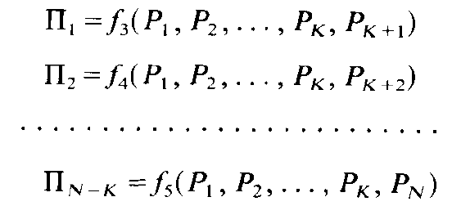
DIMENSIONAL ANALYSIS:
THE BUCKINGHAM PI THEOREM
Each Π product is a dimensionless product of a set of K physical variables plus one other physical variable. Let P₁, P₂, …, P_{K} be the selected set of K physical variables. Then
The choice of repeating variable, should be such that:
- They include all the K dimensions used in problem.
- The dependent variable should appear in only one of the Π products.
FUNDAMENTAL PRINCIPLES

Slide 27
DIMENSIONAL ANALYSIS:
THE BUCKINGHAM PI THEOREM
m = dimensions of mass
l = dimension of length
t = dimension of time
FUNDAMENTAL PRINCIPLES

Slide 28
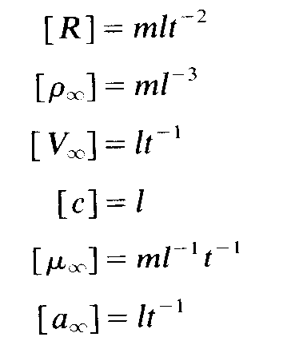
DIMENSIONAL ANALYSIS:
THE BUCKINGHAM PI THEOREM
Physical variables and their dimensions:
N = 6
K = 3
FUNDAMENTAL PRINCIPLES

Slide 29
DIMENSIONAL ANALYSIS:
THE BUCKINGHAM PI THEOREM
can be reexpressed in terms of N – K =3 dimensionless Π products
The Π products are:
FUNDAMENTAL PRINCIPLES

Slide 30
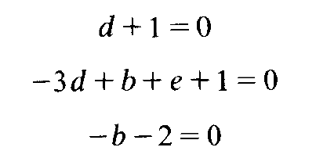

DIMENSIONAL ANALYSIS:
THE BUCKINGHAM PI THEOREM
FUNDAMENTAL PRINCIPLES

Slide 31
DIMENSIONAL ANALYSIS:
THE BUCKINGHAM PI THEOREM
A
S
Force Coefficient
A-A
A
S
FUNDAMENTAL PRINCIPLES

Slide 32

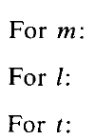
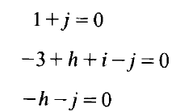



DIMENSIONAL ANALYSIS:
THE BUCKINGHAM PI THEOREM
Reynolds Number
FUNDAMENTAL PRINCIPLES

Slide 33

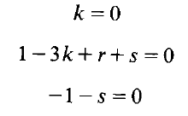



DIMENSIONAL ANALYSIS:
THE BUCKINGHAM PI THEOREM
Mach Number
FUNDAMENTAL PRINCIPLES

Slide 34
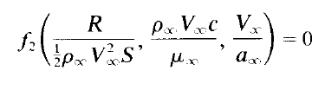

DIMENSIONAL ANALYSIS:
THE BUCKINGHAM PI THEOREM
FUNDAMENTAL PRINCIPLES

Slide 35
DIMENSIONAL ANALYSIS:
THE BUCKINGHAM PI THEOREM
If α is allowed to vary, then:
C_{L}, C_{D}, and C_{M} will in general depend on the value of α.
FUNDAMENTAL PRINCIPLES

Slide 36
FLOW SIMILARITY
By definition, different flows are dynamically similar if:
1. The bodies and any other solid boundaries are geometrically similar for both flows.
2. The similarity parameters are the same for both flows.
FUNDAMENTAL PRINCIPLES

Slide 37
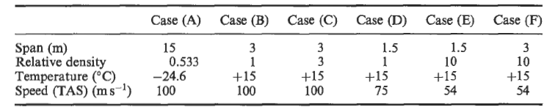
FLOW SIMILARITY - EXAMPLE
An aircraft and some scale models of it are tested under various conditions: given below. Which cases are dynamically similar to the aircraft in flight, given as case (A)?
Case (A) represents the full-size aircraft at 6000 m. The other cases represent models under test in various types of wind-tunnel
FUNDAMENTAL PRINCIPLES

Slide 38

FLOW SIMILARITY – EXAMPLE (CONT.)
The Reynolds number ρVD/ μ may be calculated for each case (Viscosity from Sutherland’s formula )
These are found to be:
Cases (A), (C) and (E) are dynamically similar.
FUNDAMENTAL PRINCIPLES

