Slide 1
BERNOULLI’S EQUATION
The Bernoulli’s equation is a powerful and useful equation that relates pressure changes to velocity and elevation changes along a streamline.
The Bernoulli’s equation gives correct results when applied to flow situations where the following four restrictions are reasonable:
  Steady flow
  Incompressible flow
  Inviscid flow
  Flow along a streamline (In general, the Bernoulli’s constant [C] has different values along different stramlines)
INVISCID, INCOMPRESSIBLE FLOW

Slide 2
BERNOULLI’S EQUATION APPLICATIONS
Bernoulli’s equation is applicable to the following two devices:
  Venturi: Flowmeter, low-speed wind tunnel, Airspeed measurement
  Pitot-tube: Airspeed measurement
INVISCID, INCOMPRESSIBLE FLOW

Slide 3

BERNOULLI’S EQUATION APPLICATIONS:
VENTURI
Venturi is a convergent-divergent duct. It’s a device that finds many applications in engineering.
Convergent duct
Divergent duct
Throat
INVISCID, INCOMPRESSIBLE FLOW

Slide 4
BERNOULLI’S EQUATION APPLICATIONS:
VENTURI
In general, venturi is a three-dimensional duct with elliptical or rectangular cross section which vary from one location to another.
INVISCID, INCOMPRESSIBLE FLOW

Slide 5
BERNOULLI’S EQUATION APPLICATIONS:
VENTURI
For moderate variation of area, it is reasonable to assume that the flowfield properties (velocity, pressure,...) are uniform across any cross section, and vary only in direction of flow.
Quasi-one-dimensional flow
INVISCID, INCOMPRESSIBLE FLOW

Slide 6
BERNOULLI’S EQUATION APPLICATIONS:
VENTURI
For steady flow through the venturi, continuity equation gives:
For incompressible flow:
the mass flow through the duct is constant.
INVISCID, INCOMPRESSIBLE FLOW

Slide 7
BERNOULLI’S EQUATION APPLICATIONS:
VENTURI
For a given variation of area A(x):
Using Bernoulli’s equation:
INVISCID, INCOMPRESSIBLE FLOW

Slide 8
BERNOULLI’S EQUATION APPLICATIONS:
VENTURI
Flow
Flow
Velocity decreases (Continuity)
Pressure increases (Bernoulli)
Velocity increases (Continuity)
Pressure decreases (Bernoulli)
INVISCID, INCOMPRESSIBLE FLOW

Slide 9
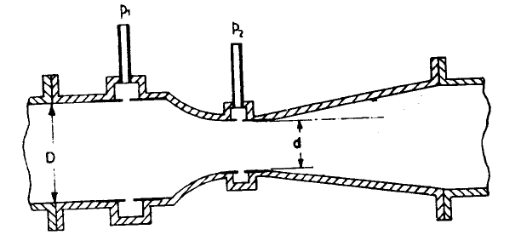
BERNOULLI’S EQUATION APPLICATIONS:
VENTURI
Venturi applications: Speed measurement
Venturi can be used to
measure airspeed.
For a venturi (with a given inlet [station 1] to throat [station 2] area ratio) and known pressure difference p₁-p₂, the inlet velocity can be obtained from the combination of continuity and Bernoulli’s equation:
INVISCID, INCOMPRESSIBLE FLOW

Slide 10
BERNOULLI’S EQUATION APPLICATIONS:
VENTURI
Venturi applications: Wind tunnel
Another application of venturi is the low-speed wind tunnel.
A low-speed wind tunnel is a large venturi, where the airflow is driven by a fan connected to some type of motor drive.
INVISCID, INCOMPRESSIBLE FLOW

Slide 11
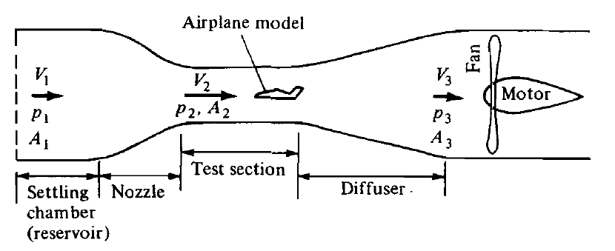
BERNOULLI’S EQUATION APPLICATIONS:
VENTURI
Venturi applications: Wind tunnel
There are two general types of low-speed wind tunnels:
  1. Open-circuit tunnel
INVISCID, INCOMPRESSIBLE FLOW

Slide 12
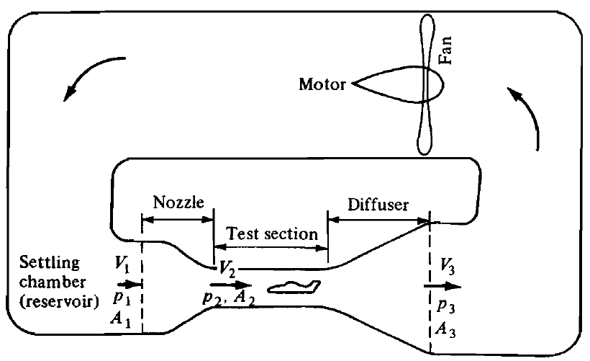
BERNOULLI’S EQUATION APPLICATIONS:
VENTURI
Venturi applications: Wind tunnel
There are two general types of low-speed wind tunnels:
  2. Closed-circuit tunnel
INVISCID, INCOMPRESSIBLE FLOW

Slide 13
BERNOULLI’S EQUATION APPLICATIONS:
VENTURI
Venturi applications: Wind tunnel
The air velocity in the test section of a low-speed wind tunnel (with fixed area ratio A₂/A₁), is obtained from the combination of continuity and Bernoulli’s equation:
In low-speed wind tunnels, a method of measuring the pressure difference P1-P2, is by means of manometers.
INVISCID, INCOMPRESSIBLE FLOW

Slide 14

BERNOULLI’S EQUATION APPLICATIONS:
PITOT TUBE
Pitot tube is one of the most common and frequently used instruments in any modern aerodynamic laboratory.
Pitot tube is the most common device for measuring flight velocities of airplanes.
Can connect a differential pressure transducer to directly measure V²/2g.
Can be used to measure the flow of water in pipelines.
INVISCID, INCOMPRESSIBLE FLOW

Slide 15
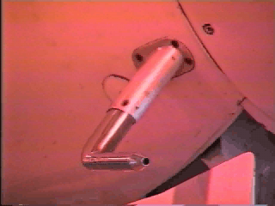
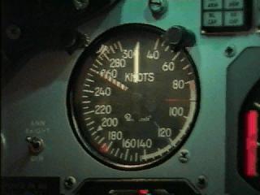
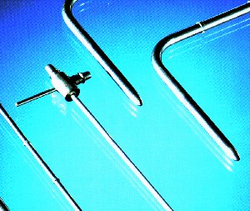
BERNOULLI’S EQUATION APPLICATIONS:
PITOT TUBE
Point measurement!
INVISCID, INCOMPRESSIBLE FLOW

Slide 16
BERNOULLI’S EQUATION APPLICATIONS:
PITOT TUBE
Stagnation pressure tap
Static pressure tap
2
V₁ =
0
V
1
z₁ = z₂
Connect two ports to differential pressure transducer. Make sure Pitot tube is completely filled with the fluid that is being measured.
Solve for velocity as function of pressure difference
INVISCID, INCOMPRESSIBLE FLOW

Slide 17
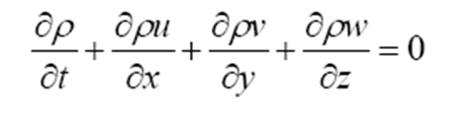
FUNDUMENTALS OF INVISCID, INCOMPRESSIBLE FLOW
INCOMPRESSIBLE
2-D
Irrotational
INVISCID, INCOMPRESSIBLE FLOW

Slide 18
VELOCITY POTENTIAL
Velocity Potential is defined as:
1- φ automatically satisfies the Irrotationality condition.
2- If it has to meet the continuity requirement it has to obey,
INVISCID, INCOMPRESSIBLE FLOW

Slide 19

VELOCITY POTENTIAL
Thus the problem is reduced to that of finding φ.
Boundary Condition
On the boundary
INVISCID, INCOMPRESSIBLE FLOW

Slide 20

CIRCULATION
Circulation, Γ is defined as the line integral of tangential velocity component around a closed curve in the flow.
V
α
ds
C
INVISCID, INCOMPRESSIBLE FLOW

Slide 21


CIRCULATION
v
u
Kelvin-Stokes theorem:
Thus for an irrotational flow circulation around any closed contour is zero.
INVISCID, INCOMPRESSIBLE FLOW

Slide 22
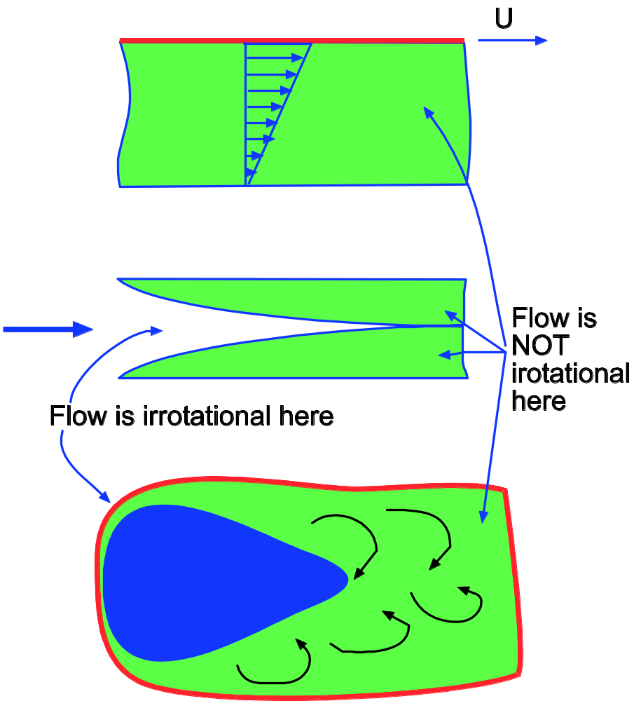
CIRCULATION
INVISCID, INCOMPRESSIBLE FLOW

Slide 23
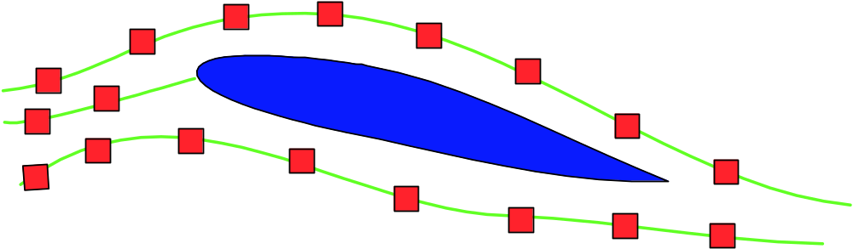
CIRCULATION
INVISCID, INCOMPRESSIBLE FLOW

Slide 24
STREAM FUNCTION, ψ
Stream Function, ψ is defined such that
ψ = constant, denotes a streamline.
INVISCID, INCOMPRESSIBLE FLOW

Slide 25
STREAM FUNCTION, ψ
For irrotationality, we have
INVISCID, INCOMPRESSIBLE FLOW

Slide 26

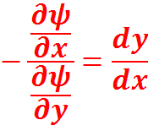



PROPERTIES OF STREAMLINES
-v
u
INVISCID, INCOMPRESSIBLE FLOW

Slide 27
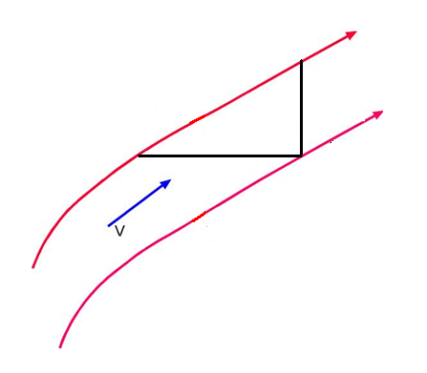
PROPERTIES OF STREAMLINES
Difference dψ between successive streamlines is proportional to volumetric flow rate.
dψ
dy
ψ
dx
dψ=dQ
INVISCID, INCOMPRESSIBLE FLOW

Slide 28
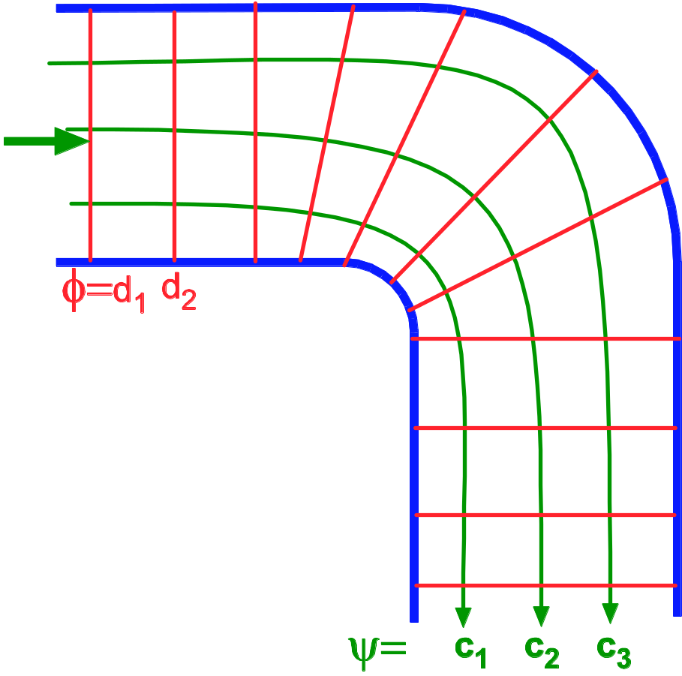
PROPERTIES OF STREAMLINES
Streamlines and velocity potential lines are normal to each other.
INVISCID, INCOMPRESSIBLE FLOW

Slide 29
CYLINDRICAL COORDINATE SYSTEM
θ
r
INVISCID, INCOMPRESSIBLE FLOW

Slide 30
CAUCHY-REIMANN EQUATIONS
INVISCID, INCOMPRESSIBLE FLOW

Slide 31
ELEMENTARY PLANE FLOWS
Elemantary plane flows:
Uniform flow
Source / Sink flow
Doublet Flow
Vortex flow
INVISCID, INCOMPRESSIBLE FLOW

Slide 32
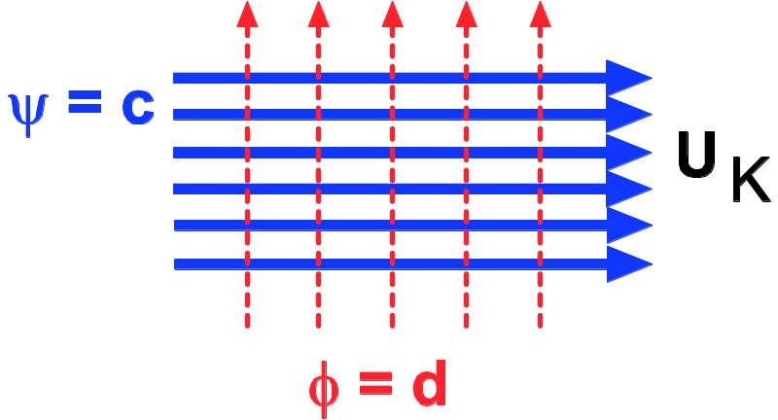
ELEMENTARY PLANE FLOWS
Uniform flow
INVISCID, INCOMPRESSIBLE FLOW

Slide 33
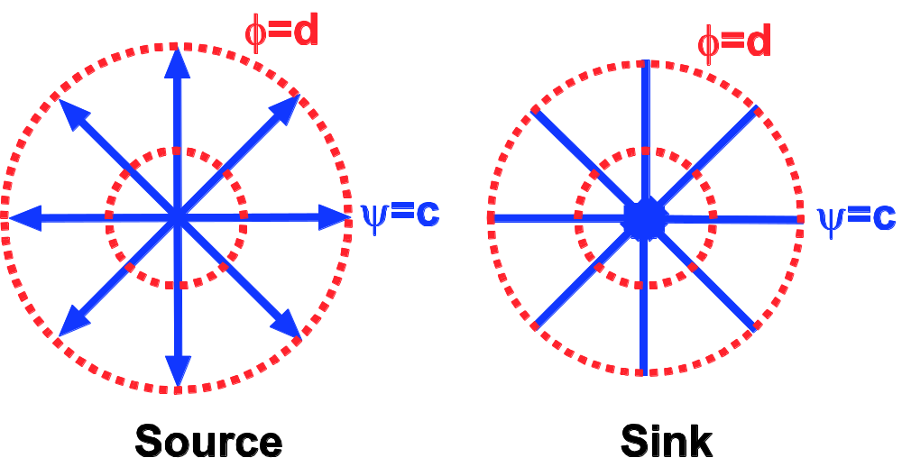
ELEMENTARY PLANE FLOWS
Source/Sink flow
INVISCID, INCOMPRESSIBLE FLOW

Slide 34
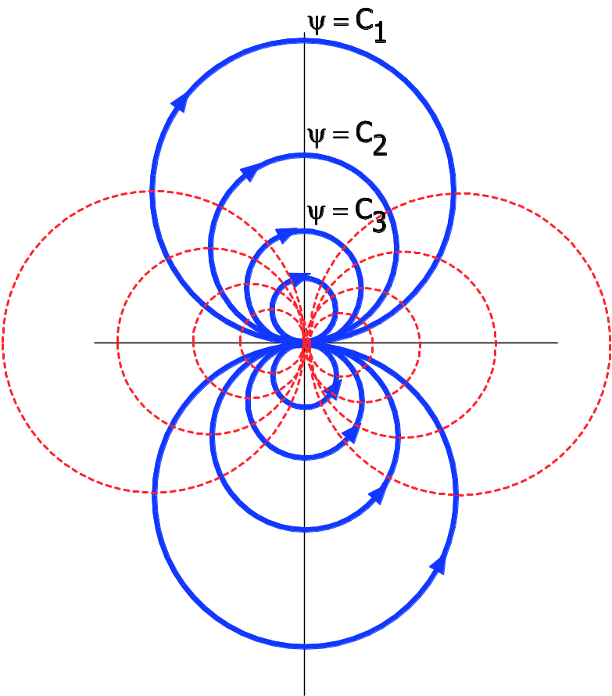
SUPERPOSITION OF ELEMENTARY PLANE FLOWS
Doublet
Source and Sink approach each other ie., a→0, But qa/π is constant or finite.
INVISCID, INCOMPRESSIBLE FLOW

Slide 35
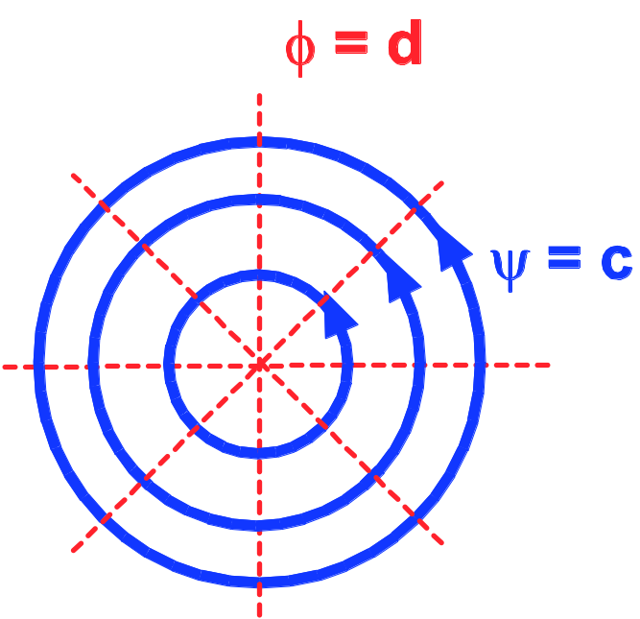
ELEMENTARY PLANE FLOWS
Vortex flow
INVISCID, INCOMPRESSIBLE FLOW

Slide 36
SUPERPOSITION OF ELEMENTARY PLANE FLOWS
Laplace Equation is linear. So if φ₁ and φ₂ are two solutions,
φ₃ = φ₁±φ₂ is also a solution.
Simple flows are superposed to calculate more complex flows.
NOTE: A solid wall is also a streamline. This helps us locate solid boundaries.
INVISCID, INCOMPRESSIBLE FLOW

