Slide 1







POTENTIAL FLOW: PLANE POTENTIAL FLOWS
Laplace’s equation is a second-order linear Partial Differential Equation. The fact that the Laplace’s equation is linear is particularly important, because linear superposition of solutions is allowed:
where
and
are solutions of Laplace’s equation
For simplicity, we consider 2D (planar) flows:
Cartesian:
Cylindrical:
We note that the stream functions also exist for 2D planar flows:
Cartesian:
Cylindrical:
POTENTIAL FLOWS

Slide 2






POTENTIAL FLOW: PLANE POTENTIAL FLOWS
For irrotational, planar flow:
Now substitute the stream function:
Then,
Laplace’s Equation
For plane, irrotational flow, we use either the potential or the stream function, which both must satisfy Laplace’s equations in two dimensions.
Lines of constant Ψ are streamlines:
Now, the change of φ from one point (x, y) to a nearby point (x + dx, y + dy) is:
Along lines of constant φ we have dφ =0,
0
POTENTIAL FLOWS

Slide 3
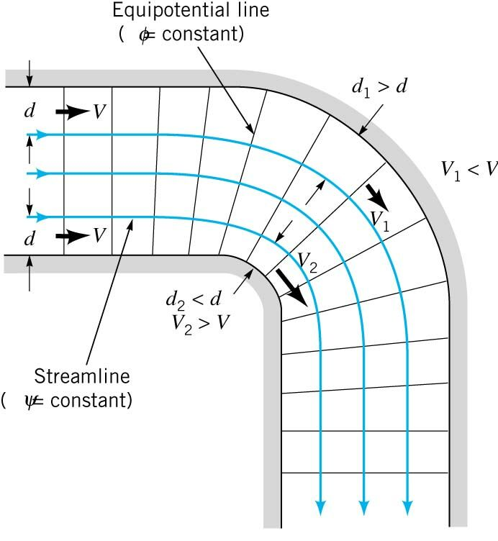
POTENTIAL FLOW: PLANE POTENTIAL FLOWS
Lines of constant φ are called Equipotential lines.
The Equipotential lines are orthogonal to lines of constant Ψ (streamlines) where they intersect.
The flow net consists of a family of streamlines and equipotential lines.
The combination of streamlines and equipotential lines are used to visualize a graphical flow situation.
The velocity is inversely proportional to the spacing between streamlines.
Velocity decreases along this streamline.
Velocity increases along this streamline.
POTENTIAL FLOWS

Slide 4
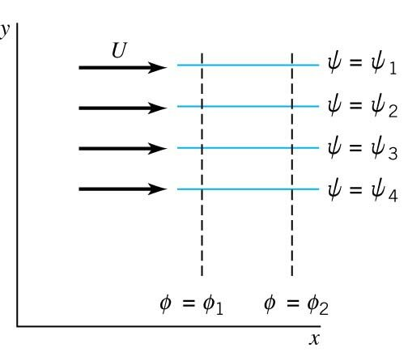







POTENTIAL FLOW: UNIFORM FLOW
The simplest plane potential flow is a uniform flow in which the streamlines are all parallel to each other.
Consider a uniform flow in the x-direction:
Integrate the two equations:
φ = Ux + f(y) + C
φ = f(x) + C
Matching the solution
C is an arbitrary constant, can be set to zero:
Now for the stream function solution:
Integrating the two equations similar to above.
POTENTIAL FLOWS

Slide 5
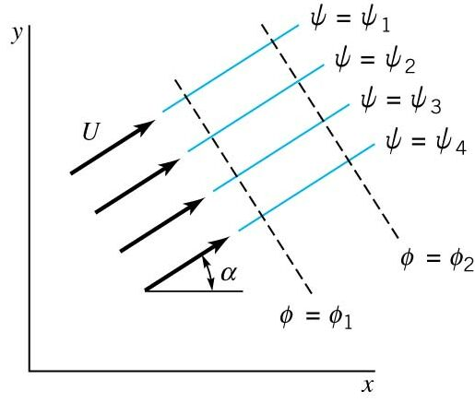


POTENTIAL FLOW: UNIFORM FLOW
For Uniform Flow in an Arbitrary direction, α :
POTENTIAL FLOWS

Slide 6
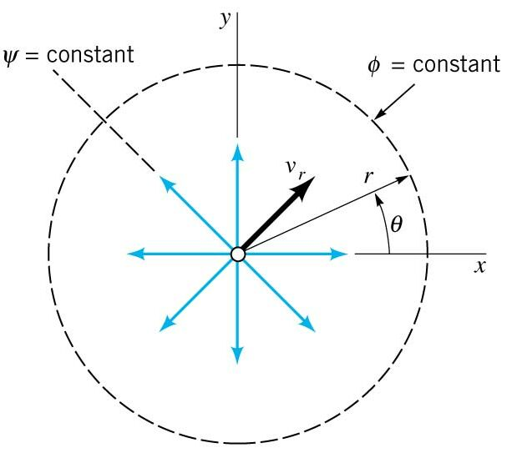






POTENTIAL FLOW: SOURCE/SINK FLOW
Source Flow:
Source/Sink Flow is a purely radial flow.
Fluid is flowing radially from a line through the origin perpendicular to the x-y plane.
Let m be the volume rate emanating from the line (per unit length).
Then, to satisfy mass conservation:
Since the flow is purely radial:
Now, the velocity potential can be obtained:
0
m is the strength of the source or sink!
Integrate
If m is positive, the flow is radially outward, source flow.
If m is negative, the flow is radially inward, sink flow.
This potential flow does not exist at r = 0, the origin, because it is not a “real” flow, but can approximate flows.
POTENTIAL FLOWS

Slide 7



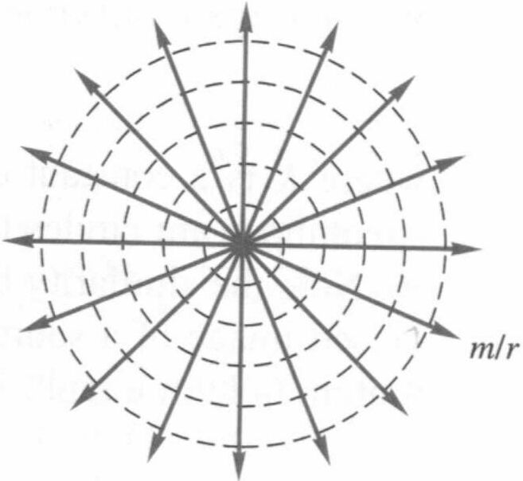
POTENTIAL FLOW: SOURCE/SINK FLOW
Now, obtain the stream function for the flow:
0
Then, integrate to obtain the solution:
The streamlines are radial lines and the equipotential lines are concentric circles centered about the origin:
φ lines
Ψ lines
POTENTIAL FLOWS

Slide 8
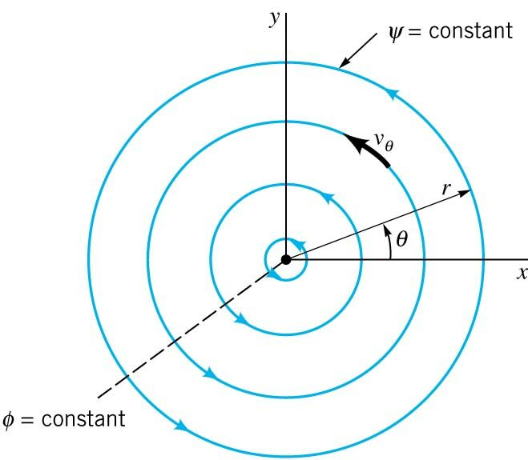
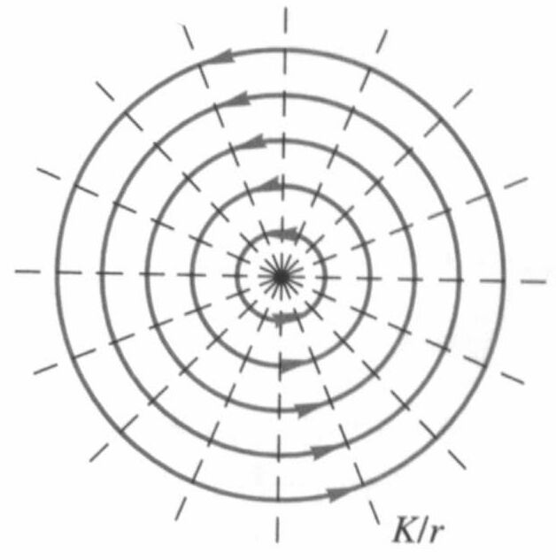
POTENTIAL FLOW: VORTEX FLOW
In vortex flow, the streamlines are concentric circles, and the equipotential lines are radial lines.
Solution:
where K is a constant.
The sign of K determines whether the flow rotates clockwise or counterclockwise.
In this case:
The tangential velocity varies inversely with the distance from the origin. At the origin it encounters a singularity becoming infinite.
φ lines
Ψ lines
POTENTIAL FLOWS

Slide 9
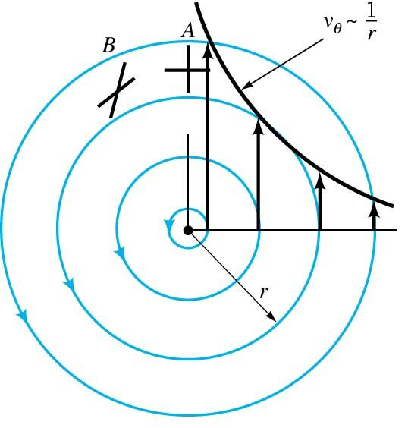
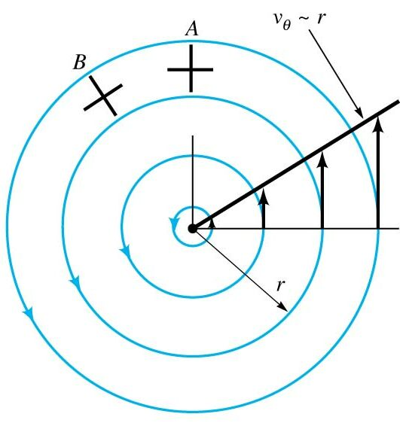
POTENTIAL FLOW: VORTEX FLOW
How can a vortex flow be irrotational?
Rotation refers to the orientation of a fluid element and not the path followed by the element.
Irrotational Flow: Free Vortex
Rotational Flow: Forced Vortex
Velocity increases inward.
Velocity increases outward.
i.e., water draining from a bathtub
i.e., a rotating tank filled with fluid
Traveling from A to B, consider two sticks
Irrotational Flow:
Rotational Flow: Rigid Body Rotation
Initially, sticks aligned, one in the flow direction, and the other perpendicular to the flow.
Initially, sticks aligned, one in the flow direction, and the other perpendicular to the flow.
As they move from A to B the perpendicular-aligned stick rotates clockwise, while the flow-aligned stick rotates counter clockwise.
As they move from A to B they sticks move in a rigid body motion, and thus the flow is rotational.
The average angular velocities cancel each other, thus, the flow is irrotational.
POTENTIAL FLOWS

Slide 10
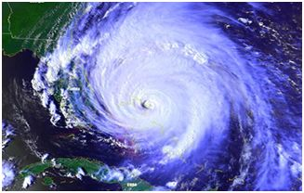


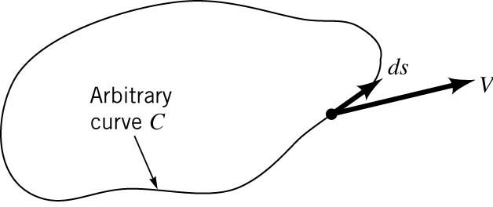



POTENTIAL FLOW: VORTEX FLOW
A combined vortex flow is one in which there is a forced vortex at the core, and a free vortex outside the core.
A Hurricane is approximately a combined vortex
Circulation is a quantity associated with vortex flow. It is defined as the line integral of the tangential component of the velocity taken around a closed curve in the flow field.
For irrotational flow the circulation is generally zero.
POTENTIAL FLOWS

Slide 11
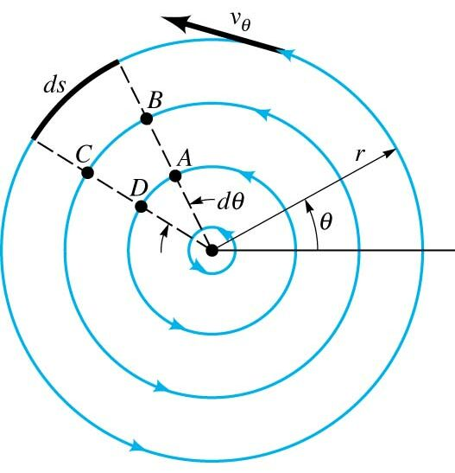
POTENTIAL FLOW: VORTEX FLOW
However, if there are singularities in the flow, the circulation is not zero if the closed curve includes the singularity.
For the free vortex:
The circulation is non-zero and constant for the free vortex:
The velocity potential and the stream function can be rewritten in terms of the circulation:
An example in which the closed surface circulation will be zero:
POTENTIAL FLOWS

Slide 12
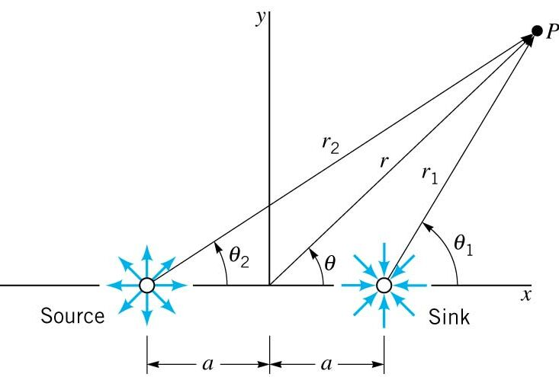







POTENTIAL FLOW: DOUBLET FLOW
Combination of a Equal Source and Sink Pair:
Rearrange and take tangent,
Note, the following:
and
Substituting the above expressions,
Then,
If a is small, then tangent of angle is approximated by the angle:
POTENTIAL FLOWS

Slide 13
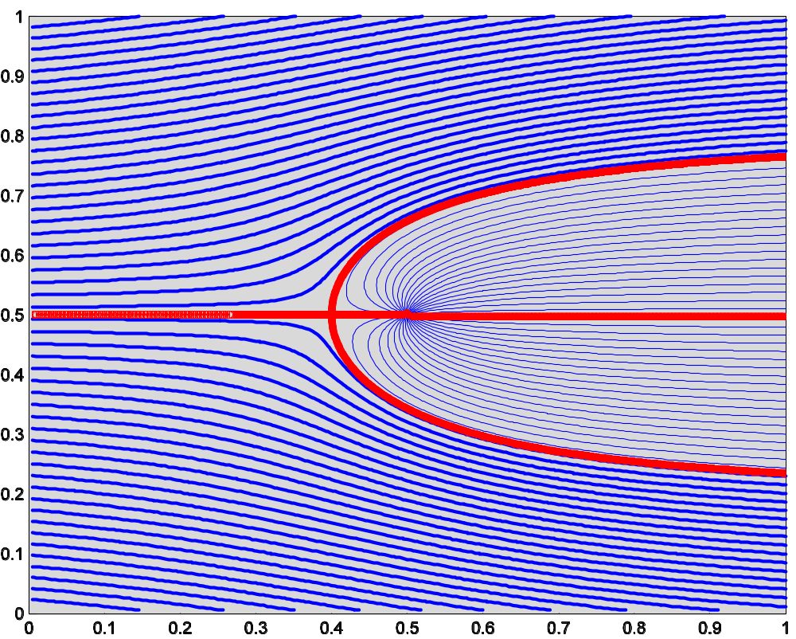
POTENTIAL FLOW: DOUBLET FLOW
POTENTIAL FLOWS

Slide 14





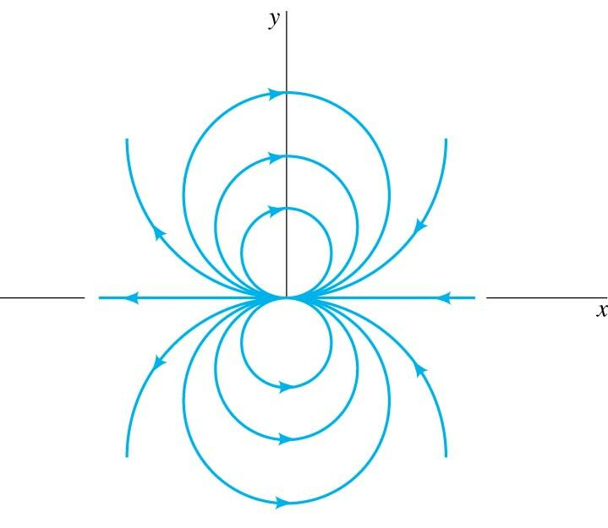
POTENTIAL FLOW: DOUBLET FLOW
Now, we obtain the doublet flow by letting the source and sink approach one another, and letting the strength increase.
is then constant.
K is the strength of the doublet, and is equal to ma/π.
The corresponding velocity potential then is the following:
Streamlines of a Doublet:
POTENTIAL FLOWS

Slide 15
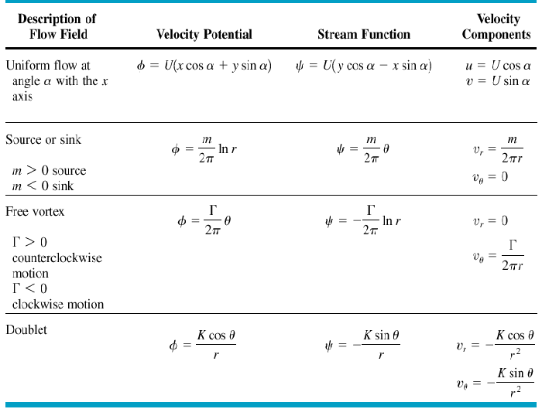
POTENTIAL FLOW: SUMMARY OF BASIC FLOWS
-
-
POTENTIAL FLOWS

Slide 16
POTENTIAL FLOW: SUPERPOSITION OF BASIC FLOWS
Because Potential Flows are governed by linear partial differential equations, the solutions can be combined in superposition.
Any streamline in an inviscid flow acts as solid boundary, such that there is no flow through the boundary or streamline.
Thus, some of the basic velocity potentials or stream functions can be combined to yield a streamline that represents a particular body shape.
The superposition representing a body can lead to describing the flow around the body in detail.
POTENTIAL FLOWS

Slide 17
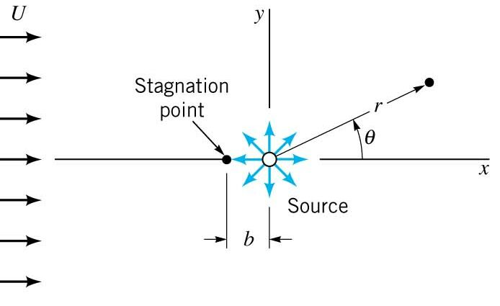







SUPERPOSITION OF POTENTIAL FLOWS: RANKINE HALF-BODY
The Rankine Half-Body is a combination of a source and a uniform flow.
Stream Function (cylindrical coordinates):
Potential Function (cylindrical coordinates):
There will be a stagnation point, somewhere along the negative x-axis where the source and uniform flow cancel (θ = π):
Evaluate the radial velocity:
For the source:
For the uniform flow:
For θ = π,
Then for a stagnation point, at some r = -b, θ = π :
and
POTENTIAL FLOWS

Slide 18




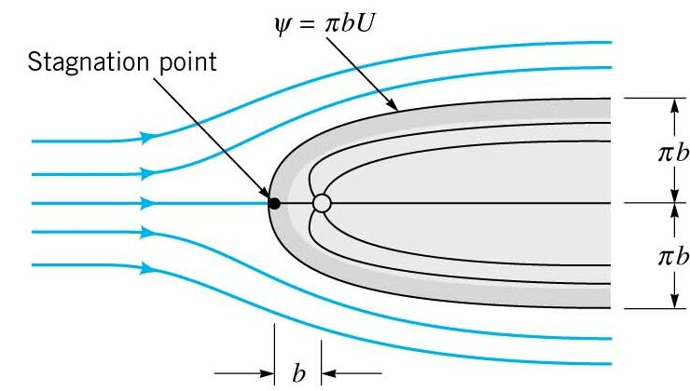
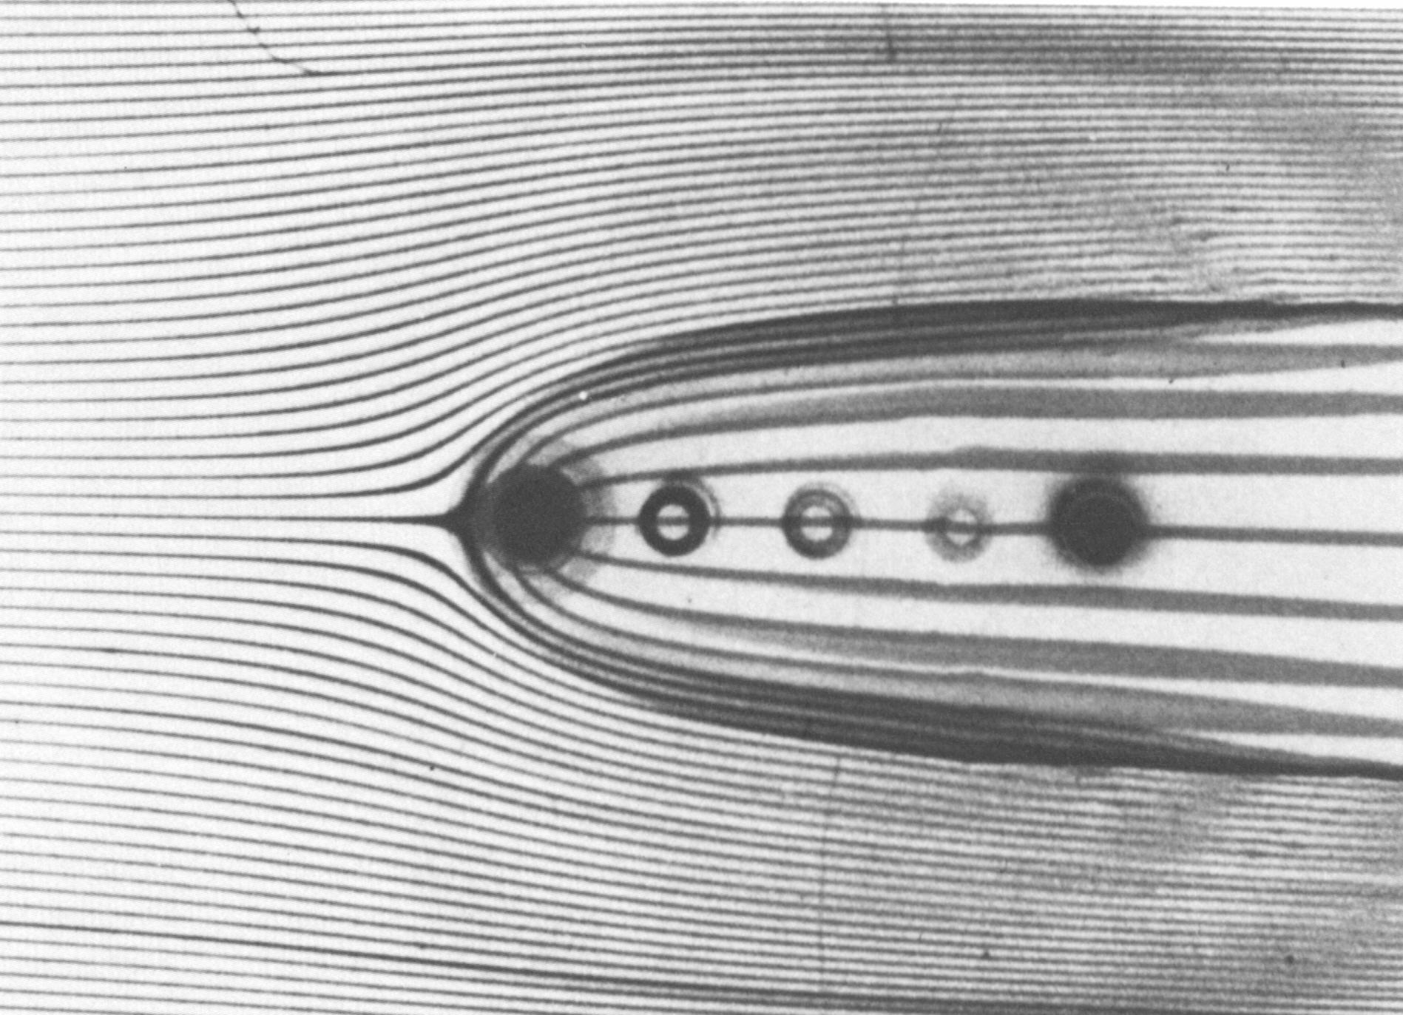
SUPERPOSITION OF POTENTIAL FLOWS: RANKINE HALF-BODY
Now, the stagnation streamline can be defined by evaluating ψ at r = b, and θ = π.
Now, we note that m/2 = πbU, so following this constant streamline gives the outline of the body:
Then,
describes the half-body outline.
So, the source and uniform flows can be used to describe an aerodynamic body.
The other streamlines can be obtained by setting y constant and plotting:
POTENTIAL FLOWS

Slide 19




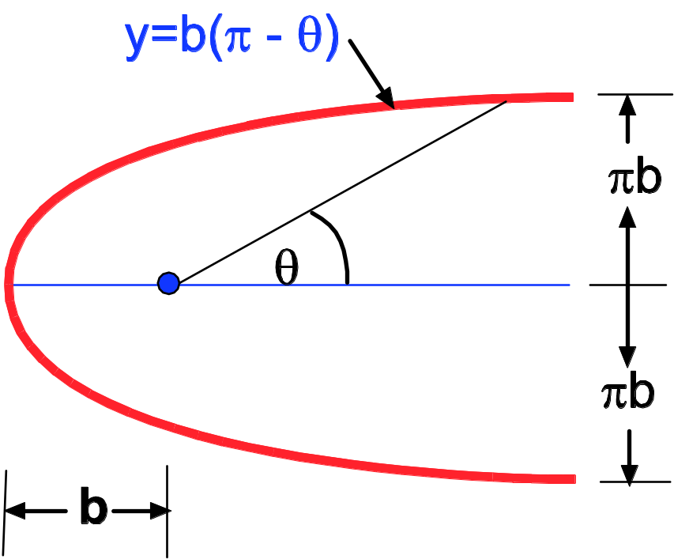






SUPERPOSITION OF POTENTIAL FLOWS: RANKINE HALF-BODY
The width of the half-body:
Total width then,
The magnitude of the velocity at any point in the flow:
and
Noting,
Knowing, the velocity we can now determine the pressure field using the Bernoulli Equation:
p_{o} and U are at a point far away from the body and are known.
POTENTIAL FLOWS

Slide 20
SUPERPOSITION OF POTENTIAL FLOWS: RANKINE HALF-BODY
Notes on this type of flow:
Provides useful information about the flow in the front part of streamlined body.
A practical example is a bridge pier or a strut placed in a uniform stream
In a potential flow the tangent velocity is not zero at a boundary, it “slips”
The flow slips due to a lack of viscosity (an approximation result).
At the boundary, the flow is not properly represented for a “real” flow.
Outside the boundary layer, the flow is a reasonable representation.
The pressure at the boundary is reasonably approximated with potential flow.
The boundary layer is to thin to cause much pressure variation.
POTENTIAL FLOWS

Slide 21
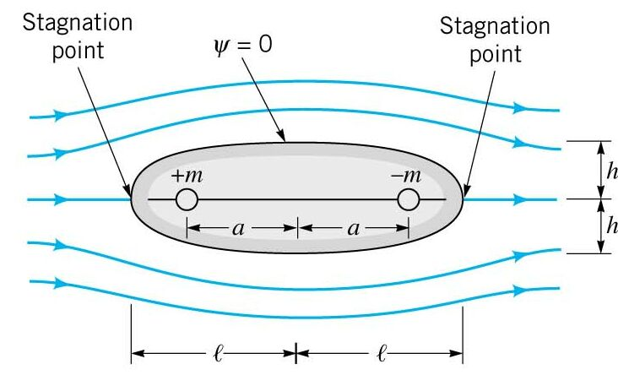
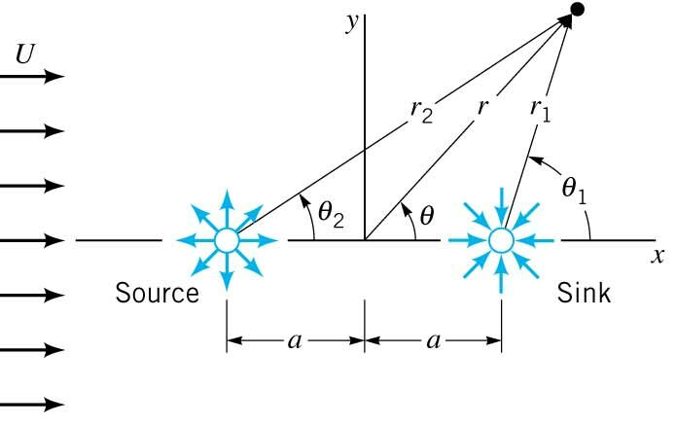





SUPERPOSITION OF POTENTIAL FLOWS: RANKINE OVAL
Rankine Ovals are the combination a source, a sink and a uniform flow, producing a closed body.
Some equations describing the flow:
The body half-length
Potential and Stream Function
The body half-width
“Iterative”
POTENTIAL FLOWS

Slide 22
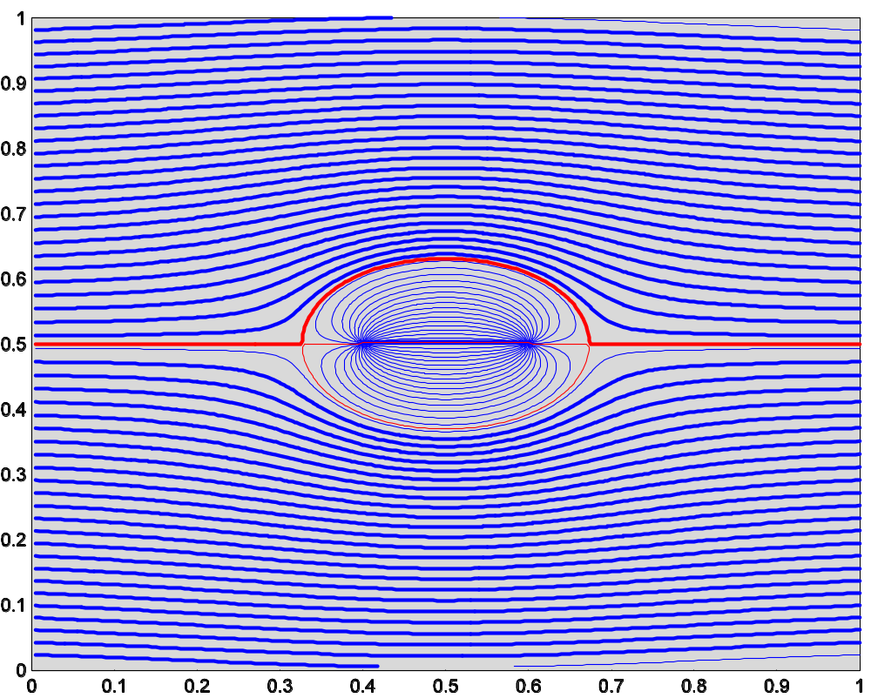
SUPERPOSITION OF POTENTIAL FLOWS: RANKINE OVAL
POTENTIAL FLOWS

Slide 23
SUPERPOSITION OF POTENTIAL FLOWS: RANKINE OVAL
Notes on this type of flow:
Provides useful information about the flow about a streamlined body.
At the boundary, the flow is not properly represented for a “real” flow.
Outside the boundary layer, the flow is a reasonable representation.
The pressure at the boundary is reasonably approximated with potential flow.
Only the pressure on the front of the body is accurate though.
Pressure outside the boundary is reasonably approximated.
POTENTIAL FLOWS

Slide 24
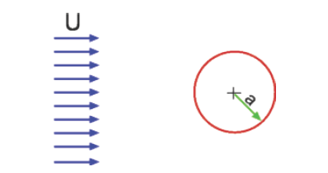
SUPERPOSITION OF POTENTIAL FLOWS:
FLOW AROUND A CIRCULAR CYLINDER
POTENTIAL FLOWS

Slide 25









SUPERPOSITION OF POTENTIAL FLOWS:
FLOW AROUND A CIRCULAR CYLINDER
Combines a uniform flow and a doublet flow:
and
Then require that the stream function is constant for r = a, where a is the radius of the circular cylinder:
K = Ua²
Then,
and
Then the velocity components are:
POTENTIAL FLOWS

Slide 26
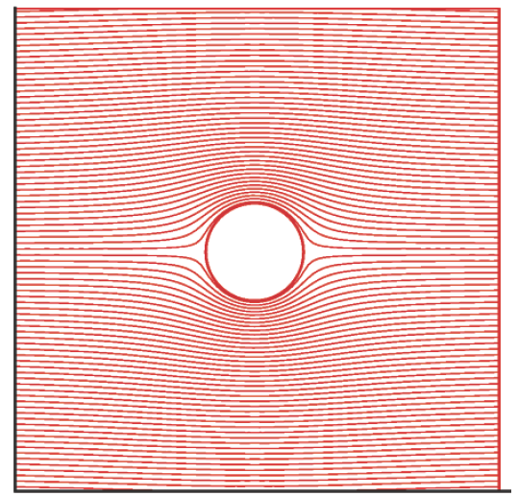
SUPERPOSITION OF POTENTIAL FLOWS:
FLOW AROUND A CIRCULAR CYLINDER
POTENTIAL FLOWS

Slide 27

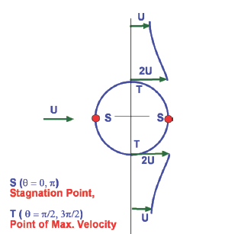
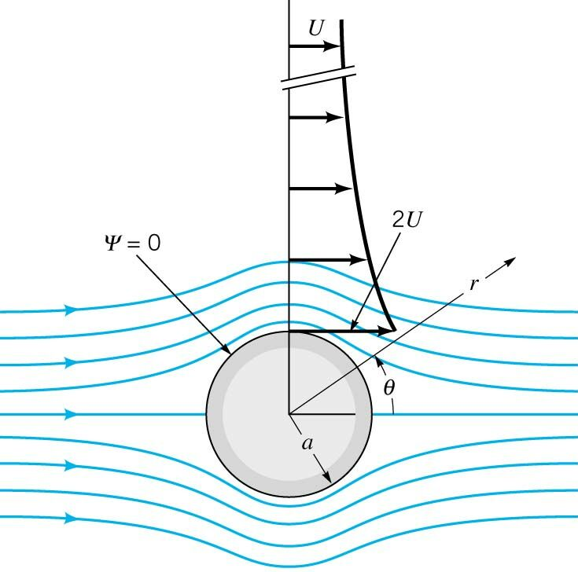
SUPERPOSITION OF POTENTIAL FLOWS:
FLOW AROUND A CIRCULAR CYLINDER
At the surface of the cylinder (r = a):
The maximum velocity occurs at the top and bottom of the cylinder, of magnitude 2U.
POTENTIAL FLOWS

Slide 28


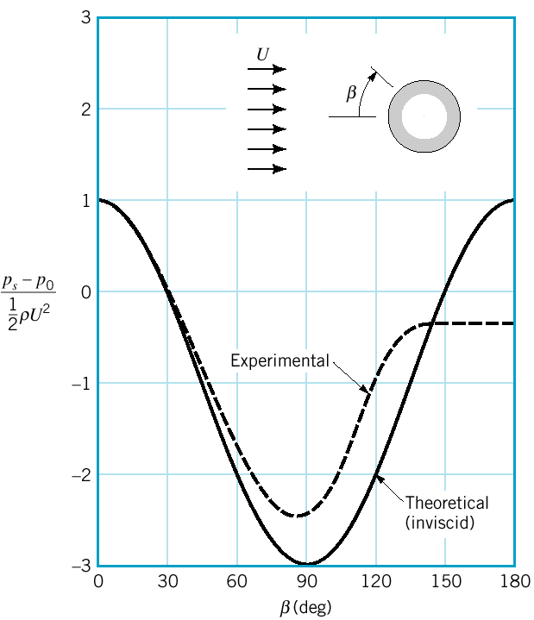

SUPERPOSITION OF POTENTIAL FLOWS:
FLOW AROUND A CIRCULAR CYLINDER
Pressure distribution on a circular cylinder found with the Bernoulli’s equation
Then substituting for the surface velocity:
Theoretical and experimental results agree well on the front of the cylinder.
Flow separation on the back-half in the real flow due to viscous effects causes differences between the theory and experiment.
POTENTIAL FLOWS

Slide 29
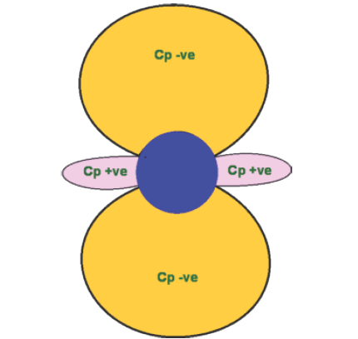
SUPERPOSITION OF POTENTIAL FLOWS:
FLOW AROUND A CIRCULAR CYLINDER
Cp distribution for flow past a circular cylinder plotted around the cylinder.
POTENTIAL FLOWS

Slide 30
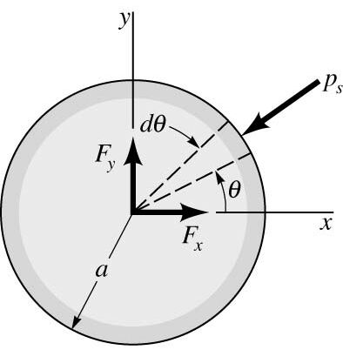

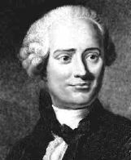


SUPERPOSITION OF POTENTIAL FLOWS:
FLOW AROUND A CIRCULAR CYLINDER
The resultant force per unit force acting on the cylinder can be determined by integrating the pressure over the surface (equate to lift and drag).
(Drag)
(Lift)
Substituting,
Jean le Rond d’Alembert (1717-1783)
Evaluating the integrals:
Both drag and lift are predicted to be zero on fixed cylinder in a uniform flow?
Mathematically, this makes sense since the pressure distribution is symmetric about cylinder, ahowever, in practice/experiment we see substantial drag on a circular cylinder (d’Alembert’s Paradox, 1717-1783).
Viscosity in real flows is the Culprit Again!
POTENTIAL FLOWS

Slide 31
SUPERPOSITION OF POTENTIAL FLOWS:
FLOW AROUND A LIFTING CYLINDER
Uniform Flow + Doublet + Vortex
Circular Cylinder
POTENTIAL FLOWS

Slide 32
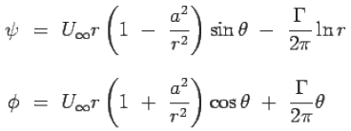
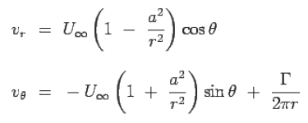
SUPERPOSITION OF POTENTIAL FLOWS:
FLOW AROUND A LIFTING CYLINDER
+
-
Consequently the velocity components will be,
-
POTENTIAL FLOWS

Slide 33
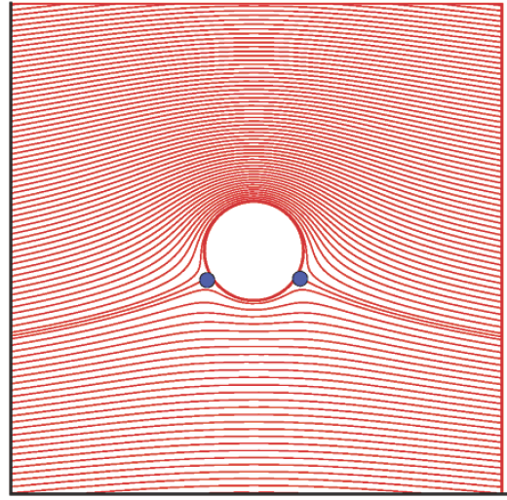
SUPERPOSITION OF POTENTIAL FLOWS:
FLOW AROUND A LIFTING CYLINDER
Flow past a Lifting Cylinder
POTENTIAL FLOWS

Slide 34


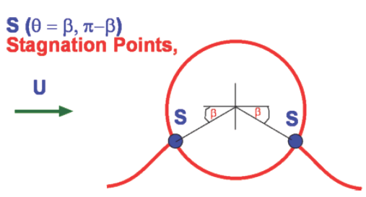
SUPERPOSITION OF POTENTIAL FLOWS:
FLOW AROUND A LIFTING CYLINDER
At r = a, the radial velocity is still zero allowing us to consider the same circular cylinder as the "body".
-
-
The stagnation points:
POTENTIAL FLOWS

Slide 35
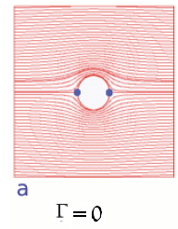
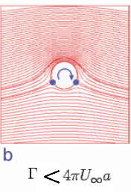
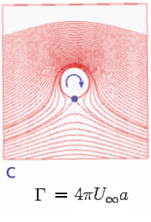
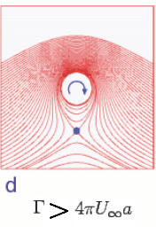
SUPERPOSITION OF POTENTIAL FLOWS:
FLOW AROUND A LIFTING CYLINDER
POTENTIAL FLOWS

Slide 36

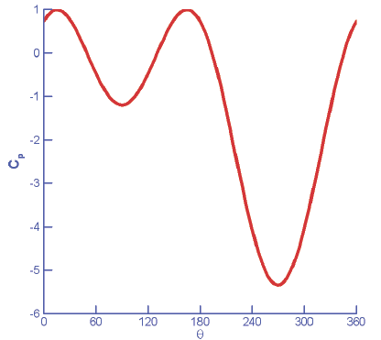



SUPERPOSITION OF POTENTIAL FLOWS:
FLOW AROUND A LIFTING CYLINDER
Surface Pressure Distribution and Lift
POTENTIAL FLOWS

Slide 37
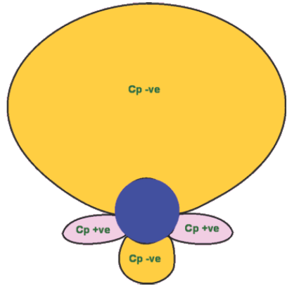
SUPERPOSITION OF POTENTIAL FLOWS:
FLOW AROUND A LIFTING CYLINDER
POTENTIAL FLOWS

Slide 38




SUPERPOSITION OF POTENTIAL FLOWS:
FLOW AROUND A LIFTING CYLINDER
a
dθ
dθ
POTENTIAL FLOWS

Slide 39
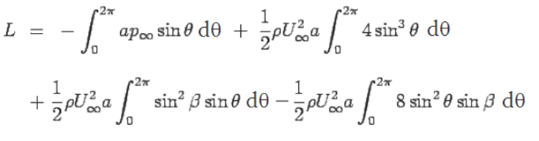


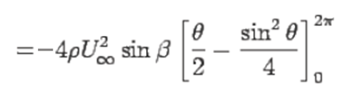

SUPERPOSITION OF POTENTIAL FLOWS:
FLOW AROUND A LIFTING CYLINDER
-
POTENTIAL FLOWS

Slide 40
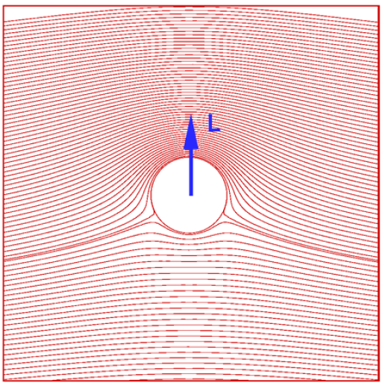
SUPERPOSITION OF POTENTIAL FLOWS:
FLOW AROUND A LIFTING CYLINDER
POTENTIAL FLOWS

Slide 41
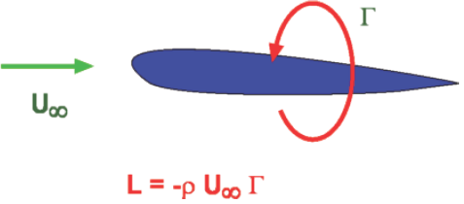
KUTTA-JOUKOWSKY THEOREM
POTENTIAL FLOWS

Slide 42
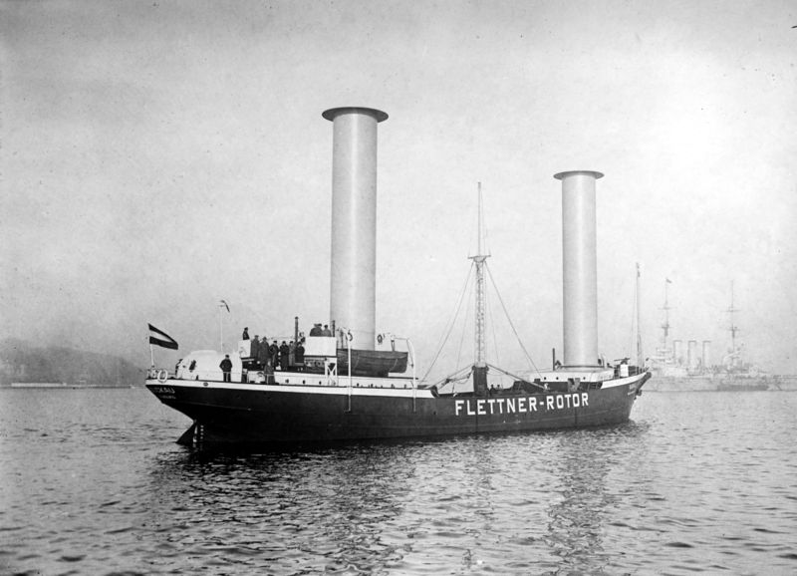
MAGNUS EFFECTS
Flettner’s Ship
POTENTIAL FLOWS

Slide 43
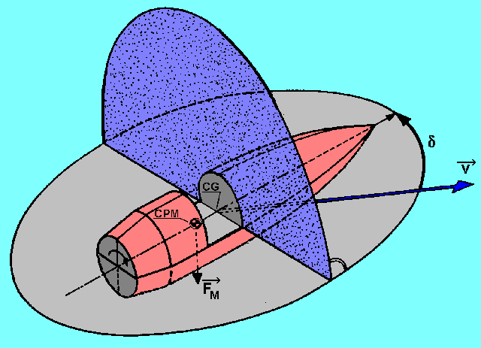
MAGNUS EFFECTS
POTENTIAL FLOWS

Slide 44

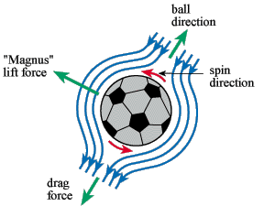
MAGNUS EFFECTS
Bend it like Beckham
Dynamic lift
POTENTIAL FLOWS

Slide 45
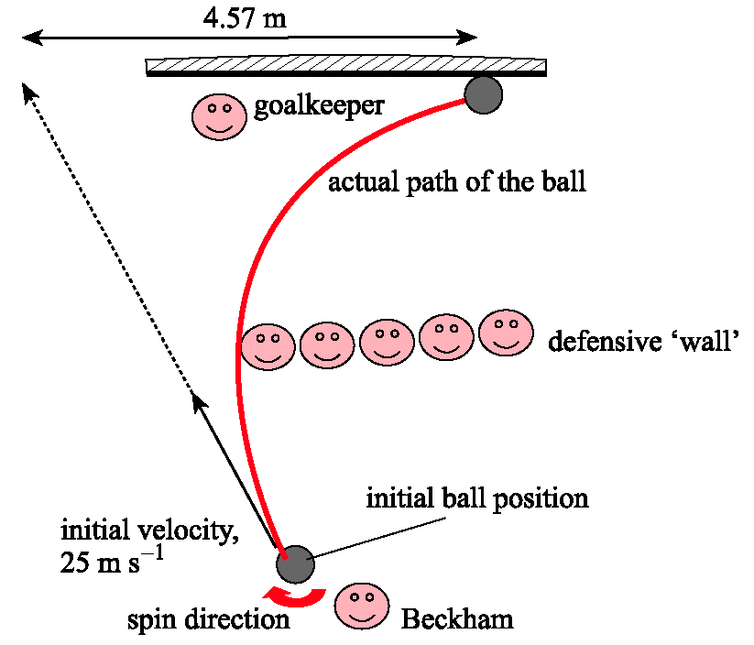
MAGNUS EFFECTS
Beckham, Applied Physicist
~ 5m
Distance 25 m
Initial v = 25 m/s
Flight time 1s
Spin at 10 rev/s
Lift force ~ 4 N
Ball mass ~ 400 g
a = 10 m/s²
A swing of 5 m!
Goal!!
45
POTENTIAL FLOWS

Slide 46
MAGNUS EFFECTS - EXAMPLE
Flettner’s Ship with the following conditions
Propulsive Trust?
30 km/h
750 RPM
x
15 m.
4 km/h
y
2.75m
30 km/h
V_{rel}
F
F
V_{rel}
4 km/h
POTENTIAL FLOWS

Slide 47
MAGNUS EFFECTS - EXAMPLE
POTENTIAL FLOWS

