Slide 1
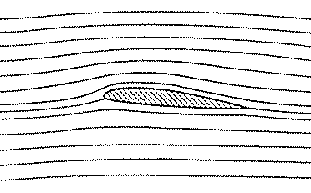
NONLIFTING FLOWS OVER ARBITRARY BODIES:
  THE NUMERICAL SOURCE PANEL METHOD
We added our elementary flows in certain ways and discovered that the dividing streamlines turned out to fit the shapes of special bodies (semi-infinite body, Rankine oval and both the nonlifting and the lifting flows over a circular cylinder)
This indirect method of starting with a given combination of elementary flows and seeing what body shape comes out of it can hardly be used in a practical sense for bodies of arbitrary shape.
Do we know in advance the correct combination of elementary flows to synthesize the flow over an airfoil?
The answer is NO.
PANEL METHODS

Slide 2
NONLIFTING FLOWS OVER ARBITRARY BODIES:
  THE NUMERICAL SOURCE PANEL METHOD
In order to determine the flow over a specified body, we want a direct method.
In direct methods, we specify the shape of an arbitrary body and solve for the distribution of singularities which, in combination with a uniform stream, produce the flow over the given body.
We consider a numerical method appropriate for solution on a computer. The technique is called the Source Panel Method and is limited to nonlifting flows over arbitrary bodies.
PANEL METHODS

Slide 3
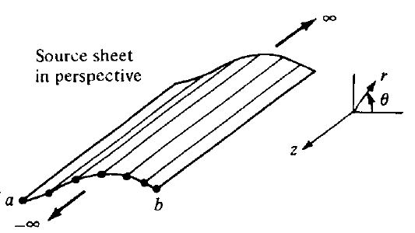
NONLIFTING FLOWS OVER ARBITRARY BODIES:
  THE NUMERICAL SOURCE PANEL METHOD
Let us extend the concept of a source or sink.
Imagine that we have an infinite number of line sources side by side, where the strength of each line source is infinitesimally small.
These side-by-side line sources form a source sheet.
Looking along the “z axis”
PANEL METHODS

Slide 4
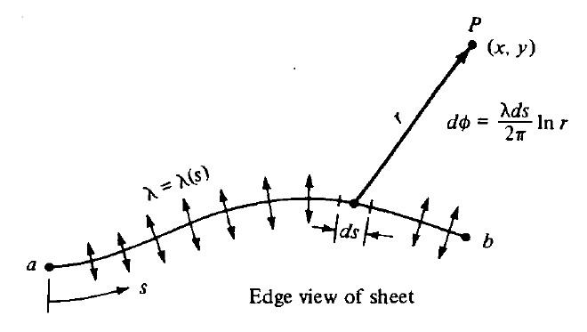


NONLIFTING FLOWS OVER ARBITRARY BODIES:
  THE NUMERICAL SOURCE PANEL METHOD
Define λ = λ(s) to be the source strength per unit length along s. Therefore, the strength of an infinitesimal portion ds of the sheet is λds.
The small section of the source sheet of strength λds, induces an infinitesimally small potential dϕ at point P:
Velocity potential
at point P, induced
by the entire source sheet
PANEL METHODS

Slide 5
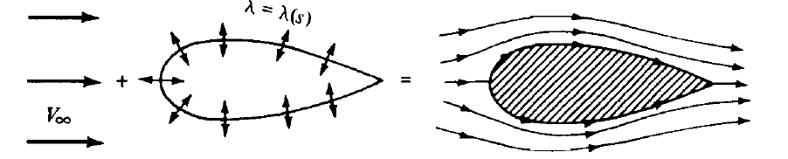
NONLIFTING FLOWS OVER ARBITRARY BODIES:
  THE NUMERICAL SOURCE PANEL METHOD
Uniform flow +
Source sheet on surface
Flow over the body
= Flow over the body
Our problem is one of finding the appropriate λ(s).
The solution of this problem is carried out numerically.
PANEL METHODS

Slide 6
NONLIFTING FLOWS OVER ARBITRARY BODIES:
  THE NUMERICAL SOURCE PANEL METHOD
Let us approximate the source sheet by a series of straight panels.
P
r
θ
S
j
2
1
i
n
Control Points
Boundary points
PANEL METHODS

Slide 7




NONLIFTING FLOWS OVER ARBITRARY BODIES:
  THE NUMERICAL SOURCE PANEL METHOD
(x,y)
P
r_{pj}
θ
The velocity potential induced at P due to the jth panel is:
λ_{j}
ds_{j}
j
Where:
i
The velocity potential induced at P due to all the panels:
λ_{i}
PANEL METHODS

Slide 8
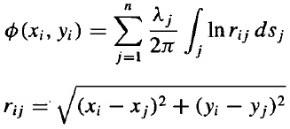
NONLIFTING FLOWS OVER ARBITRARY BODIES:
  THE NUMERICAL SOURCE PANEL METHOD
ds_{j}
j
r_{ij}
i
PANEL METHODS

Slide 9







NONLIFTING FLOWS OVER ARBITRARY BODIES:
  THE NUMERICAL SOURCE PANEL METHOD
The boundary condition at solid walls states that:
Where:
j
j
S
i
i
β_{i}
n_{i}
PANEL METHODS

Slide 10







NONLIFTING FLOWS OVER ARBITRARY BODIES:
  THE NUMERICAL SOURCE PANEL METHOD
The integral I_{i,j} is evaluated at the jth control point and the integral is taken over the complete jth panel:
PANEL METHODS

Slide 11


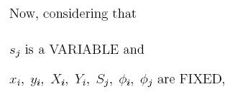
NONLIFTING FLOWS OVER ARBITRARY BODIES:
  THE NUMERICAL SOURCE PANEL METHOD
ф_{j}
(x_{j},y_{j})
ds_{j}
j
(X_{j},Y_{j})
(X_{j+1},Y_{j+1})
r_{ij}
ф_{i}
i
(X_{i},Y_{i})
(x_{i},y_{i})
β_{i}
(X_{i+1},Y_{i+1})
n_{i}
PANEL METHODS

Slide 12
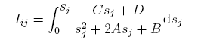
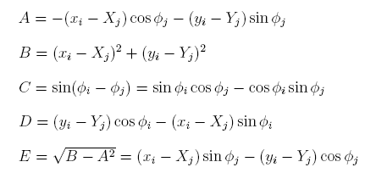
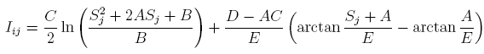
NONLIFTING FLOWS OVER ARBITRARY BODIES:
  THE NUMERICAL SOURCE PANEL METHOD
So that I_{i,j} becomes:
Where
We obtain an expression for I_{i,j} from any table of integrals:
PANEL METHODS

Slide 13

NONLIFTING FLOWS OVER ARBITRARY BODIES:
  THE NUMERICAL SOURCE PANEL METHOD
With known values of I_{i,j}‘s, this is a linear algebraic equation with n unknowns λ₁, λ₂, …, λ_{n} .
This equation represents the flow boundary condition evaluated at the control point of the ith panel.
If we apply this equation to the control point of all the panels, the results will be a system of n linear algebraic equations with n unknowns (λ₁, λ₂, …, λ_{n})
The values of λ_{j}’s should obey the relation:
PANEL METHODS

Slide 14


NONLIFTING FLOWS OVER ARBITRARY BODIES:
  THE NUMERICAL SOURCE PANEL METHOD
The total surface velocity at the ith control point is the sum of the contribution from the freestream and from the source panels:
PANEL METHODS

Slide 15
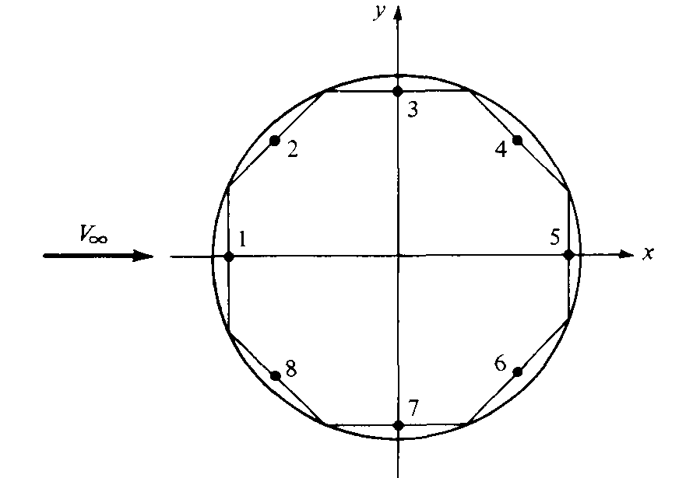
NONLIFTING FLOWS OVER ARBITRARY BODIES:
  THE NUMERICAL SOURCE PANEL METHOD
EXAMPLE: Calculate the pressure coefficient distribution around a circular cylinder using the source panel technique.
PANEL METHODS

Slide 16
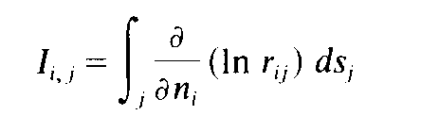
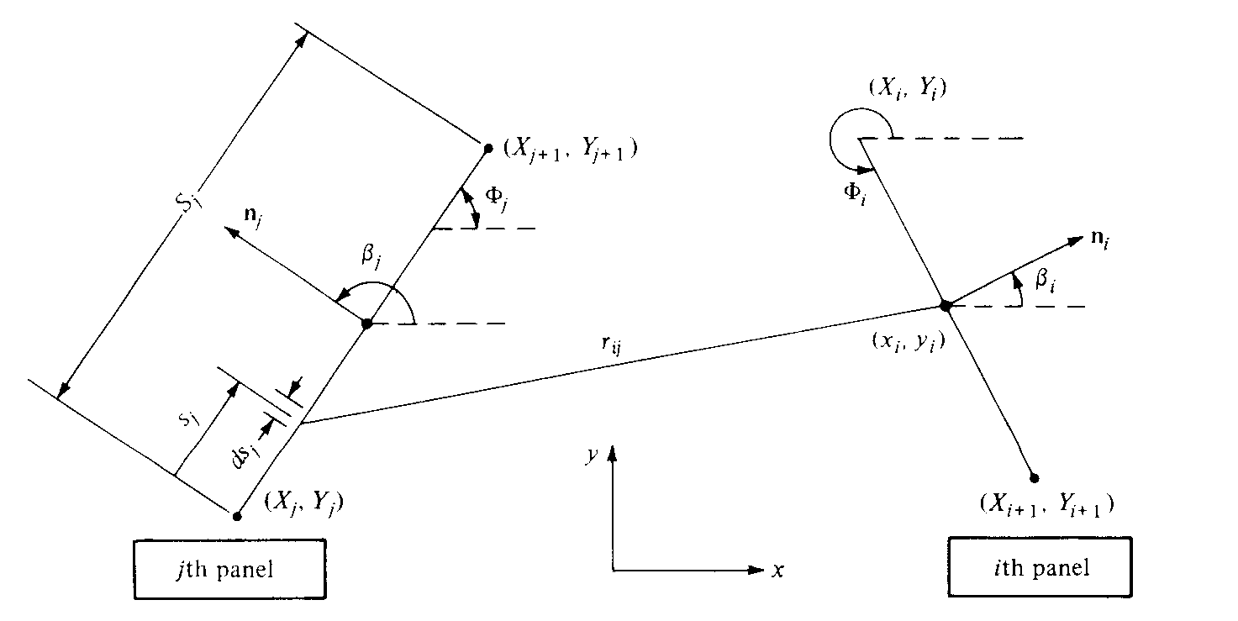
NONLIFTING FLOWS OVER ARBITRARY BODIES:
  THE NUMERICAL SOURCE PANEL METHOD
PANEL METHODS

Slide 17
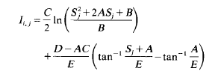
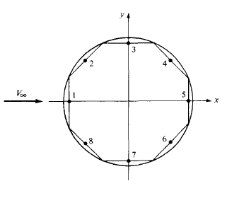



NONLIFTING FLOWS OVER ARBITRARY BODIES:
  THE NUMERICAL SOURCE PANEL METHOD
PANEL METHODS

Slide 18



NONLIFTING FLOWS OVER ARBITRARY BODIES:
  THE NUMERICAL SOURCE PANEL METHOD
PANEL METHODS

Slide 19



NONLIFTING FLOWS OVER ARBITRARY BODIES:
  THE NUMERICAL SOURCE PANEL METHOD
PANEL METHODS

Slide 20
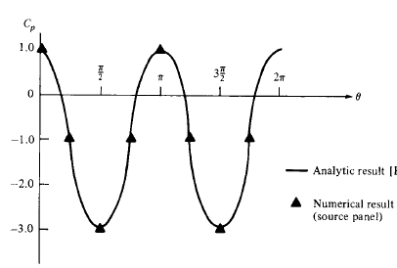
NONLIFTING FLOWS OVER ARBITRARY BODIES:
  THE NUMERICAL SOURCE PANEL METHOD
PANEL METHODS

