Slide 1
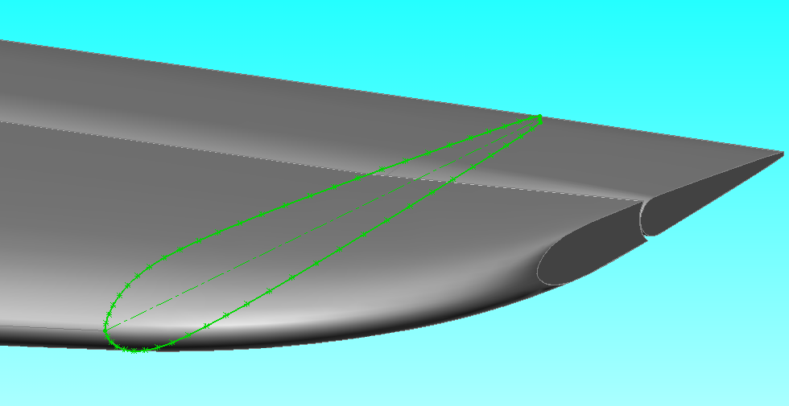
INCOMPRESSIBLE FLOW OVER AIRFOILS
Incompressible Flow over Airfoils

Slide 2
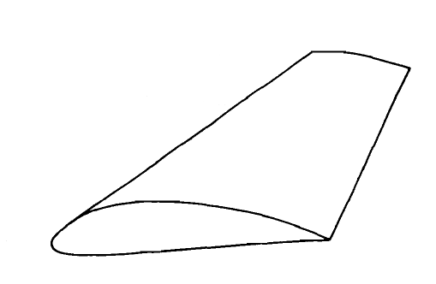
WHAT IS AN AIRFOIL?
Consider a wing as shown in the figure.
  The wing extends in the y direction
  The freestream velocity is parallel to xz plane
Any section of the wing cut by a plane parallel to the xz plane is called an airfoil.
z
y
x
V∞
Airfoil Section
Incompressible Flow over Airfoils

Slide 3
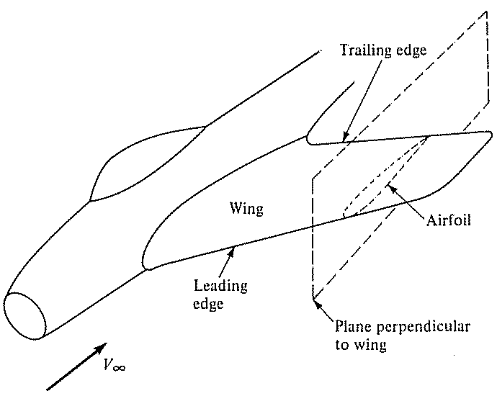
WHAT IS AN AIRFOIL?
Incompressible Flow over Airfoils

Slide 4
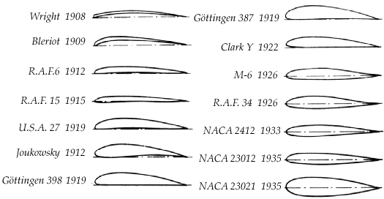
EVOLUTION OF AIRFOILS
Incompressible Flow over Airfoils

Slide 5

EVOLUTION OF AIRFOILS
Early Designs - Designers mistakenly believed that these airfoils with sharp leading edges will have low drag. In practice, they stalled quickly, and generated considerable drag.
Incompressible Flow over Airfoils

Slide 6
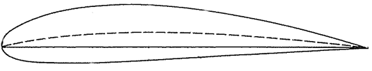
AIRFOIL NOMENCLATURE
Thickness
Camber
Mean camber line
Leading edge
Trailing edge
Chord c
Incompressible Flow over Airfoils

Slide 7
AIRFOIL GEOMETRY
Airfoil geometry is often characterized by a few parameters such as:
  Maximum thickness
  Maximum camber
  Position of max thickness
  Position of max camber
  Nose radius.
One can generate a reasonable airfoil section given these parameters.
Incompressible Flow over Airfoils

Slide 8
NACA AIRFOILS
The NACA identified different airfoil shapes with a logical numbering system.
The primary reference volume for all the NACA subsonic airfoil studies remains:
Abbott, I.H., and Von Doenhoff, A.E., “Theory of Wing Sections”, Dover, 1959.
Incompressible Flow over Airfoils

Slide 9
THE NACA FOUR-DIGIT AIRFOIL
The first family of NACA airfoils, developed in the 1930s, was the “four-digit” series.
The numbering system for these airfoils is defined by:
NACA MPXX
Where:
M is the maximum camber in hundredths of chord.
P is the location of the maximum camber in tenths of the chord.
XX is the maximum thickness, t/c, in percent chord.
Incompressible Flow over Airfoils

Slide 10
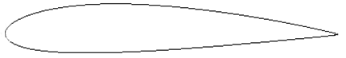
THE NACA FOUR-DIGIT AIRFOIL - EXAMPLE
NACA 2415
The maximum camber is 0.02c
Maximum camber is located at 0.4c from the leading edge.
The maximum thickness is 0.15c
Incompressible Flow over Airfoils

Slide 11
THE NACA FIVE-DIGIT AIRFOIL
This airfoil is an extension of the 4 digit series. The
numbering system for these airfoils is defined by:
NACA LMMXX
Where:
L: is the amount of camber; the design lift coefficient is 3L/2, in tenths
MM: the location of maximum camber along the chord from the leading edge is MM/2, in hundredths of the chord
XX: is the maximum thickness, t/c, in percent chord.
Incompressible Flow over Airfoils

Slide 12

THE NACA FIVE-DIGIT AIRFOIL - EXAMPLE
NACA 23012
12% thick airfoil,
The design lift coefficient is 0.3,
The position of max camber is located at x/c = 0.15,
The “standard” 5 digit foil camber line is used.
Incompressible Flow over Airfoils

Slide 13
THE NACA 6-SERIES LAMINAR FLOW AIRFOIL
One of the most widely used family of NACA airfoils is the “6-series” laminar flow airfoils, developed during World War II.
AB,C-DEE
Where:
A: Is the series designation.
B: Location of minimum pressure in tenth of chord from the leading edge (for the basic symmetric thickness distribution at zero lift)
C: The range of lift coefficient in tenth above and below the design lift coefficient in which favourable pressure gradients exist on both surfaces
D: The design lift coefficient in tenth
EE: the maximum thickness in hundredths of chord
After the six-series sections, airfoil design became much more specialized for the particular application.
Incompressible Flow over Airfoils

Slide 14

THE NACA 6-SERIES LAMINAR FLOW AIRFOIL - EXAMPLE
NACA 65,3-218
6 is the series designation.
The maximum pressure occurs at 0.5c for the basic symmetric thickness distribution at zero lift.
The range of lift coefficient above and below the design lift coefficient in which favourable pressure gradients exist on both surfaces is 0.3
The design lift coefficient is 0.2.
The airfoil is 18 percent thick.
Incompressible Flow over Airfoils

Slide 15
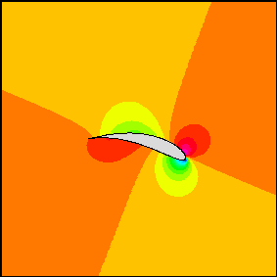
LIFT GENERATION
Generation of lift by
an airfoil is due to the
imbalance of pressure
distribution over top
and bottom surfaces.
Incompressible Flow over Airfoils

Slide 16
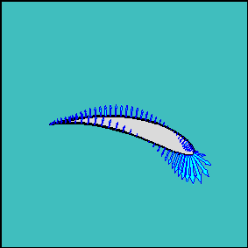
LIFT GENERATION
If pressure on top is
lower than pressure on
bottom surface, lift is
generated.
Incompressible Flow over Airfoils

Slide 17
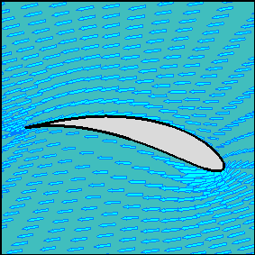
LIFT GENERATION
Flow velocity over the
top of airfoil is faster
than over bottom
surface.
Incompressible Flow over Airfoils

Slide 18
VARIATION OF LIFT WITH ANGLE OF ATTACK
The lift coefficient of an airfoil changes as the Angle-of-Attack changes.
Incompressible Flow over Airfoils

Slide 19
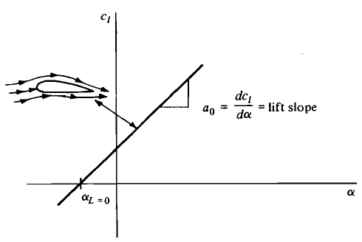
VARIATION OF LIFT WITH ANGLE OF ATTACK
LOW-TO-MODERATE ANGLES OF ATTACK
At low-to-moderate angles
of attack, c_{l} varies linearly
with α.
The slope of this straight line
is called the lift slope.
In this region, the flow moves smoothly over the airfoil and is attached over most of the surface.
Incompressible Flow over Airfoils

Slide 20
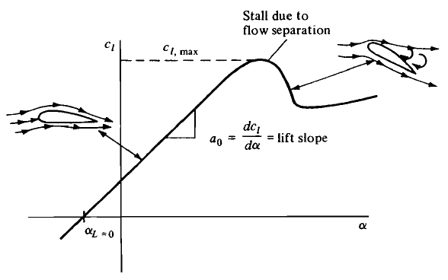
VARIATION OF LIFT WITH ANGLE OF ATTACK
HIGHT ANGLES OF ATTACK
As α becomes large, the flow
tends to separate from the
top surface of the airfoil.
The consequance of this
separated flow at high α is a precipitous decrease in lift and a large increase in drag.
Under such conditions, the airfoil is said to be stalled.
The maximum value of c_{l}, which occurs just prior to the stall, is denoted by c_{l,max}.
Incompressible Flow over Airfoils

Slide 21
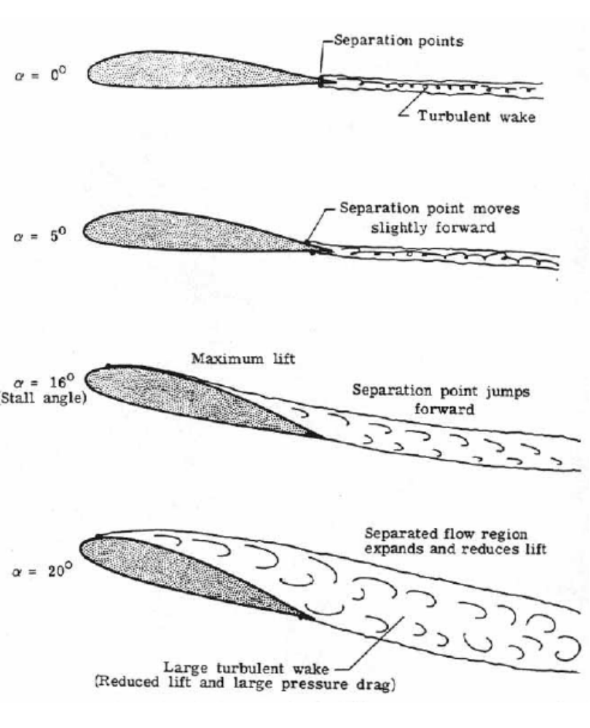
VARIATION OF LIFT WITH ANGLE OF ATTACK
Incompressible Flow over Airfoils

Slide 22
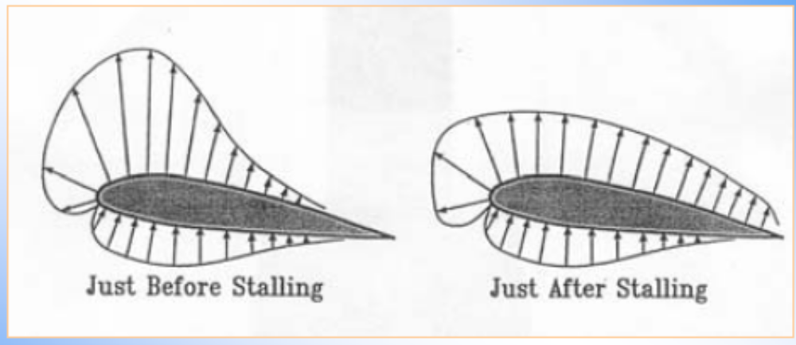
VARIATION OF LIFT WITH ANGLE OF ATTACK
Incompressible Flow over Airfoils

Slide 23
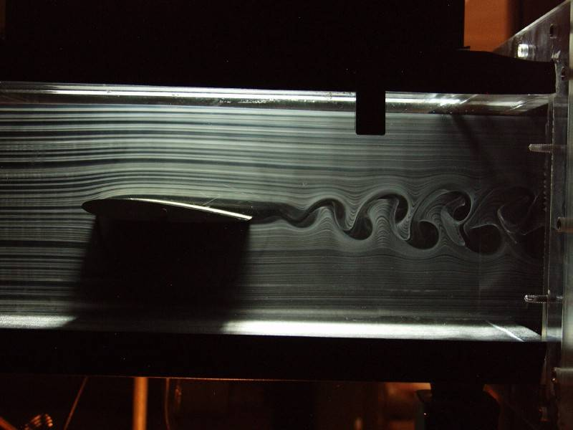
VARIATION OF LIFT WITH ANGLE OF ATTACK
(α=2 deg)
Incompressible Flow over Airfoils

Slide 24
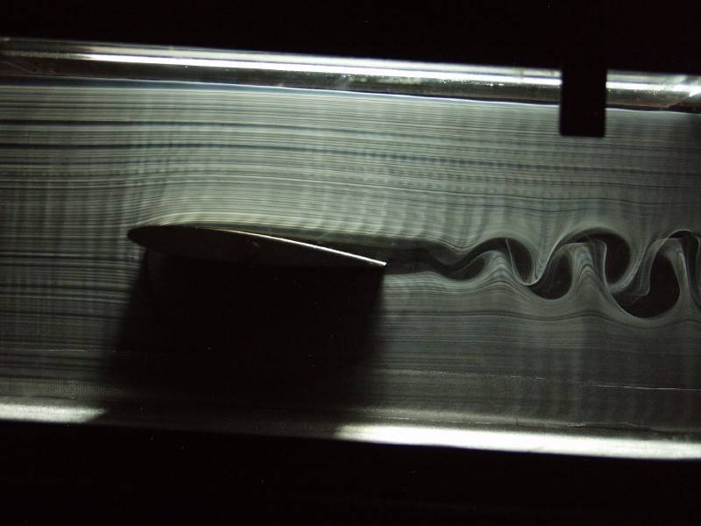
VARIATION OF LIFT WITH ANGLE OF ATTACK
(α=3 deg)
Incompressible Flow over Airfoils

Slide 25
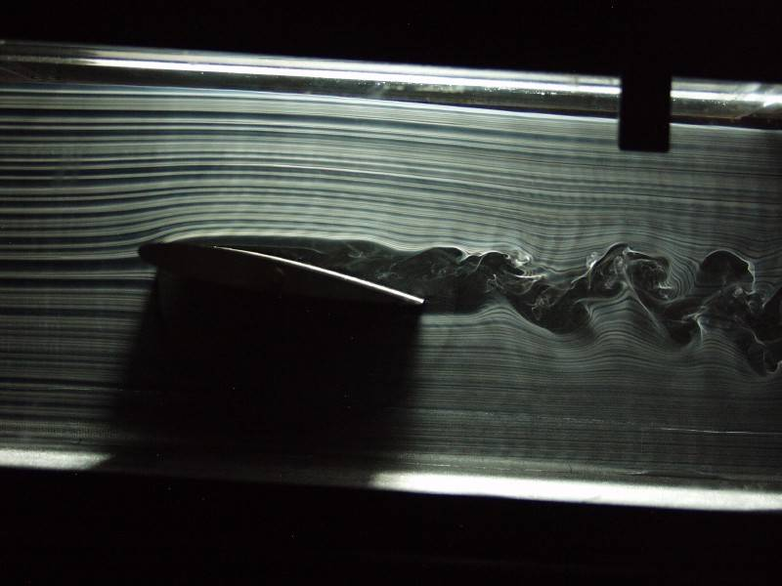
VARIATION OF LIFT WITH ANGLE OF ATTACK
(α=6 deg)
Incompressible Flow over Airfoils

Slide 26
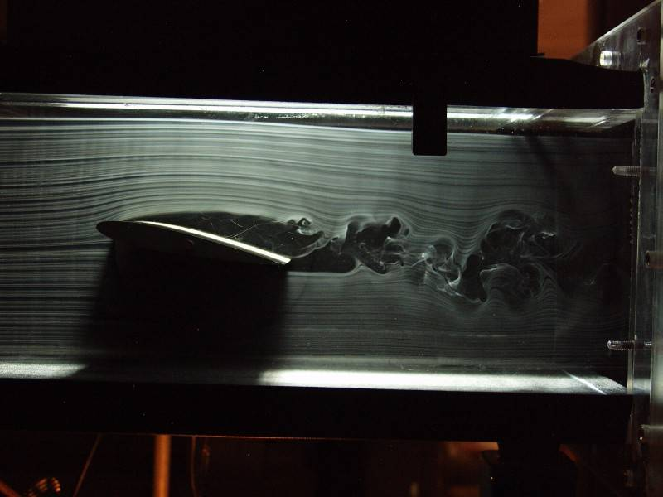
VARIATION OF LIFT WITH ANGLE OF ATTACK
(α=9 deg)
Incompressible Flow over Airfoils

Slide 27

VARIATION OF LIFT WITH ANGLE OF ATTACK
(α=12 deg)
Incompressible Flow over Airfoils

Slide 28
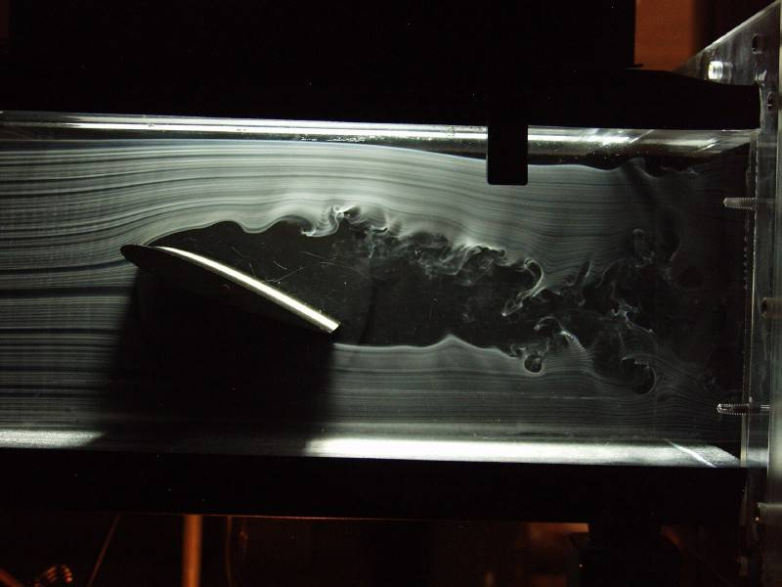
VARIATION OF LIFT WITH ANGLE OF ATTACK
(α=20 deg)
Incompressible Flow over Airfoils

Slide 29
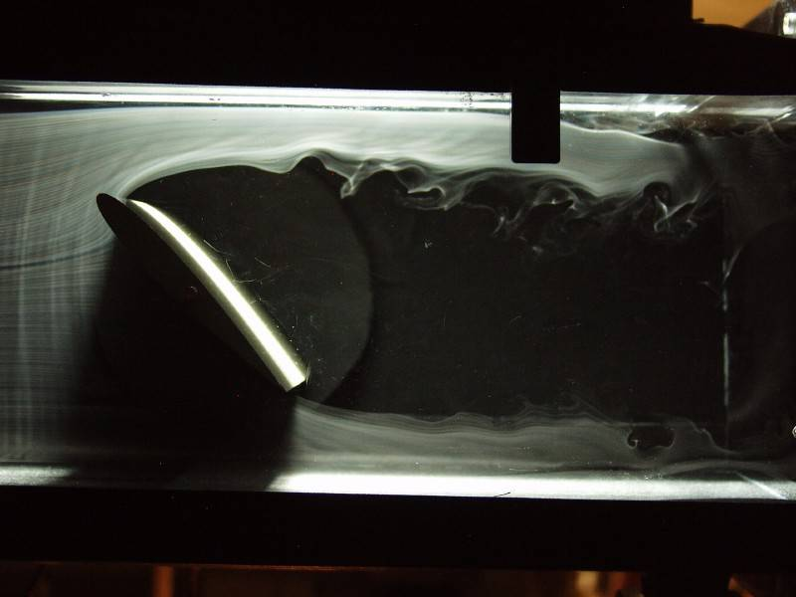
VARIATION OF LIFT WITH ANGLE OF ATTACK
(α=60 deg)
Incompressible Flow over Airfoils

Slide 30
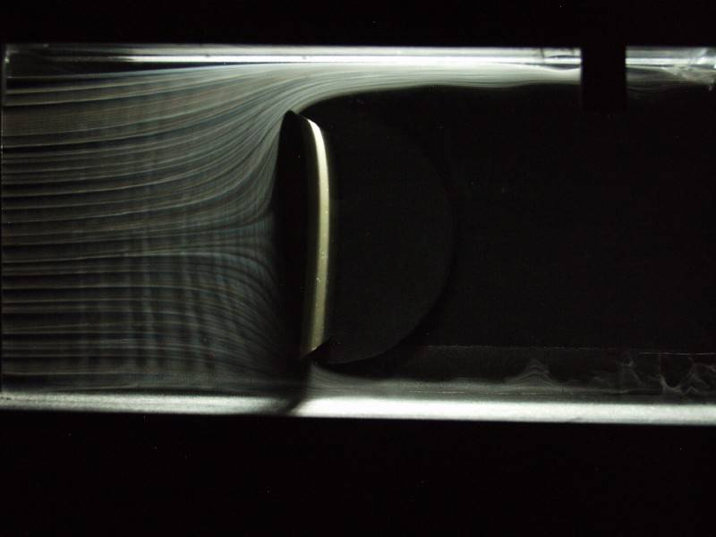
VARIATION OF LIFT WITH ANGLE OF ATTACK
(α=90 deg)
Incompressible Flow over Airfoils

Slide 31
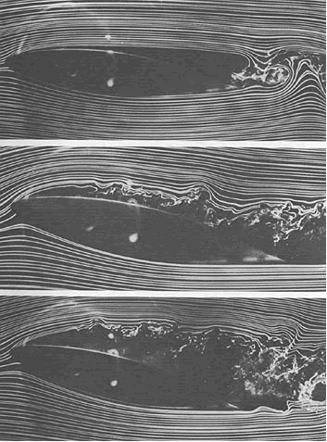
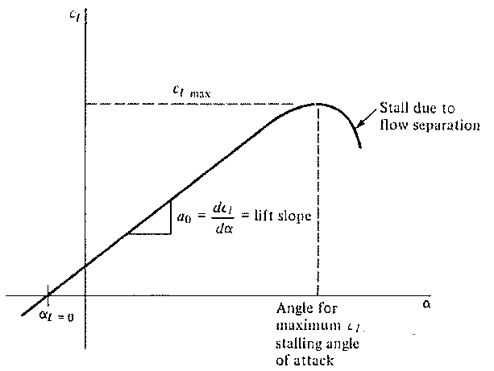
VARIATION OF LIFT WITH ANGLE OF ATTACK
(α=90 deg)
Low α
Incompressible Flow over Airfoils

Slide 32
VARIATION OF LIFT WITH ANGLE OF ATTACK
(α=90 deg)
Moderate α
Incompressible Flow over Airfoils

Slide 33
VARIATION OF LIFT WITH ANGLE OF ATTACK
(α=90 deg)
High α
Incompressible Flow over Airfoils

Slide 34

VARIATION OF LIFT WITH ANGLE OF ATTACK
c_{l,max} determines the stalling speed
of an airplane. The higher is c_{l,max}
the lower is the stalling speed.
The value of α when lift equals
zero is called the “zero-lift angle
of attack” (α_{L=0}).
At negative α airfoil will have zero lift
Incompressible Flow over Airfoils

Slide 35
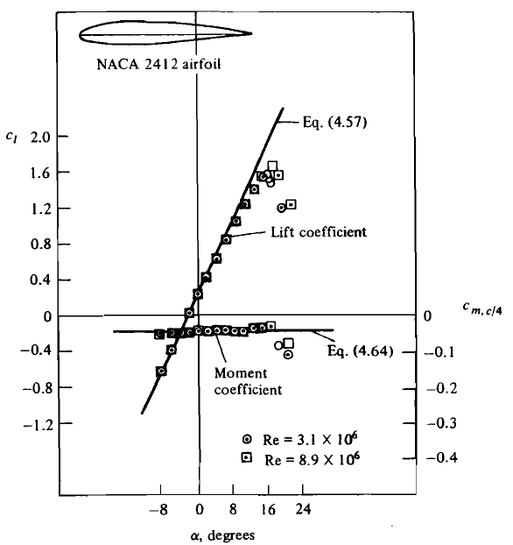
EFFECT OF REYNOLD NUMBER
The lift slope is not
influenced by Re.
c_{l,max} is dependent upon
Re.
The moment coefficient
is insensitive to Re except
At large α.
Incompressible Flow over Airfoils

Slide 36
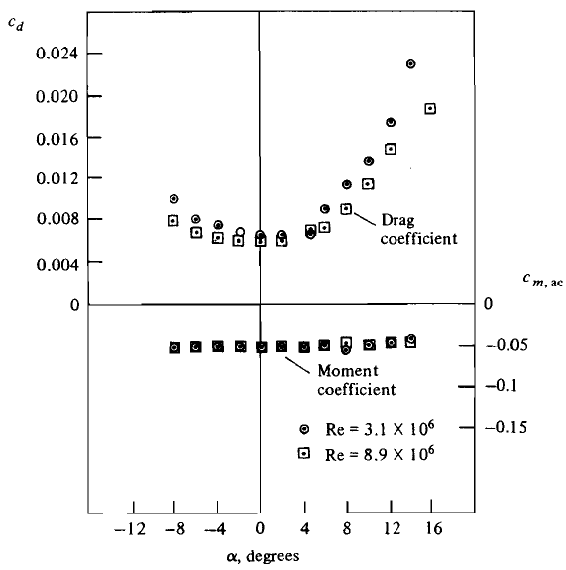
EFFECT OF REYNOLD NUMBER
The sum of skin
friction drag and
pressure drag yields the
profile drag.
Profile drag coefficient
is sensitive to Re.
Incompressible Flow over Airfoils

Slide 37



EXAMPLE
Incompressible Flow over Airfoils

Slide 38
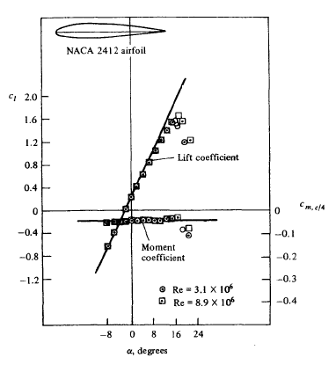

EXAMPLE (CONT.)
Incompressible Flow over Airfoils

Slide 39
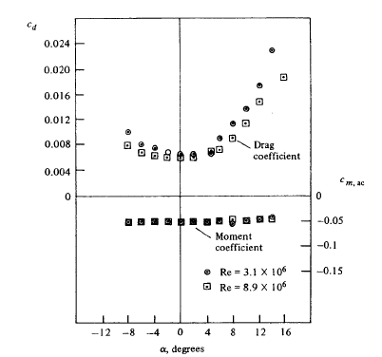




EXAMPLE (CONT.)
To obtain the drag per unit span, we must use the data diagram.
Since c_{d} = f(Re), let us calculate Re. At standard sea level, μ = 1.789 x 1 0⁻⁵ kg/(m.s). Hence,
Incompressible Flow over Airfoils

