Slide 1
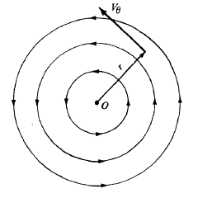
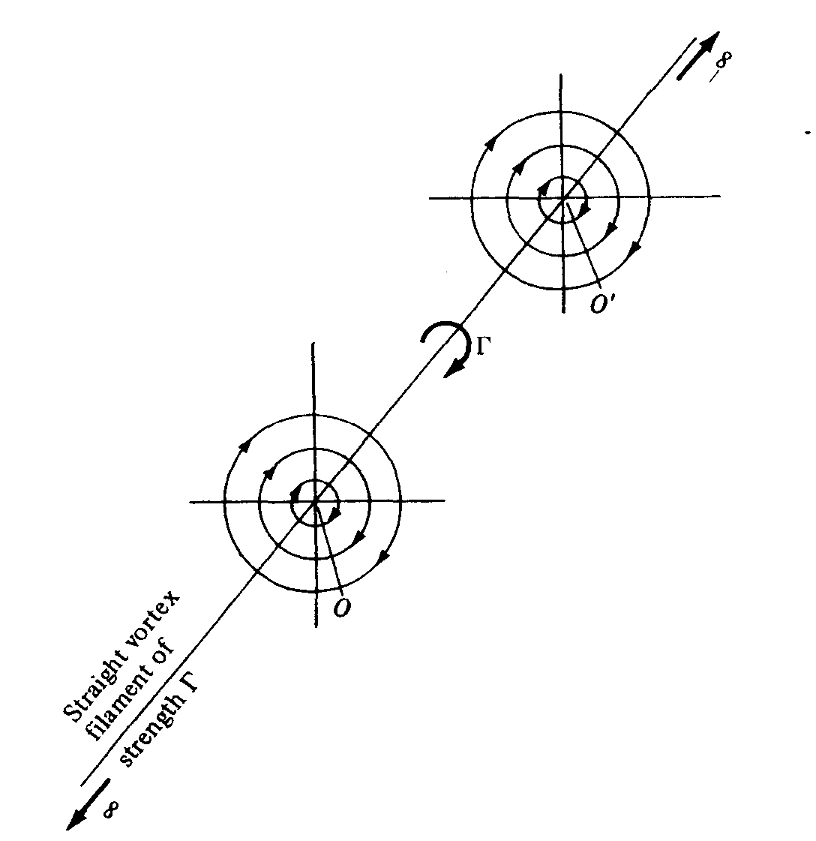
THE VORTEX FILAMENT
Let us expand the concept a point vortex.
Imagine a straight line perpendicular to the
page, going through point O, and extending to
infinity both out and into the page. This line
is a straight “vortex filament of strength Γ”.
The flows in the planes perpendicular to the
vortex filament at O and O’ are identical
to each other and are identical to the
flow induced by a point vortex of
strength Γ.
Incompressible Flow over Airfoils

Slide 2
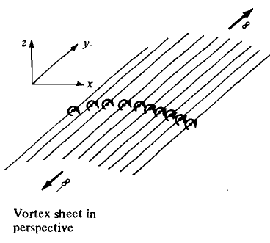
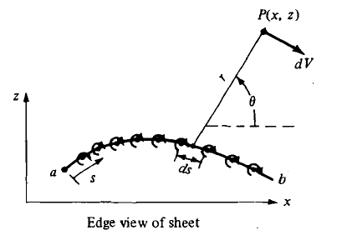
THE VORTEX SHEET
Imagine an infinite number of straight vortex filaments side by side, where the strength of each filament is infinitesimally small.
These side by side vortex filaments form a vortex sheet.
Incompressible Flow over Airfoils

Slide 3

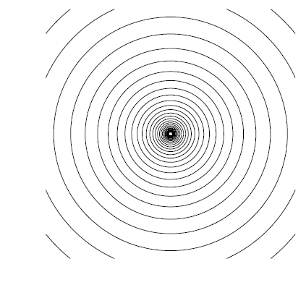

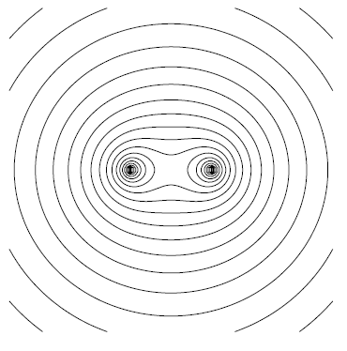
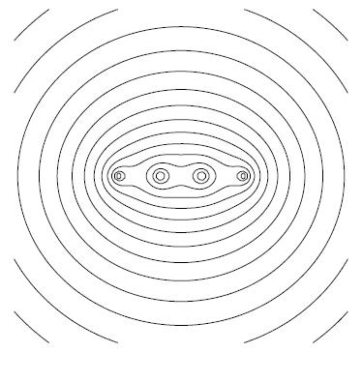

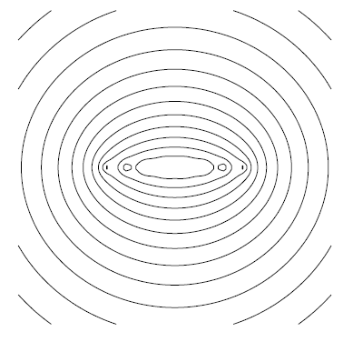
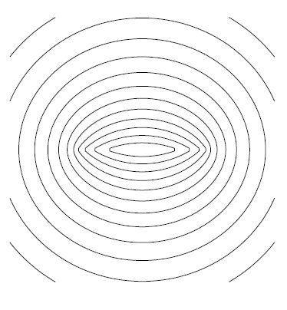
THE VORTEX SHEET
Incompressible Flow over Airfoils

Slide 4
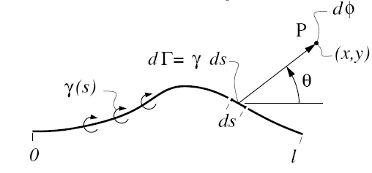

PROPERTIES OF VORTEX SHEETS
The analysis of the vortex sheet closely follows that of the source sheets.
Incompressible Flow over Airfoils

Slide 5


PROPERTIES OF VORTEX SHEETS
For a straight vortex sheet extending from (-l/2,0) to (l/2,0), with a constant strength γ, the potential and the velocity components at point P are given by:
P(x,y)
θ
ds
s
Incompressible Flow over Airfoils

Slide 6


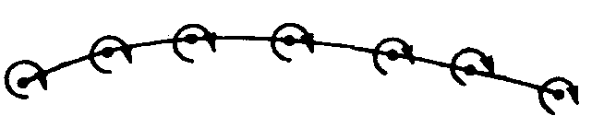

THE VORTEX SHEET
Consider a rectangular path enclosing a section of a vortex sheet of length ds. The circulation around the path is:
The strenght of the vortex
sheet contained inside the
path is:
u1
v1
v2
dn
u2
ds
Let dn 0
Incompressible Flow over Airfoils

Slide 7
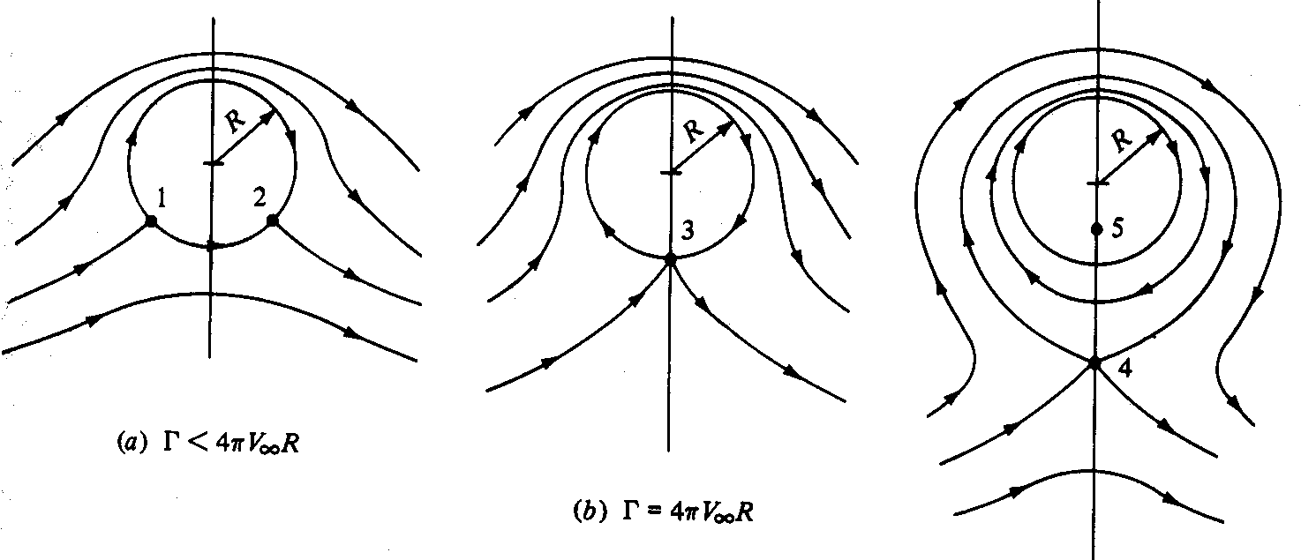
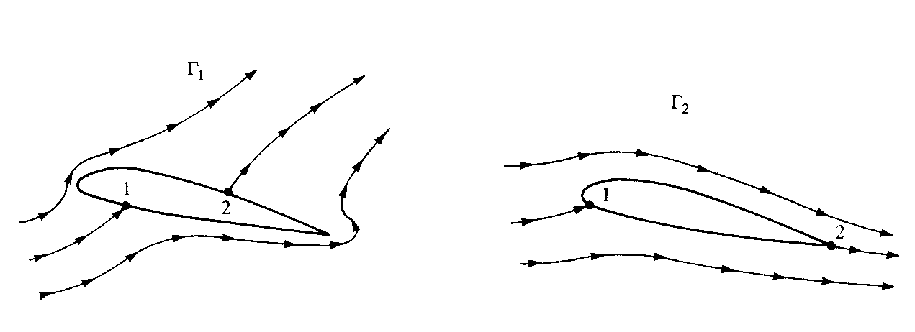
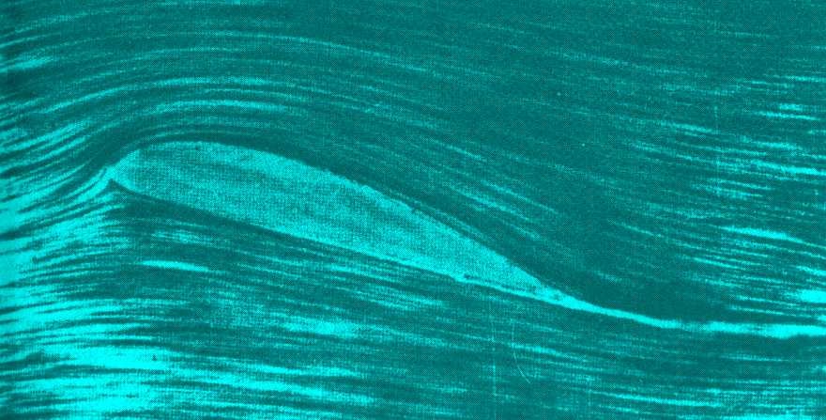
THE KUTTA CONDITION
Potential flow with lift is not unique!
(Circulation Γ may have any value)
The same happens for the flow around an airfoil
Which flow occurs in reality?
The flow that leaves smoothly at the trailing edge
(The “Kutta condition”)
Incompressible Flow over Airfoils

Slide 8
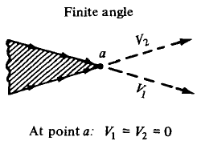
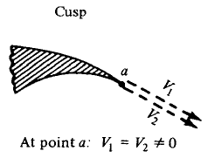



IMPLEMENTATION OF THE KUTTA CONDITION
(Point a is a stagnation point)
the Kutta condition expressed in terms of the strength of the vortex sheet is:
Incompressible Flow over Airfoils

Slide 9
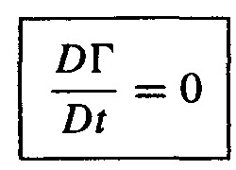
KELVIN'S CIRCULATION THEOREM
AND THE STARTING VORTEX
Question: How does nature generate this circulation?
Г1= Г2
C2
Г2
Г1
C1
time t1
time t2
Incompressible Flow over Airfoils

Slide 10

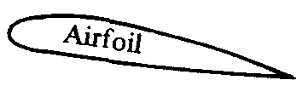
STARTING VORTEX
Г1=0
Г2=0
C4
C3
Г3
Г4
C2
C1
Г2=Г3+Г4=0
Г4=-Г3
Incompressible Flow over Airfoils

Slide 11
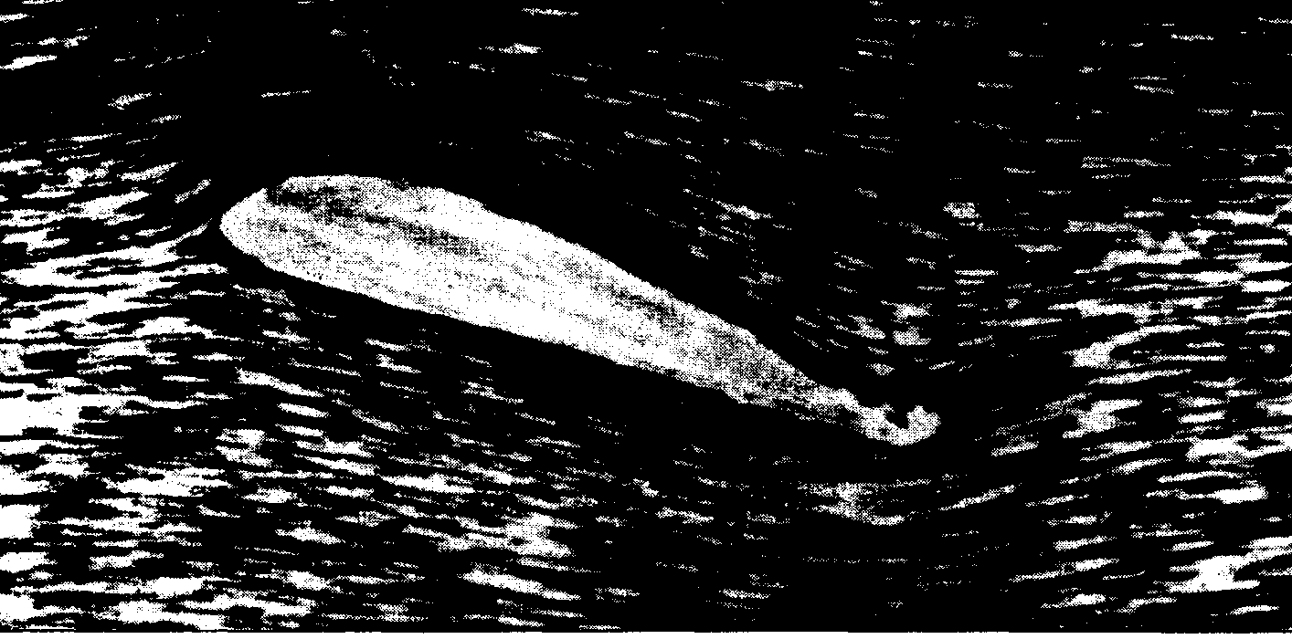
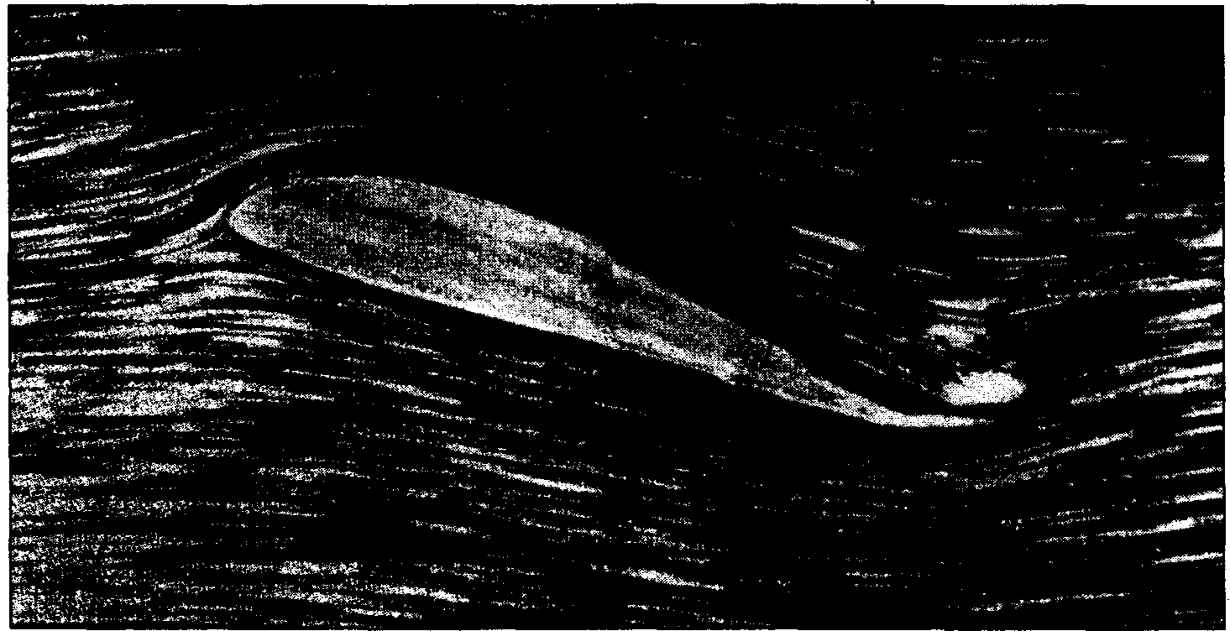
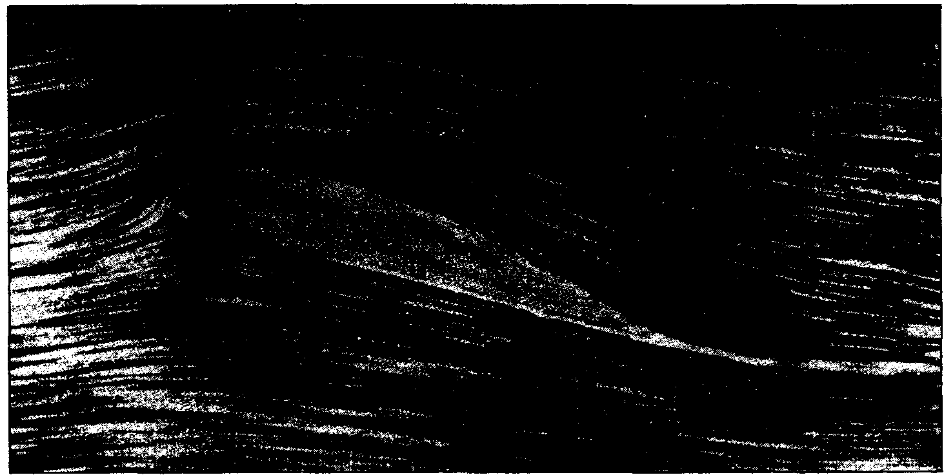
-
Incompressible Flow over Airfoils

Slide 12
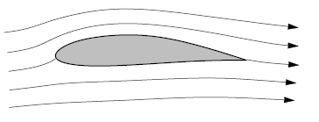


AIRFOIL APPROXIMATION
Consider an airfoil of arbitrary shape and thickness in a free stream with velocity V∞
Replace the airfoil surface with a vortex sheet of variable strength γ(i).
Calculate the variation of γ as a function of s such that the induced velocity field from the vortex sheet when added to the uniform velocity of magnitude will make the vortex sheet (hence the airfoil surface) a streamline of the flow.
Incompressible Flow over Airfoils

Slide 13
AIRFOIL APPROXIMATION
No general analytical solution for γ = γ (s) exists for an airfoil of arbitrary shape and thickness. Rather, the strength of the vortex sheet must be found numerically
foundation of the vortex panel method
Analytical solution?
Thin airfoil approximation
Incompressible Flow over Airfoils

Slide 14
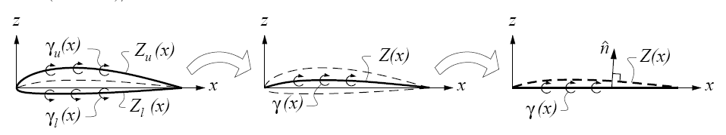
THIN AIRFOIL APPROXIMATION
1) The airfoil is assumed to be thin, with small maximum camber and thickness relative to the chord, and is assumed to operate at a small angle of attack, α ≪ 1.
2) The upper and lower vortex sheets are superimposed together into a single vortex sheet γ = γu + γℓ, which is placed on the x axis rather than on the curved mean camber line Z = (Zu + Zℓ)/2.
3) The flow-tangency condition V ・ n = 0 is applied on the x-axis at z = 0, rather than on the camber line at z = Z. But the normal vector n is normal to the actual camber line shape, as shown in the figure.
Incompressible Flow over Airfoils

Slide 15
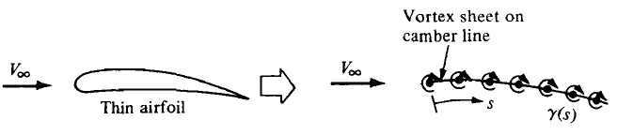
CLASSICAL THIN AIRFOIL THEORY
Thin airfoils can be simulated by a vortex sheet placed along the camber line.
Our purpose is to calculate the variation of γ(s) such that:
1) The camber line becomes a streamline of the flow
2) The Kutta condition is satisfied (γ(TE)=0).
Once we have found the particular γ(s) that satisfies above conditions, then the total circulation Γ around the airfoil is found by integrating γ(s) from the leading edge to the trailing edge.
Incompressible Flow over Airfoils

Slide 16


CLASSICAL THIN AIRFOIL THEORY
z
V_{∞,n}
Chamber line, z=z(x)
V∞
α
P
x
α
V∞
For the camber line to be a streamline:
Incompressible Flow over Airfoils

Slide 17
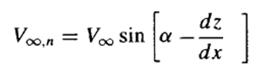


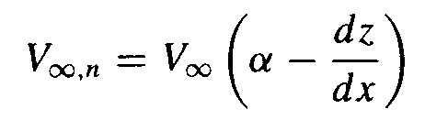
CLASSICAL THIN AIRFOIL THEORY
Incompressible Flow over Airfoils

Slide 18

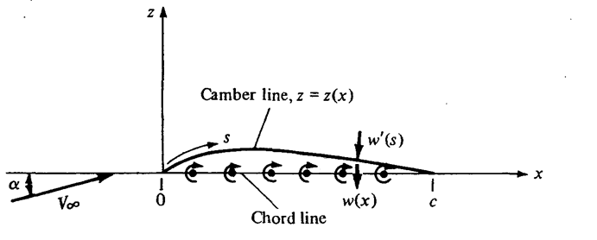

CLASSICAL THIN AIRFOIL THEORY
Let w(x) denote the component of velocity normal to the chord line induced by the vortex sheet,
If the airfoil is thin, the camber line is close to the chord line, and it is consistent with thin airfoil theory to make the approximation that
Incompressible Flow over Airfoils

Slide 19








CLASSICAL THIN AIRFOIL THEORY
z
W(x)
x
Fundamental equation of thin airfoil theory
Incompressible Flow over Airfoils

Slide 20


CLASSICAL THIN AIRFOIL THEORY
THE SAYMMETRICAL AIRFOIL
The central problem of thin airfoil theory is to solve the above equation for γ(ξ), subject to the Kutta condition, namely, γ(c) = 0.
Special Case: A symmetric airfoil has no camber; the camber line is coincident with the chord line. For this case:
dz/dx = 0
Incompressible Flow over Airfoils

Slide 21






CLASSICAL THIN AIRFOIL THEORY
THE SAYMMETRICAL AIRFOIL
Incompressible Flow over Airfoils

Slide 22


VERIFICATION OF THE SOLUTION
Is the solution of ?
Standard integrals:
(n=0,1,2…)
Incompressible Flow over Airfoils

Slide 23



VERIFICATION OF THE SOLUTION
Note that at the trailing edge, where θ=π, the above equation yields:
However, using L'Hospital's rule on Equation
Thus, the equation also satisfies the Kutta condition.
Incompressible Flow over Airfoils

Slide 24




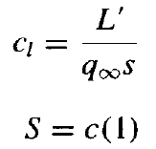


THIN SYMMETRICAL AIRFOILS
LIFT SLOPE
Incompressible Flow over Airfoils

Slide 25


THIN SYMMETRICAL AIRFOILS
MOMENT ABOUT THE LEADING EDGE
The moment about the leading edge can be calculated as follows:
z
dL
x
L.E
Incompressible Flow over Airfoils

Slide 26
THIN SYMMETRICAL AIRFOILS
MOMENT ABOUT THE LEADING EDGE
Incompressible Flow over Airfoils

Slide 27
THIN SYMMETRICAL AIRFOILS - THE CENTER OF PRESSURE AND THE AERODYNAMIC CENTER
Lift coefficient:
Moment coefficient about leading edge:
L
Center of
pressure:
LE
x_{CP}
x
Moment coefficient
about quarter-chord point:
quarter-chord point is also the aerodynamic center:
is independent of α!
Incompressible Flow over Airfoils

Slide 28
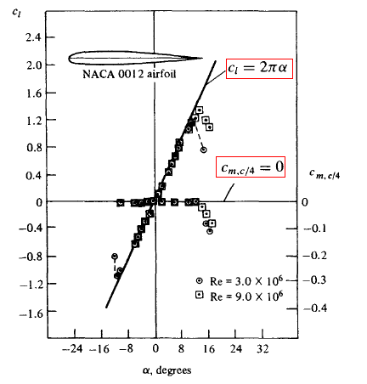
THIN SYMMETRICAL AIRFOILS
Incompressible Flow over Airfoils

Slide 29
THE SYMMETRICAL AIRFOIL: SUMMARY
Vorticity distribution (=lift distribution)
Lift coefficient:
Lift slope:
Moment coefficient
about quarter-chord point:
quarter-chord point is both the center of pressure: ( )
and the aerodynamic center: ( is independent of α)
Incompressible Flow over Airfoils

Slide 30
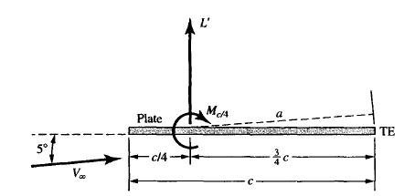
THIN AIRFOILS – EXAMPLE
Consider a thin flat plate at 5 deg. angle of attack.
Calculate the:
  (a) Lift coefficient,
  (b) Moment coefficient about the leading edge,
  (c) Moment coefficient about the quarter chord point,
  (d) Moment coefficient about the trailing edge.
Incompressible Flow over Airfoils

Slide 31






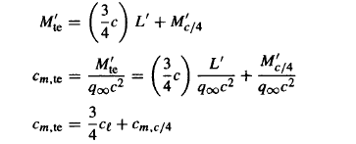


THIN AIRFOILS – EXAMPLE (CONT.)
Incompressible Flow over Airfoils

Slide 32



THE CAMBERED AIRFOIL
For a cambered airfoil, is finite.
The solution for this more general problem can be written as a Fourier series:
“Basic solution”
for the symmetrical airfoil: A₀ = α
Additional terms
The coefficients A_{n} (n=0,1,2,...) depend on the shape of the camber line z(x).
The coefficient A₀ depends also on α.
Incompressible Flow over Airfoils

Slide 33



THE CAMBERED AIRFOIL
The coefficients A₀ and A„(n = 1, 2, 3 , . . . ) in the above equation must be specific values in order that the camber line be a streamline of the flow.
f (x)
Incompressible Flow over Airfoils

Slide 34

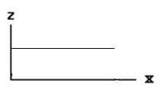







THE CAMBERED AIRFOIL
Z=f (x)
A₀
A₁ sin x
A₂ sin(2 x)
A₃ sin(3x)
Incompressible Flow over Airfoils

Slide 35
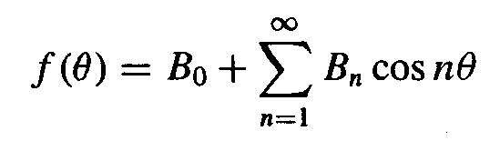






THE CAMBERED AIRFOIL
In general, the Fourier cosine series representation of a function f(θ) over an interval 0< θ <π is given by:
Incompressible Flow over Airfoils

Slide 36






THE CAMBERED AIRFOIL – AERODYNAMIC COEFFICIENTS
The total circulation due to the entire vortex sheet from the leading edge to the trailing edge is:
Incompressible Flow over Airfoils

Slide 37






THE CAMBERED AIRFOIL – AERODYNAMIC COEFFICIENTS
Incompressible Flow over Airfoils

Slide 38



THE CAMBERED AIRFOIL – AERODYNAMIC COEFFICIENTS
dL
z
x
L.E
Incompressible Flow over Airfoils

Slide 39


THE CAMBERED AIRFOIL – CENTER OF PRESSURE
As the lift approaches zero, x_{cp} moves toward infinity; that is, it leaves the airfoil. For this reason, the center of pressure is not always a convenient point at which to draw the force system on an airfoil.
the force-and-moment system on an airfoil is more conveniently considered at the aerodynamic center.
Incompressible Flow over Airfoils

Slide 40


THE CAMBERED AIRFOIL – EXAMPLE
Consider an NACA 23012 airfoil. The mean camber line for this airfoil is given by
Calculate:
the angle of attack at zero lift,
the lift coefficient when α = 4°,
the moment coefficient about c/4
the location of the center of pressure in terms of x_{cp}/c, when α = 4°.
Incompressible Flow over Airfoils

Slide 41
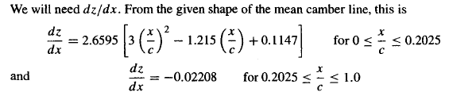

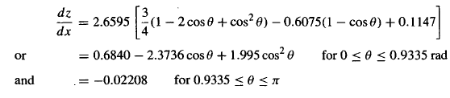

THE CAMBERED AIRFOIL – EXAMPLE (CONT.)
Incompressible Flow over Airfoils

Slide 42
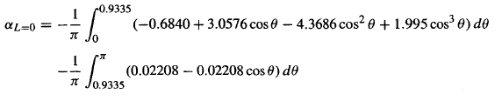
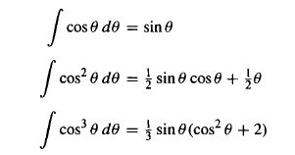
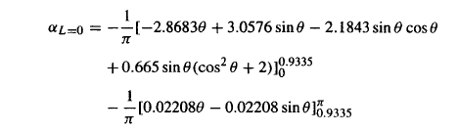
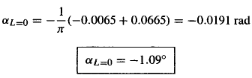
THE CAMBERED AIRFOIL – EXAMPLE (CONT.)
Incompressible Flow over Airfoils

Slide 43



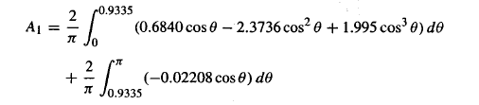
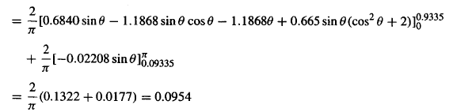
THE CAMBERED AIRFOIL – EXAMPLE (CONT.)
(b)
(c)
Incompressible Flow over Airfoils

Slide 44
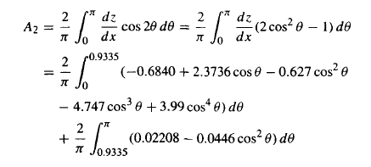

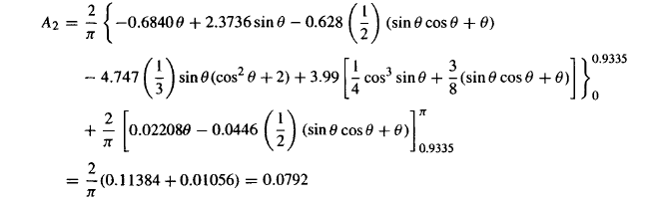
THE CAMBERED AIRFOIL – EXAMPLE (CONT.)
Incompressible Flow over Airfoils

Slide 45

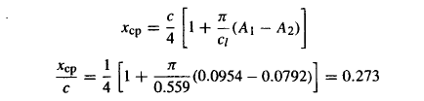

THE CAMBERED AIRFOIL – EXAMPLE (CONT.)
(d)
Experiment Thin airfoil
Incompressible Flow over Airfoils

Slide 46
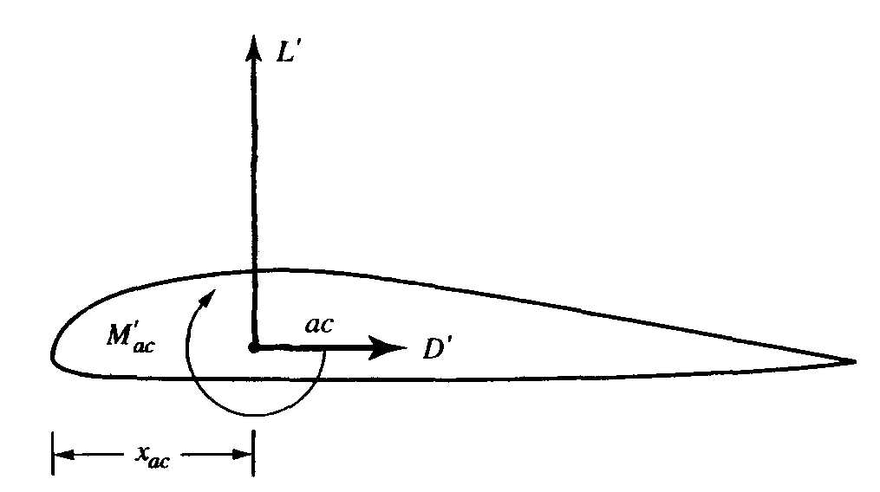
THE AERODYNAMIC CENTER
The aerodynamic center is a point on a body about which the aerodynamically generated moment is independent of angle of attack.
For most conventional airfoils, the aerodynamic center is close to, but not necessarily exactly at, the quarter-chord point.
Incompressible Flow over Airfoils

Slide 47
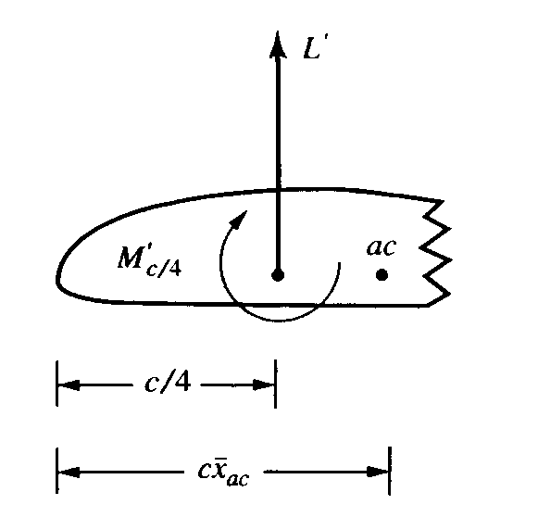





THE AERODYNAMIC CENTER
a₀
m₀
Incompressible Flow over Airfoils

Slide 48


THE AERODYNAMIC CENTER
The equation proves that, for a body with linear lift and moment curves, that is, where a_{o} and m_{o} are fixed values, the aerodynamic center exists as a fixed point on the airfoil.
Incompressible Flow over Airfoils

Slide 49
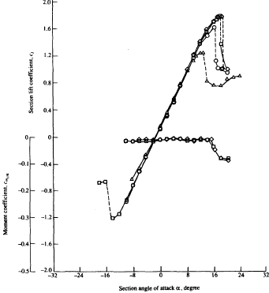
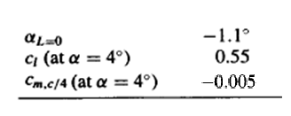





THE AERODYNAMIC CENTER - EXAMPLE
Consider the NACA 23012 airfoil. Where is it’s aerodynamic center?
Incompressible Flow over Airfoils

