Slide 1


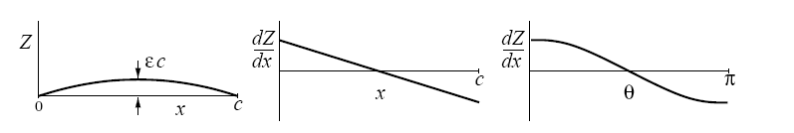
THIN AIRFOIL THEORY APPLICATION: ANALYSIS EXAMPLE
Consider a thin airfoil with a simple parabolic-arc camber line, with a maximum camber height
Tihn Airfoil Theory Applications
1

Slide 2


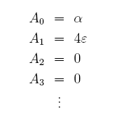

FOURIER COEFFICIENT CALCULATION
The integral in the An expression can be evaluated by using the orthogonality property of the cosine functions.
Tihn Airfoil Theory Applications
2

Slide 3


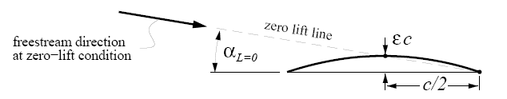
LIFT AND MOMENT COEFFICIENTS
Tihn Airfoil Theory Applications
3

Slide 4
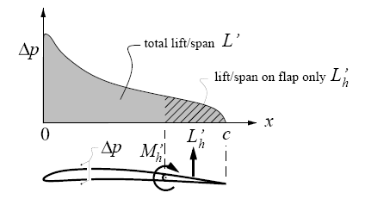

SURFACE LOADING (FURTHER DETAILS)
In many applications, obtaining just the cℓ and cm of the entire airfoil is sufficient. But in some cases, we may also want to know the force and moment on only a portion of the airfoil. For example, the force and moment on a flap are of considerable interest, since the flap hinge and flap control linkage must be designed to withstand these loads. We therefore need to know how the loading ∆p(x) is distributed over the chord, and over the flap in particular.
dL’
ds
dL’= ∆p(x) ds=ρV∞γds
Tihn Airfoil Theory Applications
4

Slide 5




THIN AIRFOIL THEORY APPLICATION: ANALYSIS EXAMPLE
Tihn Airfoil Theory Applications
5

Slide 6

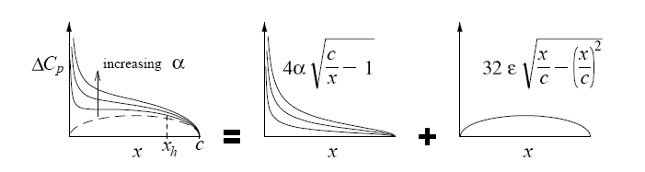

THIN AIRFOIL THEORY APPLICATION: ANALYSIS EXAMPLE
Define x_{h} as the location of the flap hinge, so the flap extends from x = x_{h}, to the trailing edge at x = c.
The corresponding locations
respectively. The load/span and moment/span coefficients on the flap hinge can now be
computed by integrating the pressure loading.
Tihn Airfoil Theory Applications
6

Slide 7
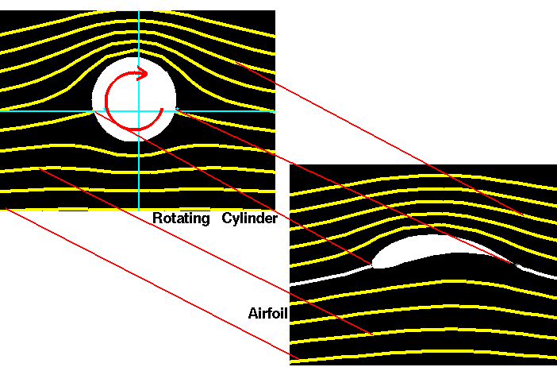
INTRODUCTION TO CONFORMAL MAPPING IN AERODYNAMICS
Conformal Mapping in Aerodynamics

Slide 8
COMPLEX ANALYSIS
We have shown that in a two-dimensional, incompressible, irrotational flow, both velocity potential (ϕ) and stream function (ψ), satisfy Laplace’s equation.
This fact gives rise to a particularly powerful method of analysing such flows, based on the properties of functions of a Complex Variable.
Conformal Mapping in Aerodynamics

Slide 9
INTRODUCTION TO CONFORMAL MAPPING IN AERODYNAMICS
A complex number can be written in polar form using Euler's equation:
y, imaginary
z = x + i⋅y
r
Where:
θ
x, real
Complex multiplication:
Conformal Mapping in Aerodynamics

Slide 10
COMPLEX ANALYSIS
Consider the function f(z) of the complex variable:
z=x+iy
f(x+iy) has real and imaginary parts given by:
Where α (real part) and β (imaginary part) are called conjugate functions.
Conformal Mapping in Aerodynamics

Slide 11




COMPLEX ANALYSIS
Partial differentiation of f with respect to x and y yields:
Hence:
Thus
Cauchy-Riemann Equations
Conformal Mapping in Aerodynamics

Slide 12




COMPLEX ANALYSIS
Partial differentiation of Cauchy-Riemann equations with respect to x and y gives:
α and β both satisfy Laplace’s Equation
Conformal Mapping in Aerodynamics

Slide 13
COMPLEX ANALYSIS
We can substitude α=ϕ, β=ψ and we can replace f(z) by w:
w is known as the complex potential of the motion and is a function of the single complex variable z.
Both components of the velocity can be obtained directly by differentiation of the complex potential w:
Conformal Mapping in Aerodynamics

Slide 14
COMPLEX ANALYSIS – ELEMENTARY PLANE FLOWS
The basic flows used in potential flow theory such as uniform flow, source, sink, doublet and vortex, can all be represented using complex numbers.
Conformal Mapping in Aerodynamics

Slide 15
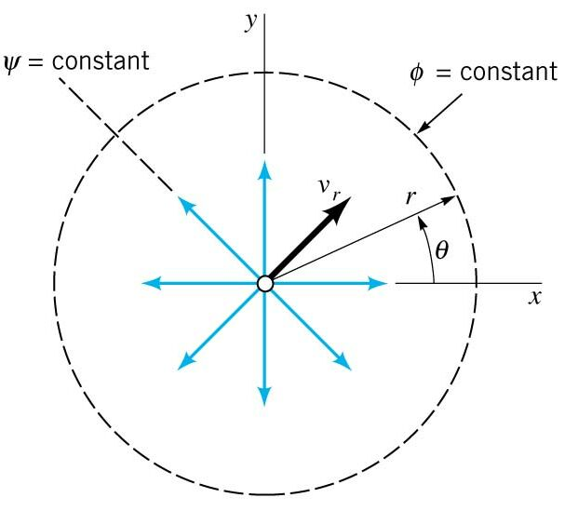
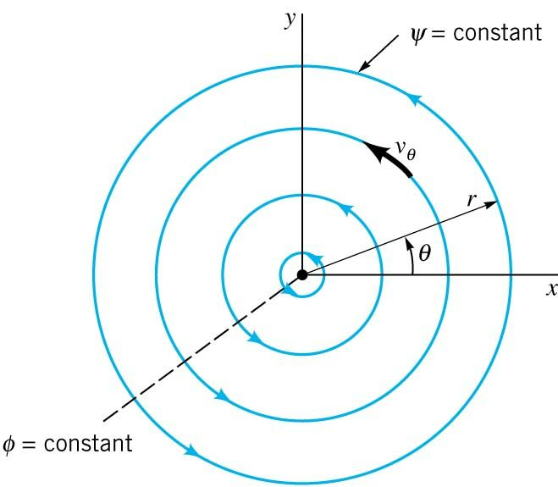
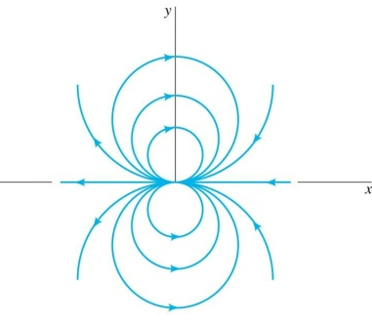
COMPLEX ANALYSIS – ELEMENTARY PLANE FLOWS
Uniform flow
Source flow
Vortex
Doublet
Conformal Mapping in Aerodynamics

Slide 16
CONFORMAL MAPPING
In the study of airfoils, we are interested in finding the flow pattern and pressure distribution.
  Direct solution of the Laplace equation for the prescribed boundary shape of the airfoil is quite straightforward using a computer, but analytically difficult. In general, analytical solutions are possible only when the airfoil is assumed thin (thin airfoil theory).
Conformal Mapping in Aerodynamics

Slide 17
CONFORMAL MAPPING
In the study of airfoils, we are interested in finding the flow pattern and pressure distribution.
  An Indirect way of solving the problem involves the method of conformal transformation. Many years ago, the Russian mathematician Joukowski developed a mapping function that converts a circular cylinder into a family of airfoil shapes.
L = ρ V Γ
Lift = ?
Conformal Mapping in Aerodynamics

Slide 18
CONFORMAL MAPPING
Conformal mapping is a mathematical technique used to convert (or map) one mathematical problem and solution into another. It involves the study of complex variables.
A conformal mapping is performed through the transformation of a complex function from one coordinate system to another. A transformation function is applied to the original function to perform the mapping.
Conformal Mapping in Aerodynamics

Slide 19
INTRODUCTION TO CONFORMAL MAPPING IN AERODYNAMICS
We deal with a case in which a given transformation maps a circle into an airfoil-like shape and determine the properties of the airfoil generated thereby.
This is the Joukowski transformation and is the most commonly used function for aerodynamic applications.
Here, b is a constant
Conformal Mapping in Aerodynamics

Slide 20
INTRODUCTION TO CONFORMAL MAPPING IN AERODYNAMICS
z plane
w plane
y
ζ
ψ = C1
ϕ =K1
ϕ =K3
ψ = C2
ψ = C1
ψ = C3
ψ = C2
ψ = C3
ϕ =K1
ϕ =K3
x
ξ
Conformal Mapping in Aerodynamics

Slide 21
TRANSFORMATION OF A CIRCLE INTO A STRAIGHT LINE
Consider a circle, centered at the origin in the z-plane, whose radius b is same as the constant in the Joukowski transformation.
z = be^{iθ}
The Joukowski transform maps the circle of radius b in z-plane, into a flat plate of length 4b in the w-plane.
y
z plane
ζ
w plane
b
θ
x
-2b
2b
ξ
Conformal Mapping in Aerodynamics

Slide 22
TRANSFORMATION OF A CIRCLE INTO AN ELLIPSE
If the circle originally had a radius slightly larger than the transform constant b:
z = ae^{iθ}, with a > b,
ζ
-2b
2b
the circle would have formed an ellipse instead of the flat plate.
Conformal Mapping in Aerodynamics

Slide 23
TRANSFORMATION OF A CIRCLE INTO A SYMMETRIC AIRFOIL
From and aerodynamics point of view, the most interesting application of the Joukowski transform is to an offset circle. If we consider a circle slightly offset from the origin along the negative real axis, one obtains a symmetric Joukowski airfoil.
The equation of the offset circle is: z = ae^{iθ}-eb, where the constant e is a small number.
y
z plane
ζ
w plane
a
x
-2b
2b
ξ
eb
b
Conformal Mapping in Aerodynamics

Slide 24
TRANSFORMATION OF A CIRCLE INTO A CAMBERED AIRFOIL
If the circle is displaced slightly along the complex axis as well, one obtains a cambered airfoil shape.
Here, the points A and B are the intercepts of the displaced circle on the real axis and their corresponding points in the transformed plane. The angle β is the angle formed by the line joining the point A (or B) and the origin with the real axis.
y
ζ
a
z plane
w plane
A
β
B
A
B
eb
x
-2b
2b
ξ
b
Conformal Mapping in Aerodynamics

Slide 25
TRANSFORMATION OF A CIRCLE INTO A CAMBERED AIRFOIL
If lifting flow about the original circle had been imposed, the Joukowski transformation would have generated a lifting flow about the Joukowski airfoil;
y
ζ
w plane
z plane
ξ
x
Although such a flow is mathematically possible, in reality it may not be realistic. The stagnation points on the cylinder map to stagnation points that are not always realistic.
Conformal Mapping in Aerodynamics

Slide 26
TRANSFORMATION OF A CIRCLE INTO A CAMBERED AIRFOIL
The only means of making a realistic flow is to impose the Kutta condition where the stagnation point is forced to exist at the trailing edge thus making the streamlines flow smoothly from this point.
This is done by adjusting the value of vorticity strength Γ, such that the stagnation points on the cylinder reside at the cylinder’s intercepts of the real axis. In this case, when the cylinder is transformed, one stagnation point will be forced to the trailing edge.
y
ζ
w plane
z plane
ξ
x
Conformal Mapping in Aerodynamics

Slide 27
TRANSFORMATION OF A CIRCLE INTO A CAMBERED AIRFOIL
The lift force generated by the lifting flow over the cylinder is proportional to the circulation about the cylinder imposed by the added vortex flow according to the Kutta-Joukowski relation, L’ = ρV∞ Γ.
The lifting force on the resulting Joukowski airfoil is not clear.
If the lifting flow about the cylinder is defined as function Q where Q = Q(z) in the z plane and Q = Q(w) in the w plane, the velocities in each plane are:
Conformal Mapping in Aerodynamics

Slide 28
TRANSFORMATION OF A CIRCLE INTO A CAMBERED AIRFOIL
Clearly, the velocity field very close to the cylinder and its transformed counterpart are dissimilar as one would expect.
Farther away from these objects the velocity fields become identical as the magnitude of z becomes larger than the constant value of b.
Since the circulation can be calculated about any closed path, including paths very far from the object surface, the circulations must be the same in both planes.
Conformal Mapping in Aerodynamics

Slide 29
TRANSFORMATION OF A CIRCLE INTO A CAMBERED AIRFOIL – VORTEX STRENGTH
The appropriate vortex strength to impose the Kutta condition must be determined.
Consider the lifting flow about a cylinder. The velocity in the θ direction is
y
z plane
stagnation points:
-β
x
If the field is rotated by α to simulate an angle of attack,
Conformal Mapping in Aerodynamics

Slide 30
TRANSFORMATION OF A CIRCLE INTO A CAMBERED AIRFOIL
Since the chord length of the Joukowski airfoil is 4b
Making the assumption that b ≈ R,
Conformal Mapping in Aerodynamics

Slide 31
EXAMPLE
A Joukowski airfoil is formed by displacing a circle of radius 1 by Δx = -0.08 (real axis) and Δy = 0.05 (imaginary axis).
Find:
  a) Vortex strength Γ if α = 0º, and V∞ = 10 m/s
  b) C_{L} at α = 0º and α = 10º
y
cylinder
0.05
β
x
-0.08
b
stagnation
point
b = 0.9187
Conformal Mapping in Aerodynamics

Slide 32
EXAMPLE
A Joukowski airfoil is formed by displacing a circle of radius 1 by Δx = -0.08 (real axis) and Δy = 0.05 (imaginary axis).
Find:
  a) Vortex strength Γ if α = 0º, and V∞ = 10 m/s
  b) C_{L} at α = 0º and α = 10º
y
Γ = 4πV∞Rsin(α+β) = 4π(10)(1)sin(2.87) = 6.2831
= 0º : C_{L} = 2πsin(2.87) = 0.31415
α = 10º : C_{L} = 2πsin(10 + 2.87) = 1.40
cylinder
0.05
β
x
-0.08
b
stagnation
point
Conformal Mapping in Aerodynamics

