Slide 1
Check it Out!!

Slide 2
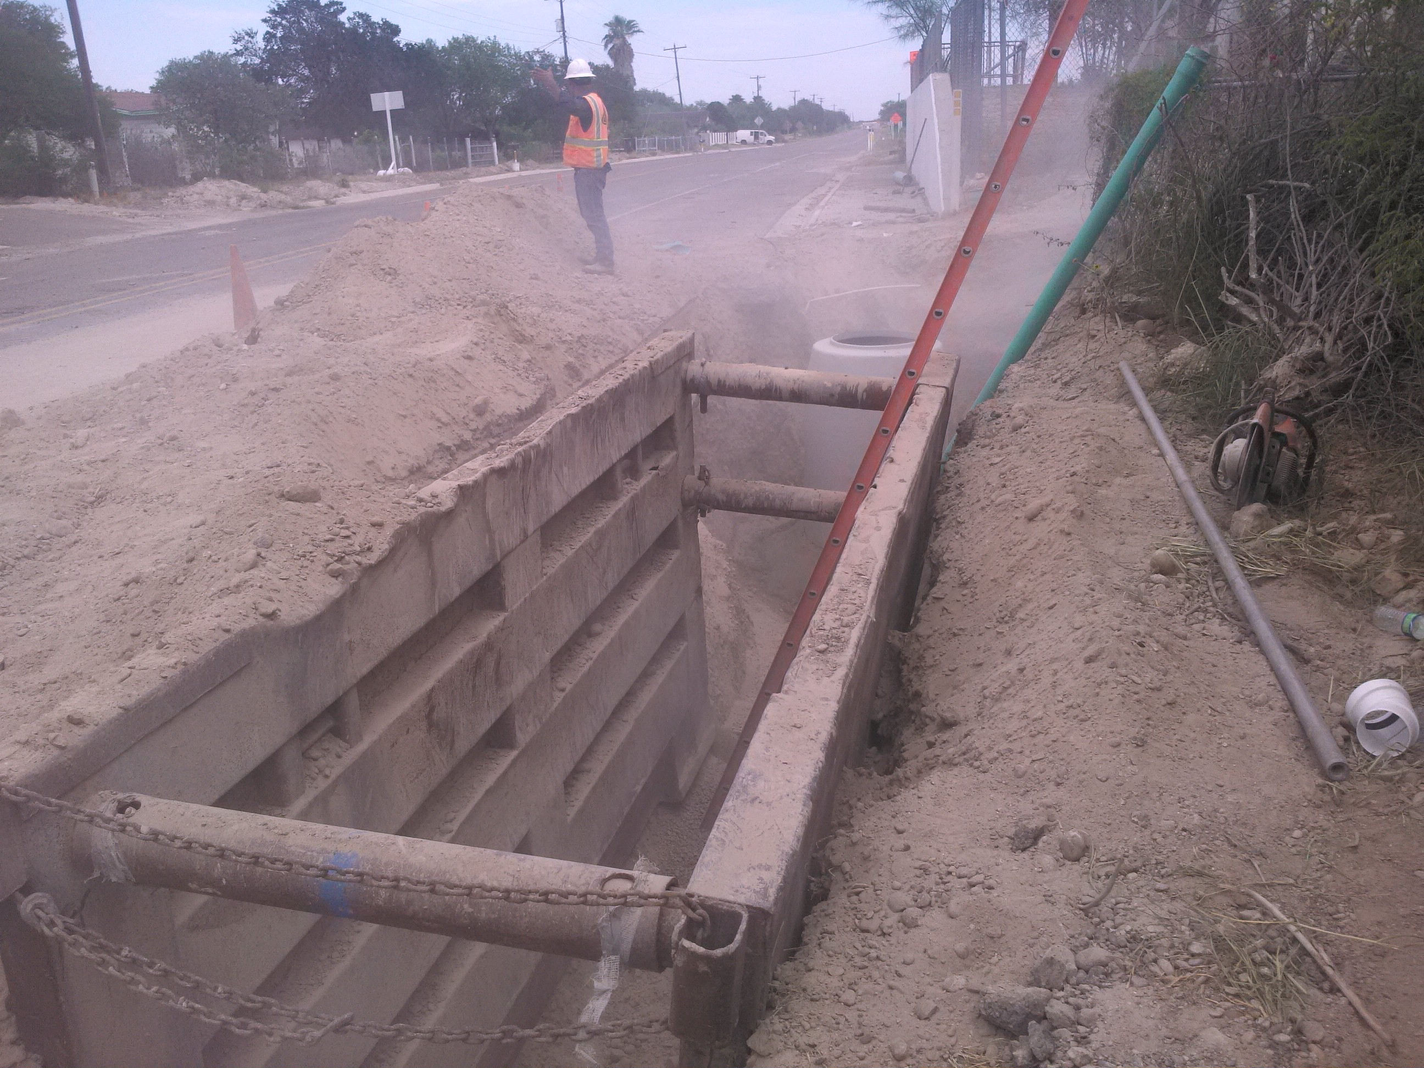

Slide 3
Dust hazard
Spoils not pushed back & trench box is too low

Slide 4
Ladder extends 3 feet or more above trench opening.

