Slide 1
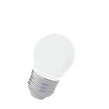

Magnetic Particle Testing

Slide 2
Magnetic Particle Testing
Magnetic Particle Testing uses magnetic fields to locate surface and near-surface discontinuities in ferromagnetic materials.
The magnetic field can be applied with a permanent magnet or an electromagnet.
When using an electromagnet, the field is present only when the current is being applied. When the magnetic field encounters a discontinuity transverse to the direction of the magnetic field, the flux lines produce a magnetic flux leakage field of their own.

Slide 3
Magnetic Particle Testing
Because magnetic flux lines don't travel well in air, when very fine colored ferromagnetic particles ("magnetic particles") are applied to the surface of the part the particles will be drawn into the discontinuity, reducing the air gap and producing a visible indication on the surface of the part.
The magnetic particles may be a dry powder or suspended in a liquid solution, and they may be colored with a visible dye or a fluorescent dye that fluoresces under an ultraviolet ("black") light.

Slide 4
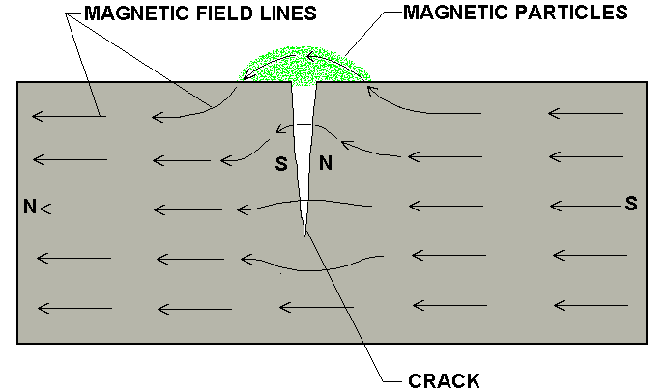
MAGNETIC PARTICLE TESTING
The first step in a magnetic particle inspection is to magnetize the component that is to be inspected.
If any defects on or near the surface are present, the defects will create a leakage field.
After the component has been magnetized, iron particles, either in a dry or wet suspended form, are applied to the surface of the magnetized part.
The particles will be attracted and
cluster at the flux leakage fields, thus forming a visible indication that the inspector can detect.

Slide 5
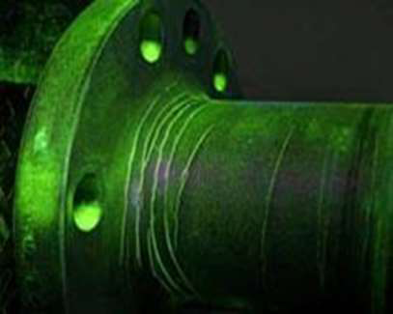
MAGNETIC PARTICLE TESTING
Magnetic particle Inspection (MPI) is a non destructive testing (NDT) process for detecting surface and slightly sub-surface discontinuities
in ferromagnetic materials such as iron, nickel, cobalt, and some of their alloys. The process puts a magnetic field into the part. The piece can be magnetized by direct or indirect magnetization.

Slide 6
Basic Procedure
Basic steps involved:
Component pre-cleaning
Introduction of magnetic field
Application of magnetic media
Interpretation of magnetic particle indications

Slide 7
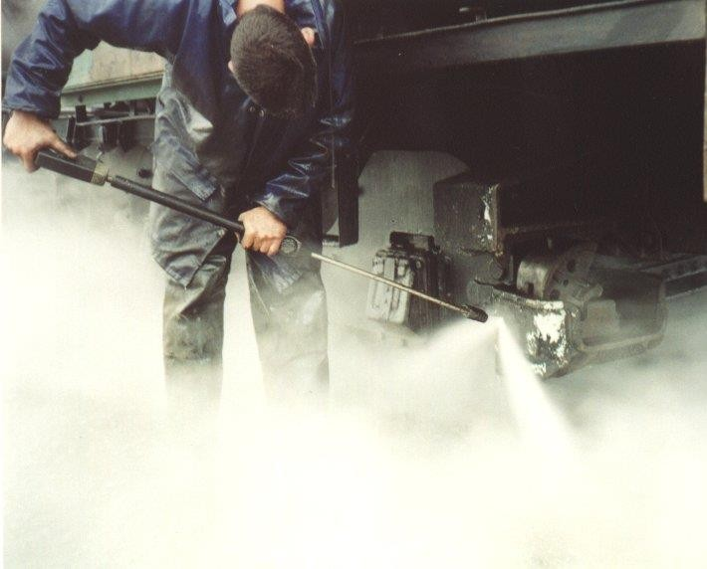
Pre-cleaning
When inspecting a test part with the magnetic particle method it is essential for the particles to have an unimpeded path for migration to both strong and weak leakage fields alike. The part’s surface should be clean and dry before inspection.
Contaminants such as oil, grease, or scale may not only prevent particles from being attracted to leakage fields, they may also interfere with interpretation of indications.

Slide 8
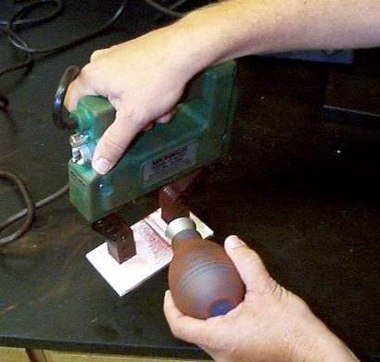
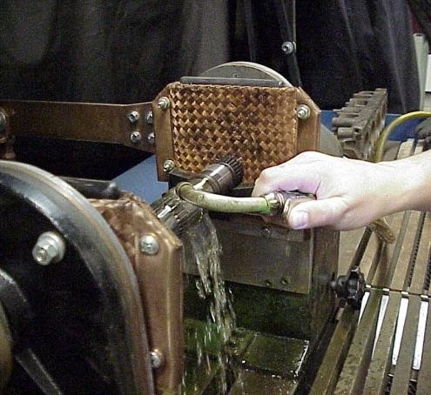
Introduction of the Magnetic Field
The required magnetic field can be introduced into a component in a number of different ways.
Using a permanent magnet or an electromagnet that contacts the test piece
Flowing an electrical current through the specimen
Flowing an electrical current through a coil of wire around the part or through a central conductor running near the part.

Slide 9
Application of Magnetic Media (Wet Versus Dry)
MPI can be performed using either dry particles, or particles suspended in a liquid. With the dry method, the particles are lightly dusted on to the surface.
With the wet method, the part is flooded with a solution carrying the particles.
The dry method is more portable. The wet method is generally more sensitive since the liquid carrier gives the magnetic particles additional mobility.

Slide 10
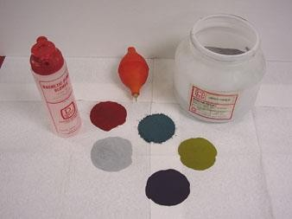
Dry Magnetic Particles
Magnetic particles come in a variety of colors. A color that produces a high level of contrast against the background should be used.

Slide 11
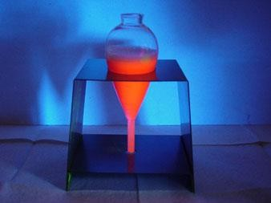
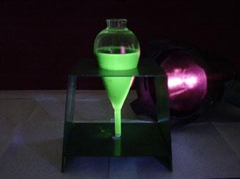
Wet Magnetic Particles
Wet particles are typically supplied as visible or fluorescent. Visible particles are viewed under normal white light and fluorescent particles are viewed under black light.

Slide 12

Interpretation of Indications
After applying the magnetic field, indications that form must interpreted. This process requires that the inspector distinguish between relevant and non-relevant indications.
The following series of images depict relevant indications produced from a variety of components inspected with the magnetic particle method.

Slide 13
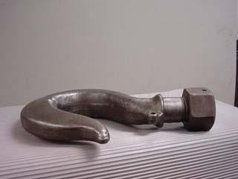
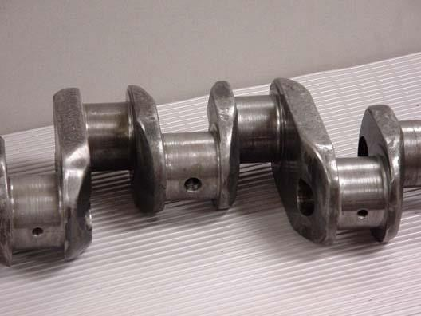
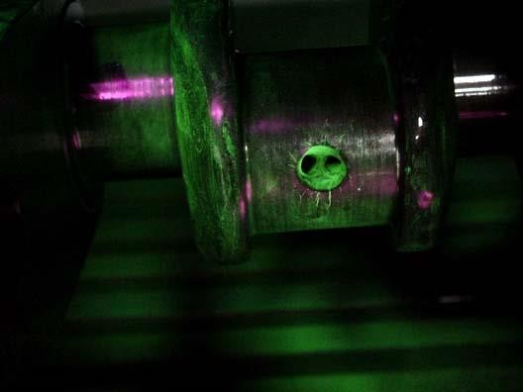
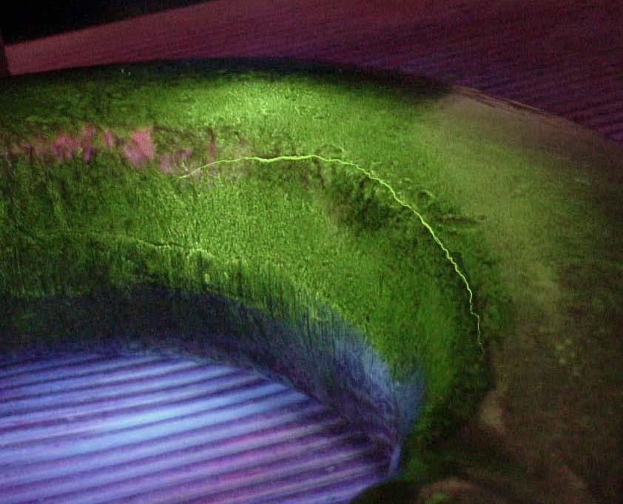
Crane Hook with Service Induced Crack
Crank Shaft with
Service Induced Crack Near Lube Hole

Slide 14
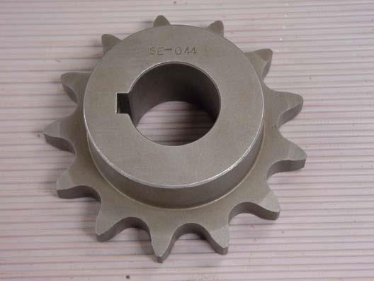
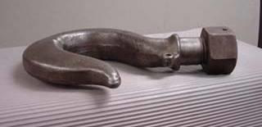
Magnetic Particle Crack Indications

Slide 15
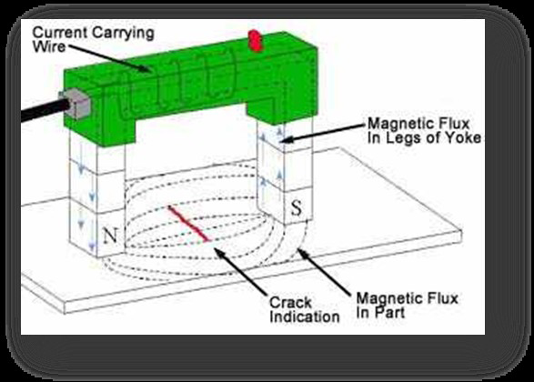
Magnetic Particle Testing
Process
The first step in a magnetic
particle testing is to magnetize the test component by a MPT
equipment.
If there any defects on the surface or near to the surface are present, the defects will create. iron particles coated with a dye pigment are applied to the specimen.
These particles are attracted to magnetic flux leakage fields and will cluster to form an indication directly over the defects. This indication can be visually detected under proper lighting conditions.

Slide 16
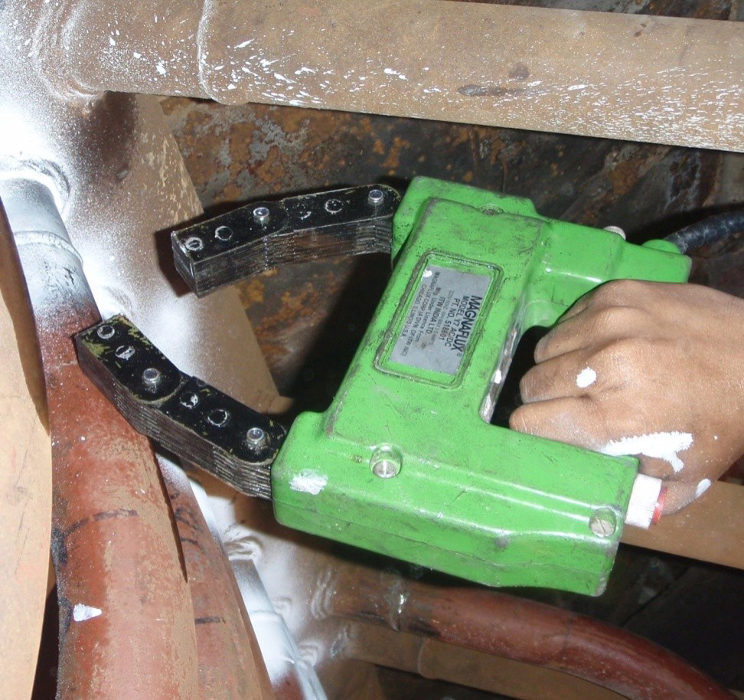
Magnetic Particle Testing in Superheater
Pipe Welding
First the welding joint is magnetized by MPT equipment. Then finely
milled iron particles are applied to the magnetized weld joint.

Slide 17
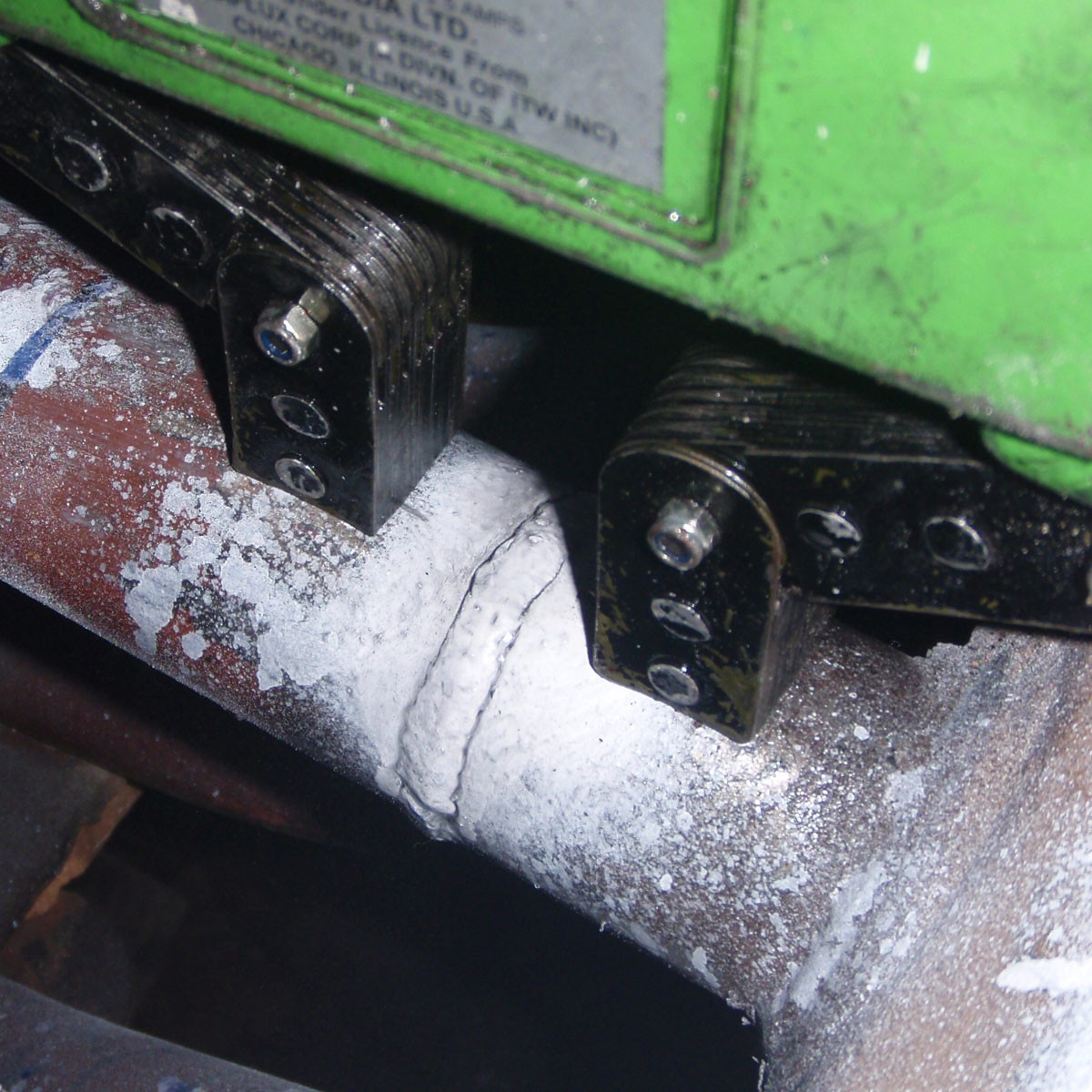
Magnetic Particle Testing in Gas Pipe Welding
Iron particles make a cluster at the welding joint for magnetic flux leakage because of welding defects.

Slide 18
Advantages & Disadvantegs of MPT

Slide 19
Advantages Magnetic Particle Testing
It does not need very stringent pre-cleaning operation.
It is the best method for the detection of surface and near to
the surface cracks in ferromagnetic materials.
Fast and relatively simple NDT method.
Generally inexpensive.
Will work through thin coating.
It is quicker.

Slide 20
Advantages of Magnetic Particle Inspection
Can detect both surface and near sub-surface defects.
Can inspect parts with irregular shapes easily.
Fast method of inspection and indications are visible directly on the specimen surface.
Is a very portable inspection method especially when used with battery powered equipment.

Slide 21
Limitations of Magnetic Particle Testing
Material must be ferromagnetic.
Orientation and strength of magnetic field is critical.
Detects surface and near-to-surface discontinuities only.
Large currents sometimes require.
Cannot inspect non-ferrous materials such as aluminum, magnesium or most stainless steels.
Inspection of large parts may require use of equipment with special power requirements.

Slide 22
Limitations of Magnetic Particle Inspection
Some parts may require removal of coating or plating to achieve desired inspection sensitivity.
Limited subsurface discontinuity detection capabilities. Maximum depth sensitivity is approximately 0.6” (under ideal conditions).
Post cleaning, and post demagnetization is often necessary.
Alignment between magnetic flux and defect is important

Slide 23


