Slide 1
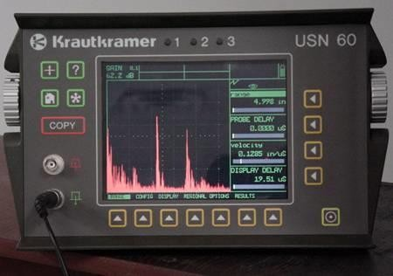

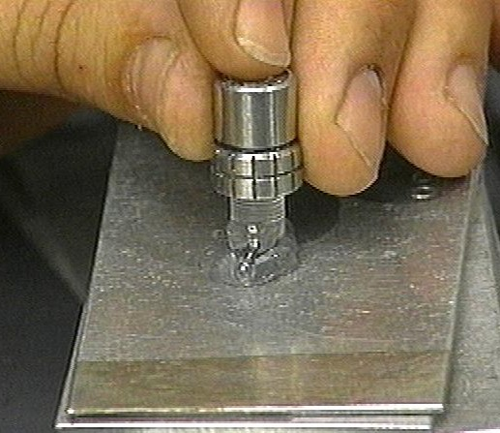
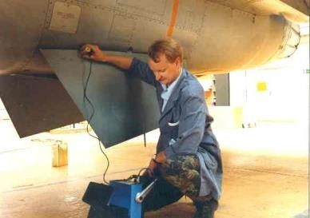
Ultrasonic Testing

Slide 2
Introduction
This module presents an introduction to the NDT method of ultrasonic testing.
Ultrasonic testing uses high frequency sound energy to conduct examinations and make measurements.
Ultrasonic examinations can be conducted on a wide variety of material forms including castings, forgings, welds, and composites.
A considerable amount of information about the part being examined can be collected, such as the presence of discontinuities, part or coating thickness.

Slide 3
Outline
Applications
Basic Principles of sound generation
Pulse echo and through transmission testing
Inspection applications
Equipment
  Transducers
  Instrumentation
  Reference Standards
Data presentation
Advantages and Limitations
Glossary of terms

Slide 4
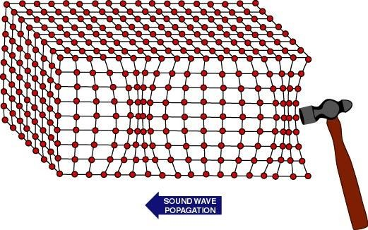
Basic Principles of Sound
Sound is produced by a vibrating body and travels in the form of a wave.
Sound waves travel through materials by vibrating the particles that make up the material.
The pitch of the sound is determined by the frequency of the wave (vibrations or cycles completed in a certain period of time).
Ultrasound is sound with a pitch too high to be detected by the human ear.

Slide 5
Spectrum of sound
Frequency range Hz
Description
Example
0 - 20 | Infrasound | Earth quake
20 - 20.000 | Audible sound | Speech, music
> 20.000 | Ultrasound | Bat, Quartz crystal

Slide 6
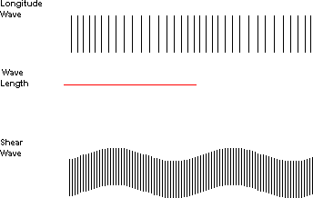
Basic Principles of Sound (cont.)
The measurement of sound waves from crest to crest determines its wavelength (λ).
The sound wavelength is inversely proportional to its frequency. (λ = 1/f)
Several wave modes of vibration are used in ultrasonic inspection. The most common are longitudinal, shear, and Rayleigh (surface) waves.

Slide 7
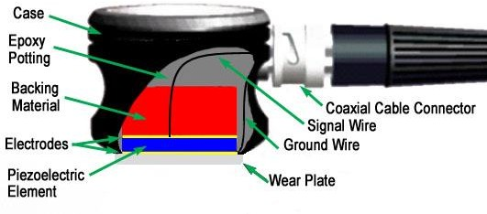
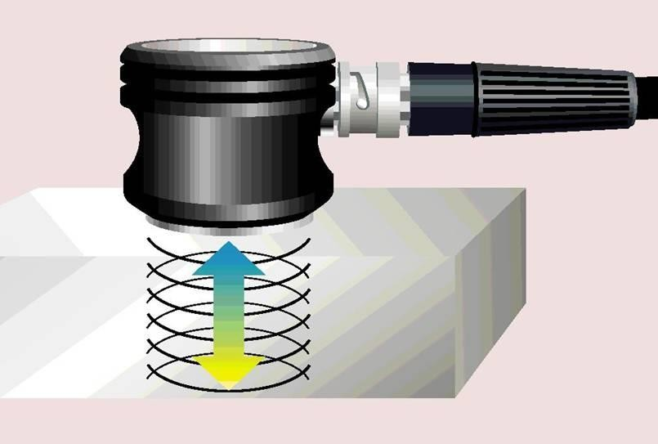
Ultrasound Generation
Ultrasound is generated with a transducer.
A piezoelectric element in the transducer converts electrical energy into mechanical vibrations (sound), and vice versa.
The transducer is capable of both transmitting and receiving sound energy.

Slide 8
Principles of Ultrasonic Inspection
Ultrasonic waves are introduced into a material where they travel in a straight line and at a constant speed until they encounter a surface.
At surface interfaces some of the wave energy is reflected and some is transmitted.
The amount of reflected or transmitted energy can be detected and provides information about the size of the reflector.
The travel time of the sound can be measured and this provides information on the distance that the sound has traveled.

Slide 9
Test Techniques
Ultrasonic testing is a very versatile inspection method, and inspections can be accomplished in a number of different ways.
Ultrasonic inspection techniques are commonly divided into three primary classifications.
  Pulse-echo and Through Transmission
(Relates to whether reflected or transmitted energy is used)
  Normal Beam and Angle Beam
(Relates to the angle that the sound energy enters the test article)
  Contact and Immersion
(Relates to the method of coupling the transducer to the test article)
Each of these techniques will be discussed briefly in the following slides.

Slide 10
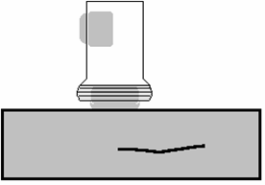
Test Techniques - Pulse-Echo
In pulse-echo testing, a transducer sends out a pulse of energy and the same or a second transducer listens for reflected energy (an echo).
Reflections occur due to the presence of discontinuities and the surfaces of the test article.
The amount of reflected sound energy is displayed versus time, which provides the inspector information about the size and the location of features that reflect the sound.
initial pulse
back surface
echo
crack
echo
crack
plate
0
2 4
6 8 10
11
UT Instrument Screen

Slide 11
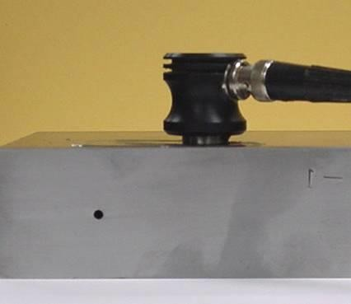
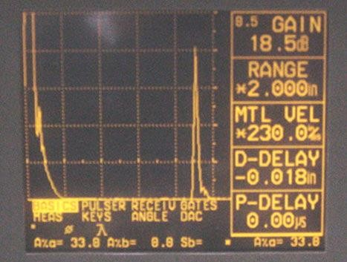
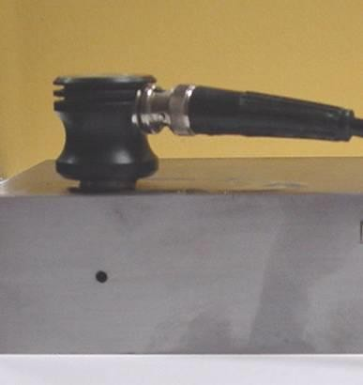
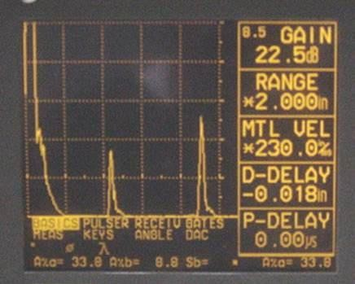
Test Techniques – Pulse-Echo (cont.)
Digital display showing signal generated from sound reflecting off back surface.
Digital display showing the presence of a reflector midway through material, with lower amplitude back surface reflector.
The pulse-echo technique allows testing when access to only one side of the material is possible, and it allows the location of reflectors to be precisely determined.

Slide 12

Test Techniques – Through-Transmission
Two transducers located on opposing sides of the test specimen are used. One transducer acts as a transmitter, the other as a receiver.
Discontinuities in the sound path will result in a partial or total loss of sound being transmitted and be indicated by a decrease in the received signal amplitude.
Through transmission is useful in detecting discontinuities that are not good reflectors, and when signal strength is weak. It does not provide depth information.
1₁
T
R
T
R
2
1₁
2
0 2 4 6 8 10

Slide 13
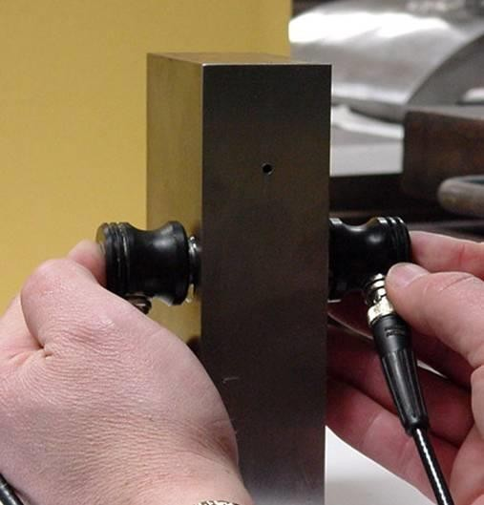
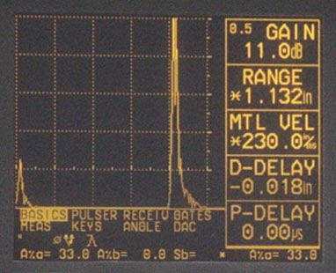
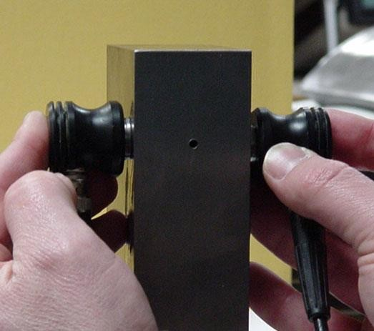
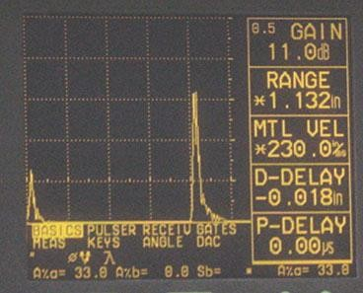
Test Techniques – Through-Transmission
Digital display showing received sound through material thickness.
Digital display showing loss of received signal due to presence of a discontinuity in the sound field.

Slide 14
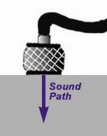
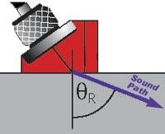
Test Techniques – Normal and Angle Beam
In normal beam testing, the sound beam is introduced into the test article at 90 degree to the surface.
In angle beam testing, the sound beam is introduced into the test article at some angle other than 90.
The choice between normal and angle beam inspection usually depends on two considerations:
  The orientation of the feature of interest – the sound should be directed to produce the largest reflection from the feature.
  Obstructions on the surface of the
Hareesha N G,^{p}Deªpt^{r}o^{t}f A^{th}eroªE^{t}ng^{m}g, D^{u}S^{s}CE^{t be worked around.} 15

Slide 15


Test Techniques – Contact Vs Immersion
To get useful levels of sound energy into a material, the air between the transducer and the test article must be removed. This is referred to as coupling.
In contact testing (shown on the previous slides) a couplant such as water, oil or a gel is applied between the transducer and the part.
In immersion testing, the part and the transducer are place in a water bath. This arrangement allows better movement of the transducer while maintaining consistent coupling.
With immersion testing, an echo from the front surface of the part is seen in the signal but otherwise signal interpretation is the same for the two techniques.
2
1
2
1
IP
IP
IP = Initial Pulse FWE = Front Wall Echo
BWE DE = Defect Echo
BWE = Back Wall Echo
FWE
FWE
BWE
DE
Defect
0 2 4 6 8 10
0 2 4 6 8 10

Slide 16
Inspection Applications
Some of the applications for which ultrasonic testing may be employed include:
Flaw detection (cracks, inclusions, porosity, etc.)
Erosion & corrosion thickness gauging
Assessment of bond integrity in adhesively joined and brazed components
Estimation of void content in composites and plastics
Measurement of case hardening depth in steels
Estimation of grain size in metals
On the following slides are examples of some common applications of ultrasonic inspection.

Slide 17
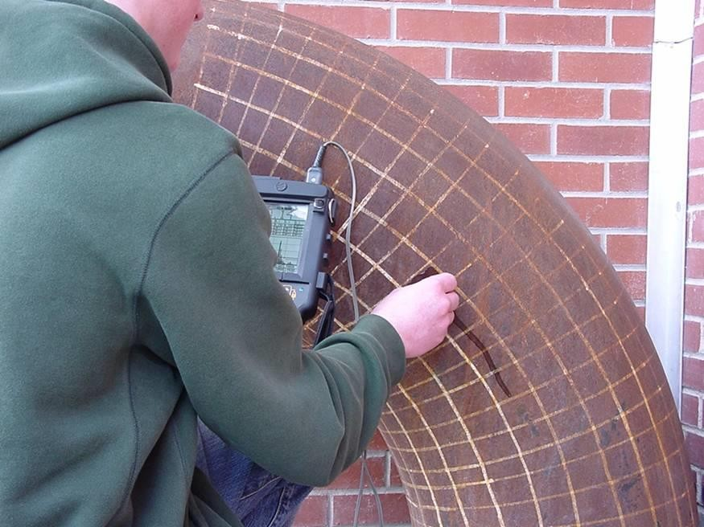
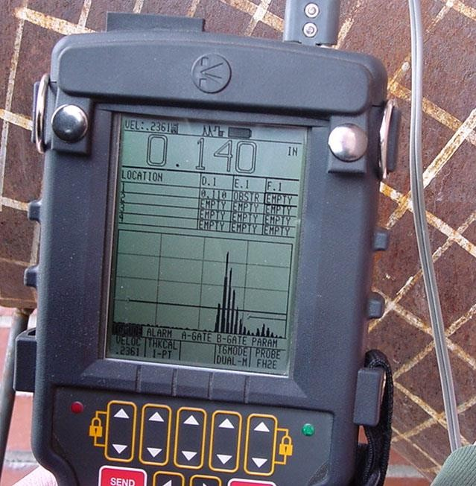
Thickness Gauging
Ultrasonic thickness gauging is routinely utilized in the petrochemical and utility industries to determine various degrees of corrosion/erosion.
Applications include piping systems, storage and containment facilities, and pressure vessels.

Slide 18
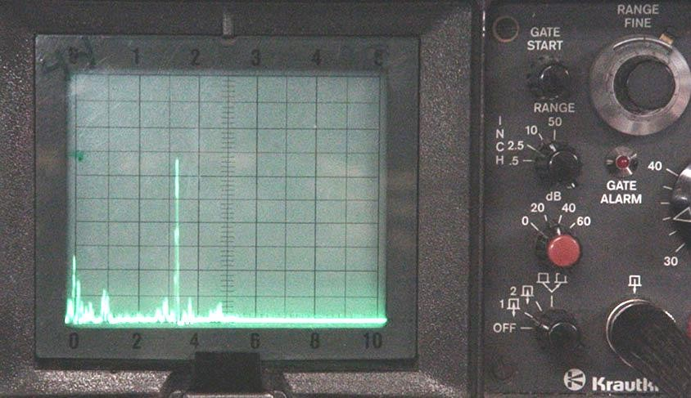
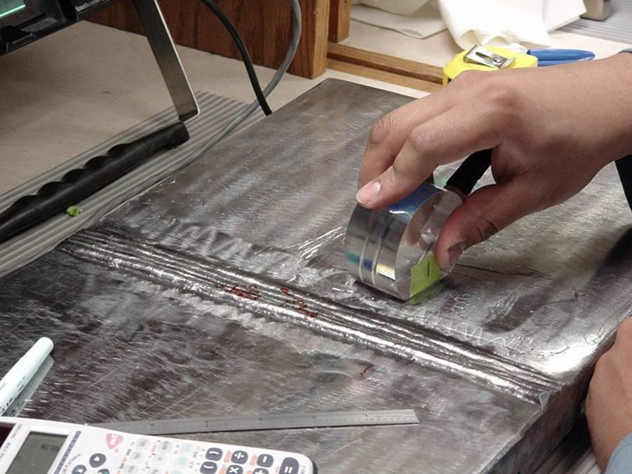
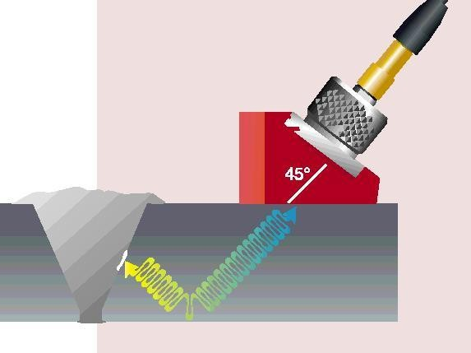
Flaw Detection in Welds
One of the most widely used methods of inspecting weldments is ultrasonic inspection.
Full penetration groove welds lend themselves readily to angle beam shear wave examination.

Slide 19
Equipment
Equipment for ultrasonic testing is very diversified. Proper selection is important to insure accurate inspection data as desired for specific applications.
In general, there are three basic components that comprise an ultrasonic test system:
Instrumentation
Transducers
Calibration Standards

Slide 20
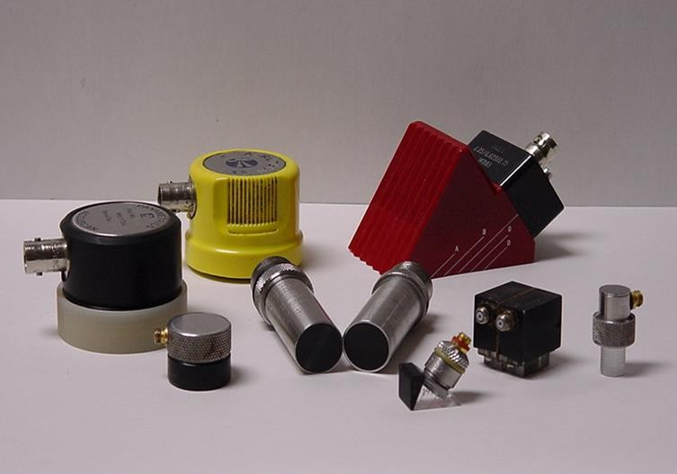
Transducers
Transducers are manufactured in a variety of forms, shapes and sizes for varying applications.
Transducers are categorized in a number of ways which include:
  Contact or immersion
  Single or dual element
  Normal or angle beam
In selecting a transducer for a given application, it is important to choose the desired frequency,
bandwidth, size, and in some cases focusing which optimizes the inspection capabilities.

Slide 21
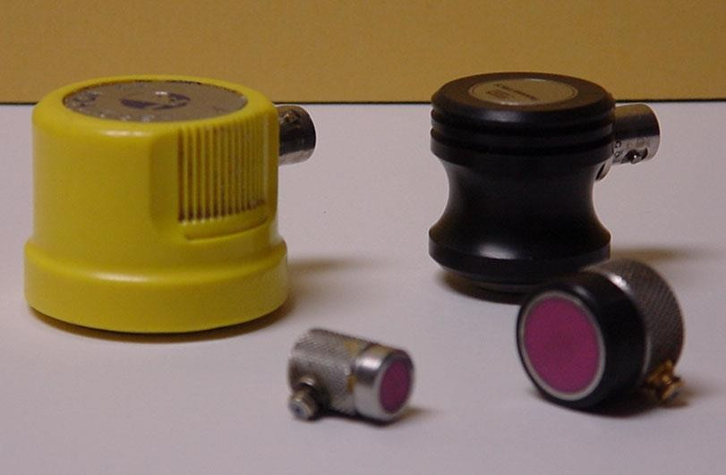
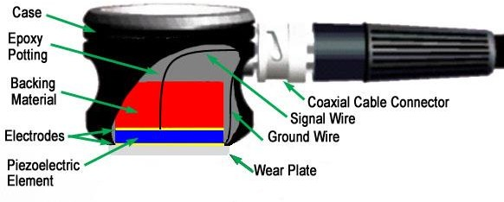
Contact Transducers
Contact transducers are designed to withstand rigorous use, and usually have a wear plate on the bottom surface to protect the piezoelectric element from contact with the surface of the test article.
Many incorporate ergonomic designs for ease of grip while scanning along the surface.

Slide 22
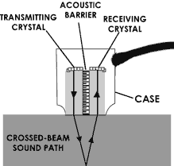
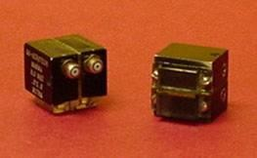
Contact Transducers (cont.)
Contact transducers are available with two piezoelectric crystals in one housing. These transducers are called dual element transducers.
One crystal acts as a transmitter, the other as a receiver.
Dual elements are commonly employed in thickness gauging of thi materials.
n

Slide 23
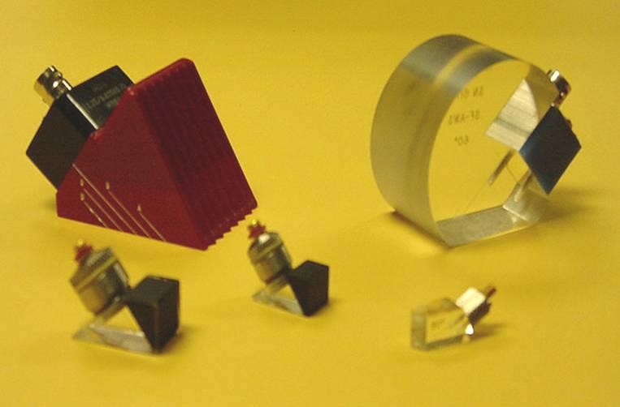
Transducers (cont.)
Angle beam transducers incorporate wedges to introduce a refracted shear wave into a material.
Transducers can use fixed or variable wedge angles.
Common application is in weld examination.

Slide 24
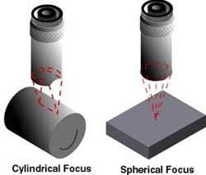
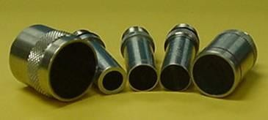
Transducers (cont.)
Immersion transducers are designed to transmit sound whereby the transducer and test specimen are immersed in a liquid coupling medium (usually water).
Immersion transducers are manufactured with
planar, cylindrical or spherical acoustic
lenses (focusing lens).

Slide 25
Instrumentation
Ultrasonic equipment is usually purchased to satisfy specific inspection needs, some users may purchase general purpose equipment to fulfill a number of inspection applications.
Test equipment can be classified in a number of different ways, this may include portable or stationary, contact or immersion, manual or automated.
Further classification of instruments commonly divides them into four general categories: D-meters, Flaw detectors, Industrial and special application.

Slide 26
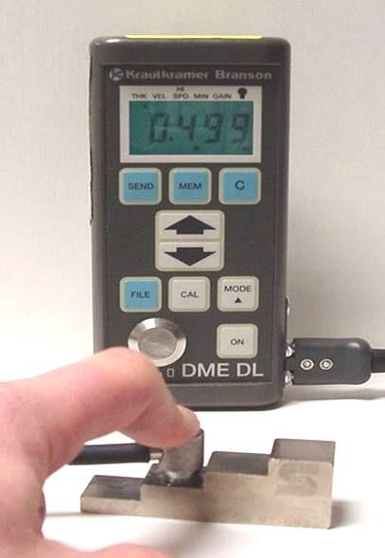
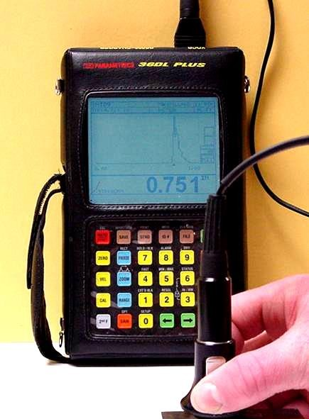
Instrumentation (cont.)
D-meters or digital thickness gauge instruments provide the user with a digital (numeric) readout.
They are designed primarily for corrosion/erosion inspection applications.
Some instruments provide the user with both a digital readout and a display of the signal. A distinct advantage of these units is that they allow the user to evaluate the signal to ensure that the digital measurements are of the desired features.

Slide 27
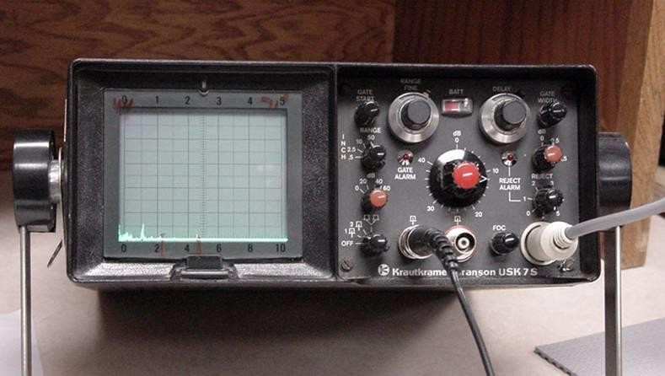
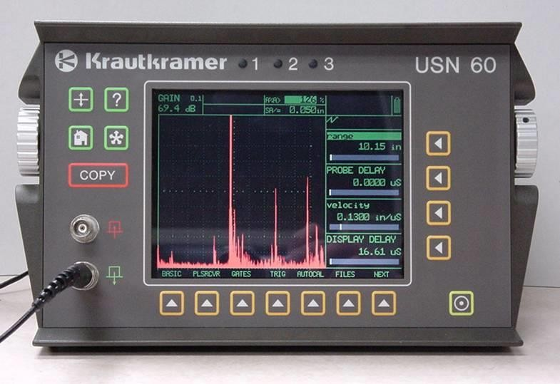
Instrumentation (cont.)
Flaw detectors are instruments designed primarily for the inspection of components for defects.
However, the signal can be evaluated to obtain other information such as material thickness values.
Both analog and digital displa
y.

Slide 28
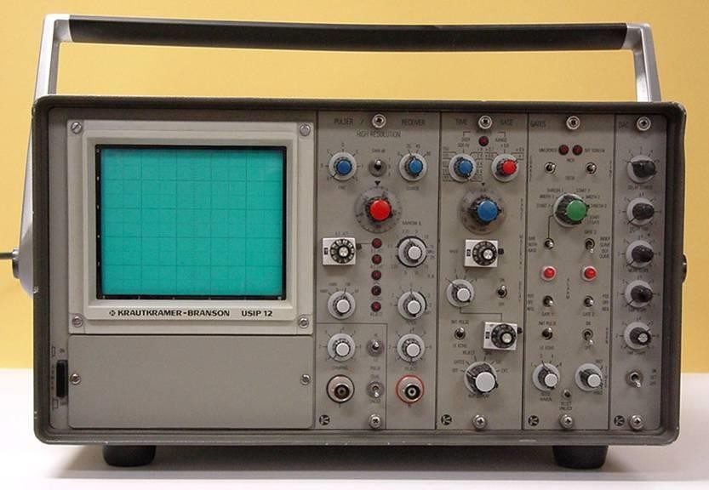
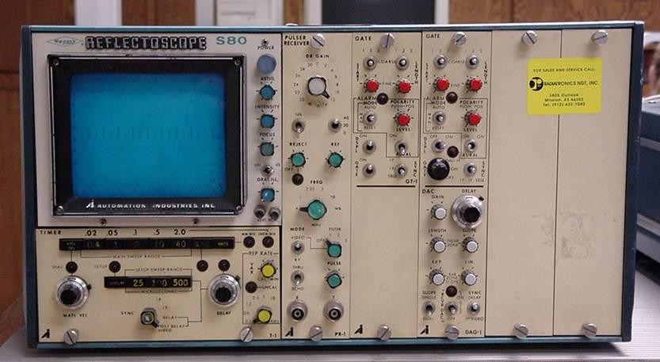
Instrumentation (cont.)
Industrial flaw detection instruments, provide users with more options than standard flaw detectors.
May be modulated units allowing users to tailor the instrument for their specific needs.
Generally not as portable as standard flaw detectors.

Slide 29
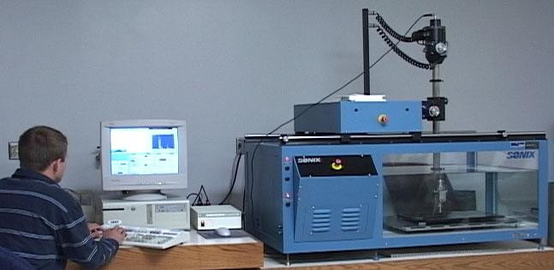
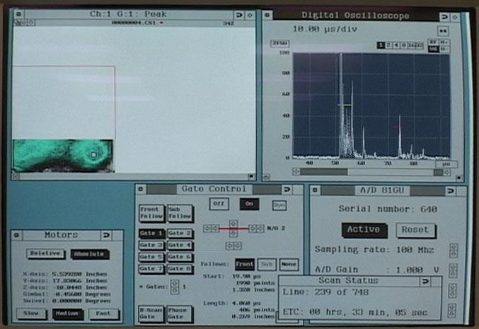
Instrumentation (cont.)
Immersion ultrasonic scanning systems are used for automated data acquisition and imaging.
They integrate an immersion tank, ultrasonic instrumentation, a scanning bridge, and computer controls.
The signal strength and/or the time- of-flight of the signal is measured for every point in the scan plan.
The value of the data is plotted using colors or shades of gray to produce detailed images of the surface or internal features of a component.

Slide 30
Calibration Standards
Calibration is a operation of configuring the ultrasonic test equipment to known values. This provides the inspector with a means of comparing test signals to known measurements.
Calibration standards come in a wide variety of material types, and configurations due to the diversity of inspection applications.
Calibration standards are typically manufactured from materials of the same acoustic properties as those of the test articles.
The following slides provide examples of specific types of standards.

Slide 31
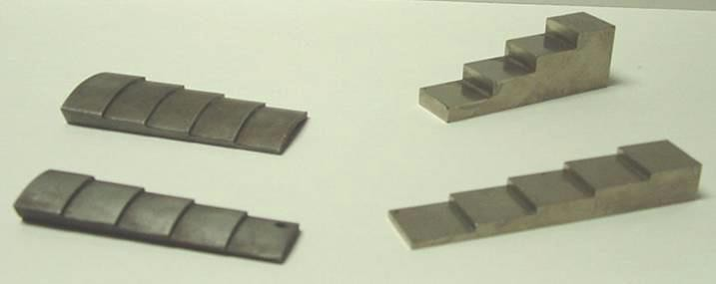
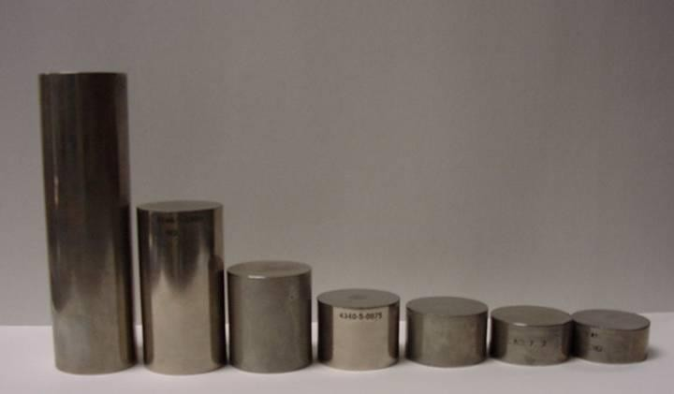
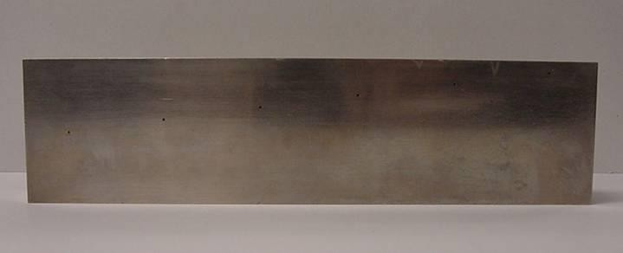
Calibration Standards (cont.)
Thickness calibration standards may be flat or curved for pipe and tubing applications, consisting of simple variations in material thickness.
Distance/Area Amplitude standards utilize flat bottom holes or side drilled holes to establish known reflector size with changes in sound path form the entry surface.
ASTM Distance/Area Amplitude
NAVSHIPS

Slide 32
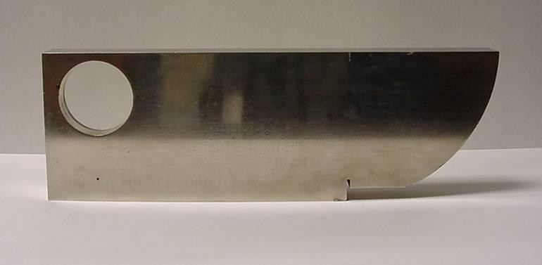
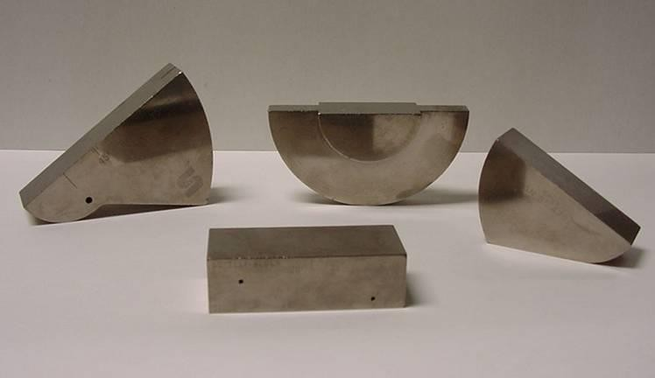
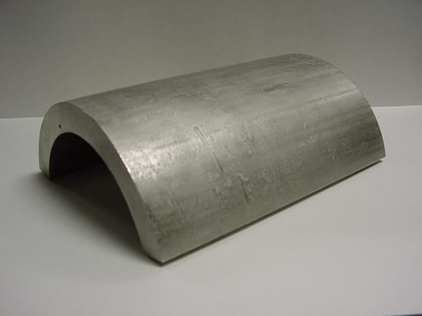
Calibration Standards (cont.)
There are also calibration standards for use in angle beam inspections when flaws are not parallel to entry surface.
These standards utilized side drilled holes, notches, and geometric configuration to establish time distance and amplitude relationships.
IIW
DSC
DC
Rhompas
SC
ASME Pipe Sec. XI
33

Slide 33
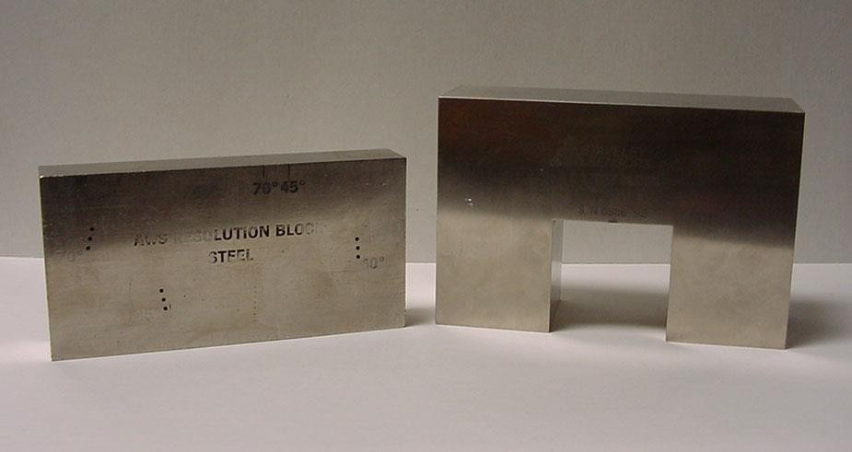
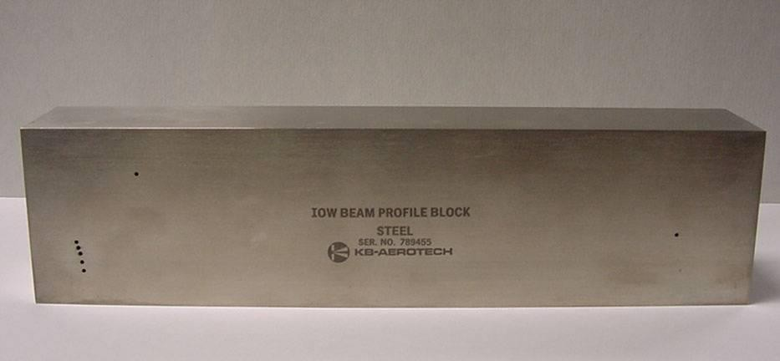
Qualification Standards
Qualification standards differ from calibration standards in that their use is for purposes of varying proper equipment operation and qualification of equipment use for specific codes and standards.
AWS Resolution
DC-dB Accuracy
IOW Beam Profile

Slide 34
Data Presentation
Information from ultrasonic testing can be presented in a number of differing formats.
Three of the more common formats include:
  A-scan
  B-scan
  C-scan
These three formats will be discussed in the next few slides.

Slide 35
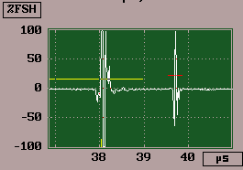
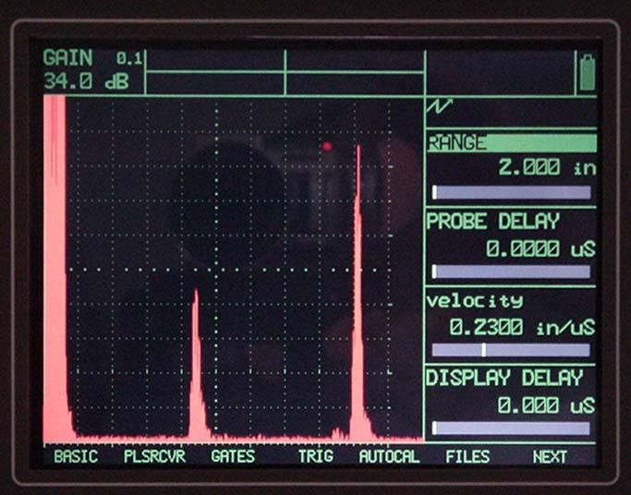
Data Presentation - A-scan
A-scan presentation displays the amount of received ultrasonic energy as a function of time.
Relative discontinuity size can be estimated by comparing the signal amplitude to that from a known reflector.
Reflector depth can be determined by the position of the signal on the horizontal sweep.
Signal Amplitude
Time
Signal Amplitude
Time

Slide 36
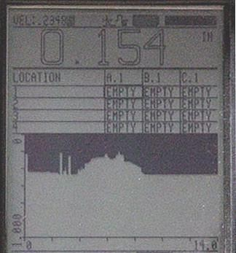

Data Presentation - B-scan
B-scan presentations display a profile view (cross-sectional) of a test specimen.
Only the reflector depth in the cross-section and the linear dimensions can be determined.
A limitation to this display technique is that reflectors may be masked by larger reflectors near the surface.

Slide 37



Data Presentation - C-scan
The C-scan presentation displays a plan type view of the test specimen and discontinuities.
C-scan presentations are produced with an automated data
acquisition system, such as in immersion scanning.
Use of A-scan in conjunction with C-scan is necessary when depth determination is desired.
38

Slide 38
Advantage of Ultrasonic Testing
Sensitive to both surface and subsurface discontinuities.
Depth of penetration for flaw detection or measurement is superior to other methods.
Only single-sided access is needed when pulse-echo technique is used.
High accuracy in determining reflector position and estimating size and shape.
Minimal part preparation required.
Electronic equipment provides instantaneous results.
Detailed images can be produced with automated systems.
Has other uses such as thickness measurements, in addition to flaw detection.

Slide 39
Limitations of Ultrasonic Testing
Surface must be accessible to transmit ultrasound.
Skill and training is more extensive than with some other methods.
Normally requires a coupling medium to promote transfer of sound energy into test specimen.
Materials that are rough, irregular in shape, very small, exceptionally thin or not homogeneous are difficult to inspect.
Cast iron and other coarse grained materials are difficult to inspect due to low sound transmission and high signal noise.
Linear defects oriented parallel to the sound beam may go
undetected.
Reference standards are required for both equipment calibration, and characterization of flaws.

