Slide 1
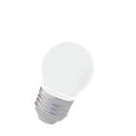

Eddy Current Testing

Slide 2
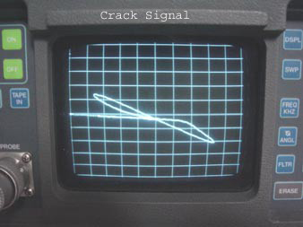
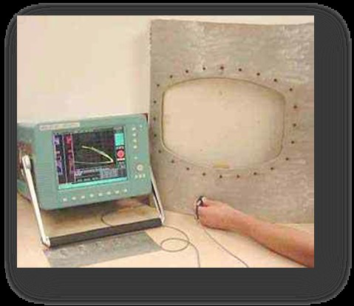
Eddy Current Testing
This method is widely used to detect surface flaws, to measure thin walls from one surface only, to measure thin coatings and in some applications to measure depth. This method is applicable to electrically conductive materials only. In this method eddy currents are produced in the product by bringing it close to an alternating current carrying coil. The main applications of the eddy current technique are for the detection of surface or subsurface flaws, conductivity measurement and coating thickness measurement.

Slide 3
Application of ECT
Crack Detection
Corrosion Monitoring
Material Thickness Measurements
Coating Thickness Measurements
Conductivity Measurements

Slide 4
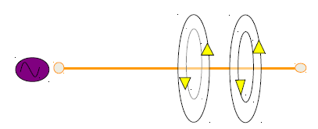
Electromagnetic Induction
•Eddy currents are created through a process called
electromagnetic induction.
•When alternating current is applied to the conductor, such as
copper wire, a magnetic field develops in and around the
conductor.
•This magnetic field expands as the alternating current rises to
maximum and collapses as the current is reduced to zero.

Slide 5
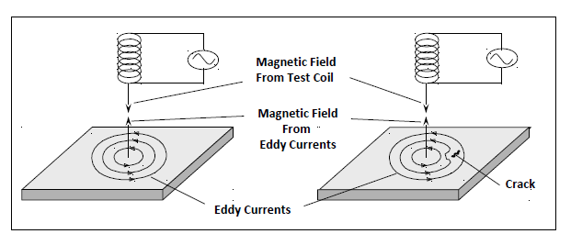
Crack Detection
Crack detection is one of the primary uses of eddy current
inspection. Cracks cause a disruption in the circular flow patterns
of the eddy currents and weaken their strength. This change in
strength at the crack location can be detected.

Slide 6
Limitations of Eddy Current Testing
Only conductive materials can be inspected.
Surface must be accessible to the probe.
Skill and training required is more extensive than other
techniques.
Surface finish and roughness may interfere.
Depth of penetration is limited.

Slide 7
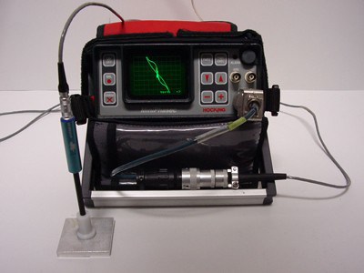
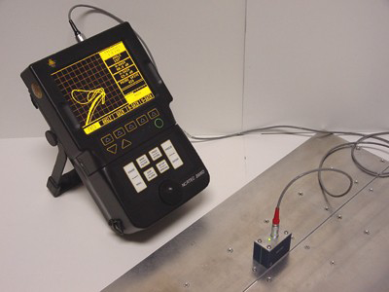
Eddy Current Testing Equipments

Slide 8
Probes - Mode of Operation
Eddy current probes are available in a large variety of shapes
and sizes. In fact, one of the major advantages of eddy current
inspection is that probes can be custom designed for a wide
variety of applications. Eddy current probes are classified by the
configuration and mode of operation of the test coils.

Slide 9
Advantages of Eddy Current Testing
Sensitive to small cracks and other defects
Detect surface and near surface defects
Inspection gives immediate results
Equipment is very portable
Method can be used for much more than flaw detection
Inspects complex shapes and sizes of conductive materials

Slide 10
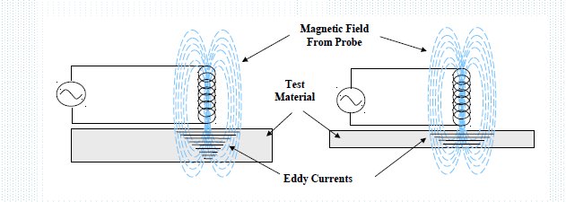
Eddy Current Testing
Applied to electrically conducting materials for defect detection.
Sensitive to small cracks and near surface cracks.
Physical Principal : Electromagnetism.
Used for sorting materials, control of dimensions, measuring coating thickness.

Slide 11
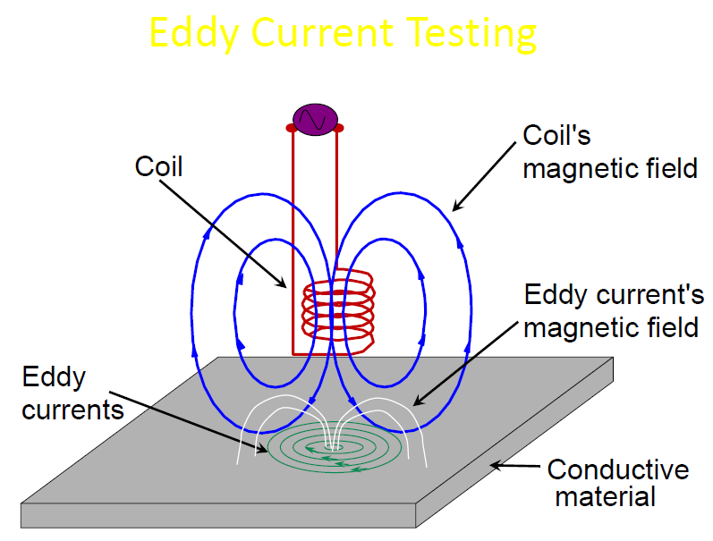

Slide 12


