Slide 1


Radiography Testing

Slide 2
Introduction
This module presents information on the NDT method of radiographic inspection or radiography.
Radiography uses penetrating radiation that is directed towards a component.
The component stops some of the radiation. The amount that is stopped or absorbed is affected by material density and thickness differences.
These differences in “absorption” can be recorded on film, or electronically.

Slide 3
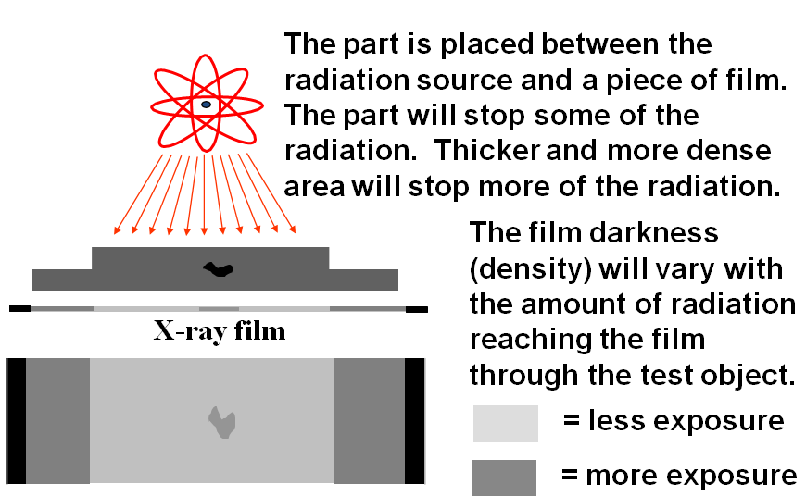
General Principles of Radiography

Slide 4
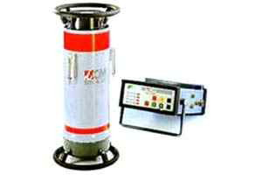
Radiography Testing
Radiography Testing (RT), or industrial radiography is a nondestructive testing (NDT) method of inspecting materials for hidden flaws by using the ability of short wavelength electromagnetic radiation (high energy photons) to penetrate various materials.
Radiographic Testing Method is nothing but to take the shadow picture of an object onto a film
by the passage of X-ray or Gamma ray through it. It is the same as the medical radiography (Xray). Only difference in their wave length.

Slide 5
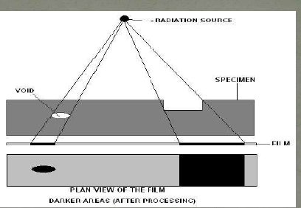
Radiography Testing
Short wavelength electromagnetic radiation (high energy photons) to penetrate various materials.
The amount of radiation emerging from the opposite side of the material can be detected and measured

Slide 6
Radiography Testing Process
The principles are the same for both X and Gamma radiography.
In X-radiography the penetrating power is determined by the number of volts applied to the X-Ray tube - in steel approximately 1000 volts per inch thickness is necessary.
To produce an X or Gamma radiograph, the film package is placed close to the surface of the subject. The source of radiation is positioned on the other side of the subject some distance away, so that the radiation passes through the subject and on to the film.

Slide 7
Radiography Testing Process
After the exposure period the film is removed, processed, dried, and then viewed by transmitted light on a special viewer.
Various radiographic and photographic accessories are necessary, including such items as radiation monitors, film markers, image quality indicators, darkroom equipment, etc.
Where the last is concerned there are many degrees of sophistication, including fully automatic processing units. These accessories are the same for both X and Gamma radiography systems.
Also required are such consumable items as radiographic film and processing chemicals

Slide 8
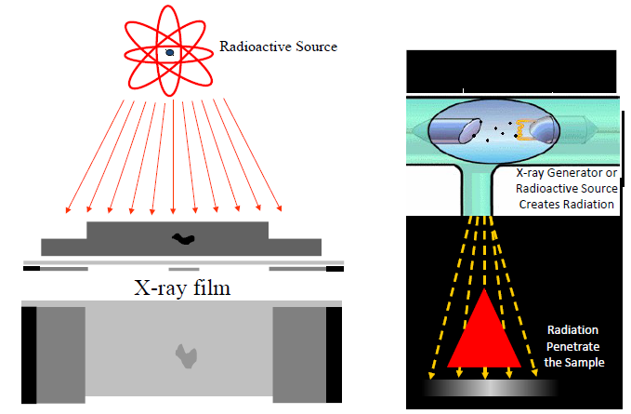
Radiography Testing Process

Slide 9
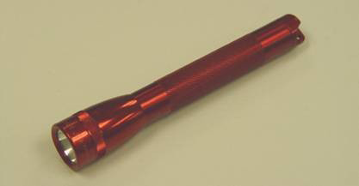
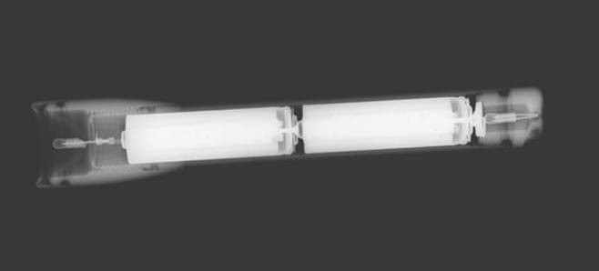
Radiographic Image

Slide 10
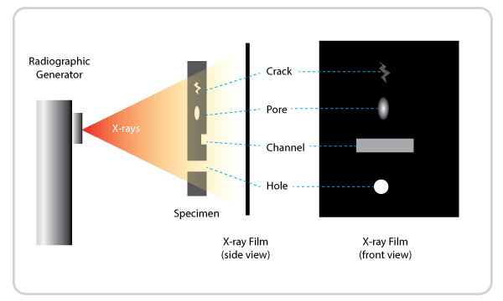
RADIOGRAPHIC TESTING
Radiographic Testing (RT), or industrial radiography, is a nondestructive testing (NDT) method of inspecting materials for hidden flaws by using the ability of short wavelength electromagnetic radiation (high energy photons) to penetrate various materials.

Slide 11
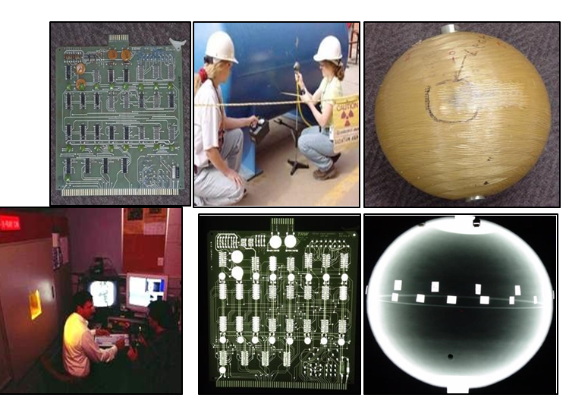
RADIOGRAPHIC TESTING

Slide 12
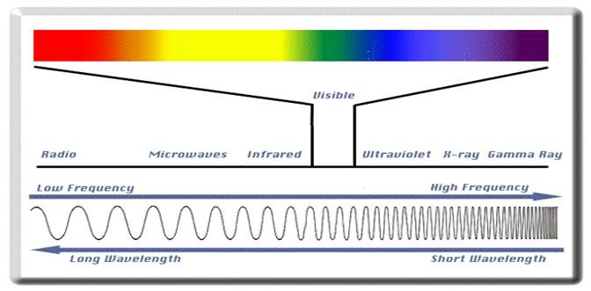
Electromagnetic Radiation
The radiation used in Radiography testing is a higher energy (shorter wavelength) version of the electromagnetic waves that we see every day. Visible light is in the same family as x- rays and gamma rays.

Slide 13
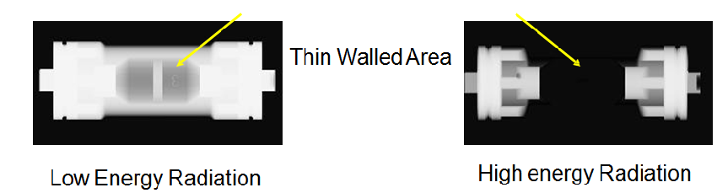
General Principles of Radiography
The energy of the radiation affects its penetrating power. Higher energy radiation can penetrate thicker and more dense materials.
The radiation energy and/or exposure time must be controlled to properly image the region of interest.

Slide 14
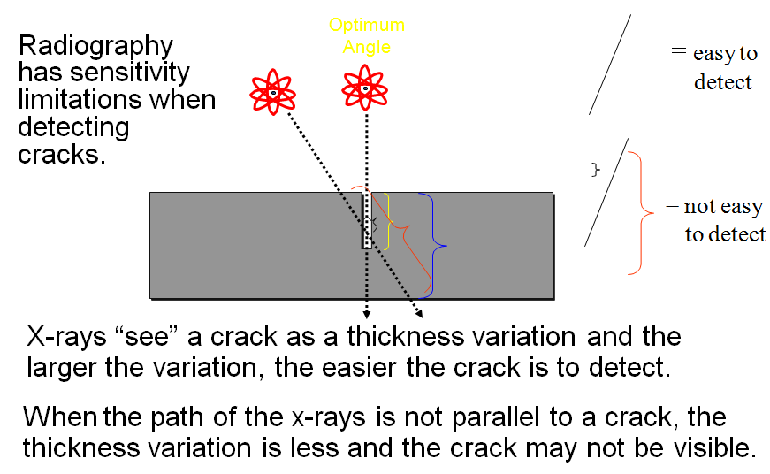
Flaw Orientation

Slide 15
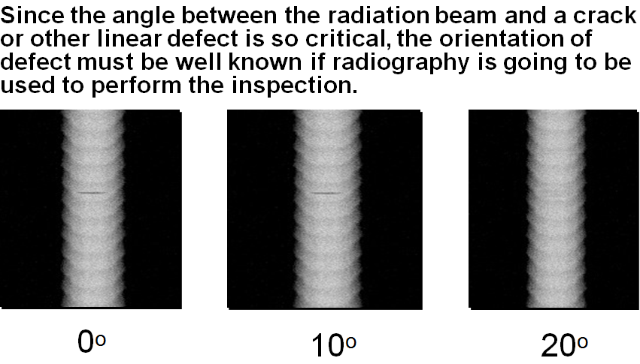
Flaw Orientation (cont.)

Slide 16
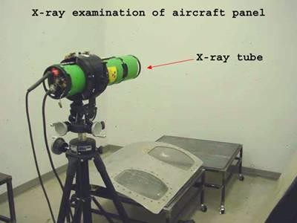
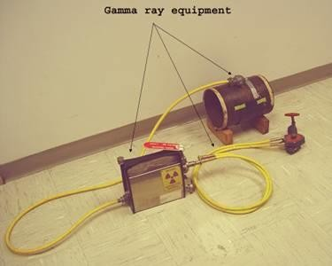


Radiation Sources
Two of the most commonly used sources of radiation in industrial radiography are x-ray generators and gamma ray sources. Industrial radiography is often subdivided into “X-ray Radiography” or “Gamma Radiography”, depending on the source of radiation used.

Slide 17
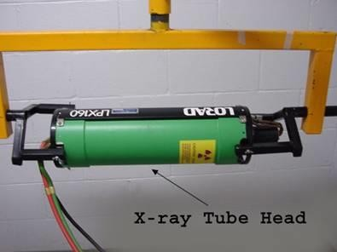
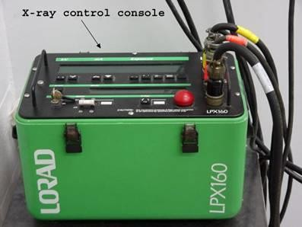
X-ray Radiography
Unlike gamma rays, x-rays are produced by an X-ray generator system. These systems typically include an X-ray tube head, a high voltage generator, and a control console.

Slide 18
Imaging Modalities
Several different imaging methods are available to display the final image in industrial radiography:
Film Radiography
Real Time Radiography
Computed Tomography (CT)
Digital Radiography (DR)
Computed Radiography (CR)

Slide 19
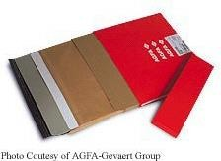
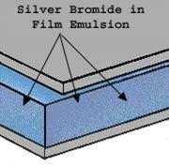
Film Radiography
One of the most widely used and oldest imaging mediums in industrial radiography is radiographic film.
Film contains microscopic material called silver bromide.
Once exposed to radiation and developed in a darkroom, silver bromide turns to black metallic silver which forms the image.

Slide 20
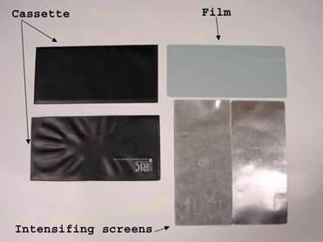
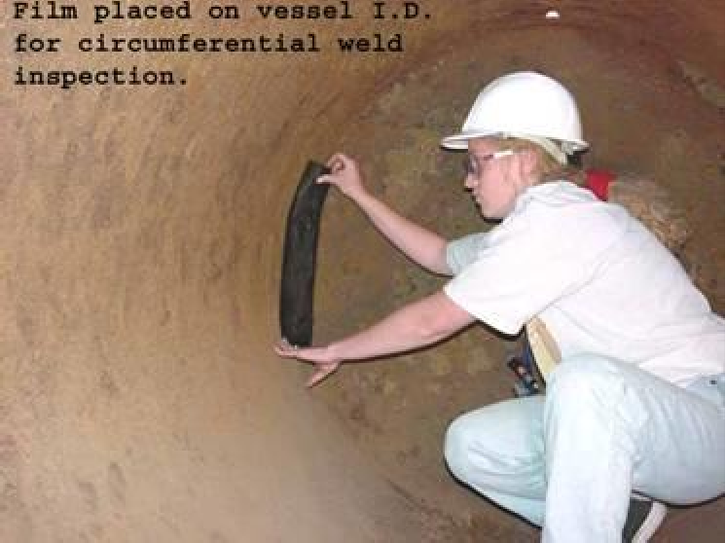
Film Radiography (cont.)
Film must be protected from visible light. Light, just like x-rays and gamma rays, can expose film. Film is loaded in a “light proof” cassette in a darkroom.
This cassette is then placed on the specimen opposite the source of radiation. Film is often placed between screens to intensify radiation.

Slide 21
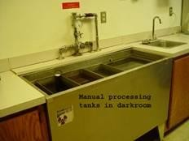
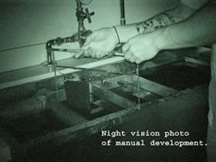
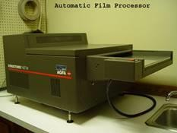
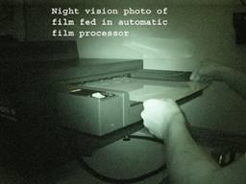
Film Radiography (cont.)
In order for the image to be viewed, the film must be “developed” in a darkroom. The process is very similar to photographic film development.
Film processing can either be performed manually in open tanks or in an automatic processor.

Slide 22
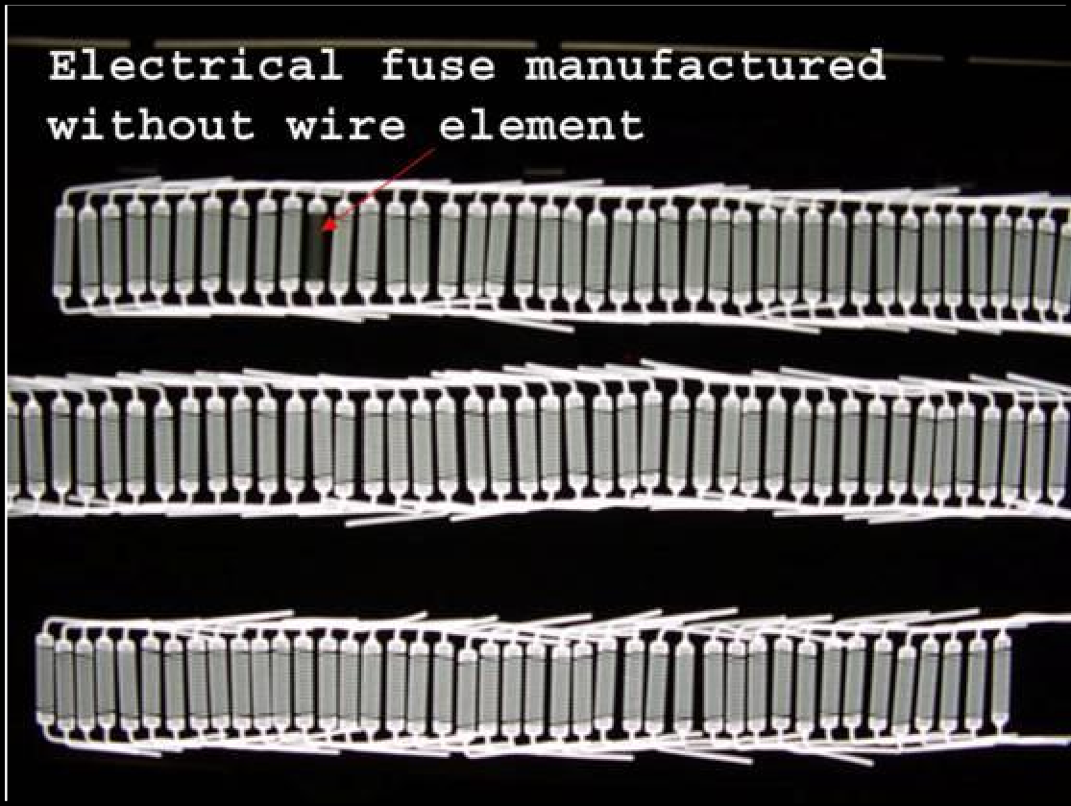
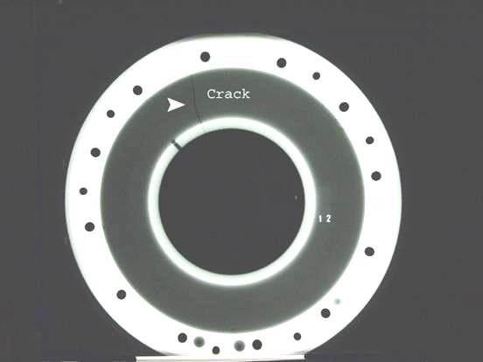
Film Radiography (cont.)
Once developed, the film is typically referred to as a “radiograph.”

Slide 23
Digital Radiography
One of the newest forms of radiographic imaging is “Digital Radiography”.
Requiring no film, digital radiographic images are captured using either special phosphor screens or flat panels containing micro-electronic sensors.
No darkrooms are needed to process film, and captured images can be digitally enhanced for increased detail.
Images are also easily archived (stored) when in digital form.

Slide 24
Digital Radiography (cont.)
There are a number of forms of digital radiographic imaging including:
Computed Radiography (CR)
Real-time Radiography (RTR)
Direct Radiographic Imaging (DR)
Computed Tomography

Slide 25
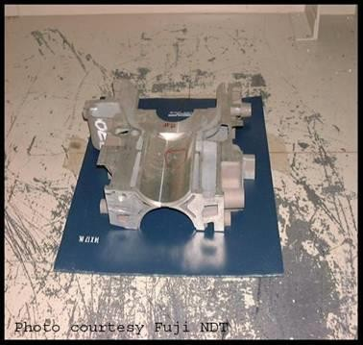
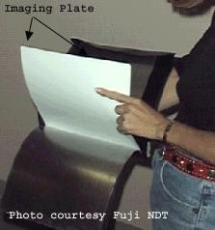
Computed Radiography
Computed Radiography (CR) is a digital imaging process that uses a special imaging plate which employs storage phosphors.

Slide 26
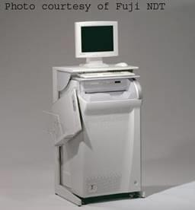
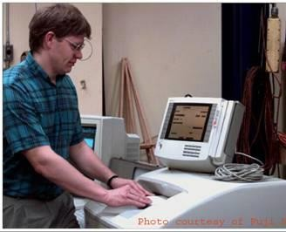
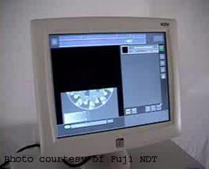
Computed Radiography (cont.)
The imaging plate is read electronically and erased for re- use in a special scanner system.

Slide 27
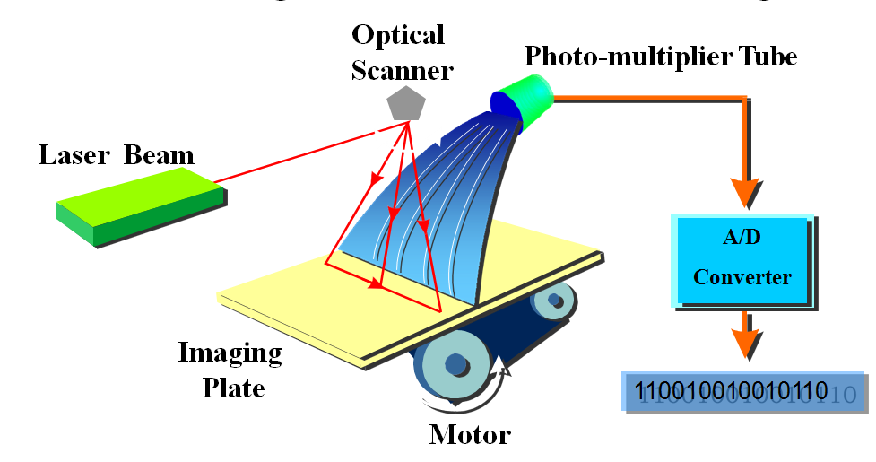
Computed Radiography (cont.)
As a laser scans the imaging plate, light is emitted where X- rays stimulated the phosphor during exposure. The light is then converted to a digital value.

Slide 28
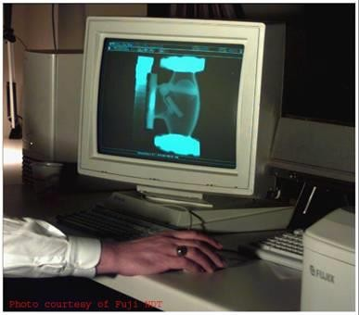
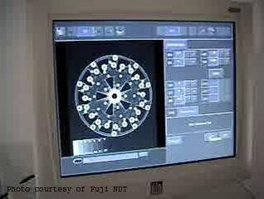
Computed Radiography (cont.)
Digital images are typically sent to a computer workstation where specialized software allows manipulation and enhancement.

Slide 29
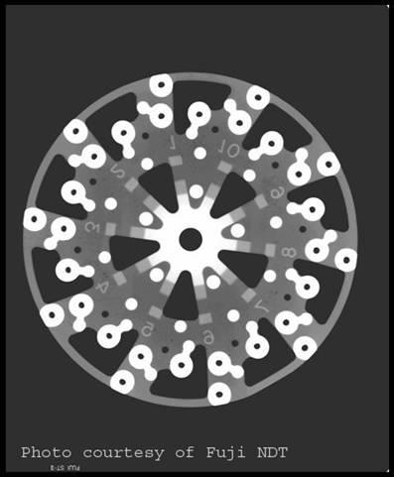
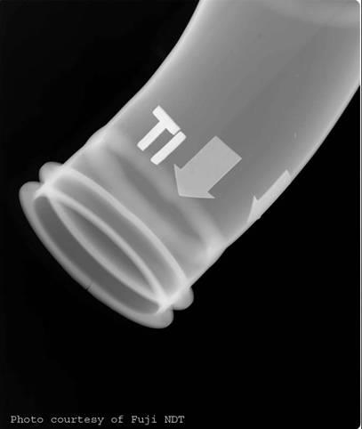
Computed Radiography (cont.)
Examples of computed radiographs:

Slide 30
Real-Time Radiography
Real-Time Radiography (RTR) is a term used to describe a form of radiography that allows electronic images to be captured and viewed in real time.
Because image acquisition is almost instantaneous, X-ray images can be viewed as the part is moved and rotated.
Manipulating the part can be advantageous for several reasons:
  It may be possible to image the entire component with one exposure.
  Viewing the internal structure of the part from different angular
prospectives can provide additional data for analysis.
  Time of inspection can often be reduced.

Slide 31
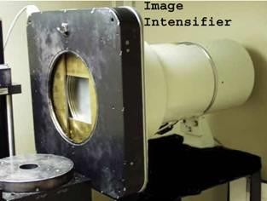
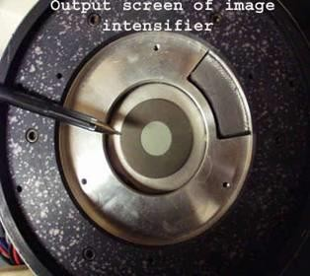
Real-Time Radiography (cont.)
The image intensifier is a device that converts the radiation that passes through the specimen into light.
It uses materials that fluoresce when struck by radiation.
The more radiation that reaches the input screen, the more light that is given off.
The image is very faint on the input screen so it is intensified onto a small screen inside the intensifier where the image is viewed with a camera.

Slide 32
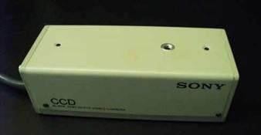
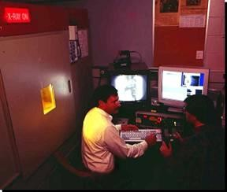
Real-Time Radiography (cont.)
A Special Camera Which Captures The Light Output Of The Screen Is Located Near The Image Intensifying Screen.
The Camera Is Very Sensitive To A Variety Of Different Light Intensities.
A monitor is then connected to the camera to provide a viewable image.
If a sample positioning system is employed, the part can be moved around and rotated to image different internal features of the part.

Slide 33
Real-Time Radiography (cont.)
A special camera which captures the light output of the screen is located near the image intensifying screen.
The camera is very sensitive to a variety of different light intensities.
A monitor is then connected to the camera to provide a viewable image.
If a sample positioning system is employed, the part can be moved around and rotated to image different internal features of the part.

Slide 34
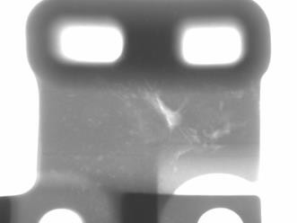
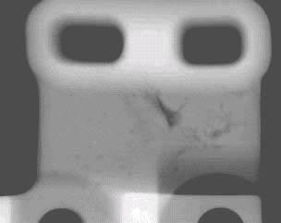

Comparing Film and Real-Time Radiography
Real-time images are lighter in areas where more X-ray photons reach and excite the fluorescent screen.
Film images are darker in areas where more X-ray photons reach and ionize the silver molecules in the film.

Slide 35
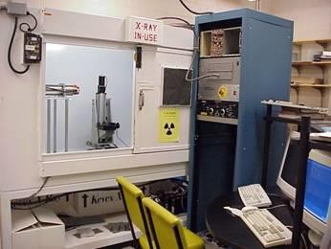
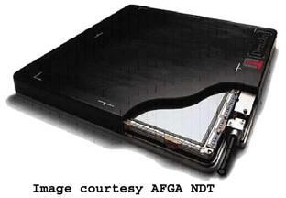
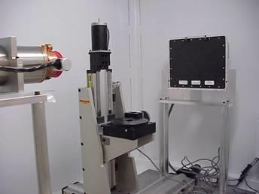
Direct Radiography
Direct radiography (DR) is a form of real-time radiography that uses a special flat panel detector. The panel works by converting penetrating radiation passing through the test specimen into minute electrical charges.
The panel contains many micro- electronic capacitors. The capacitors form an electrical charge pattern image of the specimen.
Each capacitor’s charge is converted into a pixel which forms the digital image.

Slide 36
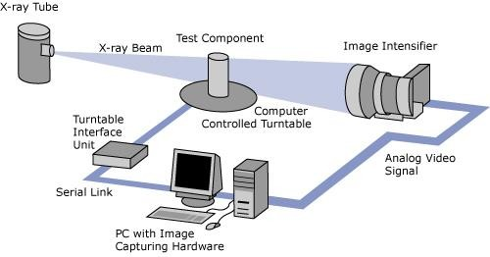
Computed Tomography
Computed Tomography (CT) uses a real-time inspection system employing a sample positioning system and special software.

Slide 37
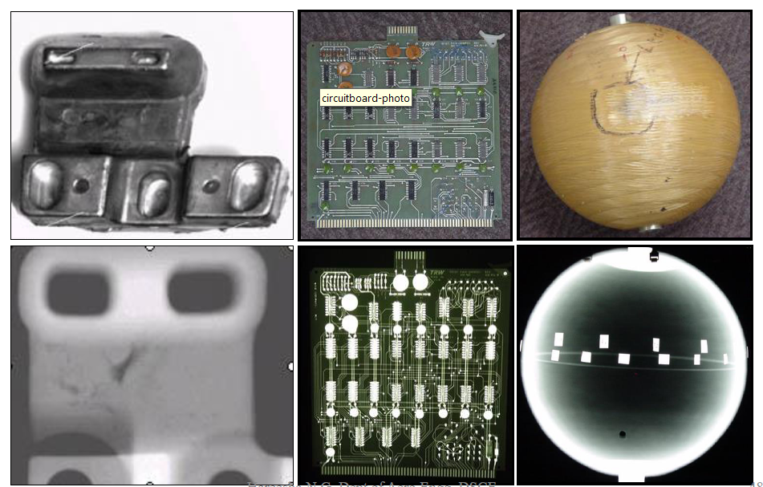
Radiographic Images

Slide 38
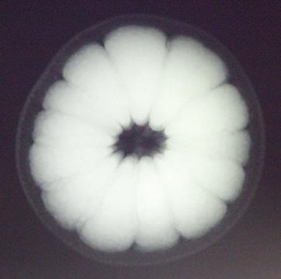

Radiographic Images

Slide 39
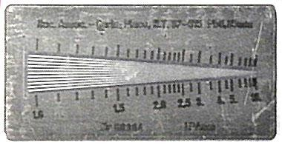
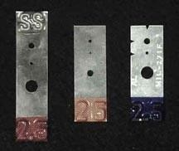

Image Quality
Image quality is critical for accurate assessment of a test specimen’s integrity.
Various tools called Image Quality Indicators (IQIs) are used for this purpose.
There are many different designs of IQIs. Some contain artificial holes of varying size drilled in metal plaques while others are manufactured from wires of differing diameters mounted next to one another.

Slide 40



Image Quality (cont.)
IQIs are typically placed on or next to a test specimen.
Quality typically being determined based on the smallest hole or wire diameter that is reproduced on the image.

Slide 41

Radiation Safety
Use of radiation sources in industrial radiography is heavily regulated by state and federal organizations due to potentia public and personal risks

Slide 42


Radiation Safety (cont.)
There are many sources of radiation. In general, a person receives roughly 100 mrem/year from natural sources and roughly 100 mrem/year from manmade sources

Slide 43

Radiation Safety
Ionizing radiation is an extremely important NDT tool but it can pose a hazard to human health. For this reason, special precautions must be observed when using and working around ionizing radiation.
Complicating matters further is the fact that Gamma and X-ray radiation are not detectable by the human body. However, the risks can be minimized when the radiationis handled and managed properly.

Slide 44

Radiation Safety (cont.)
X-rays and gamma rays are forms of ionizing radiation, which means that they have the ability to form ions in the material that is penetrated. All living organisms are sensitive to the effects of ionizing radiation (radiation burns, x-ray food pasteurization, etc.)
X-rays and gamma rays have enough energy to liberate electrons from atoms and damage the molecular structure of cells. This can cause radiation burns or cancer.

Slide 45

Radiation Safety (cont.)

Slide 46


Radiation Safety (cont.)
There are three means of protection to help reduce exposure to radiation:

Slide 47
Advantages & Disadvantages of Radiography Testing

Slide 48
Advantages of Radiography Testing
Information is presented pictorially.
A permanent record is provided which may be viewed at a time and place distant from the test.
Useful for thin sections.
Sensitivity declared on each film suitable for any material.

Slide 49
Advantages of Radiography
Technique is not limited by material type or density.
Can inspect assembled components.
Minimum surface preparation required.
Sensitive to changes in thickness, corrosion, voids, cracks, and material density changes.
Detects both surface and subsurface defects.

Slide 50
Limitations of Radiography Testing
Possible health hazard.
Need to direct the beam accurately for two-dimensional defects.
Film processing and viewing facilities are necessary
Not suitable for automation.
Not suitable for surface defects.

Slide 51
Disadvantages of Radiography
Many safety precautions for the use of high intensity radiation.
Many hours of technician training prior to use.
Access to both sides of sample required.
Orientation of equipment and flaw can be critical.
Determining flaw depth is impossible without additional angled exposures.
Expensive initial equipment cost.

