Slide 1


Acoustic emmision

Slide 2
Acoustic Emission Testing
Acoustic monitoring is used to detect growing or active faults.
When materials are deformed, stressed or undergo some permanent deformation such as crack propagation.
they emit very high frequency sound waves. These acoustic emissions can be detected with the use of electronic equipment such as transducers, microprocessors and amplifiers.
This acoustic emission indicates any dynamic change within the material. This test can be done on any material and fibre failure in composite materials

Slide 3
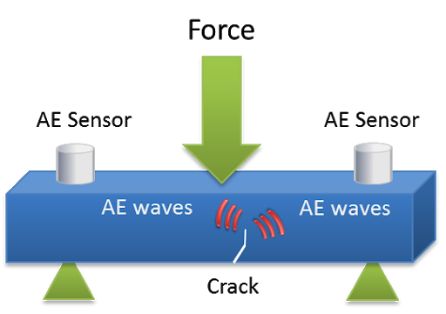
Acoustic Emission Testing
Acoustic Emission Testing is performed by applying a localized external force such as an abrupt mechanical load or rapid temperature or pressure change to the part being tested.
The resulting stress waves in turn generate short-lived, high frequency elastic waves in the form of small material displacements, or plastic deformation, on the part surface that are detected by sensors that have been attached to the part surface.
When multiple sensors are used, the resulting data can be evaluated to locate discontinuities in the part.

Slide 4
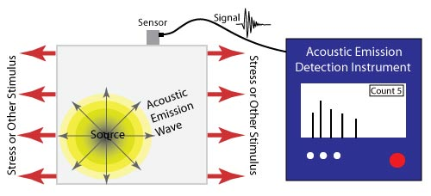
Acoustic Emission Testing
Acoustic Emission (AE) refers to the generation of transient elastic waves produced by a sudden redistribution of stress in a material.
When a structure is subjected to an external stimulus (change in pressure, load, or temperature), localized sources trigger the release of energy, in the form of stress waves, which propagate to the surface and are recorded by sensors. With the right equipment and setup, motions on the order of pico-meters (10 -12 m) can be identified.

Slide 5
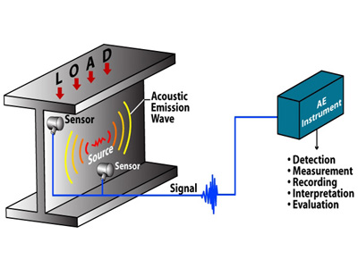
AE systems can only qualitatively gauge how much damage is contained in a structure.
In order to obtain quantitative results about size, depth, and overall acceptability of a part, other NDT methods (often ultrasonic testing) are necessary. Another drawback of AE stems from loud service environments which contribute extraneous noise to the signals.

Slide 6
Acoustic Emission Testing
Acoustic emissions can result from the initiation and growth of cracks, slip and dislocation movements, twinning, or phase transformations in metals.
AE’s originate when a stress is exerted on a material, a strain is induced in the material as well. Depending on the magnitude of the stress and the properties of the material, an object may return to its original dimensions or be permanently deformed after the stress is removed.
These two conditions are known as elastic and plastic deformation, respectively.

Slide 7
Acoustic Emission Testing
The most detectible acoustic emissions take place when a loaded material undergoes plastic deformation or when a material is loaded at or near its yield stress.
On the microscopic level, as plastic deformation occurs, atomic planes slip past each other through the movement of dislocations. These atomic-scale deformations release energy in the form of elastic waves which “can be thought of as naturally generated ultrasound” traveling through the object.
When cracks exist in a metal, the stress levels present in front of the crack tip can be several times higher than the surrounding area. Therefore, AE activity will also be observed when the material ahead of the crack tip undergoes plastic deformation.

Slide 8
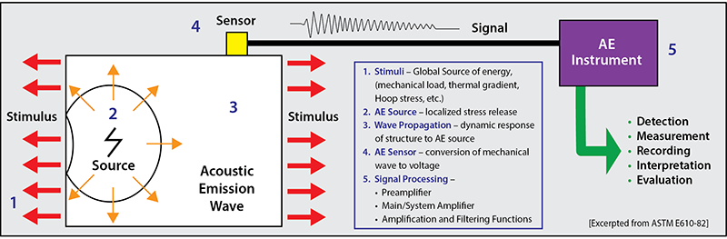

Slide 9
Acoustic Emission Instrumentation
Specialized equipment is necessary to detect the wave energy and decipher which signals are meaningful.
Typical AE apparatus consist of the following components:
Sensors used to detect AE events.
Preamplifiers amplifies initial signal. Typical amplification gain is 40 or 60 dB.
Cables transfer signals on distances up to 200m to AE devices. Cables are typically of coaxial type.
Data acquisition device performs filtration, signals’ parameters evaluation, data analysis and charting.

Slide 10

Acoustic Emission Testing
Typical Schematic of AE instrumentation
Sensors
Preamplifiers
with filters
Main amplifiers
with filters
Measurement Circuitry
Computer
Acquisition software
Data
storage
Data presentation

Slide 11
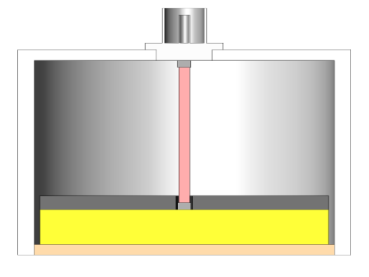
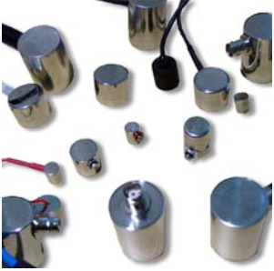
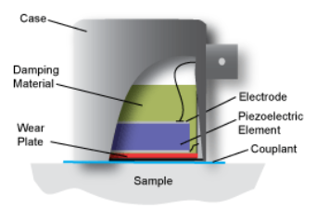
AE Sensors
AE sensors detect stress wave motion that cause a local dynamic material displacement and converts this displacement to an electrical signal.
AE sensors are typically piezoelectric sensors with elements made of special ceramic elements like lead zirconate titanate (PZT). Mechanical strain of a piezo element generates an electric signals.
Sensors may have internally installed preamplifier Other types of sensors include capacitive transducers, laser interferometers.

Slide 12
Sensors Characteristics
Typical frequency range between 30kHz and 1 MHz.
Selection of a specific sensor depends on the application and type of flaws to be revealed.
Transducers are selected based on operating frequency, sensitivity and environmental characteristics, and are grouped into two classes: resonant and broadband.
The majority of AE equipment is responsive to movement in its typical operating frequency range of 30 kHz to 1 MHz. For materials with high attenuation (e.g. plastic composites), lower frequencies may be used to better distinguish AE signals. The opposite holds true as well.

Slide 13
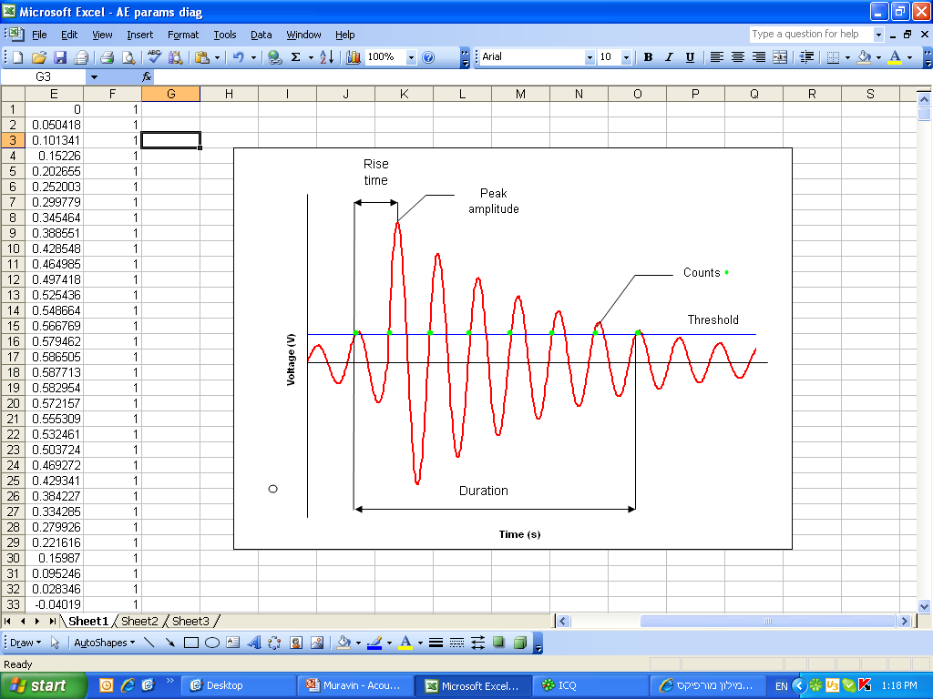
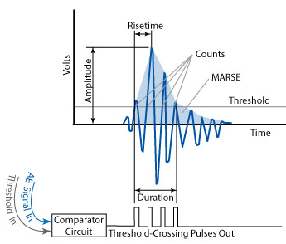
AE Parameters

Slide 14
Acoustic Emission Testing
Background Noise
Background noise significantly affects the result of AE testing and need to be considered and controlled.
Types of noise:
Hydraulic noise –Cavitations, turbulent flows, boiling of fluids and leaks.
Mechanical noise –Movement of mechanical parts in contact with the structure e.g. fretting of pressure vessels against their supports caused by elastic expansion under pressure.
Cyclic noise – Repetitive noise such as that from reciprocating or rotating machinery.
Electro-magnetic noise.

Slide 15
Acoustic Emission Testing
AE Source Location Techniques
Locating the source of acoustic emissions is often accomplished by one of three methods
Linear Location Technique
Point Location
Zonal Location Technique

Slide 16
Acoustic Emission Testing
Linear Location
Linear location is a time difference method commonly used to locate AE source on linear structures such as pipes. It is based on the arrival time difference between two sensors for known velocity.
Sound velocity evaluated by generating signals at know distances.
D
d

Slide 17
Acoustic Emission Testing
Zone Location
Zone location is based on the principle that the sensor with the highest amplitude or energy output will be closest to the source.
Zonal location aims to trace the waves to a specific zone or region around a sensor.
Zones can be lengths, areas or volumes depending on the dimensions of the array.
With additional sensors added, a sequence of signals can be detected giving a more accurate result using time differences and attenuation characteristics of the wave.

Slide 18
Applications of AE
Acoustic emission is a very versatile, non-invasive way to gather information about a material or structure.
Acoustic Emission testing (AET) is be applied to inspect and monitor pipelines, pressure vessels, storage tanks, bridges, aircraft, and bucket trucks, and a variety of composite and ceramic components. It is also used in process control applications such as monitoring welding processes. A few examples of AET applications follow
Inspection of Pressure Vessels
Weld Monitoring
Bucket Truck (Cherry Pickers) Integrity Evaluation
Gas Trailer Tubes
Bridges
Aerospace Structures

Slide 19
Advantages & Disadvantages of Acoustic emmision

Slide 20
Advantages of Acoustic Emission
High sensitivity.
Early and rapid detection of defects, flaws, cracks etc.
Real time monitoring
Cost Reduction
Defective area location: only critical defects provide sustainable Acoustic Emission sources.

Slide 21
Advantages of Acoustic Emission
Minimization of plant downtime for inspection, no need for scanning the whole structural surface.
Minor disturbance of insulation.
Application of Artificial Intelligence (AI) and Technological Packages: Expert systems for evaluating the condition of metallic pressure systems and tank bottoms based on the acquired experience of a huge number of tests are world wide used

Slide 22
Disadvantage of Acoustic Emission
The disadvantage of acoustic emission monitoring is that commercial acoustic emissions systems can only estimate qualitatively how much damage is in the material and approximately how long the components will last. So, other methods are still needed to do more thorough examinations and provide quantitative results.
Operating environments are often very noisy, and the acoustic emission signals are usually very weak. Thus, signal discrimination can be very difficult, yet extremely important for successful applications.
Although acoustic emissions have been used in materials-related studies for about four decades, many problems still exist. The most important difficulty is associated with the reliability of acoustic emissions results.

