Slide 1
Personal Protective Equipment
(PPE)
OSHA Standard
29 CFR
1926.95
1910 Sub Part I
Notes:
As a provider Owe it to family Owe it to yourself to understand the dangers and hazzards that exist on the job, and how to protect your self against them.
Owe it to your employer so that your safe practices enable your employer to secure future jobs which is more work and more money in your pocket
It is my mission to ensure that you return home, in the same condition in which you left
I know your busy….so I have taken tons of safety content conducted in the field with hard working men and women such as you
Compiled it into short, convenient, yet effective courses that you can take any where...in your truck, at home on the couch, or on your lunch break right on your phone or computer.

Slide 2
What You Will Get
Understand what the law says
Policies that will protect you…exceed the standard
Different types of PPE and what it protects
Simple care and maintenance of you PPE
Components of a PPE program at your work
Years of field trainings condensed in this easy and efficient course

Slide 3
This Course Is Yours
Download the slides for field training
Enroll colleagues and employees in this course
Download the videos for group training
Use this course as initiative
Present it to employers and safety departments

Slide 4

Your Family Needs You
Your responsibility to protect yourself:
  Family
  Co-workers
  Employers
  Yourself

Slide 5
7 Most Expensive Words In Business
“But we have always done it this way”
The world is changing rapidly, and we need to adapt and overcome
Things we have put our bodies through assuming we’ve been doing ‘it’ the right way.
There is always a safer way to do something.
Just because ‘its always been done’ a certain way, doesn’t mean its right.
Because something has been a certain way is usually because it’s the cheap way of doing it, and when you do things to save money, risk increases.
Pause…Think! You have all the tools.
Notes:
There is a time and aplace for those expensive words…but NOT at the risk of your health and safety
I wonder how much pain has been suffered, and lives and money lost because of those 7 words...because we didn’t change something simply because its the way we’ve always done it.

Slide 6
Hero
Be an enabler, promote keeping yourself, and others safe.
Be a hero…remain open to new ideas in safety, and YOU discover ways to save lives by preventing bad accidents from happenig in the first place.

Slide 7


The Law
29 CFR 1926.95 Protective equipment including personal protective equipment for eyes, face, head, and extremities, protective clothing, respiratory devices, and protective shields and barriers shall be provided, used and maintained in a sanitary and reliable condition wherever it is necessary by reason of hazards or processes or environment, chemical hazards, radiological hazards, or mechanical irritants encountered in a manner capable of causing injury or impairment in the function of any body part through absorption, inhalation, or physical contact.

Slide 8
Policy that protects you!
Maintain and clean your PPE
Inspect your PPE prior to use
Equipment must be used in the manner it was designed for
Right personal protective equipment for the right job
Training on proper use of the personal protective equipment
No Exceptions

Slide 9
Hard Hats: Head
Safety Glasses: Eyes
Safety Vests: Body and clothing
Gloves: Hands Fingers, & Arms
Safety Boots/Shoes: Feet
Face Shields: Eyes & Face
Earplugs and ear muffs: Hearing and ears
Metatarsal Protection: Feet
Respirator mask: Lungs
Welding shields: Eyes & Skin
Rubber boots: feet and skin
Types of PPE
&
What They Protect

Slide 10
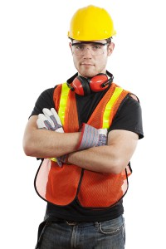
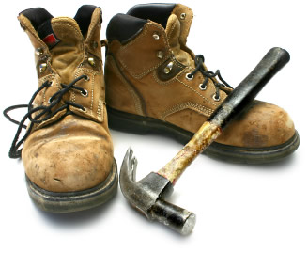
All phases of work!
Hard hat
Safety Glasses
Safety Vest
Gloves
Boots

Slide 11

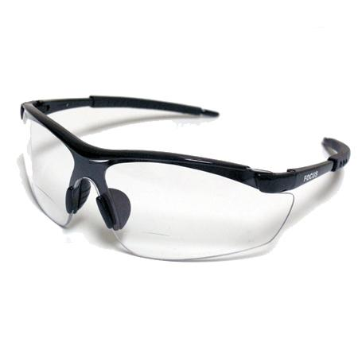
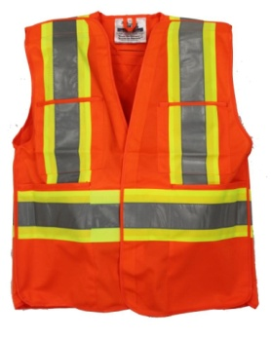
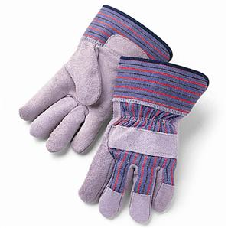

Use for protection against falling or flying objects, electrical and bump hazards
Use for protection from dust, dirt, metal, chemical splash, and flying objects
Use for protection against being struck by heavy equipment operating at the site. Protects against hazardous chemicals
Use for protection against sparks, moderate heat, blows, chips and rough objects. Protects against chemicals, cuts, and abrasions.
For protection against heavy objects striking the foot, sharp objects piercing the soles, slippery surfaces, and electrical hazards

Slide 12
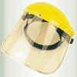
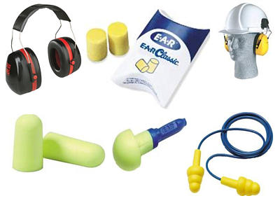
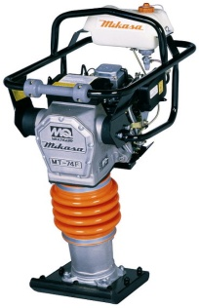
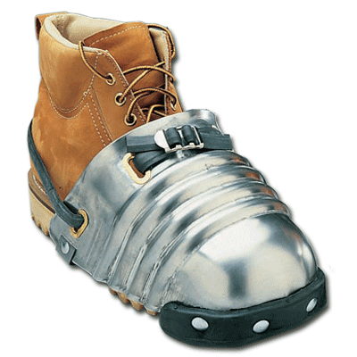
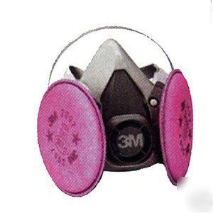
Protects face against flying objects and chemical splash
Protects against excessive noise. Wear at decibel levels greater than 85db
Protects feet against high pressure impacts, falling objects and being struck. Use when operating a jumping jack
=
Protects lungs from harmful dusts, vapors, or mists such as concrete dust and paint

Slide 13
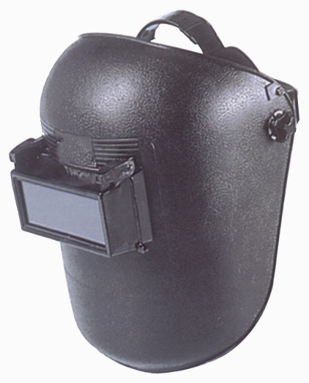
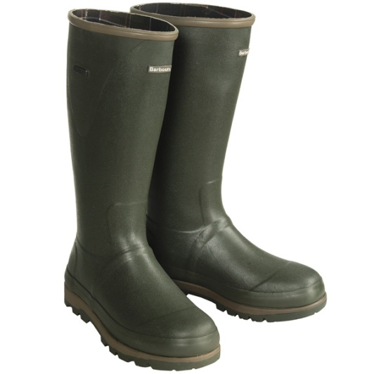
Protects against retinal burn, cataracts, and blindness that can occur from welding
Protects feet from chemical burn from concrete chemicals present during concrete pours

Slide 14
A simple yet effective personal protective equipment program for YOU to use.

Slide 15
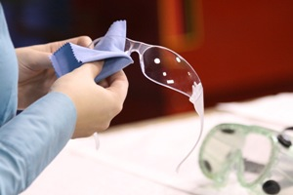
A Good PPE Program For You To Use
Clean safety glasses daily

Slide 16

Safety Glasses
(Differences)
VS

Slide 17
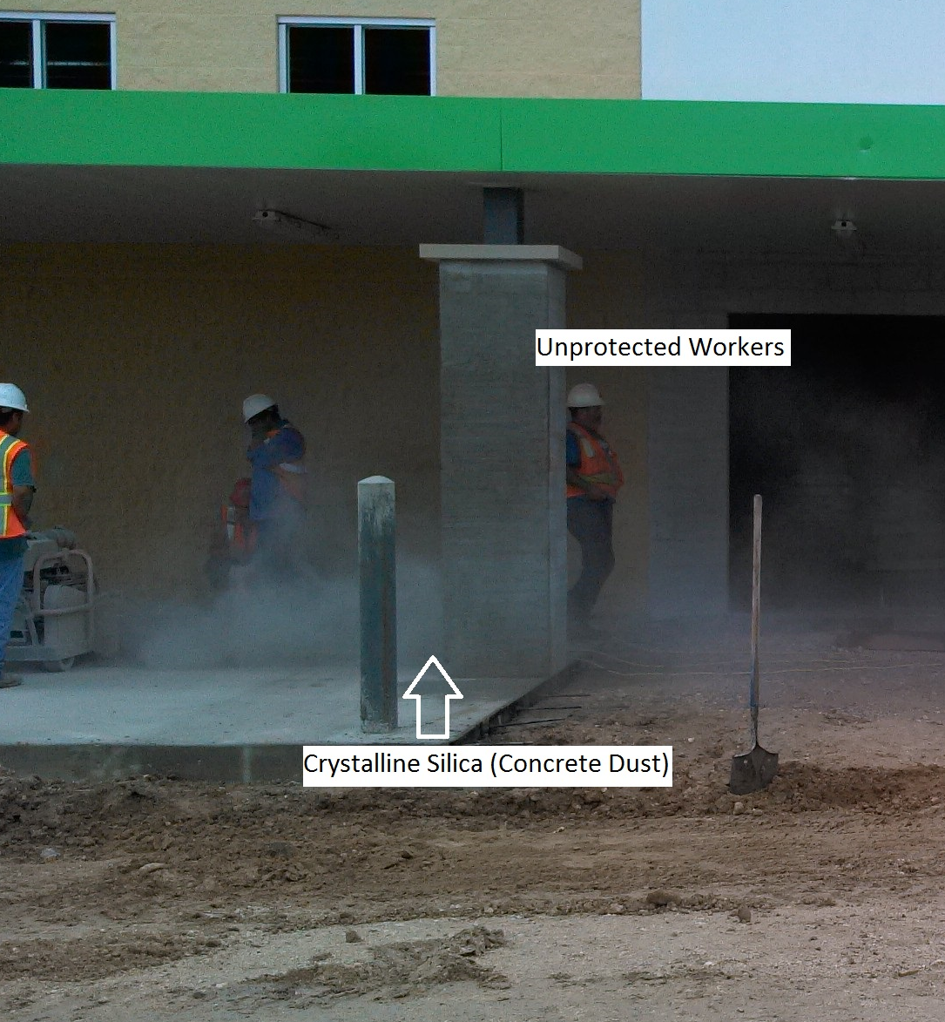
A Good PPE Program For You To Use
Any grinder, anywhere =
DUST MASKS!!

Slide 18
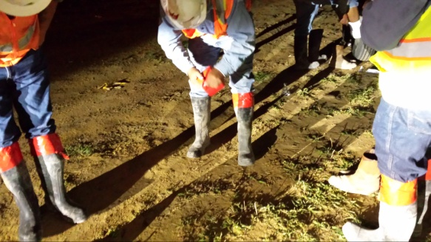
A Good PPE Program For You To Use
Tape the tops of rubber boots, or pull pant legs over the boots to prevent chemical burns resulting from ‘spillage’ into the boot.

Slide 19
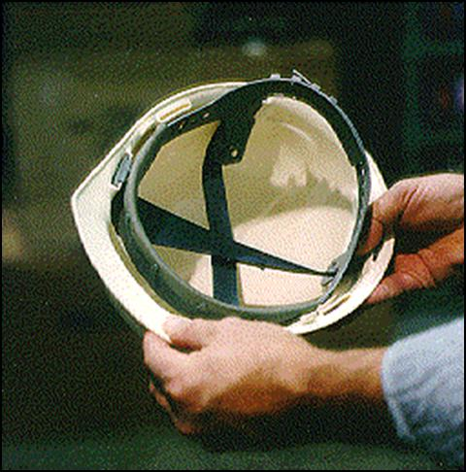
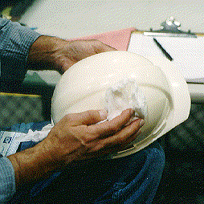
A Good PPE Program For You To Use
Inspect, clean, and maintain your Personal Protective Equipment.

Slide 20
Hardhat Inspection

Slide 21
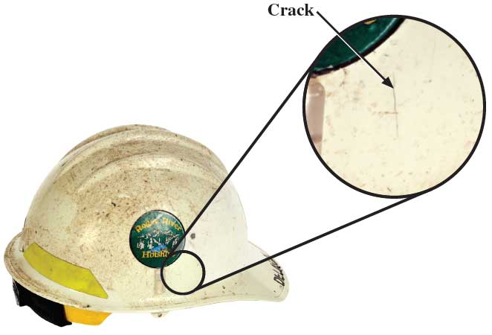
Inspect your hard hat for damage or cracks. Replace a hardhat when cracked or every 5 years
Replace suspension systems when damaged, or every 12 months
Clean your hard hat daily

Slide 22
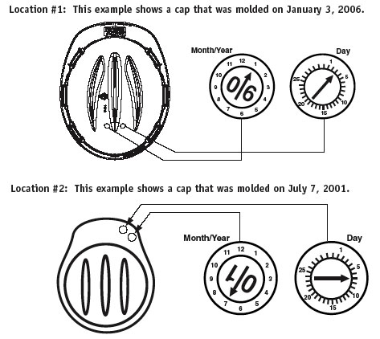
Checking the date of your hardhat

Slide 23
Check It Out
Job site inspection

Slide 25

Deadly Concrete Dust!!
No ear protection!!
No dust mask!!

Slide 26
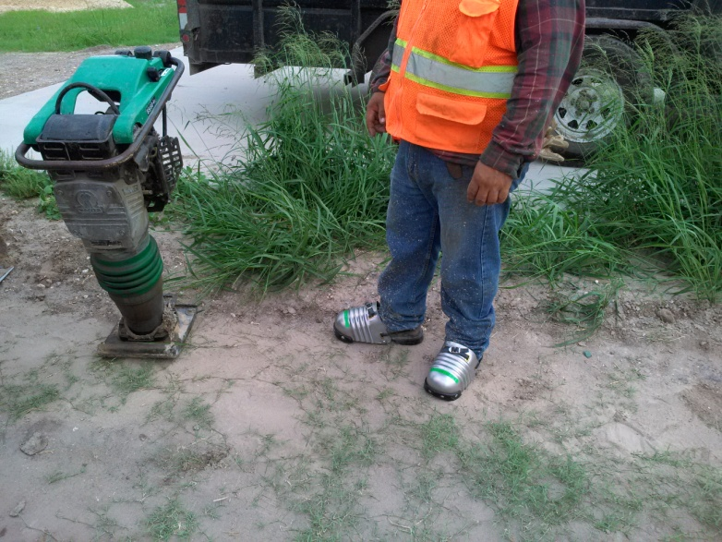
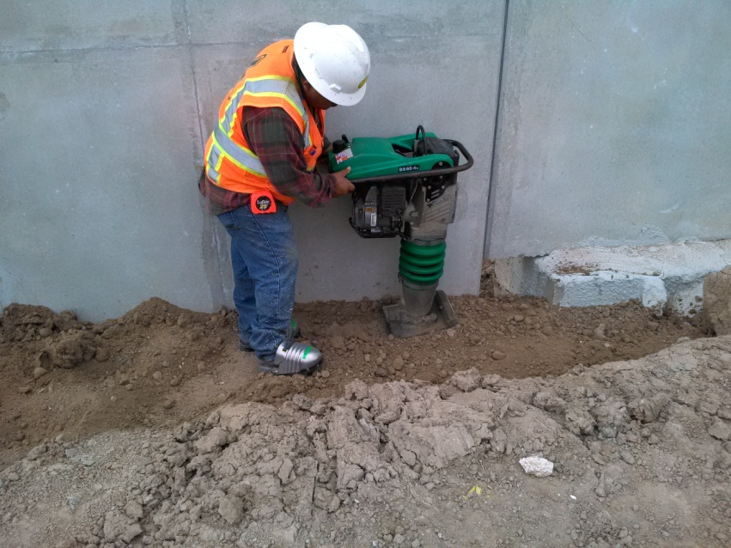
Good Job!!

Slide 27
Conclusion
Understand what the law says
Policies that will protect you…exceed the standard
Different types of PPE and what it protects
Simple care and maintenance of you PPE
Components of a PPE program at your work
How to address issues when conducting inspections

