Slide 1
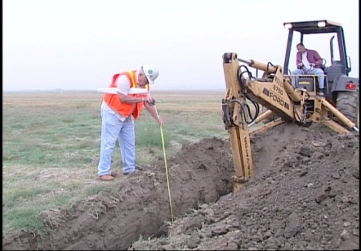
Trenching, Excavation & Soil Mechanics
OSHA Construction Safety
Standard Operating Procedures
OSHA Standard 29 CFR 1926 Subpart (P)
Notes:
IN this course you will be trained on not only OSHA’s…Trenching, Excavation and soil mechanics standard, but you will additionally receive thorough general safety training that you can apply to all aspects of the job making you a more well rounded worker and or safety officer to your business.
We are living and breathing human beings with families…taking this course will enable you and your fellow workers to return safely to your leved-ones in the same condition in which you left to work
There is a psychological effect on the familes of the injured worker, and those who witness the accident. Not only is the family of the injured worker effected due to the injury hindering hiim from earning forhis family...
But the psychological effect that it had on the witnesses, may hinder them from being able to work the job and provide for their familes.
Imagine seeing your best friend’s body, or even a co-workers body whom you didnt know very well being pulled from a trench cave in...
...and now your being asked to go down in the trench at the risk of your paycheck...and your life??
Avoid that situation all together.
Keep your self and your fellow workers safe and healthy and returning home to their familes every night.

Slide 2
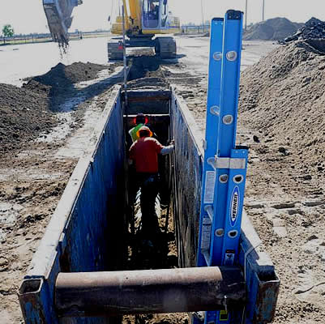
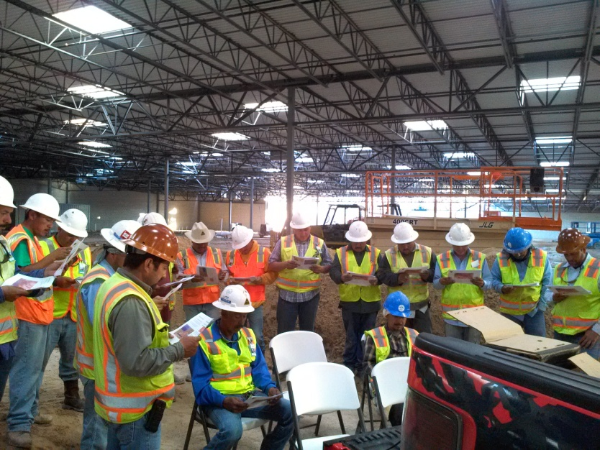
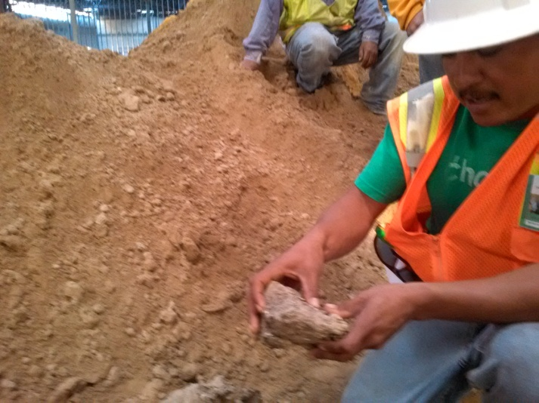
Apply what you learn … this is what you get!
Take, download and use this content
Present it to supervisors AS YOURS
Don’t just meet the standard…exceed it.
Develop Safety Practices where you work
Shine!!!
Notes:
This is what you get from tis course
You get the course
Put your name on it…
Take this to your supervisor and tell him what YOU”VE done by making it.
Apply the content to your own safety practices
Take, download and use this content to conduct your own training classes in the field as if it were your own material
Don’t just meet the standard…exceed it. Doing the bare miniumum is not what gets you promoted...going above and beyond does.
With this course you can develop standard OSHA safety Operating procedures for your company…And by doing so
display to your management the high level of safety expertise and motivation you possess…
Pass on the information..
Your fellow workers will appreciate you caring...whether they admit it or not..
This course is proof of your genuine care...
your ability in the field of safety combined with
After this course..you will be equipped witht the skills that gives your management a reason to move you up!!!
Even better...you can be your own boss as independently conduct safety consulttations to businesses for a fee.

Slide 3
Notes:
Here are a couple of pictured of a course I did at a major retailer that was under cosntruction
Due to the nature of the trenches, the prime contractor needed this work crew trained and certified in OSHA’s trench and excavation standard.
I through a course together and taught it that afternoon off the tail gate of my truck with this lap top, and some computer speakers plugged into it.
Imagine how squared away I looked to the corporate office
Invite you to take this content and do the same with it
The picture on the right is a worker who I was testing on his knowledge of the type of soil he was working with.
20 minutes before I gave this very course off the tail gat of my truck he wouldn’t have been able to tell me…
Using this course, the reousrces around the job site, and a little bit of paper...this course was delivered to the workers in the field
You are more than welcome to fo the same.

Slide 4
Soil & Trenching Excavation Operations
The Standard:
OSHA 29 CFR 1926 Sub Part P
Everywhere and Dangerous
Complacency kills
Digging a hole seems simple but is not
100 deaths per year
1000 injuries per year
Law: Proper excavation & trenching techniques and OSHA rules
Never dig until you know that it is safe
Notes:
We can agree that trenches and excavations are everywhere on job site…for that reason we get used to them, and they become as common as the air you breath
Because of that we get used to them and over look and take for granted how deadly they truly are
100 deaths per year
It is the law that workers must know the proper excavation and trenching techniques and the OSHA rules regarding them
Never dig...until you are show that it is safe...remember...go home at the end of the day to the ones who depend you....in the same condition in which you left

Slide 5

Outlined in this Course…
Aspects of Excavation & Trenching
OSHA Requirements (Reviewing OSHA guidelines prior to every dig)
The responsibilities your employers have to you and your team
Definitions and differences between a trench and an excavation
Hazards (cave ins)
How to work safely in and around trenches
(Proper planning)
Per OSHA Standard 29 CFR 1926 Sub Part P

Slide 6
Outlined in this Course…
General Requirements (Soil Testing)
Mobile Equipment Operating near and around the trench
Underground utilities
Before you dig
Competent Person
Per OSHA Standard 29 CFR 1926 Sub Part P

