Slide 1
What Causes Hazards
&
Confined Space
The specific hazards that exist and how to identify them
What causes these hazards and how to avoid them
What is a confined space and why it is a hazard

Slide 2
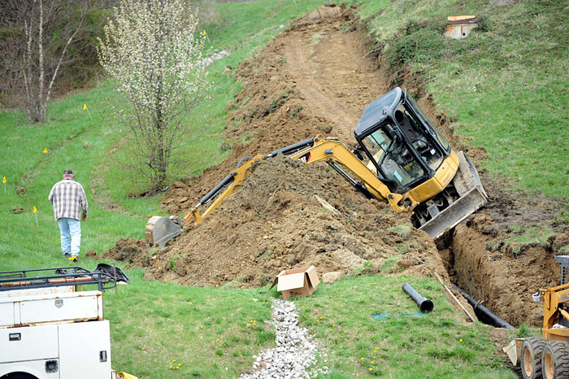
Hazards
Cave-ins
Trenches do not have to be deep for accidents to occur
Serious injuries occur in trenches less than 5 feet deep. A cubic yard of dirt can weigh as much as 2700 pounds and move at 25 feet per second
Cave ins make little noise and give little or no warning
The weight of a car landing on you
Per OSHA Standard 29 CFR 1926 Sub Part P

Slide 3
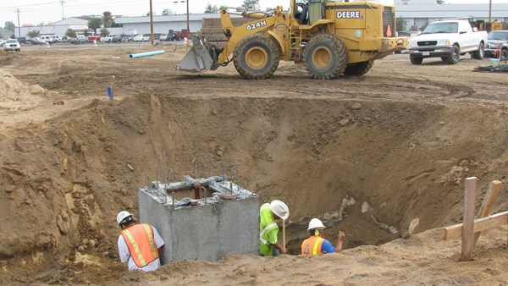
Causes of Cave-ins
Vibrations from equipment or traffic in the area
Weight of equipment near the trench edge
Weight of excavated dirt or spoils near the trench edge
Poor soil conditions
Rain or water
If more than one of the these conditions exist, the risk of collapse increases
Per OSHA Standard 29 CFR 1926 Sub Part P

Slide 4
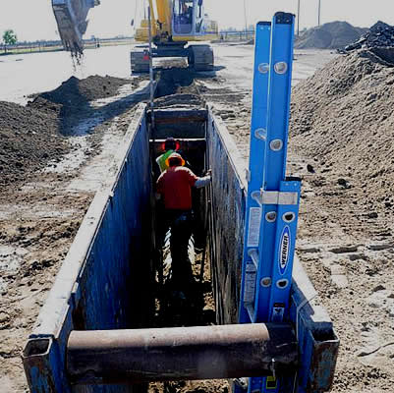
Confined space excavation
A confined space is: (according to 1926.1201 & 1910.146):
  A space not designed for workers though a worker may enter it to perform a job
  Limited means of entry or exit
  Not designed for continued occupancy
Examples: Pipelines, tanks, silos, pits, vaults, man-holes, tunnels
Per OSHA Standard 29 CFR 1926 Sub Part P

Slide 5
Confined space excavation - continued
Asphyxiation due to lack of oxygen can occur
Build up of toxic fumes released during a dig in the bottom of an excavation
A space not designed for workers though a worker may enter it to perform a job
Limited means of entry or exit
Not designed for continued occupancy
Per OSHA Standard 29 CFR 1926 Sub Part P

Slide 6
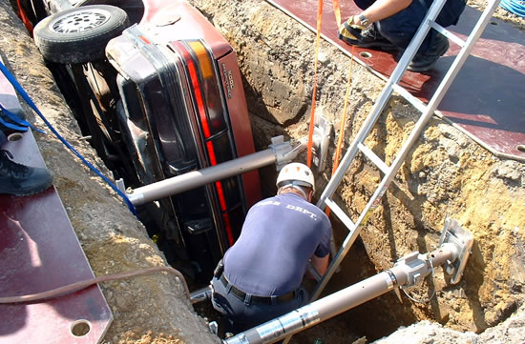
Other possible hazards
Risk of being hit by a vehicle or equipment
Drowning
Electrocution
Explosions
Per OSHA Standard 29 CFR 1926 Sub Part P

