Slide 1
Section 4
Working Safely In And Around Trenches
The Competent Person
Soil Types
Soil Testing

Slide 2
Working Safely in Trenches & Excavations
Have a plan in advance for working in trenches
Safety cannot be improvised as “you go”
Conduct job site analysis to identify hazards and potential hazards before work begins
An employee working in or around an excavation must be trained (Minimum, Hazards & Protection)

Slide 3
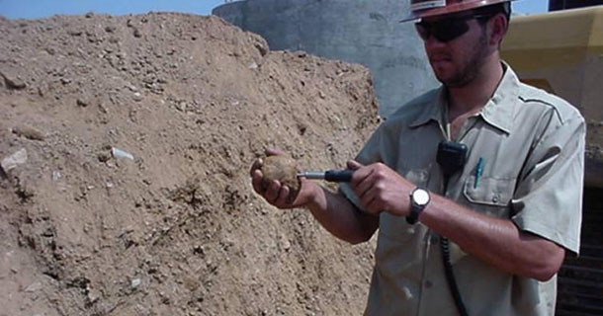
The Competent Person
A competent person must always be on site (usually a supervisor) and must have knowledge of soil sampling and excavation standards
The competent person must be able to identify unsafe conditions and have the authority to stop work if they exist

Slide 4
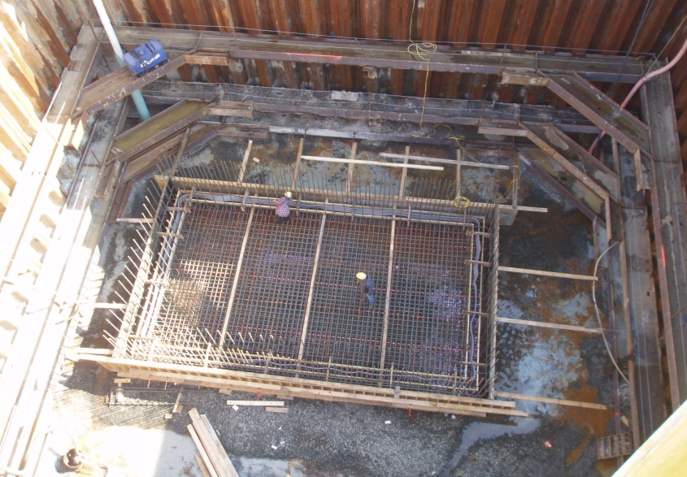
The competent person requires a greater level of training and experience than a regular worker
All excavations over 5 feet require protection
Some contractors require protection for excavations over 4 feet
If excavations are made in stable rock, or are less than 5 feet deep, and a competent person has indicated that there is no risk of a cave-in then the protection is not needed
Excavations deeper than 20 feet or below the base of an existing wall require protection designed by a professional engineer
Per OSHA Standard 29 CFR 1926 Sub Part P

Slide 5
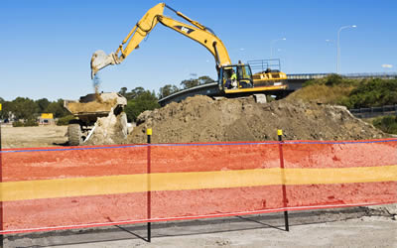
Finish excavations and trenching operations as soon as possible
Barricade, protect, or cover an excavation or trench when workers are not present
Per OSHA Standard 29 CFR 1926 Sub part P

Slide 6
General requirements of the competent person
Before digging the competent must evaluate the soil conditions
There are 4 types of soil classifications
  Stable Rock
  Type A: Very good soil
  Type B: Fair
  Type C: Least stable
The competent person must conduct 1 visual analysis and 1 manual analysis, visually inspecting and handling the soil
Per OSHA Standard 29 CFR 1926 Sub Part P

Slide 7
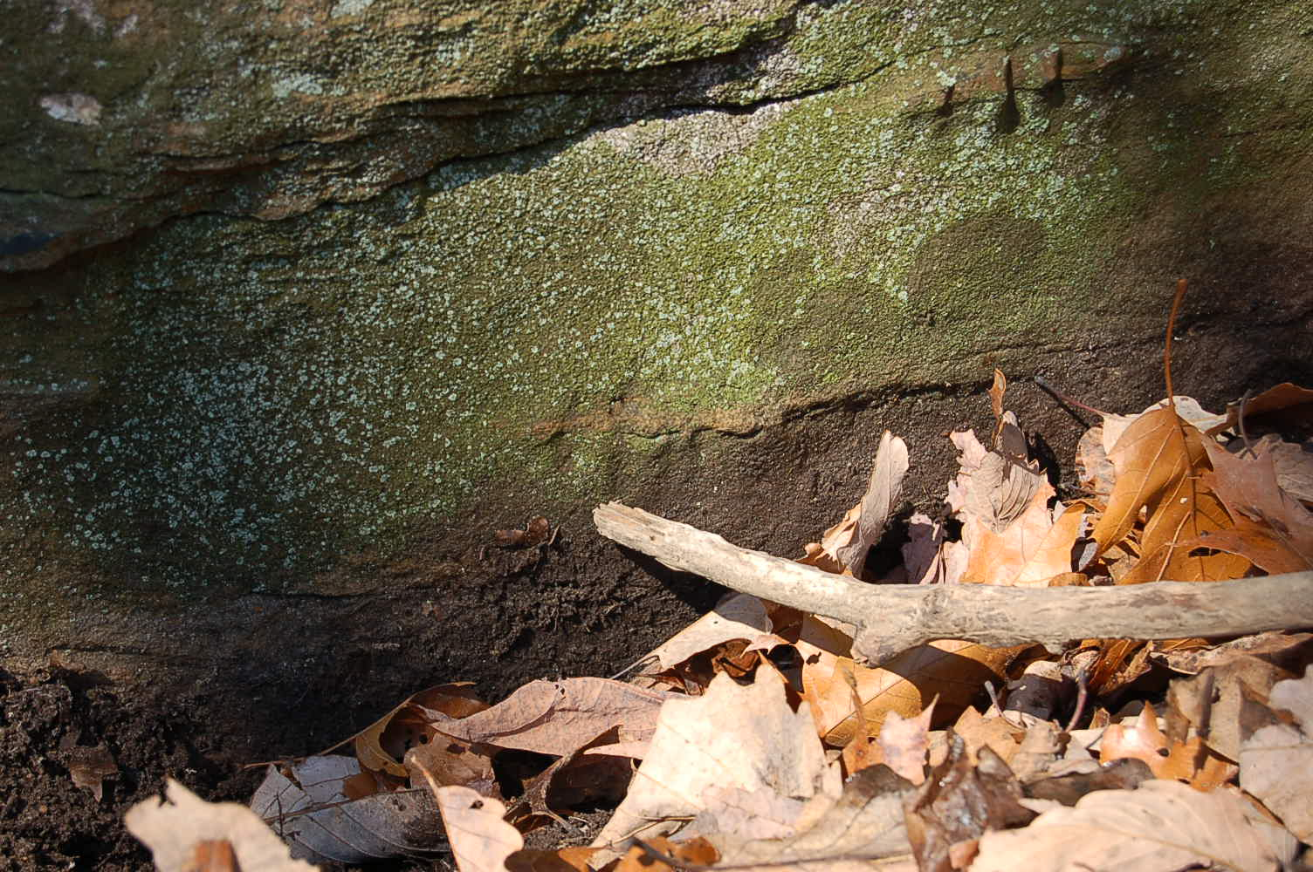
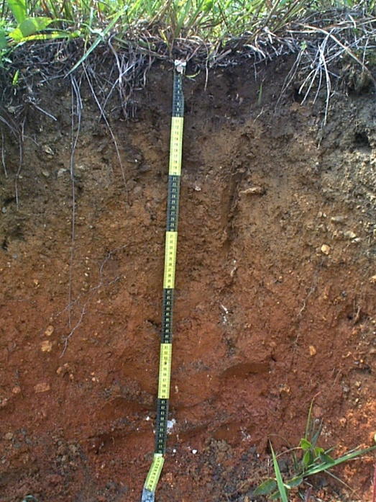
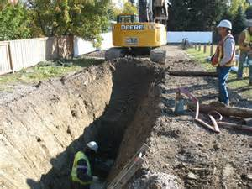
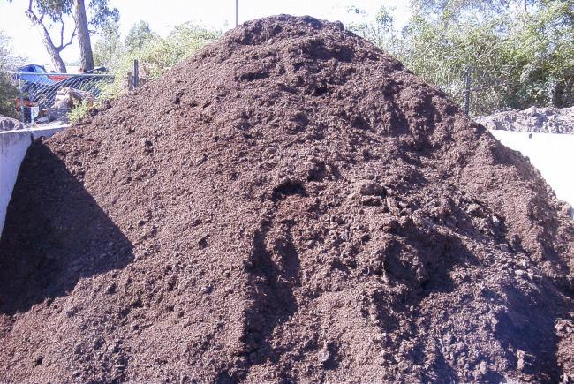
Soil Types
Solid Rock
Type A
Type B
Type C
Per OSHA Standard 29 CFR 1926 Sub Part P

Slide 8
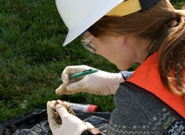
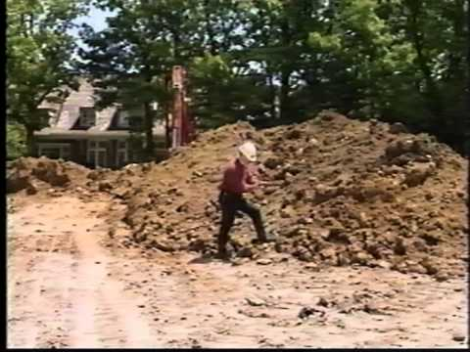
Visual test of soil
Walk the entire excavation site at least twice
Inspect soil adjacent to the excavation site
Check for any signs of vibrations, fissures, or cracks, on the surface of the excavation site

Slide 9
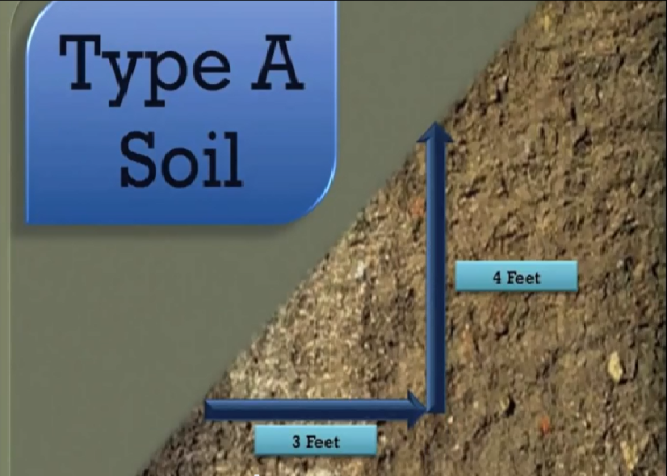
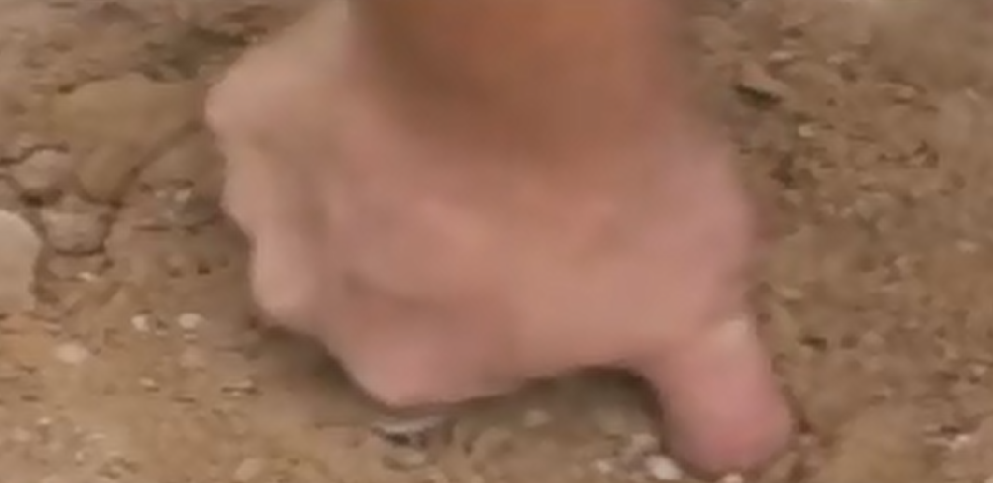
Manual test of soil
Thumb penetration test
Thumb sinks in no more than ¼ inch = Type A soil
Slope of excavation can be no less than 3 feet horizontal for every 4
feet vertical
Per OSHA Standard 29 CFR 1926 Subpart P

Slide 10
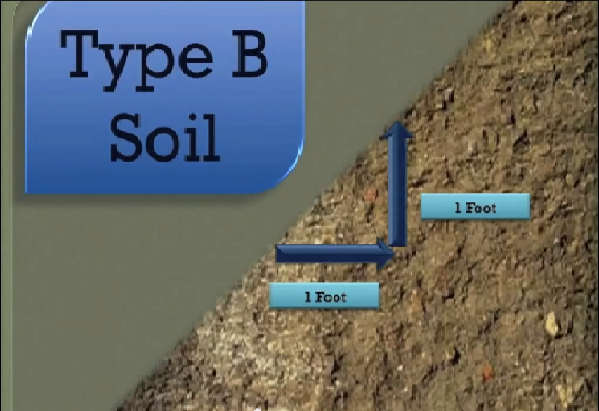
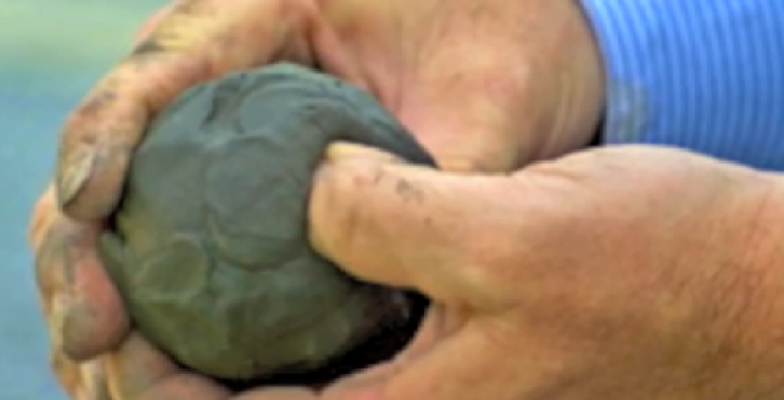
Manual test of soil
Thumb penetration test
Thumb sinks ¼ - ¾ inch = Type B soil. Silt, sandy loam, or medium density clay.
Slope of excavation must can be no less than 1 foot horizontal for every 1foot vertical
Per OSHA Standard 29 CFR 1926 Sub Part P

Slide 11
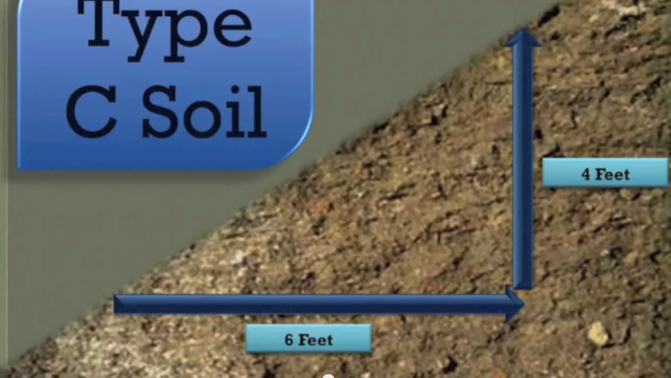
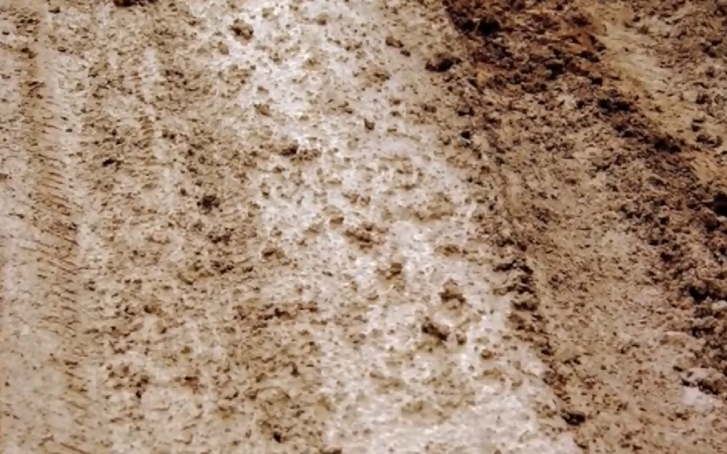
Manual test of soil
Thumb penetration test
Thumb sinks 2 inches or more= Type C soil. Least unstable. Gravel, loamy sand, or soft clay
Slope of excavation can be no less than 6 feet horizontal for every 4 feet vertical
Per OSHA standard 29 CFR 1926 Sub Part P

Slide 12
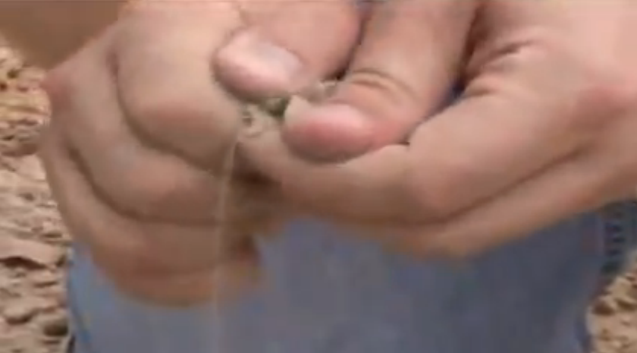
Other soil tests
Dry strength test
  Crumble a sample of soil in your hands
Per OSHA Standard 29 CFR 1926 Sub Part P

Slide 13
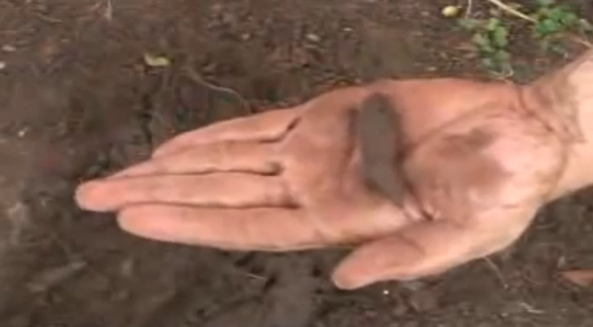
Other soil tests
Plasticity (wet thread test)
  Attempt to mold a thin sample of moist soil into a thread 1/8 inch diameter by 2 inches in length
Per OSHA Standard 29 CFR 1926 Sub Part P

Slide 14
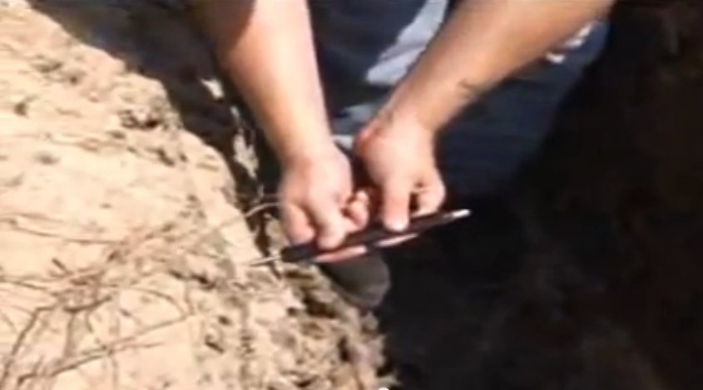
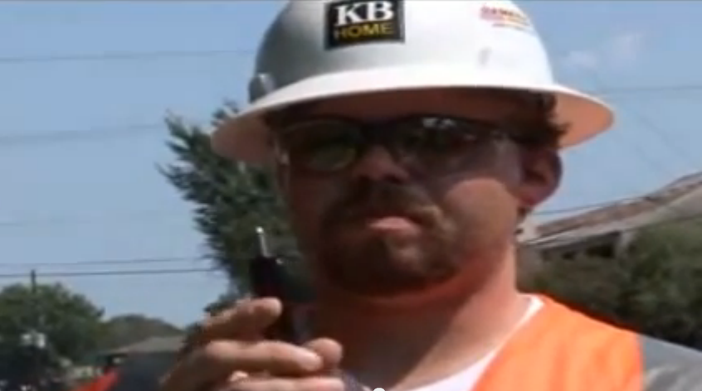
Other soil tests
Pocket penetrometer
Per OSHA Standard 29 CFR 1926 Sub Part P

Slide 15
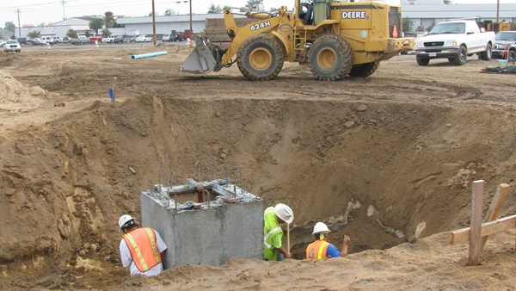
Per OSHA Standard 29 CFR 1926 Sub Part P

