Slide 1
Section 5
Before You Dig
Soil Protection
Underground Utilities

Slide 2
Before you dig
Plan and implement traffic control measures as necessary to protect workers
Air quality and atmospheric testing of the trench: Harmful gases may build up at the bottom of trenches as a result of damaged utilities or pipes
Workers must be protected from atmospheric contaminants, oxygen deficiency, toxic vapors, fumes or gases
If hazardous fumes exist or may exist, adequate ventilation and rescue equipment must be provided and ready to use at the site.
Per OSHA Standard 29 CFR 1926 Sub Part P

Slide 3
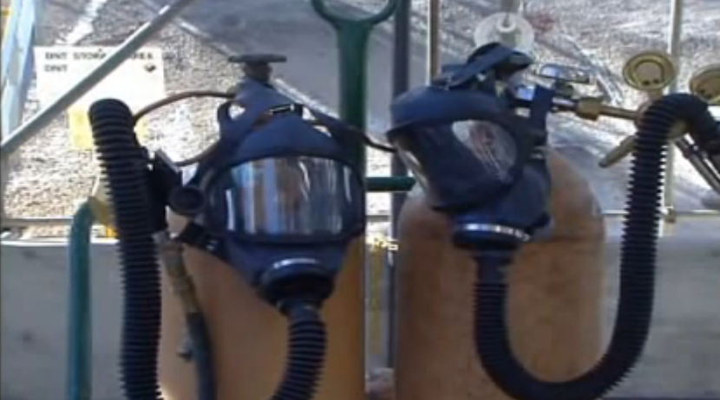
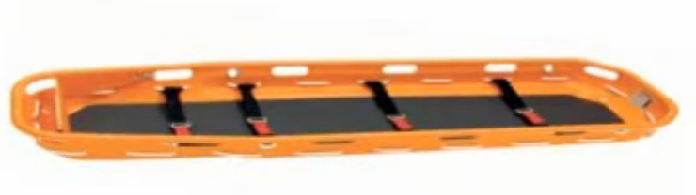

Slide 4
Underground utilities
All underground utilities must be identified and marked by calling #811 to locate underground utilities
Protect, support, or remove underground utilities while excavation is open
Immediately notify utility operators if an underground utility is damaged
If utility damage results in release of gas, call the utility operator and emergency services or 911 if necessary
Per OSHA Standard 29 CFR 1926 Sub Part P

Slide 5
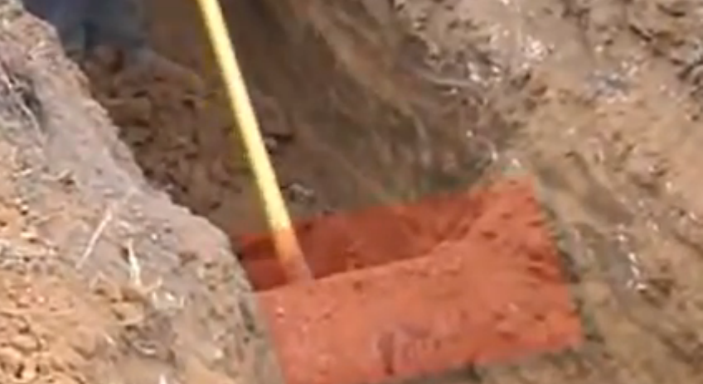

Slide 6
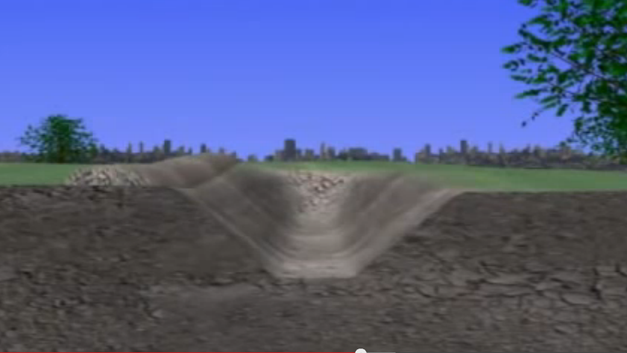

Slide 7
8ft
Type B Soil

Slide 8
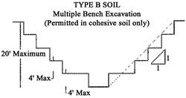

Slide 9
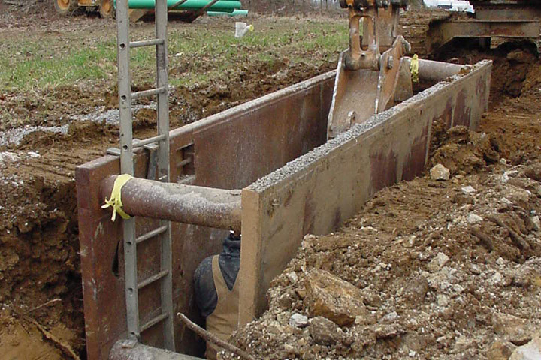

Slide 10
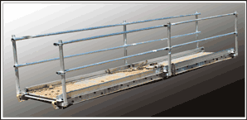
Protection
  Workers must stand away from vehicles being loaded to avoid being struck by equipment or spillage
  All workers on an excavation site must wear hard hats
  All equipment must have an operational back up alarm
  Appropriate walk ways with guard rails must be provided for trenches being crossed
Per OSHA Standard 29 CFR 1926 Sub Part P

Slide 11
Protection (Talking Head)
Choose and construct the appropriate excavation protection according to OSHA standards and based on soil type (A, B, or C).
  Sloping
  Benching
  Shoring or shielding (must use for trenches greater than 4 ft.)
Per OSHA Standard 29 CFR 1926 Subpart P

Slide 12
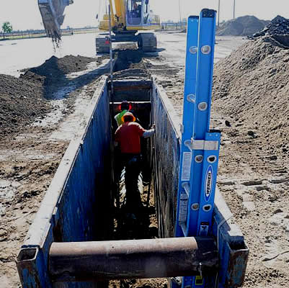
Protection (Talking Head)
Trenches deeper than 4ft must have a method of entry and exit such as a ladder.
The ladder must extend at least 3 feet above the opening of the excavation and be within 25 feet of any workers inside the trench
Earth ramps used as exits from excavations can only be used if a worker can walk on them in an upright position and are designed by a competent person
Per OSHA Standard 29 CFR 1926 Sub Part P

Slide 13
Protection (Talking Head)
  Never enter a trench with water inside of it
  Have pump equipment ready to pump out any free standing water inside of a trench
  The competent person must inspect the trench DAILY, AT THE BEGINNING OF EACH SHIFT, AFTER A RAINSTORM, AND IF THERE HAVE BEEN ANY CHANGES TO THE TRENCH
  Place excavated dirt as far away as possible from the trench
  Trench boxes will extend the top of the trench
  Workers shall never stand under loads that are being handled or lifted by digging equipment
Per OSHA Standard 29 CFR 1926 Subpart P

